Slide 1
Go over thesis and make sure you included all the stuff written there in each section here

Slide 2

Add TAU symbol
Show some sensitivity!
Using motion tracking to explore unconscious measures
Khen Heller under the supervision of Craig S. Chapman and Liad Mudrik

Slide 3



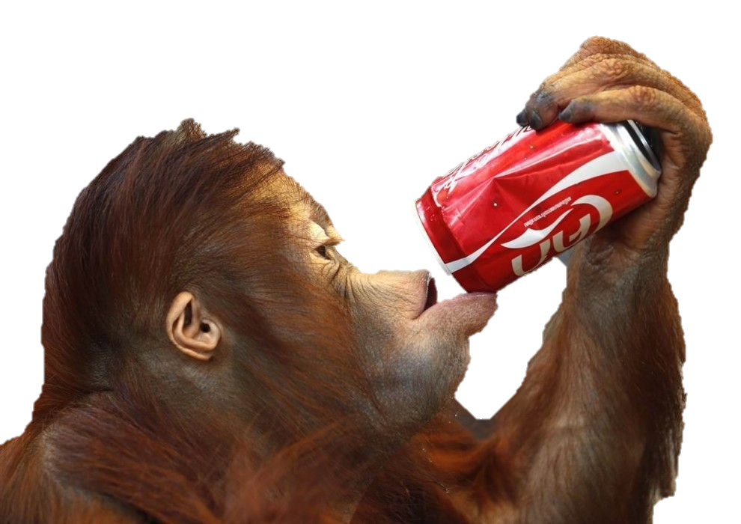
Un/conscious processing
Stimuli
Processing
Perceived?
Affects Behavior?
Conscious
Unconscious

Slide 4

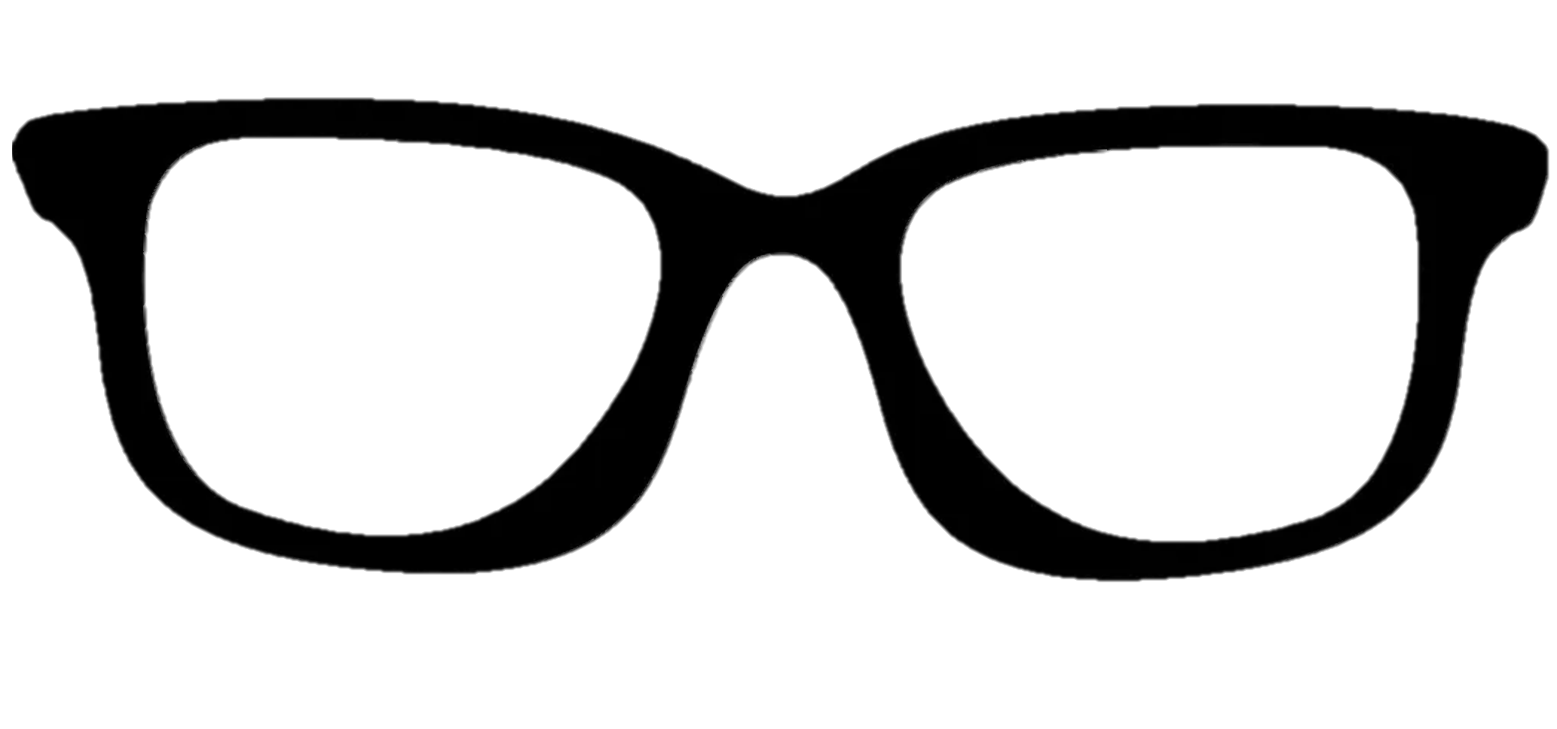
Unconscious processing
Stimuli
Processing
Perceived?
Affects Behavior?
Conscious
Unconscious
Degrading physical propeties
Supression by more salient stimuli
Diverting attention
Notes:
Stimuli can be made UC by: degrading its physical propertis, suppressing ti with more salient stimuli, diverting attention.
This decreases visibility, also decreases the neural response, → weaker behavioral change
How would one go about measuring the unconscious effect you ask? Well…

Slide 5
Measuring the Unconscious effect
Priming paradigm
RADIO
Time
radio
Natural / Artificial
Notes:
The most prominent method is the priming paradigm with a Keyboard RT measure.
A prime precedes the target, is rendered invisible, e.g. by masking with salient stimuli
Participant perform a task on the target, e.g. classify as artificial / natural.
Prime,target can be either congruent – evoke the same response.

Slide 6
Measuring the Unconscious effect
Priming paradigm
CLOUD
radio
Objective Subjective
Time
How well did you see the first stimuli?
On a scale of 1-4
Natural / Artificial
CLOUD / RIVER
1 2 3 4
Notes:
Or incongruent – evoke opposite responses.
To verify that prime is indeed invisible, two types of measures are available:
Subjective – participant asked about his experience of the prime.
Objective – participant is asked to perform a judgment about the prime, and the invisibility is inferred from low accuracy..
What is a priming paradigm
What is congruent/incongruent
congruency effect
how is it measured- usually as difference in RT between conditions.
what does it indicate[conflict between prime and target])

Slide 7
Measuring the Unconscious effect
Priming paradigm
CLOUD
Congruency effect
Time
radio
RT
Natural / Artificial
Congruent
Incongruent
Notes:
To Measure the effect we compare the RT between the conditions and that difference gives us the congruency effect.
It indicates that the prime was unconsciously processed.

Slide 8



Consequences of Low Sensitivity
Problem: Common measure can’t pick up the effect
Consequence: controversy
Put papers for and against UC processing
Notes:
harder to detect. → contradicting findings → debate on scope of processing
To solve this we will have to examine the way UC effect is measured.
From old presentation:
Some say:
Unconscious processing can perform high level functions and have a small but existing affect on behavior,
Others say:
It is negligible, and the parts of it that can be found can be explained by conscious influence.

Slide 9
How awareness is measured (objective + subjective)

Slide 10
Contradicitng findins? Or just put it at the previous part?

Slide 11
Explain the discrepenct: under estimation of UC processing.
RT measures only the end response
RT yields small effects

Slide 12
solution : Motion tracking
continuous data more suited for ongoing cognitive processes – example papers
Rich data provides various measures - example papers

Slide 13
Previous studies uses motion to trackUC processes

Slide 14
Is motion better than keyboard? Only one study
Bad awareness measure
mOuse tracking less sensitive then reaching

Slide 15
Current study
Rigorous awareness measure
Reaching

Slide 16
Three exploratory studies, one confirmatory

Slide 17
Study 1
Paradigm
Setup
Extracted variables
Results
RT too long -> non siongificnat effect

Slide 18
Study 2
Shorter RT
Results
Deviant participant – show results without him
Too quick, many excluded trials -> reduces SNR

Slide 19
Study 3
Training day
Results – showing some ra effect
Small decrease in RT, but Increase in excluded trials – they might t ask why this happened

Slide 20
Study 4
No training day
Includes both measures
Estimation of necessary num of trials to get an effect – half of the trials.
Results – significant effects
Significance, criticism about awareness ins’t relevant.
Increases num of correct answers
Expressed thorought the traj – how did you infer the time? Since traj is normalized.
Less valid trials in motion, but more correct
Effect size comparison
Discrepency with Xiao
Mouse more sensitive than reach
AUC as opposed to reach area – show analysis
Awareness measure – Xiao stems from aware participants
Accidental finding – future studies use dynamic starting condition.
Advantages
Decreases invalid trials
Noise keyboard VS reach
Short lived nature of UC effects
Heading angle
X STD

Slide 21
Jason might ask about changing the onset of subject movement to better delineate the timecourse of the UC effect.

Slide 22
XXXXXXXXXXXXXXXXXXXXXX

Slide 23
XXXXXXXXXXXXXXXXXXXXXX

Slide 24
XXXXXXXXXXXXXXXXXXXXXX

Slide 25
XXXXXXXXXXXXXXXXXXXXXX

Slide 26
XXXXXXXXXXXXXXXXXXXXXX

Slide 27
XXXXXXXXXXXXXXXXXXXXXX

Slide 28
XXXXXXXXXXXXXXXXXXXXXX

Slide 29
XXXXXXXXXXXXXXXXXXXXXX

Slide 30
XXXXXXXXXXXXXXXXXXXXXX

Slide 31
XXXXXXXXXXXXXXXXXXXXXX

Slide 32
XXXXXXXXXXXXXXXXXXXXXX

Slide 33
XXXXXXXXXXXXXXXXXXXXXX

Slide 34
XXXXXXXXXXXXXXXXXXXXXX

Slide 35
XXXXXXXXXXXXXXXXXXXXXX

Slide 36
XXXXXXXXXXXXXXXXXXXXXX

Slide 37
XXXXXXXXXXXXXXXXXXXXXX

