Slide 1
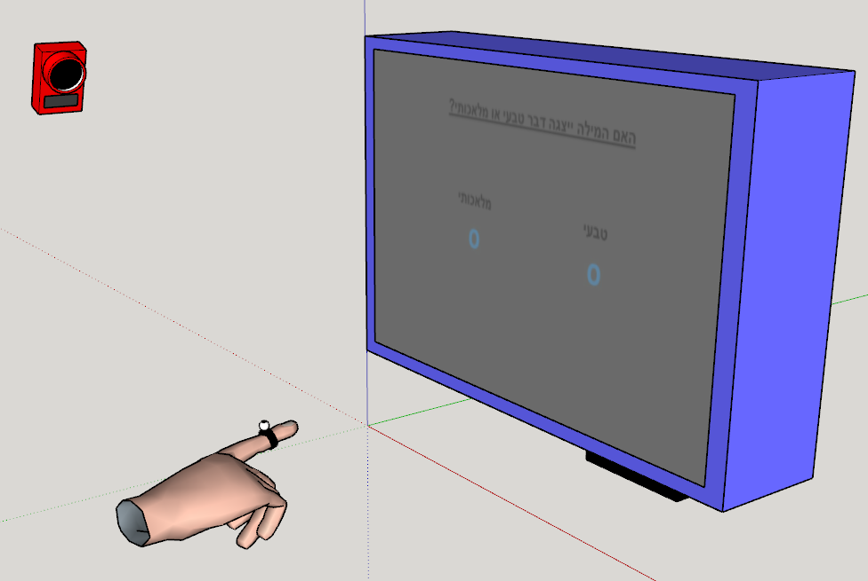
Setup

Slide 2
Screen
Answer 1 Answer 2
Deviation 1
Deviation 2
Deviation 3
Subject’s actual starting point
Marked starting point

