Slide 1
In the next slides,
I ran the classification many times and realized I don’t get consistent results.

Slide 2
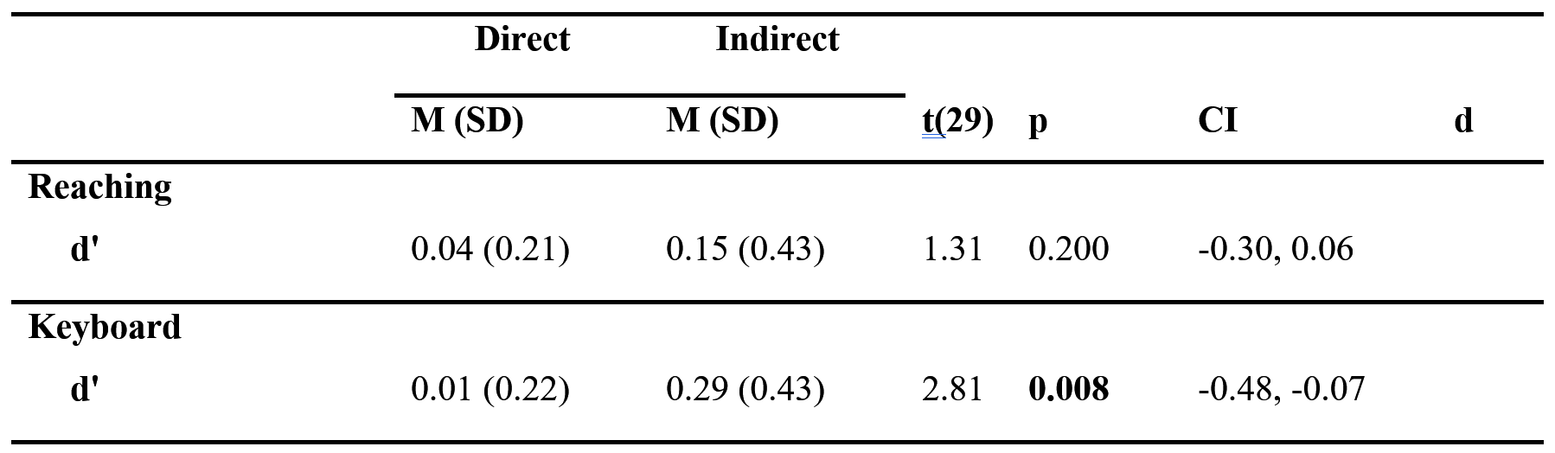
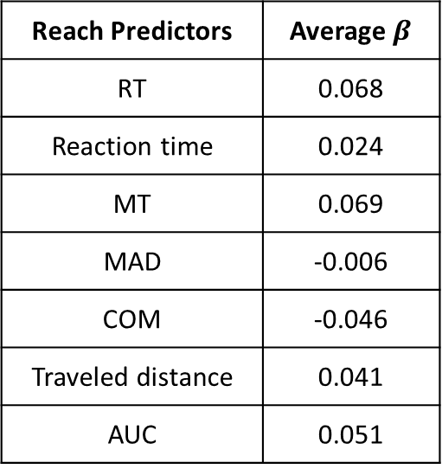
Logistic Classifier with train+test split
Average $β$ | Reach Predictors
0.068 | RT
0.024 | Reaction time
0.069 | MT
-0.006 | MAD
-0.046 | COM
0.041 | Traveled distance
0.051 | AUC

Slide 3
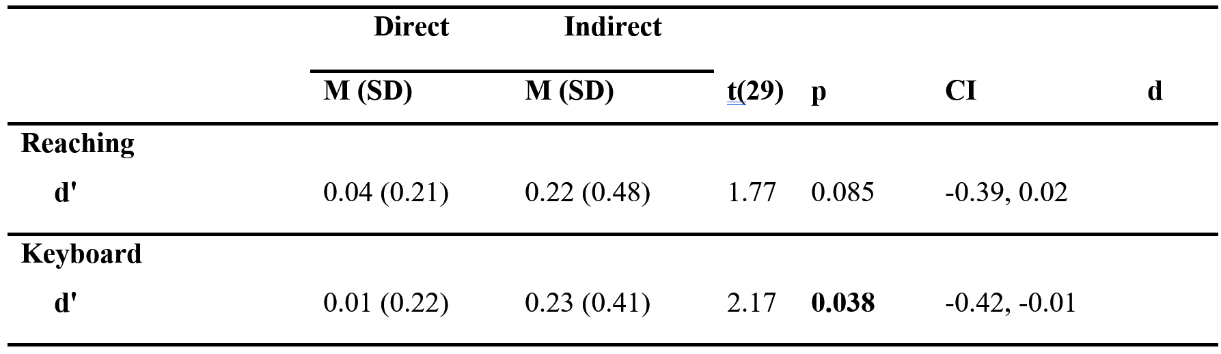
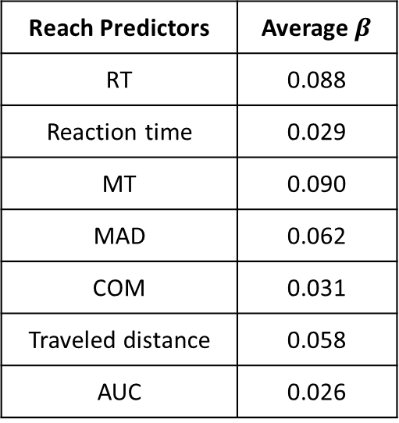
Logistic Classifier with train+test split
Average $β$ | Reach Predictors
0.088 | RT
0.029 | Reaction time
0.090 | MT
0.062 | MAD
0.031 | COM
0.058 | Traveled distance
0.026 | AUC

Slide 4
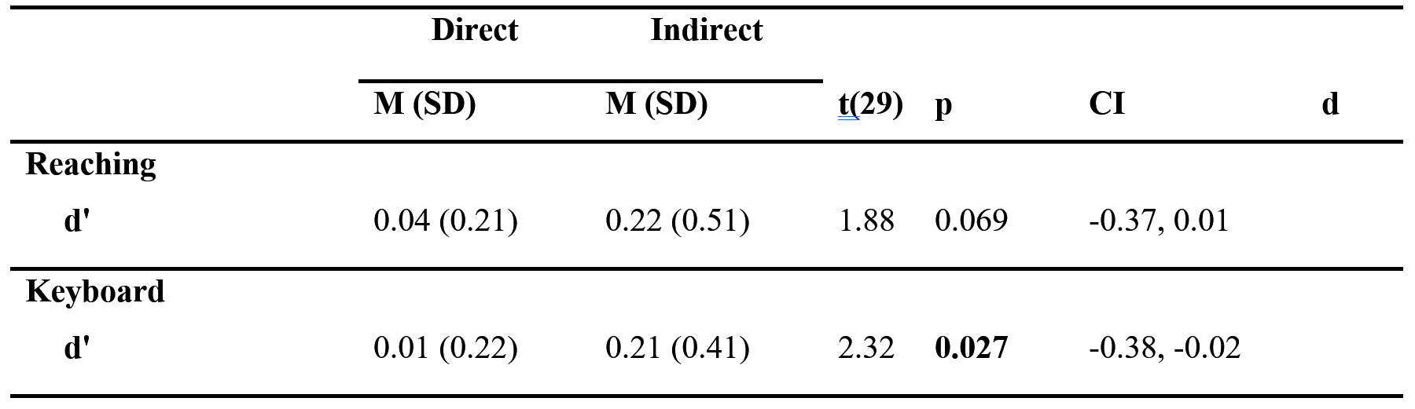
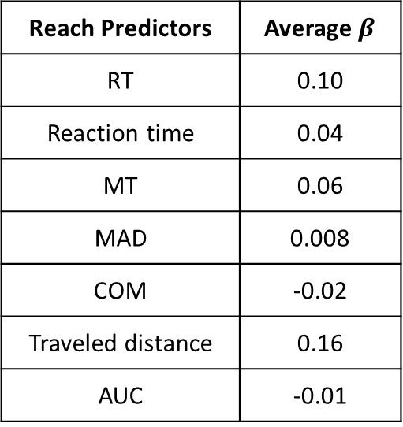
Logistic Classifier with train+test split
Average $β$ | Reach Predictors
0.10 | RT
0.04 | Reaction time
0.06 | MT
0.008 | MAD
-0.02 | COM
0.16 | Traveled distance
-0.01 | AUC

Slide 5
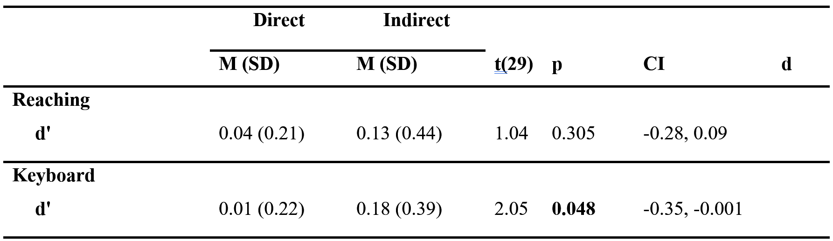
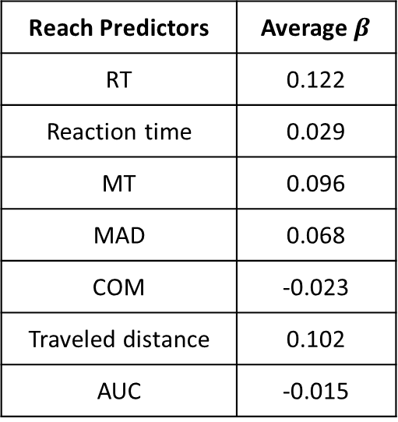
SVM Classifier with train+test split
Average $β$ | Reach Predictors
0.122 | RT
0.029 | Reaction time
0.096 | MT
0.068 | MAD
-0.023 | COM
0.102 | Traveled distance
-0.015 | AUC

Slide 6
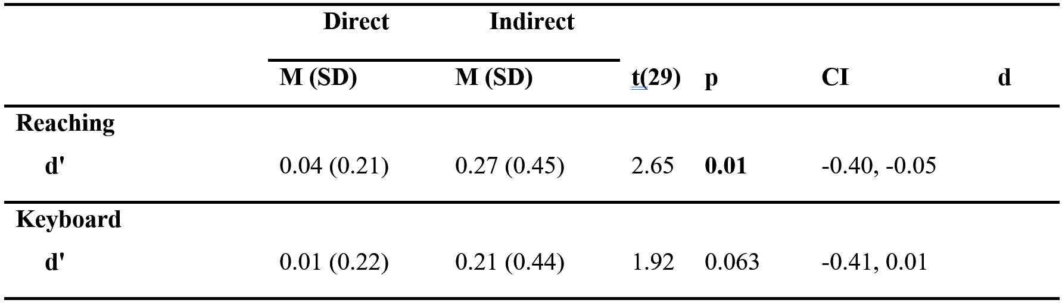
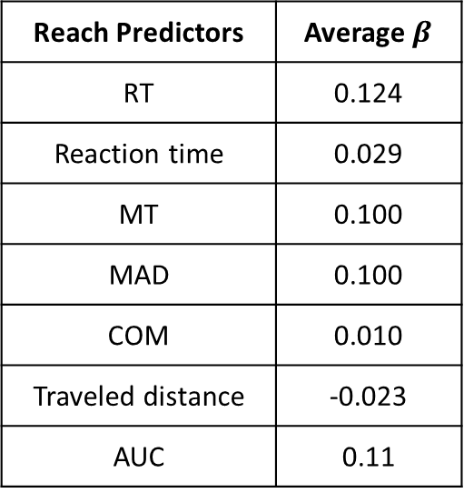
SVM Classifier with train+test split
Average $β$ | Reach Predictors
0.124 | RT
0.029 | Reaction time
0.100 | MT
0.100 | MAD
0.010 | COM
-0.023 | Traveled distance
0.11 | AUC

Slide 7
In the next slides:
I tried changing the prior parameter, to see its effect.
It doesn’t seem to make much of a difference.

Slide 8
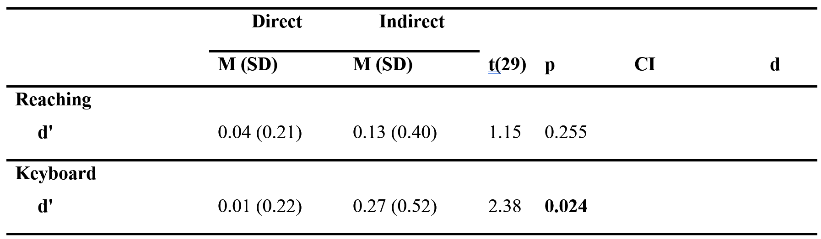
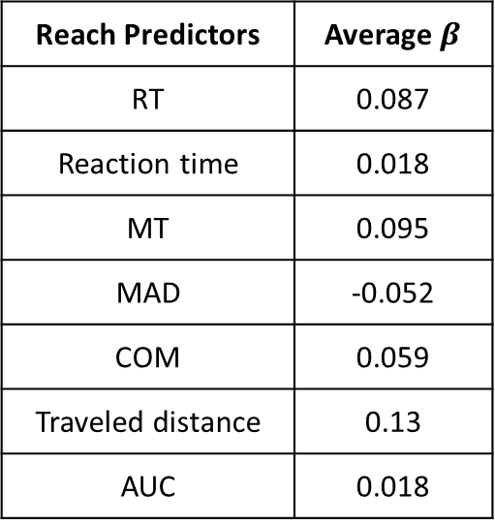
Logistic Classifier with train+test split
Prior = Uniform
Average $β$ | Reach Predictors
0.087 | RT
0.018 | Reaction time
0.095 | MT
-0.052 | MAD
0.059 | COM
0.13 | Traveled distance
0.018 | AUC

Slide 9
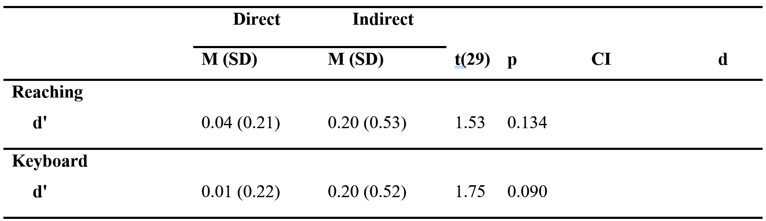
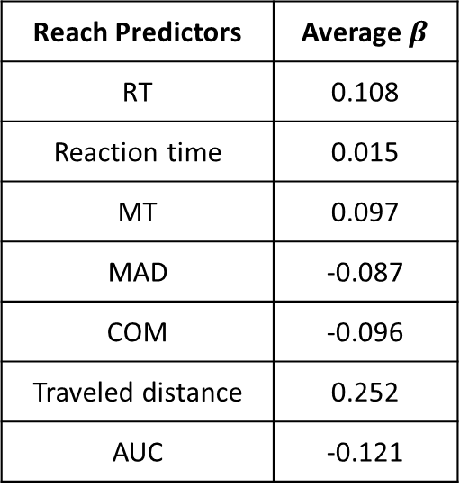
Logistic Classifier with train+test split
Prior = Uniform
Average $β$ | Reach Predictors
0.108 | RT
0.015 | Reaction time
0.097 | MT
-0.087 | MAD
-0.096 | COM
0.252 | Traveled distance
-0.121 | AUC

Slide 10
In the next slides,
I understood the inconsistency stems from the small dataset (the algorithm overfits the training data).
To verify I used constant train dataset, and indeed the results were consistent.

Slide 11
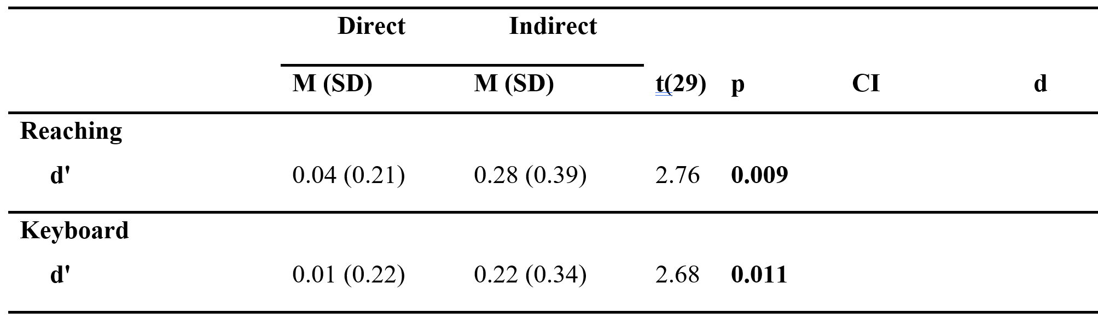
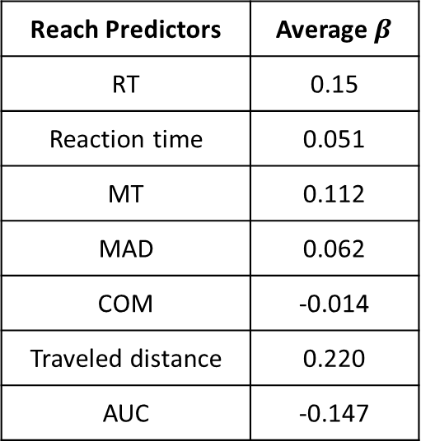
SVM Classifier with train+test split
Constant split
Average $β$ | Reach Predictors
0.15 | RT
0.051 | Reaction time
0.112 | MT
0.062 | MAD
-0.014 | COM
0.220 | Traveled distance
-0.147 | AUC

Slide 12
In the next slides,
I used regularization which should compensate for coefficients inflation in small datasets

Slide 13
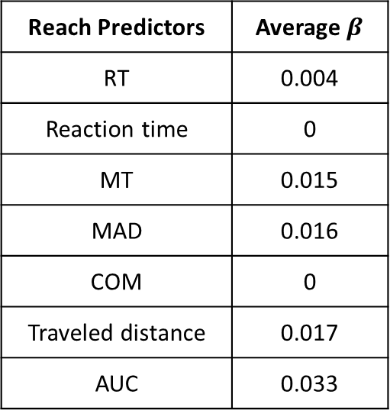
Logistic Classifier with train+test split
Prior = Uniform, lambda = 0.3, Lasso
Average $β$ | Reach Predictors
0.004 | RT
0 | Reaction time
0.015 | MT
0.016 | MAD
0 | COM
0.017 | Traveled distance
0.033 | AUC

Slide 14
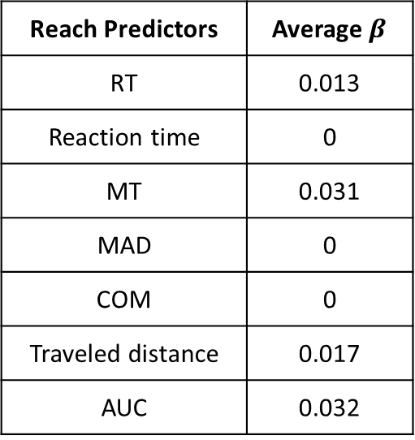
Logistic Classifier with train+test split
Prior = Uniform, lambda = 0.3, Lasso
Constant split.
Average $β$ | Reach Predictors
0.013 | RT
0 | Reaction time
0.031 | MT
0 | MAD
0 | COM
0.017 | Traveled distance
0.032 | AUC

Slide 15
In the next slides,
I tried to remove some predictors, but the results were still inconsistent

Slide 16
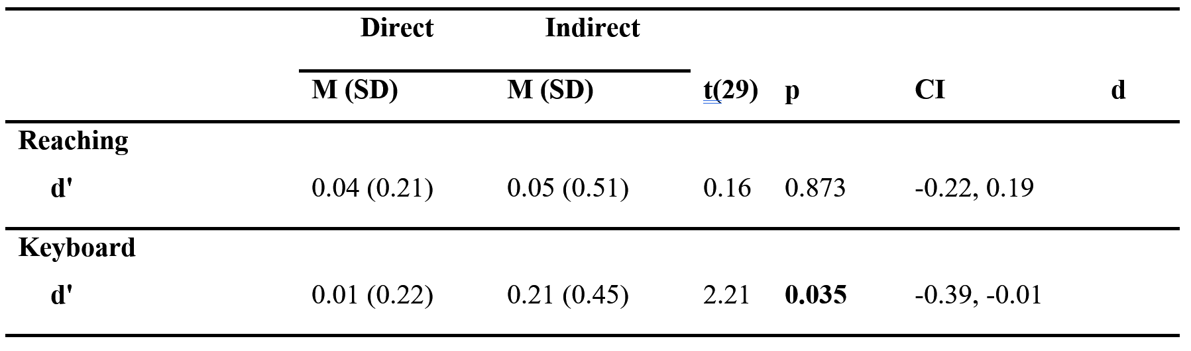
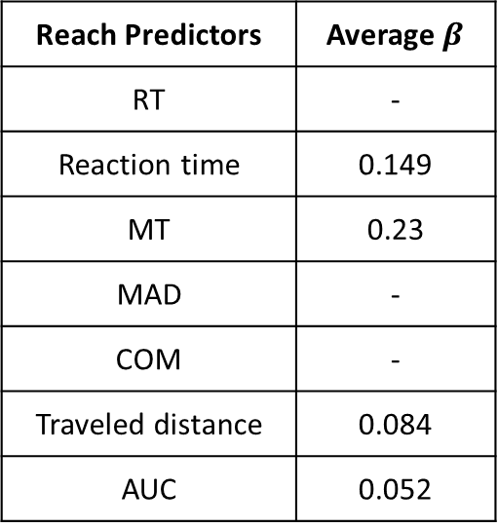
Logistic Classifier with train+test split
Average $β$ | Reach Predictors
- | RT
0.149 | Reaction time
0.23 | MT
- | MAD
- | COM
0.084 | Traveled distance
0.052 | AUC

Slide 17
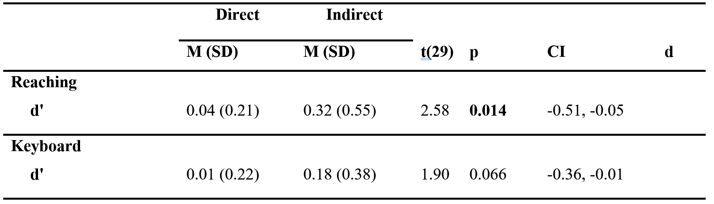
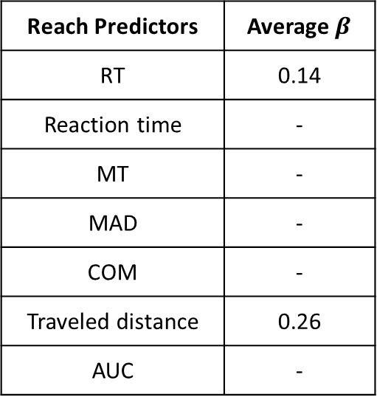
SVM Classifier with train+test split
Average $β$ | Reach Predictors
0.14 | RT
- | Reaction time
- | MT
- | MAD
- | COM
0.26 | Traveled distance
- | AUC

Slide 18
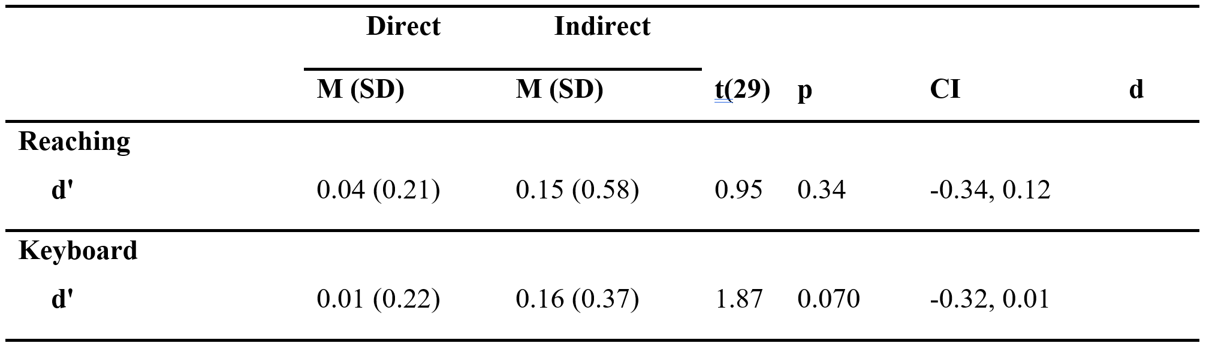
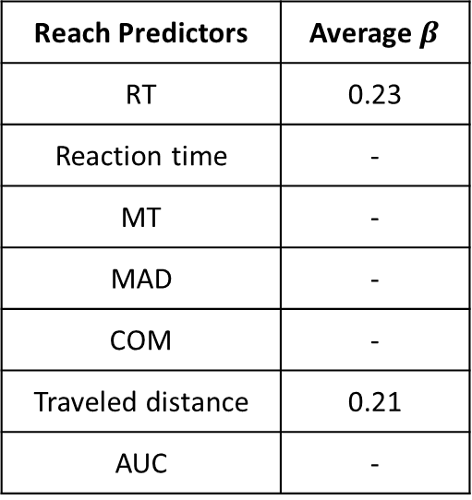
SVM Classifier with train+test split
Average $β$ | Reach Predictors
0.23 | RT
- | Reaction time
- | MT
- | MAD
- | COM
0.21 | Traveled distance
- | AUC

Slide 19
In the next slides,
I ran the analysis many times to see which coefficients are most important.

Slide 20
Logistic Classifier with train+test split
Prior = uniform, lasso

Slide 21
Logistic Classifier with train+test split
Prior = empirical, lasso

Slide 22
Logistic Classifier with train+test split
Prior = uniform, Ridge

Slide 23
In the next slides,
I ran the analysis many times to see if d’ is consistant.

Slide 24
Logistic Classifier with train+test split
Regularization = Ridge
Predictors: rt, mt, mad, tot_dist, auc
D prime

Slide 25
In the next slides,
I ran a naïve bayes classifier

Slide 26
Naïve Bayes Classifier with train+test split
Predictors: rt, mt, mad, tot_dist, auc

Slide 27
In the next slides,
I ran a naïve bayes classifier with cross validation

Slide 28
Run 1
Run 2

Slide 29
In the next slides,
I used ensemble learning

Slide 30
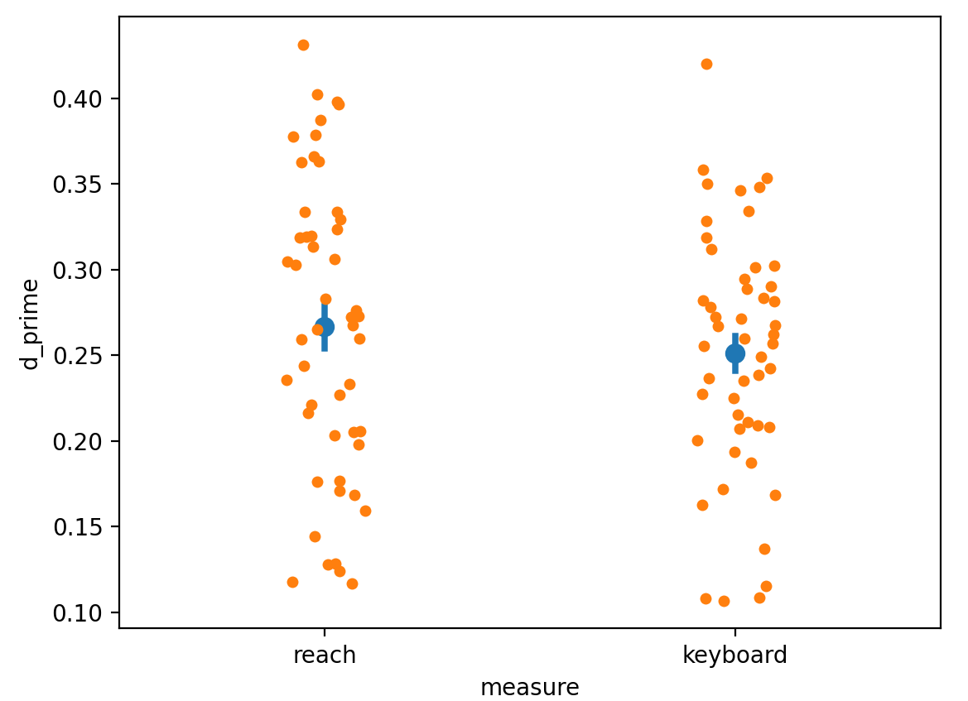
Logistic + XGBoost Classifier with train+test split
Predictors: rt, mt, mad, tot_dist, auc
50 iterations

Slide 31
In the next slides,
I used Naïve Bayes, with traj as pred

Slide 32
Naïve Bayes Classifier with train+test split
Predictors: 30 traj samples
Logistic Classifier with train+test split
Ridge, lambda = 0.7
Predictors: 30 traj samples

Slide 33
In the next slides,
I used Naïve Bayes, and I normalized the variables (features) within each subject before decoding

Slide 34
Naïve Bayes Classifier with train+test split
Predictors: rt, react, mt, mad, tot_dist, auc
Naïve Bayes Classifier with train+test split
Predictors: 30 traj samples

