Slide 1
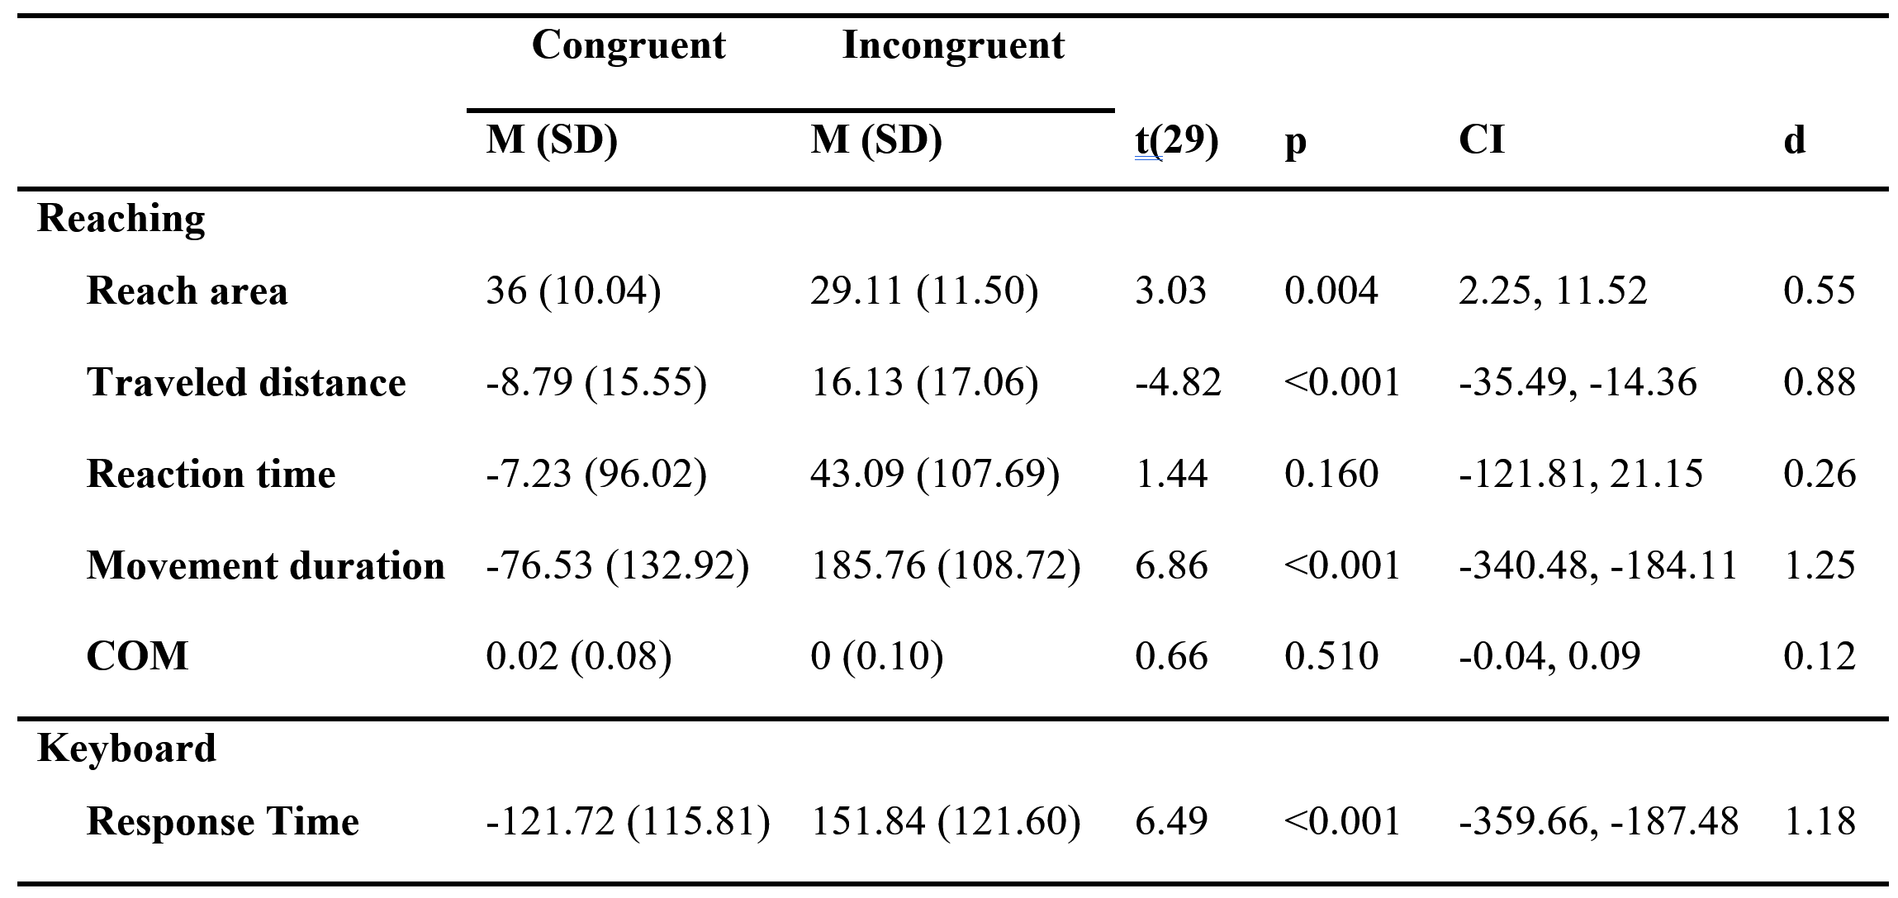
Variables normalized within subject

Slide 2
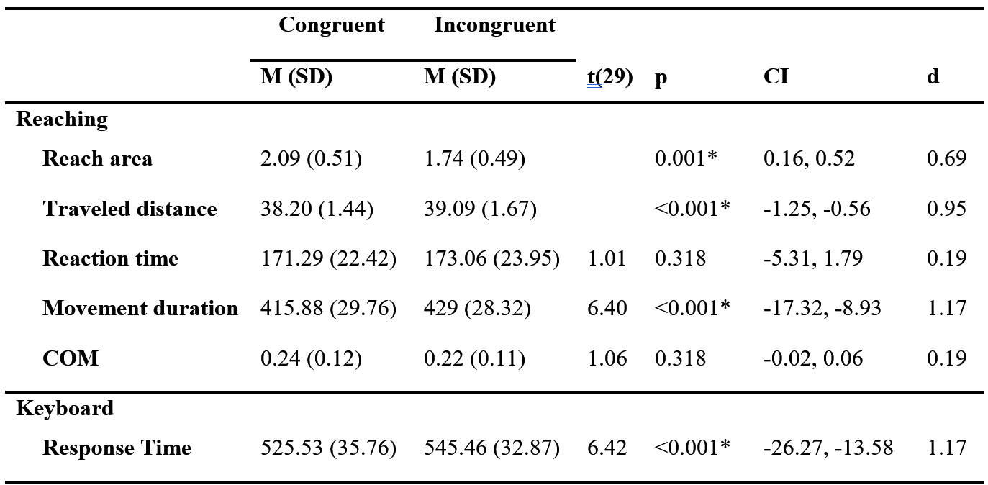
Variables w/o normalization

