Slide 1
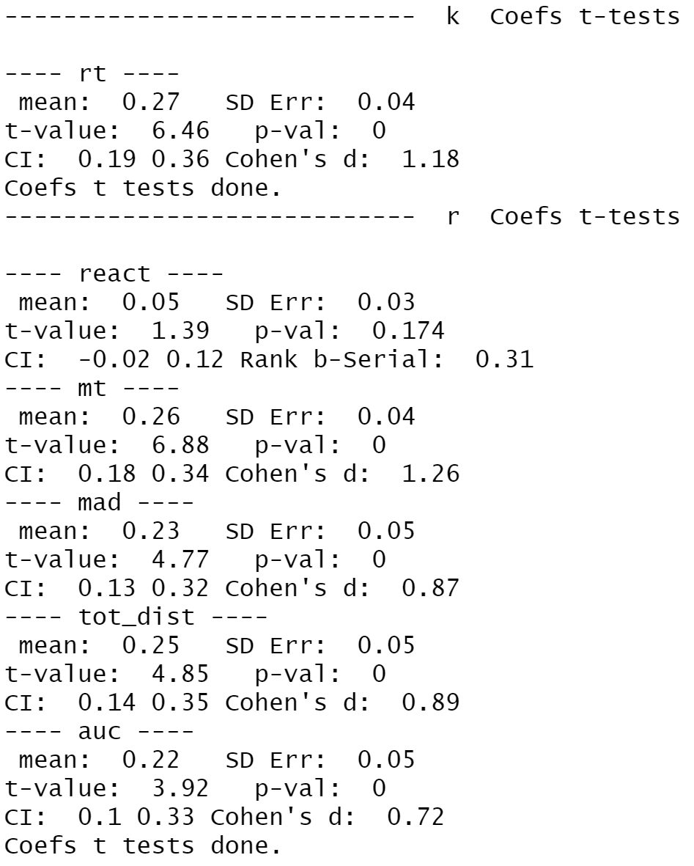
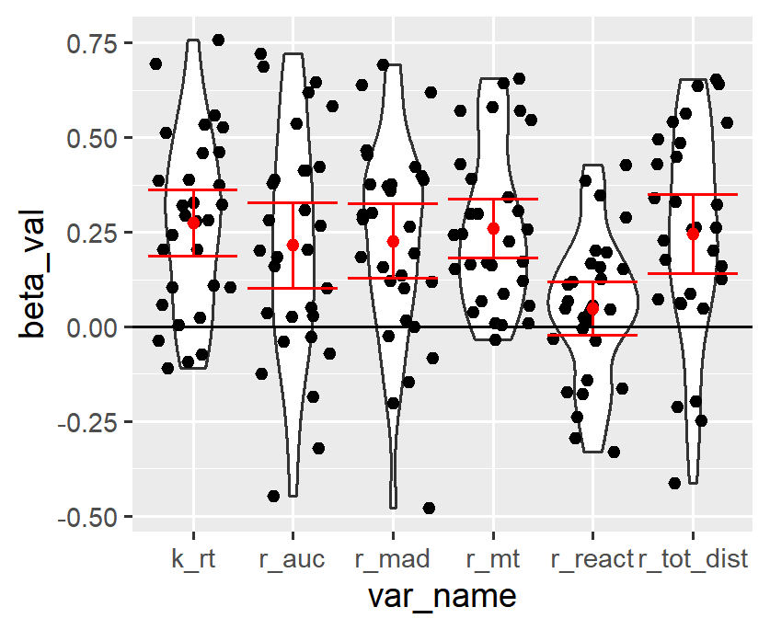

Regression formula within subject
$var \sim cond+\left(cond \right|side)$
(Fixed, rand slope, rand intercept)
Fixed effect coefficients ($β$) across subjects
k=keyboard, r=reach
Data is normalized within subject
Keyboard
Reaching

Slide 2
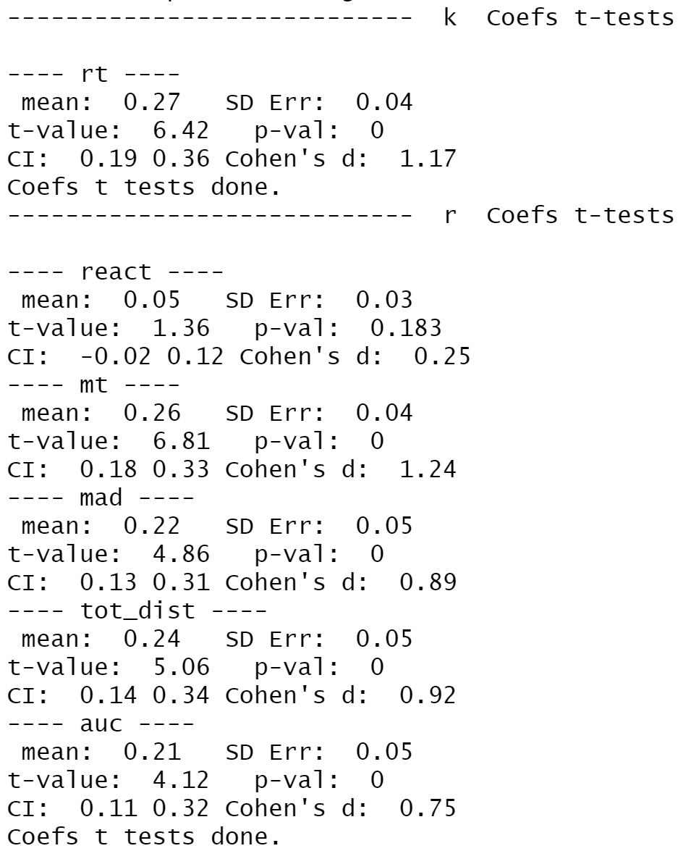
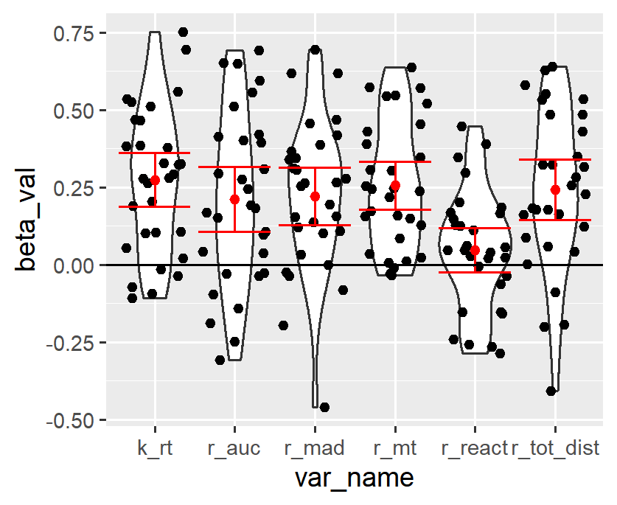

Regression formula within subject
$var \sim cond+\left(1 \right|side)$
(Fixed, rand intercept)
Fixed effect coefficients ($β$) across subjects
k=keyboard, r=reach
Data is normalized within subject
Keyboard
Reaching

Slide 3
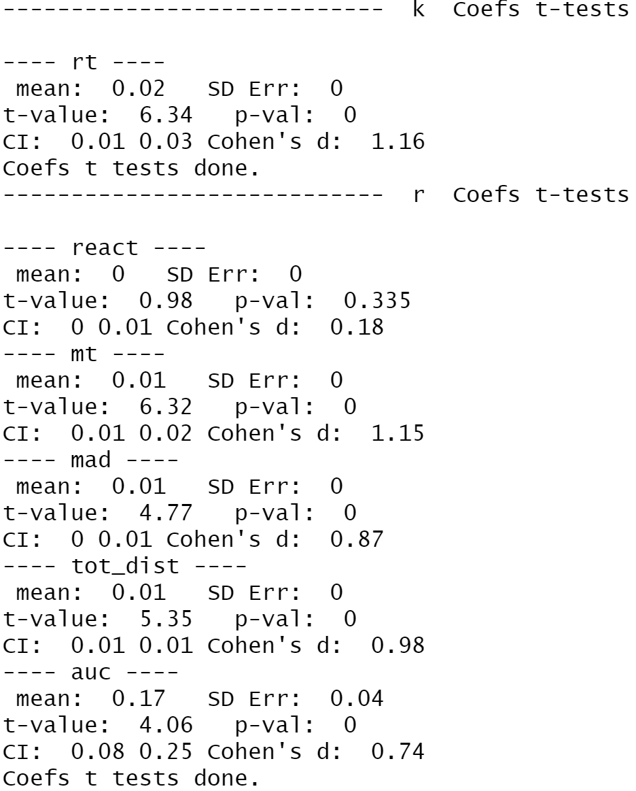
Regression formula within subject
$var \sim cond+\left(1 \right|side)$
(Fixed, rand intercept)
Fixed effect coefficients ($β$) across subjects
k=keyboard, r=reach
Data isn’t normalized
Keyboard
Reaching

Slide 4
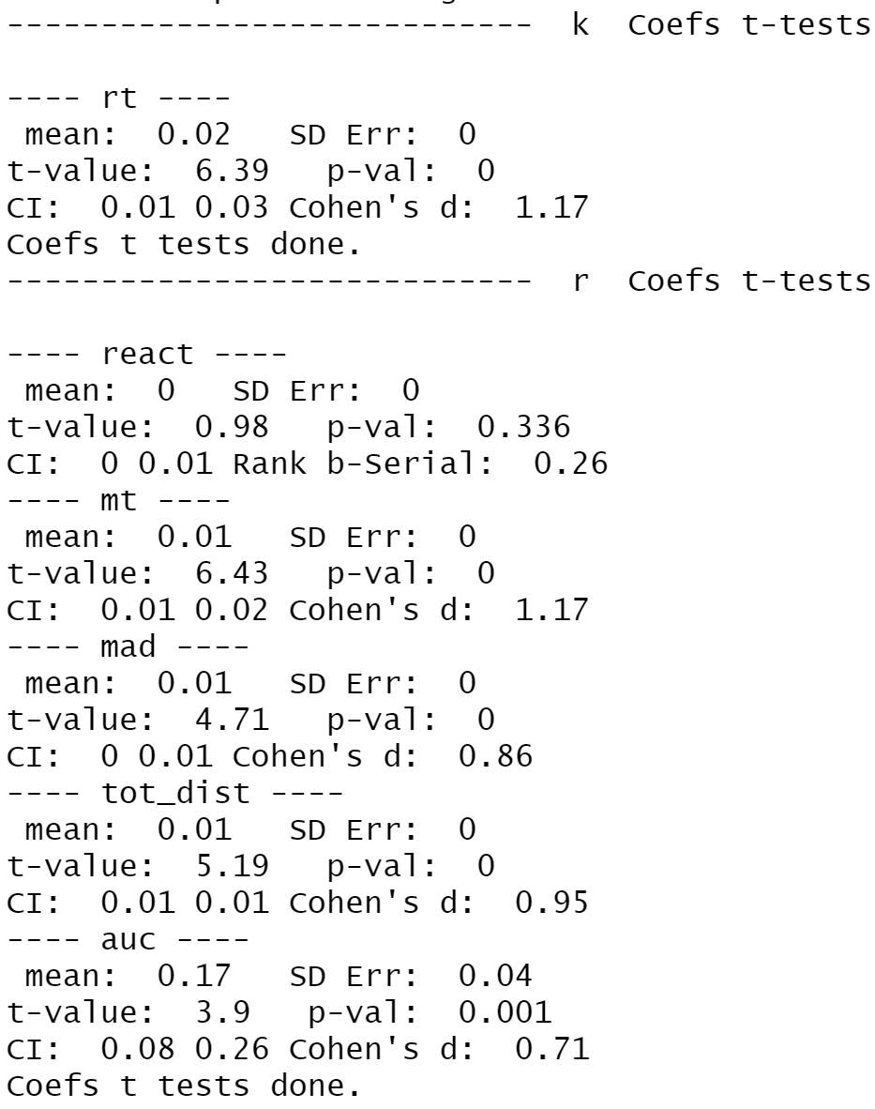

Regression formula within subject
$var \sim cond+\left(cond \right|side)$
(Fixed, rand intercept)
Fixed effect coefficients ($β$) across subjects
k=keyboard, r=reach
Data isn’t normalized
Keyboard
Reaching

