Slide 1
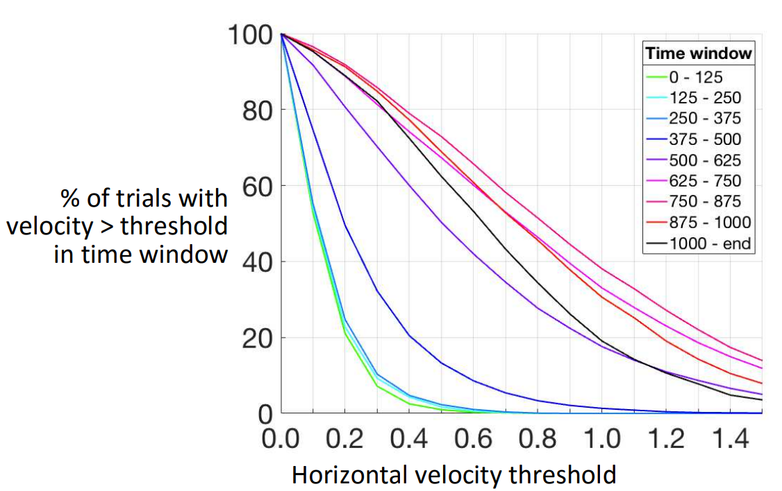
Our Profile
Dotan et al. (2016)
Our data doesn’t contain motor noise as can be seen between 0-375ms in Dotan’s experiment.
The motor noise velocity distribution is qualitatively different than the intentional movement.

Slide 2
These aren’t good
because when I flipped the velocity so that it will be positive when moving towards the selected answer, I used the last sample to estimate the answer’s side, but the trajectory is cropped so the last sample doesn’t represent the side of the selected answer.
Each sub’s average
Avg over all subs
Slope is steeper and maxima is higher in congruent condition.

Slide 3
Velocity
Acceleration
Implied Endpoint

Slide 4
Problems with trying to estimate slope: at what point before the peak does the slope start?
Negative top velocity
5% of absolute velocity?
5% of difference between peaks?
Two peaks in velocity
5% baseline is crossed before slope starts
Velocity
Velocity
Max(|velocity|)
Baseline ?
Baseline
Baseline ?
Time
Time
Start of slope ?
Max(|velocity|)

Slide 6
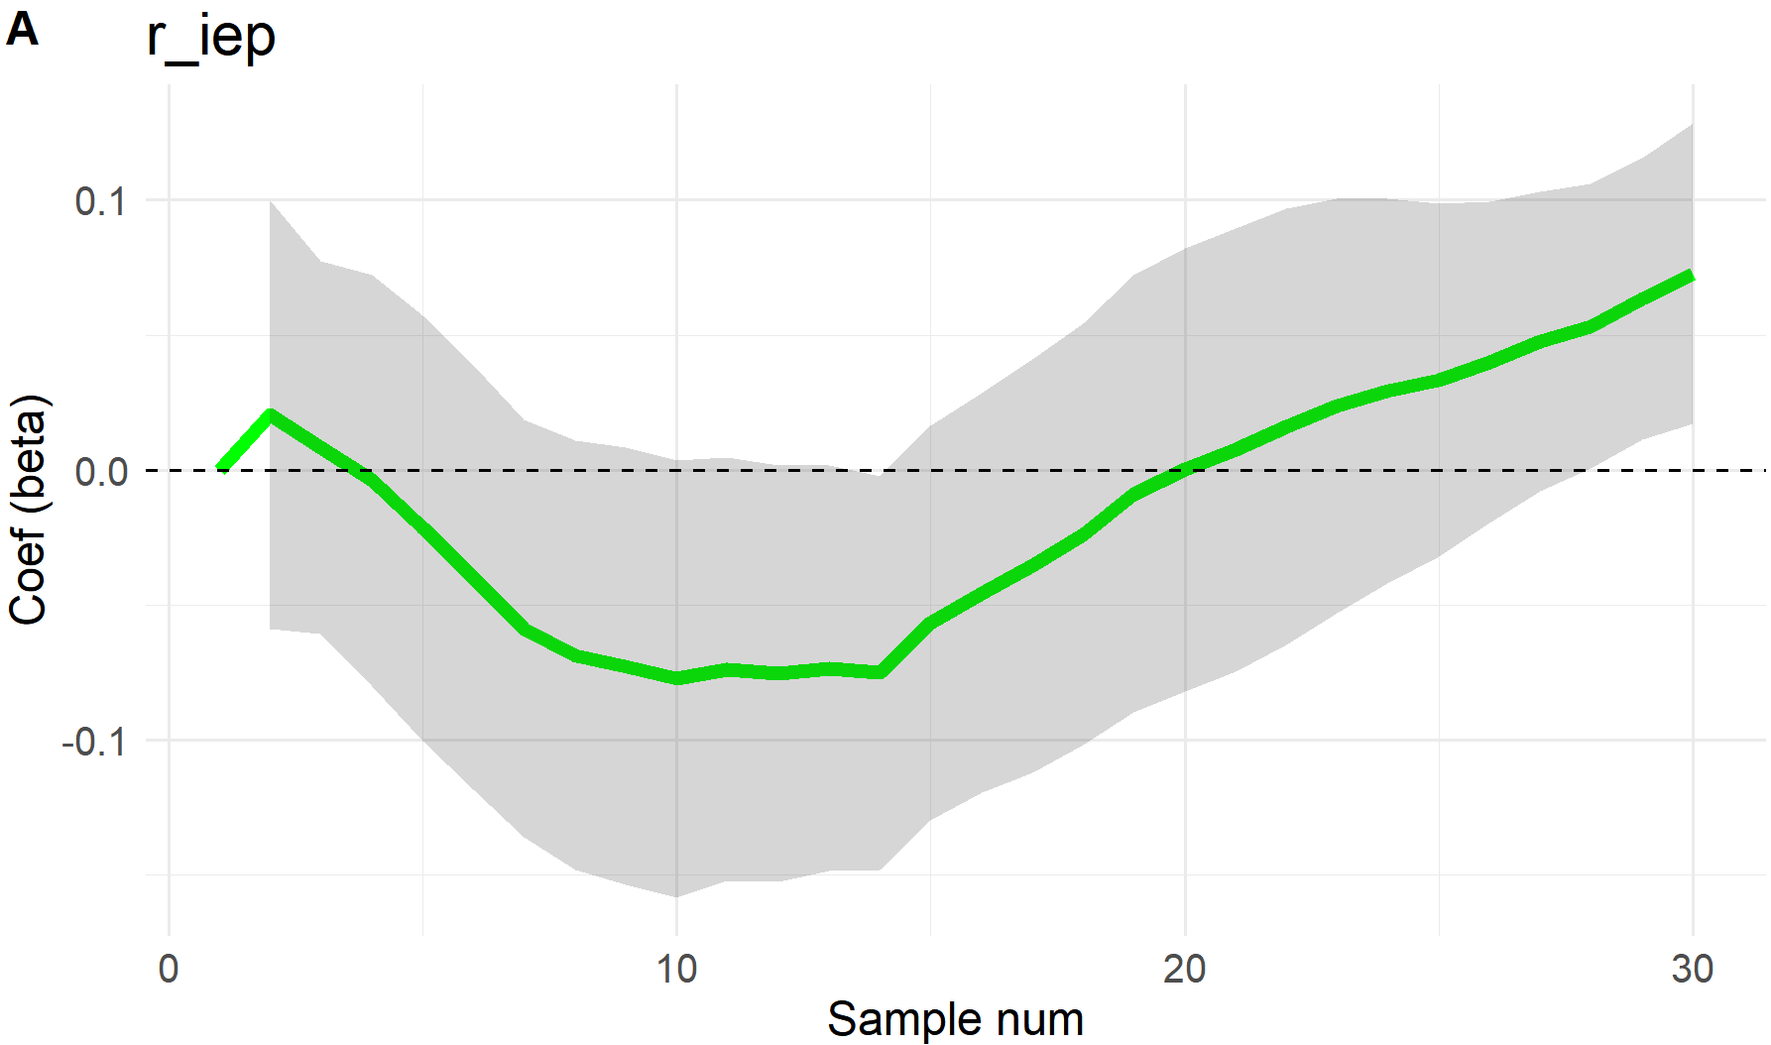
iEP with side as a random intercept and slope
iEP at each sample was normalized within participant.
Shade is CI.

