Slide 1
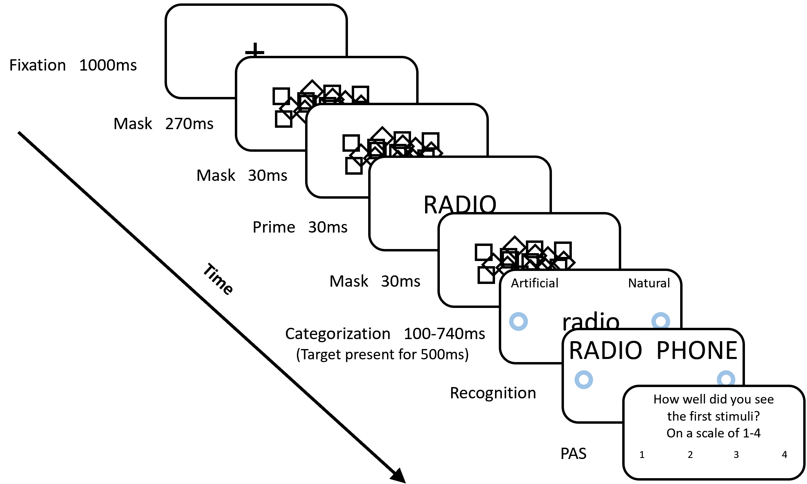
Indirect
Direct

Slide 2
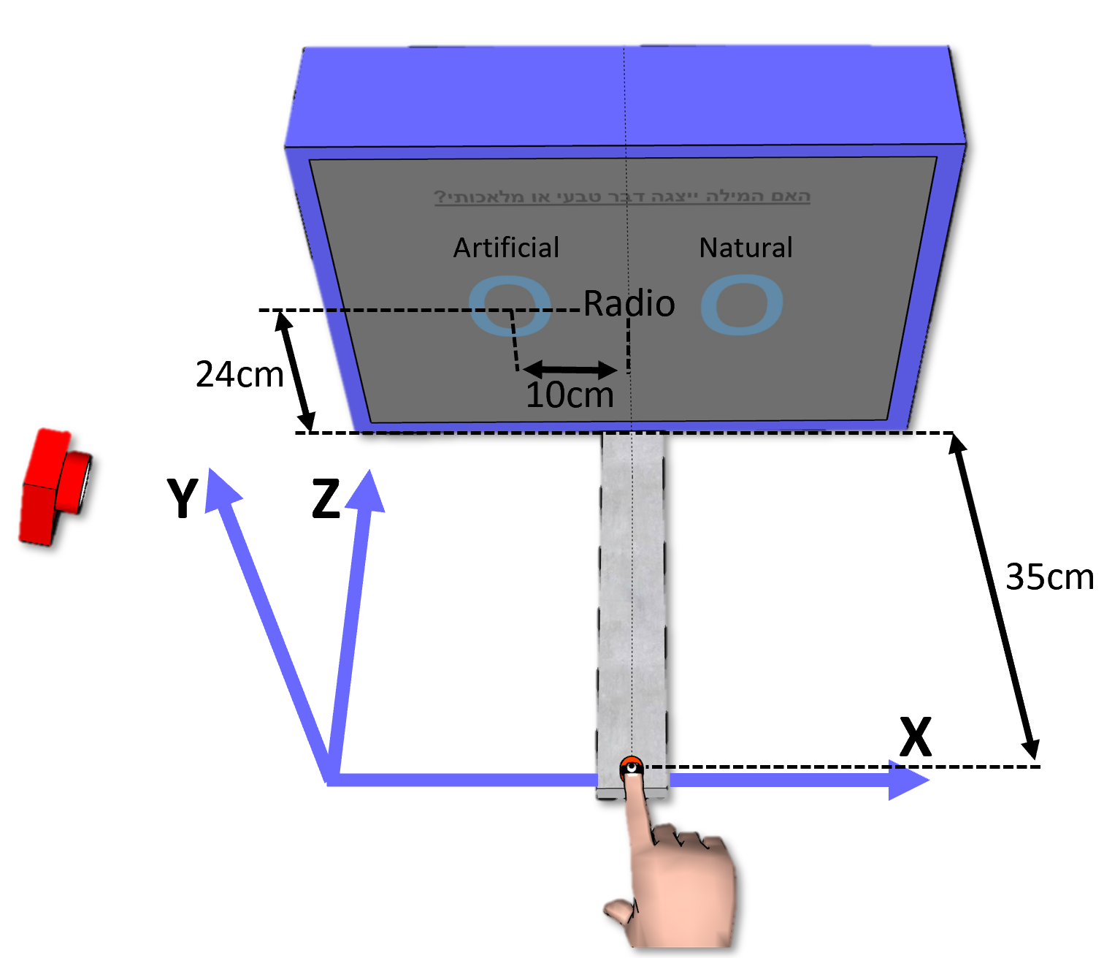


Slide 3
Direct Measure
d’=0 d’=0 d’>0

Slide 4
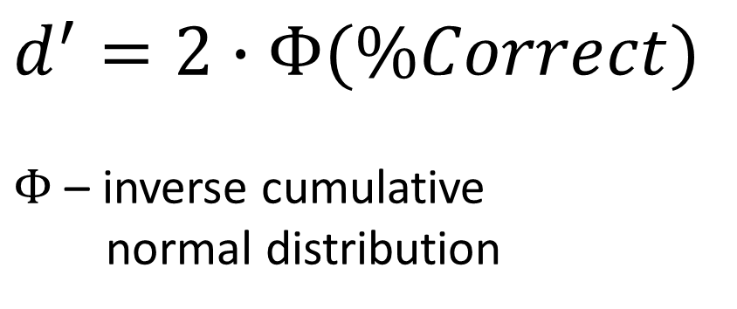
Direct Measure
$d^{′}=2∙Φ(\%Correct)$
$Φ$ – inverse cumulative
normal distribution
d’ d’ d’

Slide 5
Subject i
Features
Response time
150
175
.
.
130
166
.
.
Labels
Congruent / Incongruent
Con
Con
.
.
Incon
Incon
.
.
Congruent Trials
Incongruent Trials

Slide 6
Train set
Subject i
Features
Response time
150
175
.
.
130
166
.
.
Labels
Congruent / Incongruent
Con
Con
.
.
Incon
Incon
.
.
Test set
Congruent Trials
Incongruent Trials

Slide 7
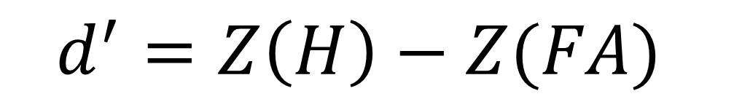
Train set
Train
Labels
Congruent / Incongruent
Con
Incon
Predictions
Congruent / Incongruent
Con
Con
Model
Test set
Predict
Hit = H
False Alarm = FA
$$d^{′}=Z\left(H\right)−Z(FA)$$

Slide 8
Subject i
Features
Trajectory n | … | Trajectory 1 | Reach Area | Movement time | Reaction time
0.1 |  | 0.010 | 111 | 340 | 150
0.95 |  | 0.021 | 123 | 337 | 175
. |  | . | . | . | .
. |  | . | . | . | .
0.99 |  | 0.011 | 90 | 402 | 130
0.97 |  | 0.010 | 100 | 370 | 166
. | . | . | . | . | .
Labels
Congruent / Incongruent
Con
Con
.
.
Incon
Incon
.
Congruent Trials
Incongruent Trials

Slide 9
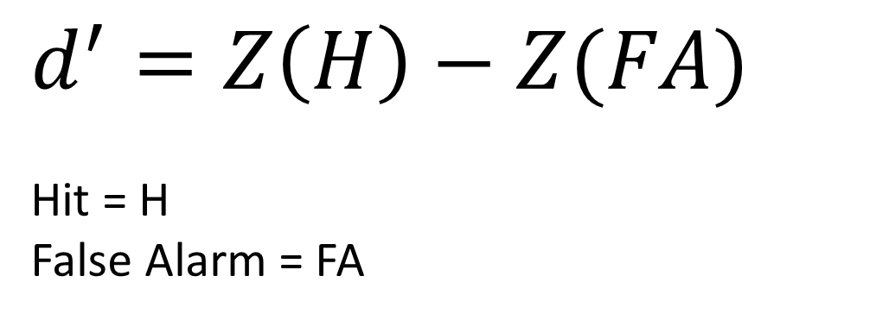
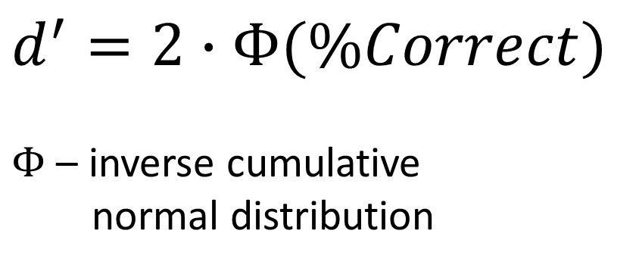
Direct Measure
$d^{′}=2∙Φ(\%Correct)$
$Φ$ – inverse cumulative
normal distribution
$d^{′}=Z\left(H\right)−Z(FA)$
Hit = H
False Alarm = FA
d’ d’ d’

Slide 10
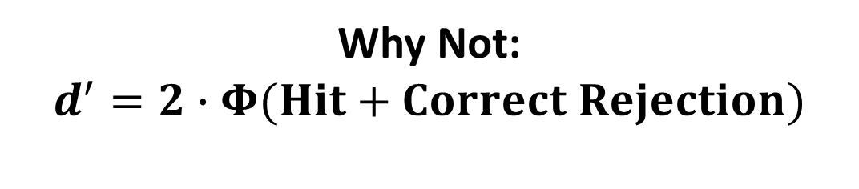
Direct Measure
Why Not:
$$d^{′}=2∙Φ(Hit+Correct Rejection)$$
$d^{′}=2∙Φ(\%Correct)$
$Φ$ – inverse cumulative
normal distribution
$d^{′}=Z\left(H\right)−Z(FA)$
Hit = H
False Alarm = FA
d’ d’ d’

Slide 11
Logistic Classifier
D Prime of each subject
Notes:
Ran a few times and results change dramatically between each run.
Held the train-test split consistent and results became consistent.
Train data is overfitted.
AVG NUM TRIALS (observations): Reach=115, Keyboard=160

Slide 12
Logistic Classifier
D prime average over subjects
50 iterations of D prime calculation

Slide 13
SVM Classifier
D Prime of each subject

Slide 14
Naïve Bayes Classifier
D prime average over subjects
50 iterations of D prime calculation

Slide 15
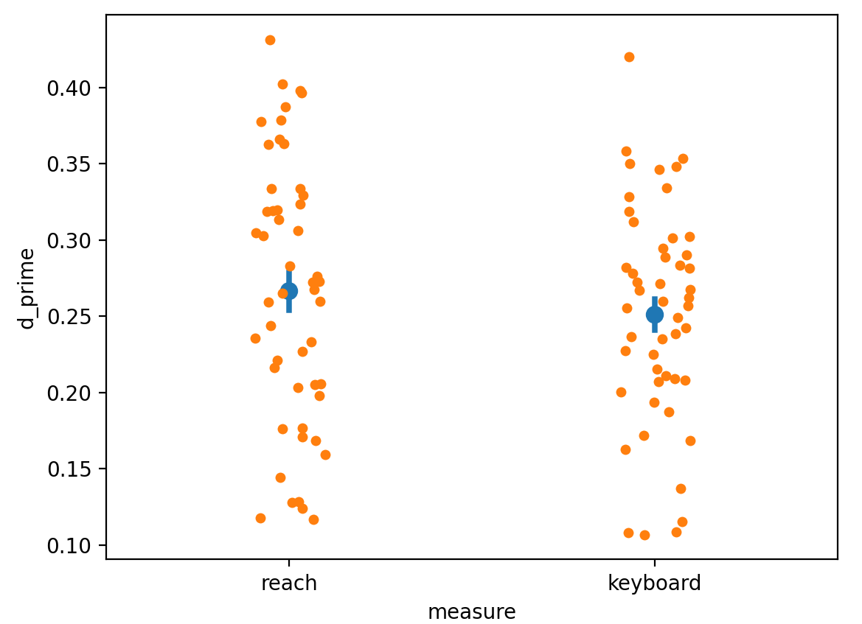
Ensemble Classifier
(Logistic + XGBoost)
D prime average over subjects
50 iterations of D prime calculation

