Slide 1



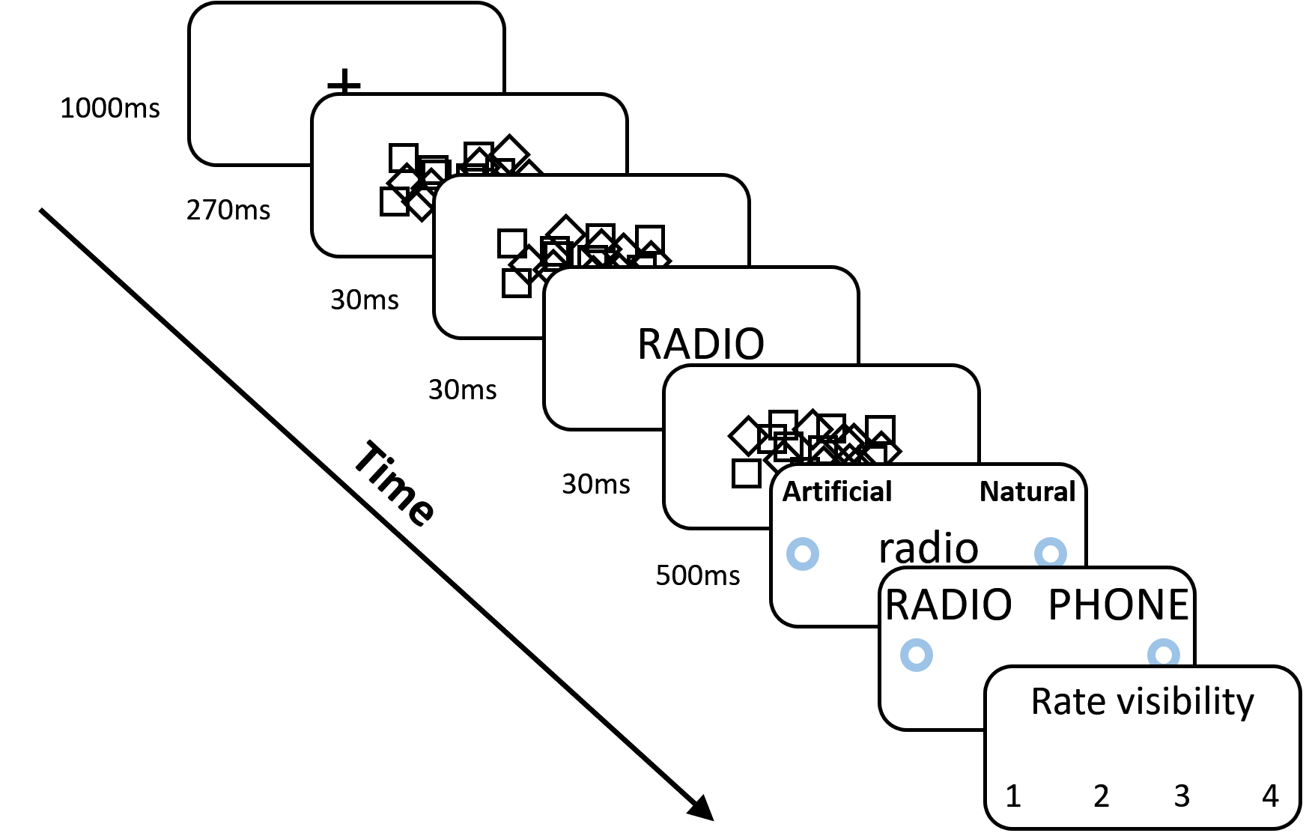
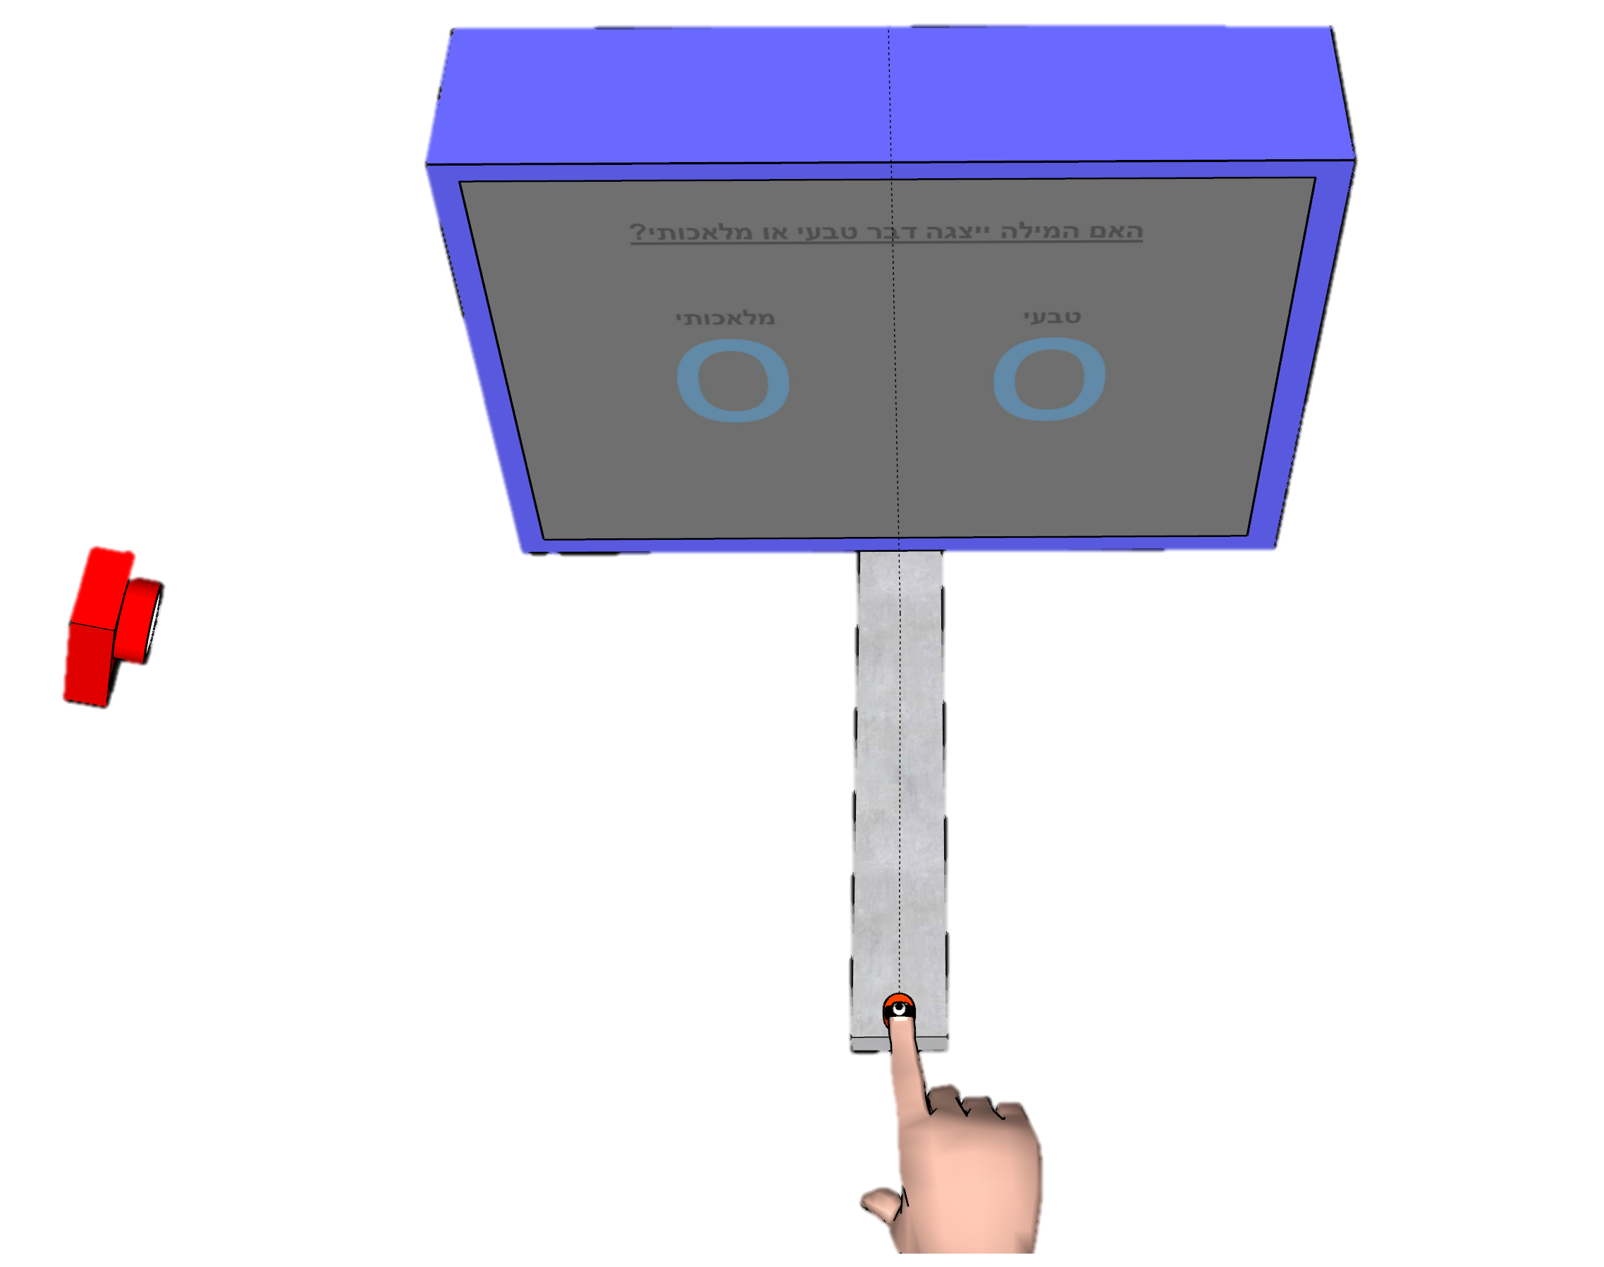
Show some sensitivity! Using motion tracking to improve unconscious measures
Khen Heller¹, Craig S. Chapman^{3,4,} and Liad Mudrik^{1,2}
¹ Sagol School of Neuroscience, Tel Aviv University; ² School of Psychological Sciences, Tel Aviv University; ³ Faculty of Kinesiology, Sport, and Recreation, University of Alberta, Edmonton, AB, Canada; ⁴ Neuroscience and Mental Health Institute University of Alberta Edmonton, Alberta, Canada
1
Introduction
Methods
1
2
Unconscious effect are hard to detect.
Motion tracking allows a continuous and richer measure.
Motion tracking was used to unravel unconscious priming effects [1-5].
Only one study compared motion tracking with keyboard response [6].
Further support is necessary to verify the superiority of motion tracking as a measure of unconscious processing.
Design Task Measure
Classify target as natural / artificial [7] RA: reach area between
average paths to the left and right targets
Pilot 2
N = 11
Practice day
Trials = 240
+
Test day
Trials = 560
Practice
6 blocks, w/o prime
Screen
Practice
1 block, w/o prime
Practice
1 block, with prime
Test
12 blocks, with prime
RA
Y
Z
Z
Pilot 1
N = 10
Test day
Trials = 560
X
3
Results
X
Effect Size Comparison
Effect comparable to previous papers
Larger than keyboard RT effect.
Average Trajectory Reach Area
Motion tracking yields a significant effect for unconscious priming.
Pilot 1 Pilot 2 Pilot 1 Pilot 2
Motion
Tracking
RA
*
Mouse
Tracking
AUC
Motion
Tracking
RA
*
*
Keyboard
RT
AUC – area under the curve, area between optimal and actual paths to the target. RA – Reach area, area between average trajectories to the left and to the right targets. Shaded areas represent CI. Error bars represent SE. * = p<0.05
References:
[1] Finkbeiner, M., & Friedman, J. (2011). The Flexibility of Nonconsciously Deployed Cognitive Processes: Evidence from Masked Congruence Priming. PLoS ONE, 6(2), e17095; [2] Friedman, J., & Finkbeiner, M. (2010). Temporal dynamics of masked congruence priming: Evidence from reaching trajectories. Proceedings of the 9th Conference of the Australasian Society for Cognitive Science, 98–105; [3] Finkbeiner, M., Song, J.-H., Nakayama, K., & Caramazza, A. (2008). Engaging the motor system with masked orthographic primes: A kinematic analysis. Visual Cognition, 16(1), 11–22; [4] Cressman, E. K., Franks, I. M., Enns, J. T., & Chua, R. (2007). On-line control of pointing is modiﬁed by unseen visual shapes. Consciousness and Cognition, 11; [5] Almeida, J., Mahon, B. Z., Zapater-Raberov, V., Dziuba, A., Cabaço, T., Marques, J. F., & Caramazza, A. (2014). Grasping with the eyes: The role of elongation in visual recognition of manipulable objects. Cognitive, Affective, & Behavioral Neuroscience, 14(1), 319–335; [6] Xiao, K., Yamauchi, T., & Bowman, C. (n.d.). Assessing Masked Semantic Priming: Cursor Trajectory versus Response Time Measures. 7; [7] Dehaene, S., Naccache, L., Cohen, L., Bihan, D. L., Mangin, J.-F., Poline, J.-B., & Rivière, D. (2001). Cerebral mechanisms of word masking and unconscious repetition priming. Nature Neuroscience, 4(7), 752–758.
Notes:
Intro
Our lab researches unconscious processing.
This field has much controversy,
partially because of the small effect sizes usually found in studies.
Motion tracking is a rich measure…
A few studies used motion tracking to probe unconscious…
To date only one directly compared it to keyboard response.
We ran 2 pilot exp which goal was to establish motion tracking as a valid measure for uncosnscious processing.
We present them here to receive feedback towards our next step,
Which would be comparing keyboard response and motion tracking as measures for unconscious processing.
Methods
We used a semantic priming paradigm… Conggruent = same word, incongruent = diff word from diff category
Subjects responded by touching the correct answer on the screen,
While we tracked the location of their index finger.
The main parameter we extracted is “reach area”:
Area circumscribed by the average trajectory to the right target and avg traj to the left target.
This area was compared between congruent and incongruent trials and the difference represents the congruency effect.
We had 2 pilots in out exp...
First had 1 session with 2 practice blocks and 12 test blocks.
But we noticed the subjects were falling within the response time limit we gave them.
So on the 2nd pilot we added a practice session a day before the test session, hoping to improve the subs RT.
Here comes the boom:
Our effect size is comparable to that found in previous studies who probed semantic priming with motion tracking.
Not only that, but is also larger than the effect size found when the same researchers used a keyboard.
This consistent advantage for motion tracking is inline with our hypothesis and is encouraging for our next planned experiment.
Advantages for motion tracking:
Final decision vs Entire decision process – cognitive processes are dynamic, they change and develop before reaching the final decision. Keyboard responses can only capture the final response and how long it took to make it, while motion tracking captures fluctuations in our final decision as it is formulated (since motion tracking represents changes of mind). These fluctuations might be exactly what we are looking for when probing unconscious effects on behavior.
Post-hoc vs online – We are interested in the processes that happens before the subject makes the final decision. With RT we learn when that processes ended and from that deduce what the processes included. So RT isn’t a direct measure of this process. On the other hand, motion tracking captures online information of this process as it is happening, which means it is a direct measure of it.
Richness – keyboard provides produces 2 parameters: accuracy and RT. On the other hand motion tracking yields a vast number of parameters.
Changes of mind represented in motion:
Real life – reaching for hot pan, realizing a second before that its hot, retracting and taking a kitchen glove.
Conscious – 1. target is changed, subject changes traj accordingly.
2. Both targets have same value, sub changes direction mid-flight voluntarily.
Unconscious – experiment show attitudes, stereotypes, semantic primes, color primes, emotional primes affect trajectory.

Slide 2
High volume of “bad” trials
Suggestions for reducing the volume?
Pilot 1
Pilot 2
Notes:
Onset time > 100 ms
Reaction time < 320 ms
Movement time < 420 ms

Slide 3
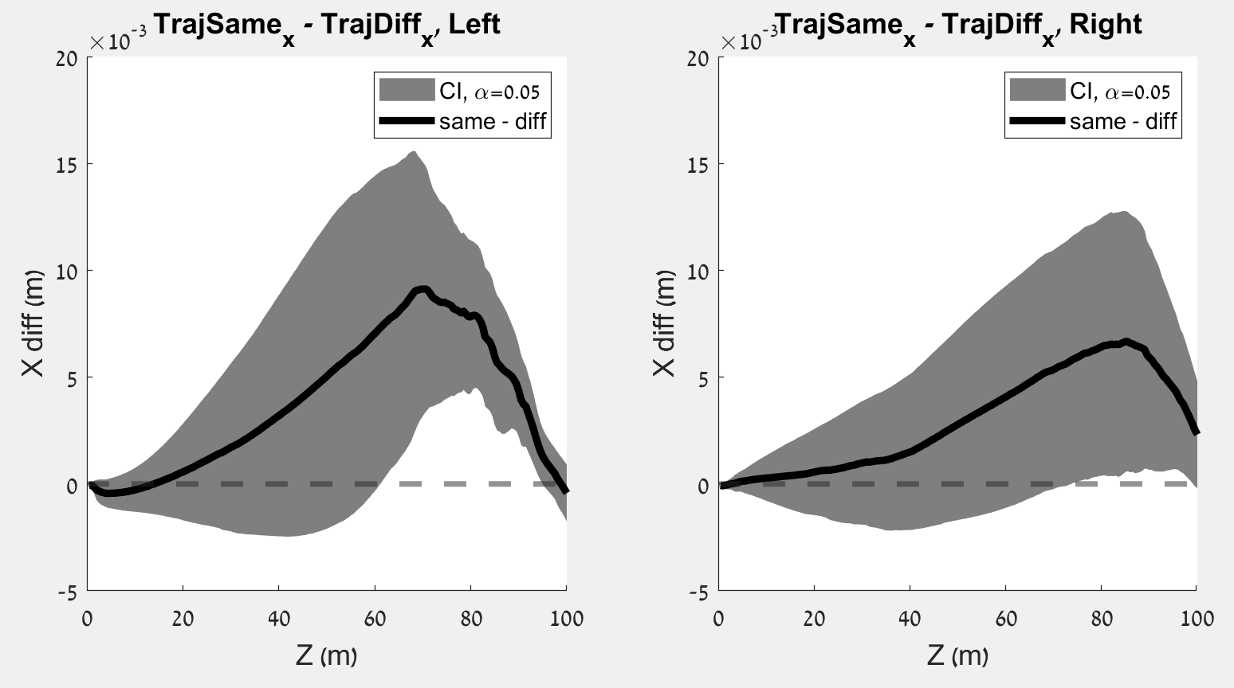
Congruent – Incongruent, left
Congruent – Incongruent, Right
Difference
Difference

