Slide 1
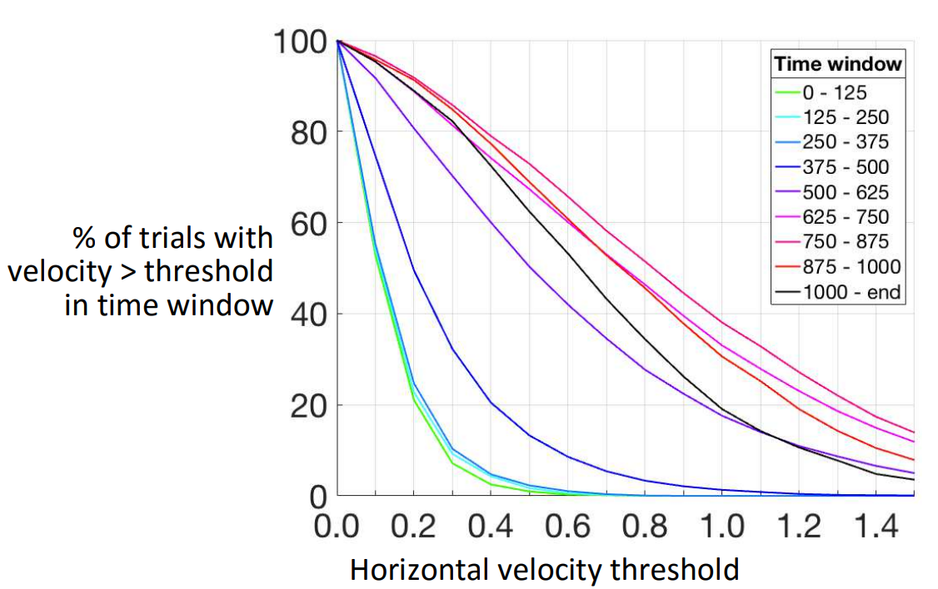
Our Profile
Dotan et al. (2016)
Our data doesn’t contain motor noise as can be seen between 0-375ms in Dotan’s experiment.
The motor noise velocity distribution is qualitatively different than the intentional movement.

Slide 2
Each sub’s average
Avg over all subs
Slope is steeper and maxima is higher in congruent condition.

