Slide 1
“K-Fold” testing
Using 80% of data to locate section in traj with largest difference.
Then using the 20% left to estimate the effect size in this section.
As a POC, I first use all the data to locate best part and estimate effect size.

Slide 2
Next slides:
Effects in a regular analysis.
No normalization in space.
No normalization within subject.

Slide 7
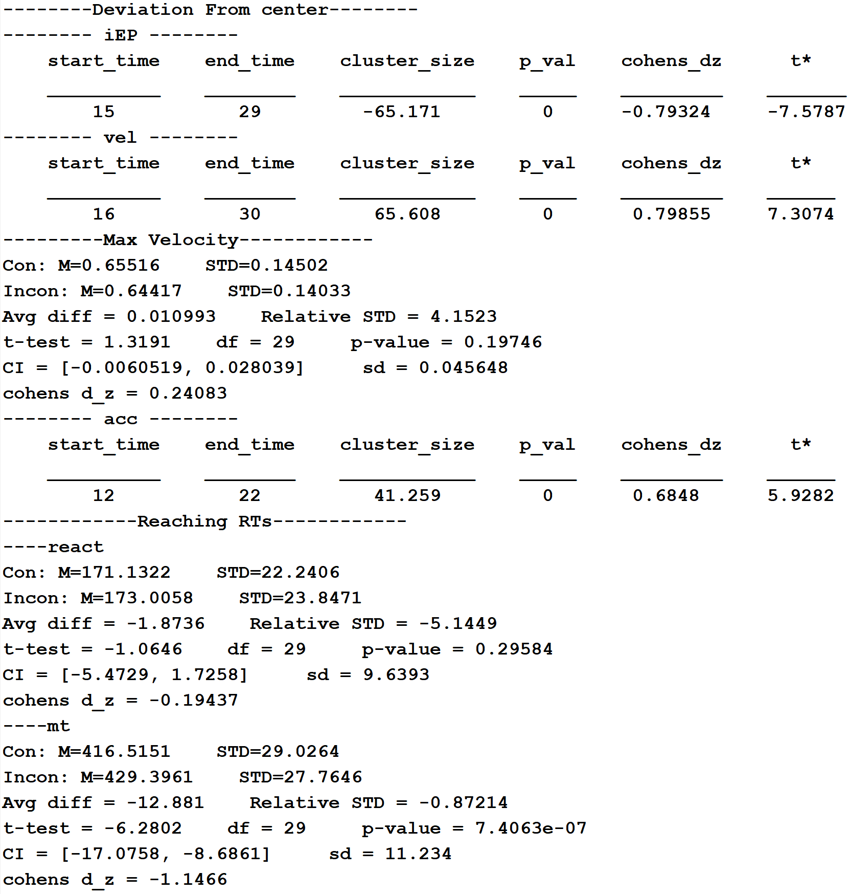
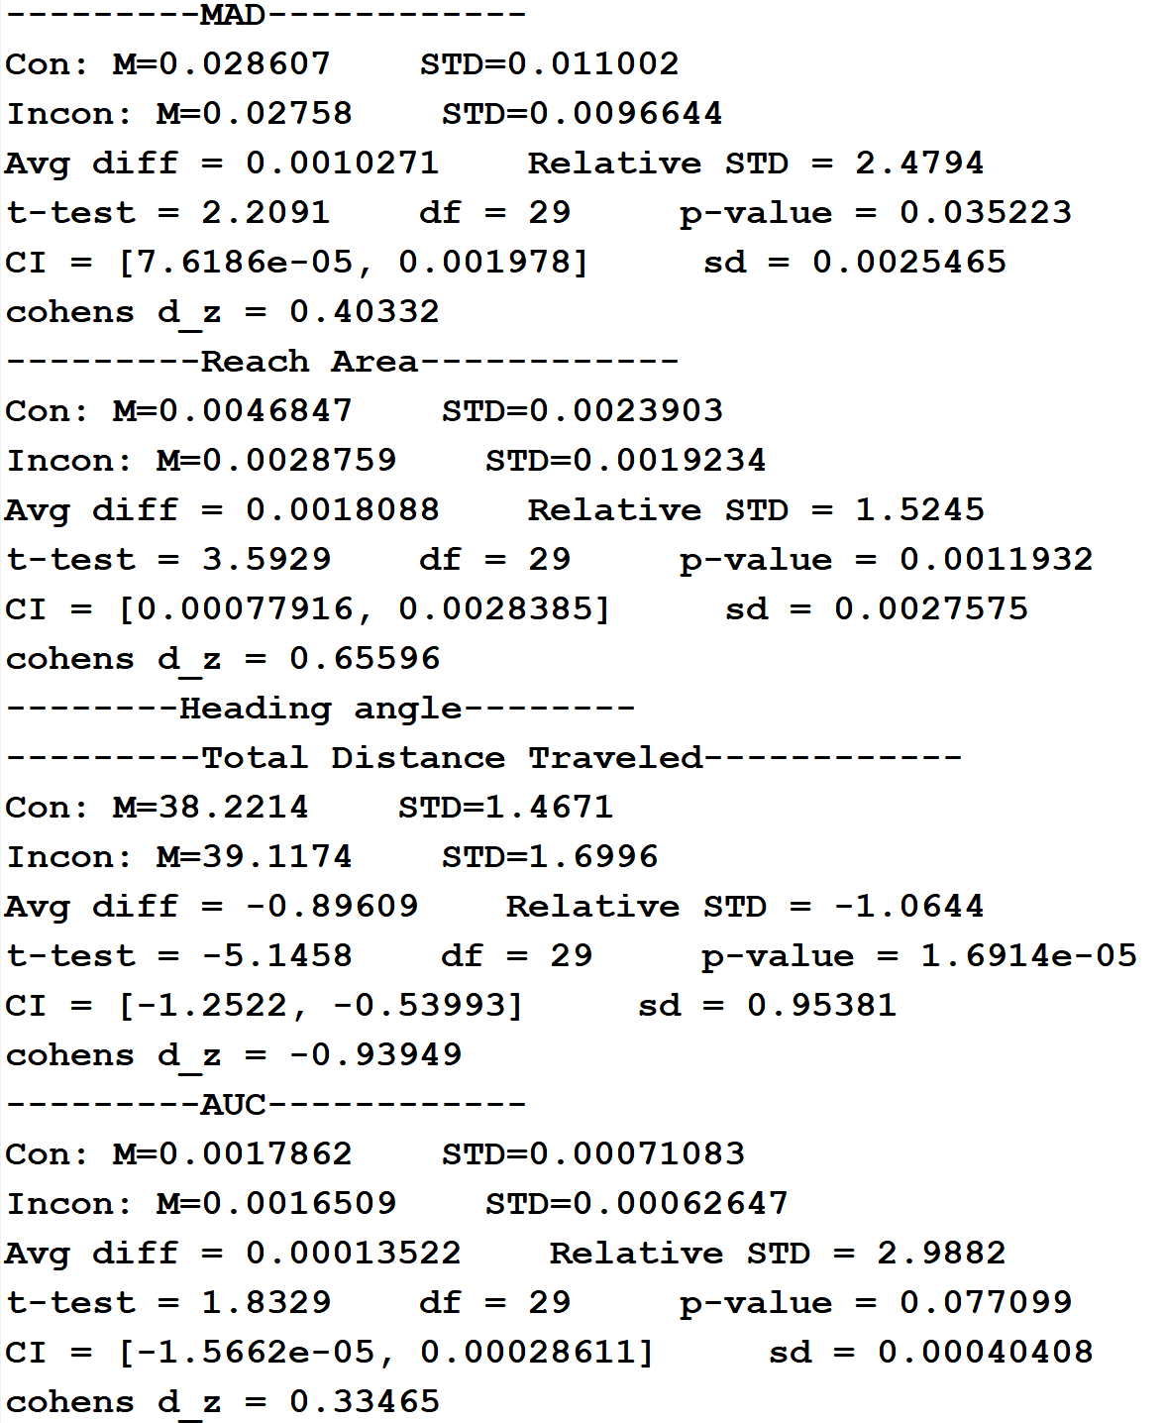
0-300ms

Slide 8
Next slides:
Effects between 150-300ms from movement intitation.
No normalization in space.
No normalization within subject.

Slide 11
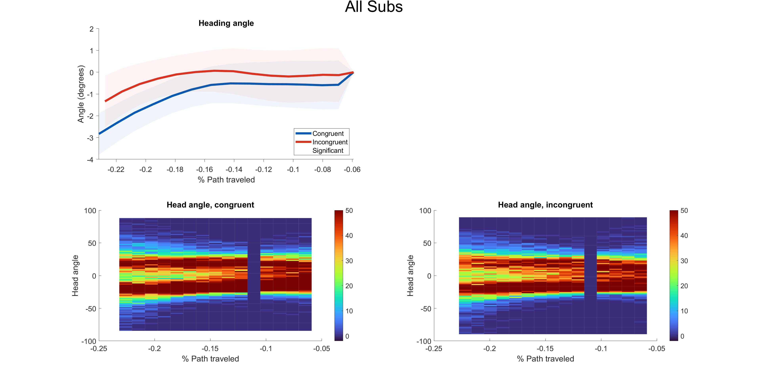

Slide 13
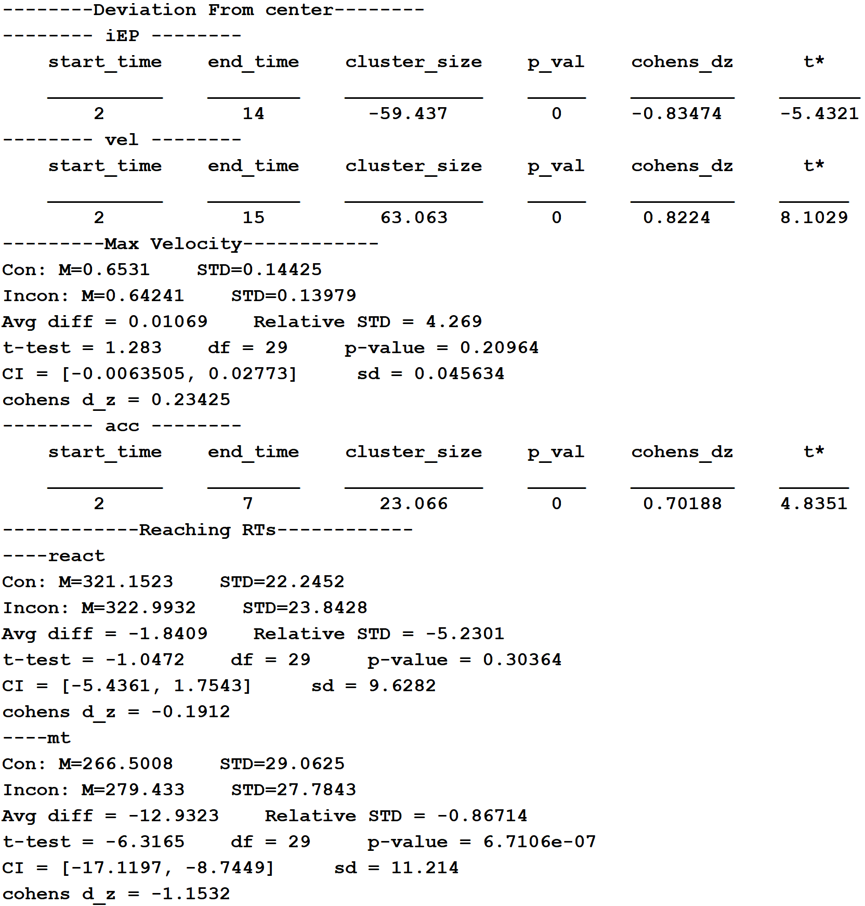
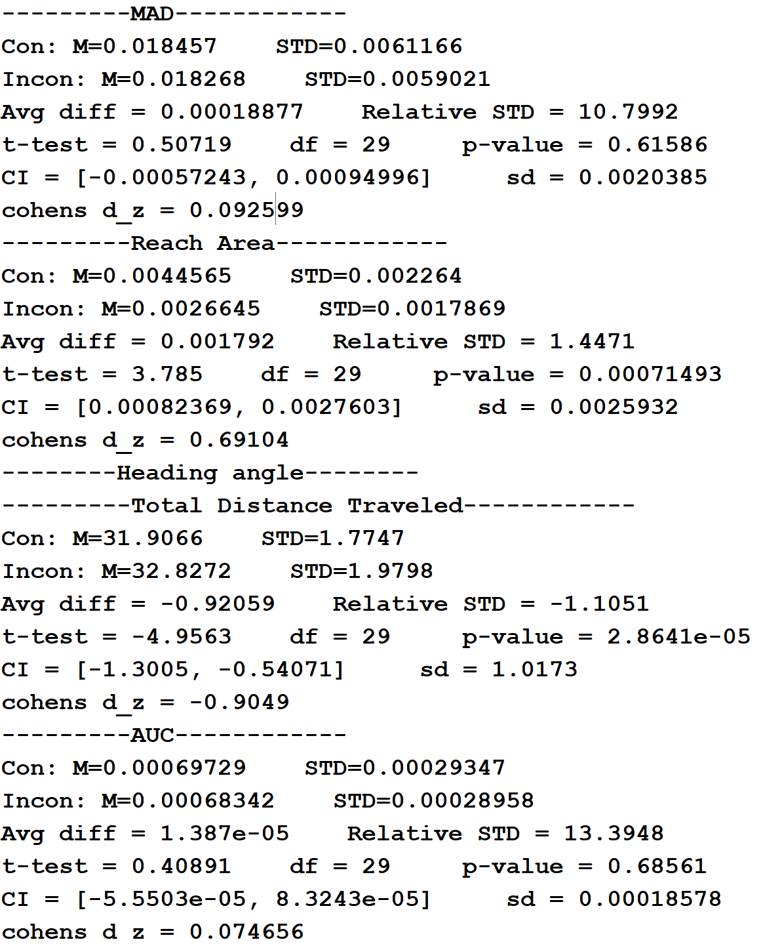
150-300ms

Slide 14
p-value |  | t-value |  | Cohen's d |  | Variable
150-300ms | 0-300ms | 150-300ms | 0-300ms | 150-300ms | 0-300ms
 |  | 5.43 | 7.57 | 0.83 | 0.79 | iEP
 |  | 8.10 | 7.3 | 0.82 | 0.79 | Velocity
0.209 | 0.197 | 1.28 | 1.31 | 0.23 | 0.24 | Max velocity
 |  | 4.83 | 5.92 | 0.70 | 0.68 | Acceleration
0.303 | 0.295 | 1.04 | 1.06 | 0.19 | 0.19 | Reaction time
<0.001 | <0.001 | 6.31 | 6.28 | 1.15 | 1.14 | Movement time
0.615 | 0.035 | 0.50 | 2.20 | 0.09 | 0.40 | MAD
<0.001 | 0.001 | 3.785 | 3.59 | 0.69 | 0.65 | Reach area
<0.001 | <0.001 | 4.95 | 5.14 | 0.90 | 0.93 | Distance traveled
0.685 | 0.077 | 0.40 | 1.83 | 0.07 | 0.33 | AUC

