Slide 1
“K-Fold” testing
Using 80% of data to locate section in traj with largest difference.
Then using the 20% left to estimate the effect size in this section.
As a POC, I first use all the data to locate best part and estimate effect size.

Slide 2
Next slides:
Effects in a regular analysis.
No normalization in space.
No normalization within subject.

Slide 7
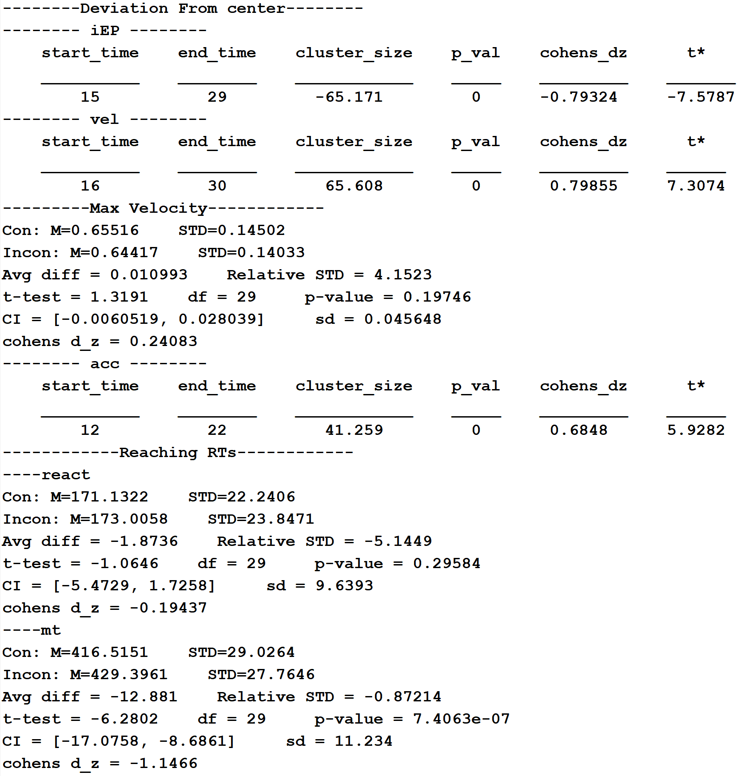
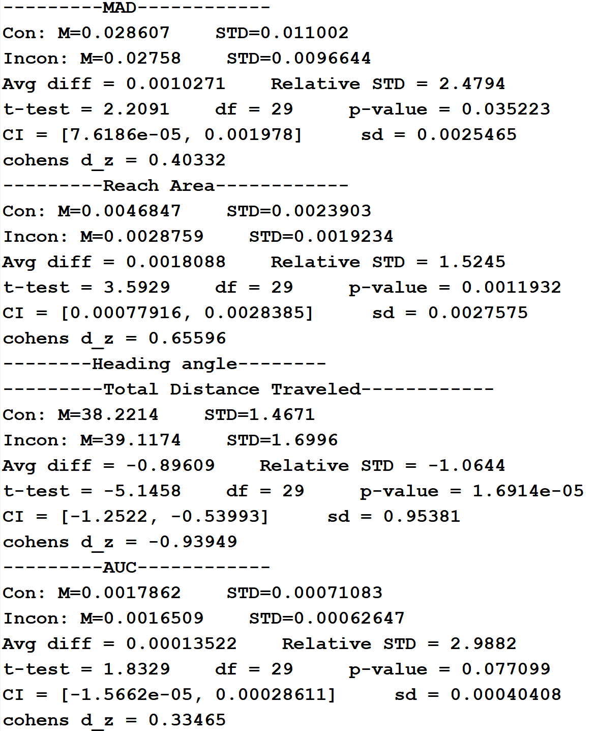

Slide 8
Next slides:
Effects between 150-300ms from movement intitation.
No normalization in space.
No normalization within subject.

