Slide 1
Linux Tracing Deep Dive
@khenidak

Slide 2
But first.

Slide 3
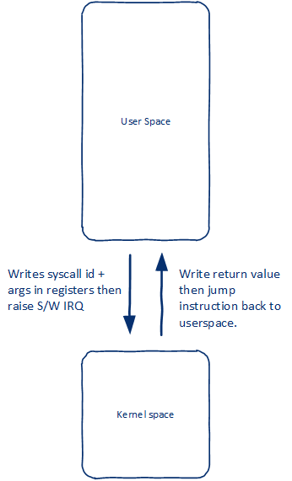
Advanced Basics/1: syscalls
All code running on any giving Linux box is either:
User space code.
Kernel space on behalf of the user.
Background kernel mode
Top half: _uninterrupted_ interrupt handling.
Bottom half (aka deferred pr background)
Custom Kernel threads.
Tasklets/worker queue.
Notes:
For more details on deferring kernel work refer to:
https://developer.ibm.com/technologies/linux/tutorials/l-tasklets/
For more details on sys calls
http://www.linux.it/~rubini/docs/ksys/

Slide 4
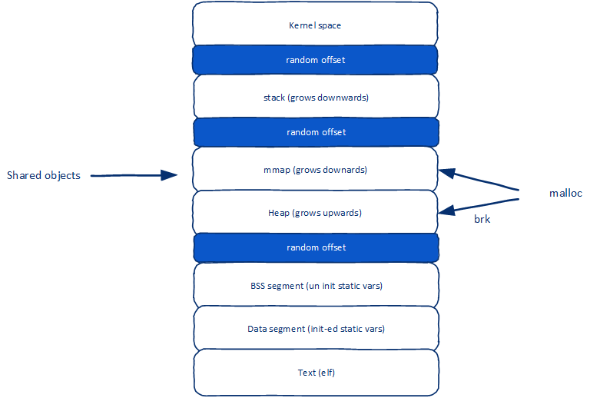
Advanced Basics/2: Process Memory Layout
Notes:
Stack size is set by setrlimit(RLIMIT_STACK)
ELF start/end data section defines the size data segement.

Slide 5
Advanced Basics/3: Quick word on binaries
Linux kernel knows one executable format. ELF.
This also applies on your “shebang line”, it references ELF that can be used to run the script.
You can teach Linux how to run different binaries via “binfmt”.
While what will be running is your file. In reality it is the interpreter/executable which is ELF, hence the memory layout is the same.

Slide 6
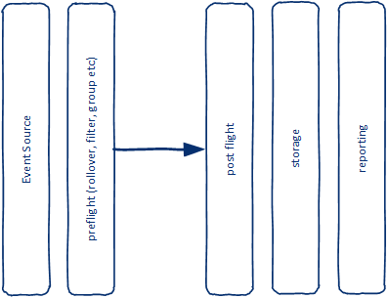
Advanced Basics/4: Tracing
Notes:
One diagram showing the difference between
event generation
Calculation/roll over
Submission/storage/reporting
Make sure audience understand where we are going to focus
Make sure that audience understand that there is no ETW
A few notes about openTelemetry and other work might be worthy
We can do our discussion top down (tools, then internals) or bottom up (internals then tools). I choose the later, because I want us to under the inner working, the tools are easy.

Slide 7
And then..

Slide 8
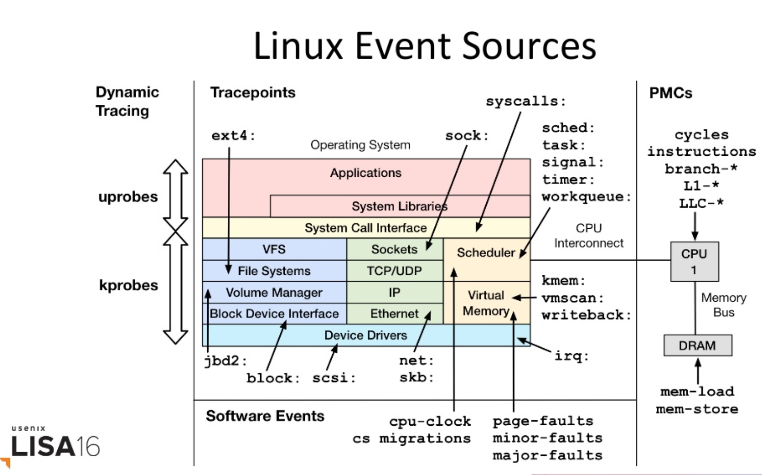
Source: https://www.slideshare.net/brendangregg/linux-4x-tracing-tools-using-bpf-superpowers
Notes:
This diagram is probably the most signfant diagram made on linux tracing in the past 5 years or so.
Created by Brendan Gregg of Netflix
Diagram has been modified to include
Observibility (using the userspace tools to view the events)
Tunning (modifying variables that effect each sub system)
Overlayed with kernel versions that supports various features
Check: https://www.google.com/search?q=linux+event+sources+tracing&rlz=1C5CHFA_enUS776US776&sxsrf=ACYBGNSVpZR6i61CQFcy3OGgO8Yhe3MYsg:1582068522004&source=lnms&tbm=isch&sa=X&ved=2ahUKEwjhnI7CoNznAhVKqJ4KHcn5BP4Q_AUoAnoECAwQBA&biw=1920&bih=969

Slide 9
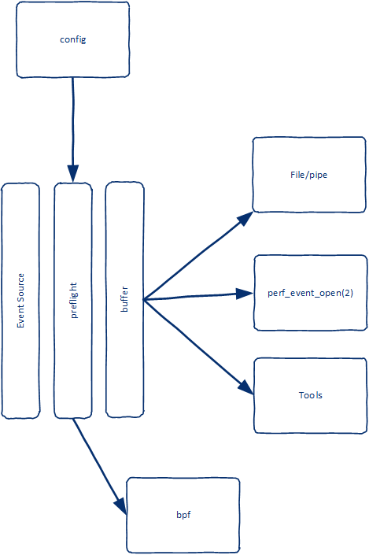
How
Mount tracefs or debugfs
Enable or disable all events (at root)
Enable or disable selective events (per system/per event).
Learn event format
Configure
filters
triggers
histograms
Read
from file or from pipe like file.
Via syscall
Use tools.
Notes:
More on debugfs vs tracefs: https://lwn.net/Articles/630526/
More on tracepoints and bpf:

Slide 10
Demo: config , format, Events, and files .. OMG!

Slide 11
Huh! That can’t be it, right?
Option 1: Raw, open the file, read the file (please don’t)
Option 2: Code, write code around perf_event_open(2) (please don’t)
Option 3: Specialized tools (per subsystem, some are better than other).
Option 4: Tools and some degree of “scripts”.
Option 5: ebpf directly or via tools like bcc
Notes:
Optio 2: perf_event_open has no gilbc wrapper check http://man7.org/linux/man-pages/man2/perf_event_open.2.html for more details. All structs defs are here linux/perf_event.h

Slide 12
Things you can use but I will not talk about (and why)
dtrace: I love “my little ponies” (I really do btw).
lTTng: power of community. Has some guard rails
SystemTap and sysdig: kernel modules everywhere!.
sTrace: traces syscalls. You should (must?) learn how to use it.
fTrace: traces kernel function calls (part of mainline tree).
Debugfs and debugfs kernel apis.
Notes:
dtrace was born in Unix (created by sun). Ported to Linux. For the longest period it was not on bar because of linux kernel missing or not equal capabilities. As of 4.9 that is no longer the case. Why? Because it is not developed by Linus. If you are on freebsd or Max then use dTrace
Linux tracing toolkit: next generation – not in mainline kernel. (though it does not matter much for a large community). Lttng source code is a great tool to learn the inner working of linux

Slide 13
Meet Perf
The swiss knife of linux tracing
A cli UX on top of linux features.
Build and maintained as part of the kernel.
It is a Tracer, a profiler, a metric generator and an analyzer.
One of the very few tools that does not follow Unix philosophy on Linux (one of the successful ones at that).

Slide 14
Demo: Perf tool
Notes:
Listing of events.
on/off event
run and view file

Slide 15
Demo: uprobe

Slide 16
What about eBPF?
User space program
e/bpf programs are byte code verified (upon loading) and executed by the kernel.
Build opts:
C =>llvm (bpf backend)=>byte code.
custom (gobpf, bcc, ..) => byte code.
Kernel has few – interlocked - data structure to share data between user space and kernel space (map/array), offers a single syscall to do everything.
e/bpf programs have limits such as no loops/everything is inlined. These limits relaxes in newer kernel versions (e.g. 5.x does not need inlining. Bounded loop are in 5.3+
uses bpf(2) to read
write to
user space
kernel space
Map/array
reads/writes to
Event source
ebpf program
calls

Slide 17
Closing notes
Apps use a higher level framework
OpenTelemetry for event collection, transport
Grapfana for visualization
Prometheus for storage
Or the likes of zipkin
Everybody likes to say “distributed tracing”
Most of “that level of” tracing happens by
System engineers e.g. building networking proxies. Or meta: e.g. who is doing something stupid with bpf?
Framework/runtime/library builders
Kernel engineers.
System operator responding to “why my system is too slow?” they typically use specialized tools (iostat etc.)
Benchmarks
You should look into using iovisior/bcc, currently position to lead the progressing on the tooling front.
Or: Folks where 0.1% save == mil$ (btw Microsoft is one of them).
Notes:
OpenTelemetry = open census and open tracing now an CNCF sandbox project

