Slide 1

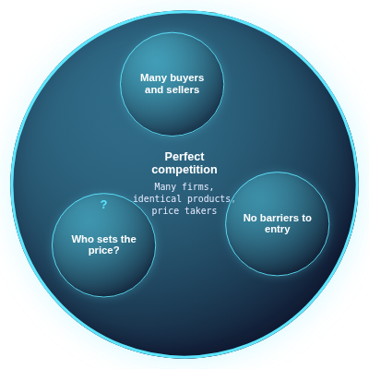
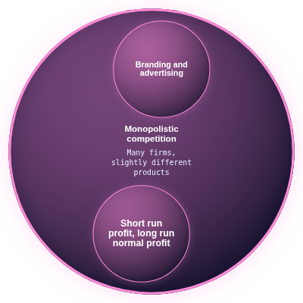

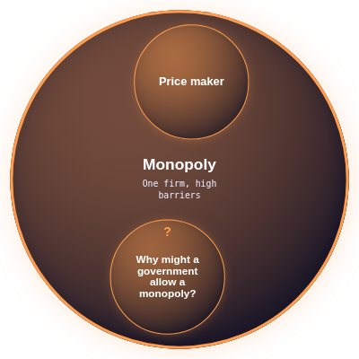
Market structures
Notes:
Market structures

Slide 2




Perfect competition
Many firms, identical products, price takers
Notes:
Perfect competition
Many firms, identical products, price takers

Slide 3
Many buyers and sellers
Notes:
Many buyers and sellers

Slide 4
No barriers to entry
Notes:
No barriers to entry

Slide 5
?
Who sets the price?
The market, firms are price takers
Notes:
Who sets the price?
Answer: The market, firms are price takers
The answer appears on the next click.

Slide 6



Monopolistic competition
Many firms, slightly different products
Notes:
Monopolistic competition
Many firms, slightly different products

Slide 7
Branding and advertising
Notes:
Branding and advertising

Slide 8
Short run profit, long run normal profit
Notes:
Short run profit, long run normal profit

Slide 9

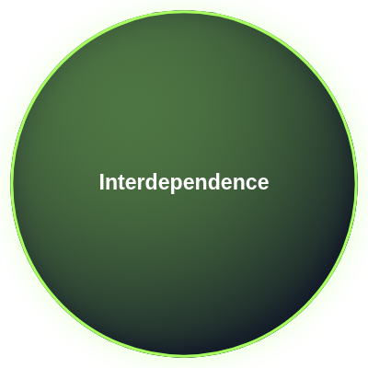
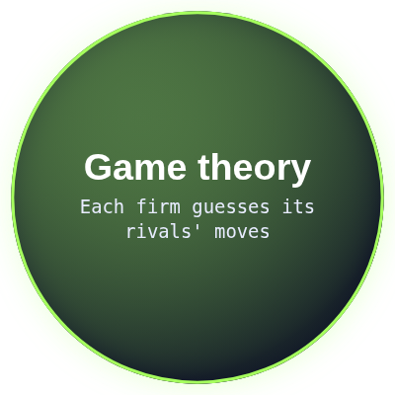

Oligopoly
A few large firms
Notes:
Oligopoly
A few large firms

Slide 10
Interdependence
Notes:
Interdependence

Slide 11
Game theory
Each firm guesses its rivals' moves
Notes:
Game theory
Each firm guesses its rivals' moves

Slide 12
Collusion and cartels
Illegal in most countries
Notes:
Collusion and cartels
Illegal in most countries

Slide 13



Monopoly
One firm, high barriers
Notes:
Monopoly
One firm, high barriers

Slide 14
Price maker
Notes:
Price maker

Slide 15
?
Why might a government allow a monopoly?
Economies of scale, natural monopoly, patents
Notes:
Why might a government allow a monopoly?
Answer: Economies of scale, natural monopoly, patents
The answer appears on the next click.

Slide 16
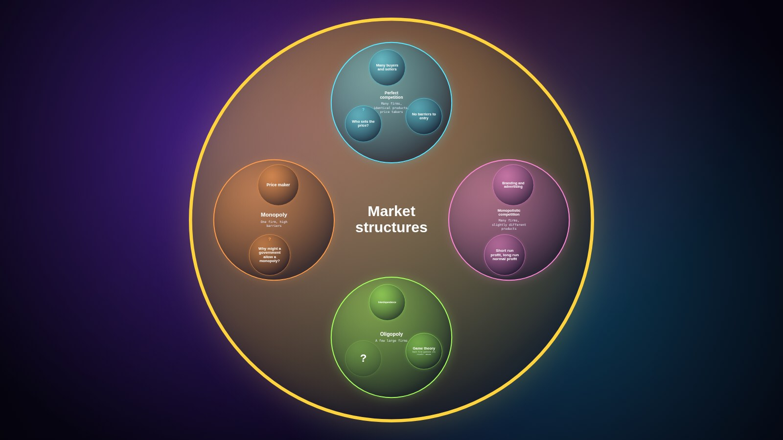
Notes:
Recap of the whole map.

