Slide 1
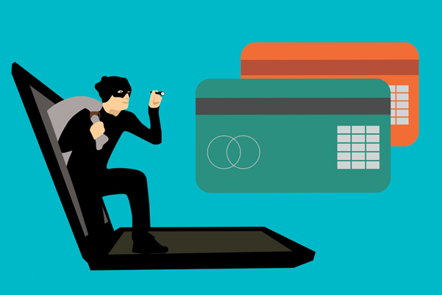
CREDIT CARD FRAUD

Slide 2
BUSINESS UNDERSTANDING
1.What time does the Credit Card Frauds usually take place?
2. What are the general trends of amounts for Credit Card Fraud Transactions?
3. How do we balance the data to not let the model overfit on legitimate transactions?

Slide 3
PATH
Loading the Dataset
Checking for null values
Visualizing the data

Slide 4
Contd..
Splitting the data
Training the data
Parameter tuning

Slide 5
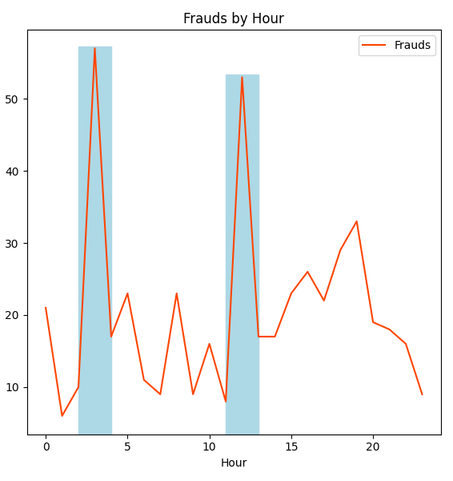
CONTD …
Graphs have been analyzed
Best Model is Selected
LGBM

Slide 6
MODEL DEPLOYMENT
PICKLE
The Model was deployed in the local server using Pickle and streamlit library.
The Model Deployed Worked pretty good and produced good results
STREAMLIT

Slide 7

THE END
THANK YOU ….

