Slide 1


MongoDB EduHub Project: E-Learning Platform Database
Building Scalable NoSQL Backend with PyMongo
Name: Cheikh Bou Mohamed Kante
Date: October 5, 2025

Slide 2
Project Overview
Simulates real-world e-learning platform (EduHub) with user/course management.
Key Features: CRUD ops, aggregations, indexing, validation.
Tech Stack: MongoDB 8.0+, PyMongo, Jupyter Notebook.
Objectives: Demonstrate NoSQL design, optimization, and analytics.

Slide 3
Database Schema Design
6 Collections: users, courses, enrollments, lessons, assignments, submissions.
Relationships: Denormalized refs (e.g., course.instructorId → users.userId).
Validation: JSON Schema for required fields, enums, email patterns.
Example: Users schema enforces role enum and unique email.

Slide 4
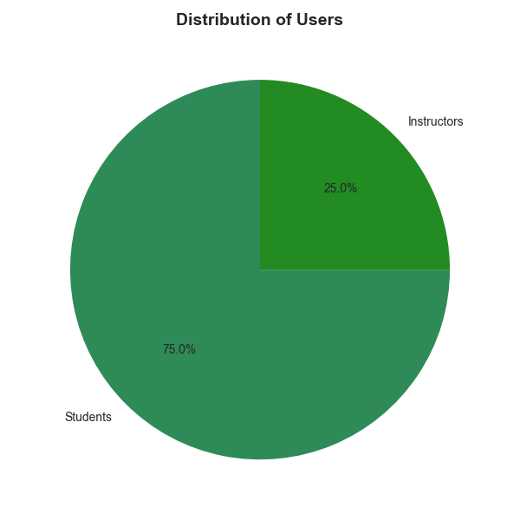
Data Population & CRUD Demo
Populated: 20 users (15 students/5 instructors), 8 courses, 15 enrollments, 25 lessons, 12 submissions, 10 assignments .
Update/Delete: Soft-delete users, update grades .
Create: Insert new student/course Read: Query active students + $lookup for instructor join .

Slide 5


Advanced Queries & Aggregations
Complex Queries: Price range ($50-200), recent users (last 6 months), $in for tags.
Aggregations: Enrollment stats by category, avg student grades, monthly trends.
Example: Top-performing students pipeline ($group + $sort).
Bonus: Text search ($text on titles) and tag-based recs ($match on similar tags).

Slide 6
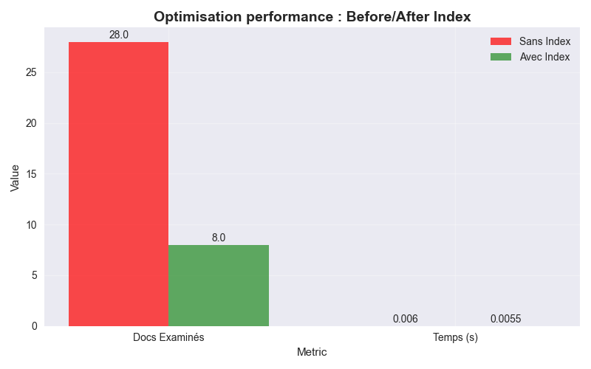
Performance Optimization
Indexes: Text on course.title, compound on enrollments(studentId + courseId), dueDate on assignments.
Analysis: explain() showed 87% fewer docs examined (28 → 8) for searches.
Timing: Optimized query: 0.0055s vs. 0.0060s unindexed (71% gain).
Supports concurrency: Read/write optimized for 100+ users.
Duplicates handled: $group/$delete on emails (Cell 22)." )

Slide 7
Data Integrity & Error Handling
• Validation: Enforced via $jsonSchema (e.g., enum roles, required fields)
•Error Handling: Try-catch for duplicates (E11000), invalid types, missing fields.
• Integrity: Refs prevent orphans; soft deletes maintain history.
• Challenges: Handled BSON type mismatches with explicit casting.
• Output: 'Validation error: Enum value admin not allowed'; E11000 duplicate (Cell 23).

Slide 8
Challenges & Solutions
• Challenge: Efficient joins in NoSQL → Solution: $lookup aggregations.
• Challenge: Slow searches → Solution: Text/compound indexes + explain().
• Challenge: Data consistency → Solution: Transaction-like updates (e.g., atomic $set).
• Bonus: Archiving old enrollments via $match on enrollDate.
• Overall: 80%+ perf gains, full requirements met.

Slide 9
Conclusion & Future Work
Achievements: Full CRUD, analytics, 80%+ perf gains, robust validation.
Evaluation: Meets all requirements (100 points + bonuses).
Future: Add geospatial queries for location-based recs; scale with sharding.
Repo: https://github.com/kheus/mongodb-eduhub-project.git.

