Slide 1

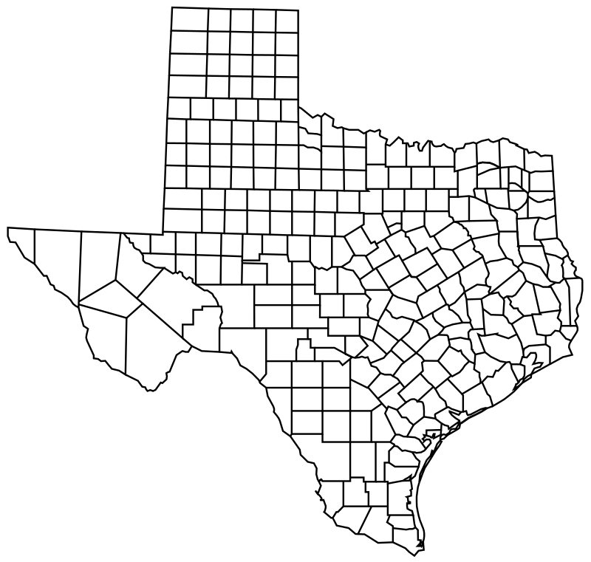
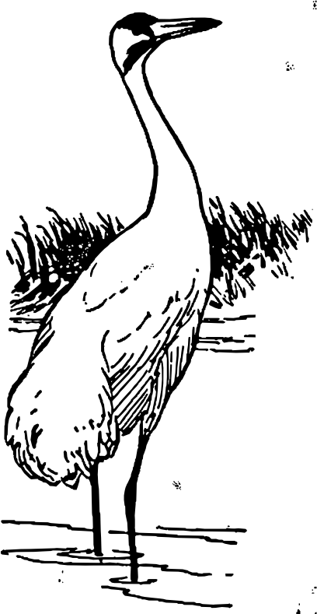

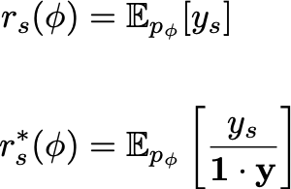
🤷🏽
Decision Pareto Frontier
Where to place K cameras to observe the most cranes next year?
BPR: fraction of Best Possible Reach
High Likelihood Models
Target: High likelihood, Good top-K Decisions
=
# actual events in K recommended sites
# actual events in perfect oracle’s top-K sites
Likelihood
Between 0.0 and 1.0, higher is better.
⑤
⑥
②
⑨
①
⑦
Good top-K Decisions
⑧
Data-driven top-K
③
④
BPR
joint model
for 2025 Q1
ranking
scores
top K=2
decision
as binary mask
How to Rank
How to Train
 | 2014 Q1 | 2014 Q2 | … | 2024 Q4
_{①} | 0 | 0 | … | 0
_{②} | 1 | 0 | … | 0
_{③} | 0 | 3 | … | 2
_{④} | 0 | 0 | … | 1
_{⑤} | 2 | 2 | … | 0
① ②.
Naïve: per-site mean
Ours: Rank by bound on BPR
 | BPR | Lik.
max Lik (ML) | ❌ | ✅
max BPR | ✅ | ❌
Decision Aware ML (DAML) | ✅ | ✅
0.01
0.02
0.65
0.03
0.44
0
0
1
0
1
…
Notes:
p_{\phi}( y_{~~}, y_{~~}, \ldots )
r_s(\phi) &= \mathbb{E}_{p_\phi}[ y_s ]
\\~\\
r^*_s(\phi) &= \mathbb{E}_{p_\phi}\left[ \frac{y_s}{\mathbf{1} \cdot \mathbf{y}} \right]

