Slide 1
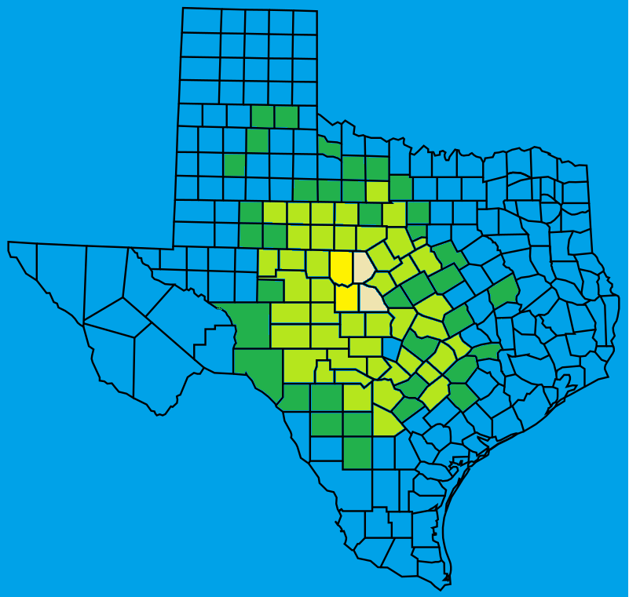
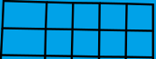

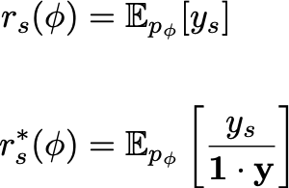
🤷🏽
BPR: fraction of Best Possible Reach
How to pick the top K sites?
# actual events in K recommended sites
# actual events in perfect oracle’s top-K sites
Between 0.0 and 1.0, higher is better.
When the model family is misspecified, fitting ɸ via maximum likelihood can produce inferior BPR.
① ② ③ ④⑤⑥ ⑦ ⑧ ⑨
Data-driven top-K
How to Rank
How to Train
joint model
for 2025 Q1
ranking
scores
top K=2
decision
as binary mask
 | 2014 Q1 | 2014 Q2 | … | 2024 Q4
① | 0 | 0 | … | 0
② | 1 | 0 | … | 0
③ | 0 | 3 | … | 2
④ | 0 | 0 | … | 1
⑤ | 2 | 2 | … | 0
Naïve: per-site mean
Ours: Rank by bound on BPR
 | BPR | Lik.
max Lik | ❌ | ✅
max BPR | ✅ | ❌
max Lik w/ BPR-decision aware constraints | ✅ | ✅
① ②.
0.01
0.02
0.65
0.03
0.44
0
0
1
0
1
…
Notes:
p_{\phi}( y_{~~}, y_{~~}, \ldots )
r_s(\phi) &= \mathbb{E}_{p_\phi}[ y_s ]
\\~\\
r^*_s(\phi) &= \mathbb{E}_{p_\phi}\left[ \frac{y_s}{\mathbf{1} \cdot \mathbf{y}} \right]

