Slide 1
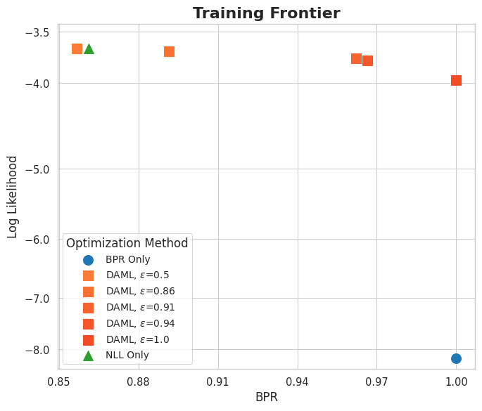
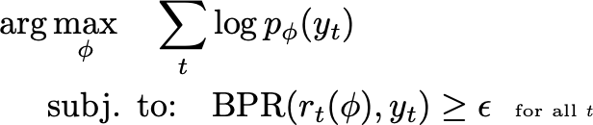
Contribution 3: How to train to balance BPR and Likelihood
Notes:
Our 3rd contribution is our objective for maximizing BPR.
"First, we can optimise likelihood alone- while this may provide the most accurate predictions at each location, when the model is misspecified it does not provide the best decisions. We can visualize the result of training to maximize log likelihood on this pareto frontier of likelihood on the y axis versus BPR on the x-axis.

Slide 2
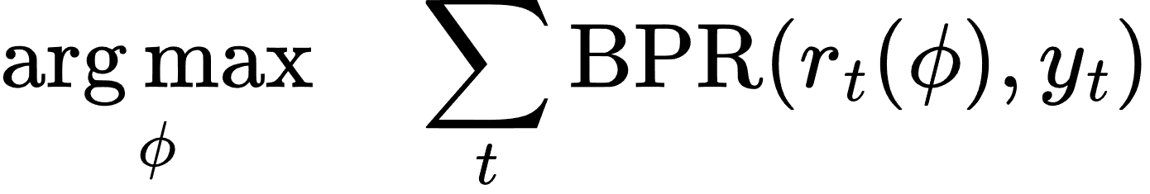
Contribution 3: How to train to balance BPR and Likelihood
Notes:
Another option would be to do direct loss minimization, and solely optimze for the best decisions. While we find this does give good decisions- we construct our models intentionally, and so a higher likelihood model may be more interpretable or have other useful biases, but only optimizing for BPR gives poor likelihood.

Slide 3
Contribution 3: How to train to balance BPR and Likelihood
Notes:
Our contribution in this paper is a hybrid objective that optimizes NLL, subject to the constraint that BPR be above a certain threshold. By adjusting this threshold, we hope to navigtate the pareto frontier between high likelihood
\arg\!\,&\max_{\phi} \quad \sum_t \log p_{\phi}( y_t )
\\
& \text{subj. to:} \quad \text{BPR}( r_t(\phi), y_t) \geq \epsilon ~~{\tiny \text{for all \emph{t}}}

Slide 4
Contribution 3: How to train to balance BPR and Likelihood

Slide 5
Contribution 3: How to train to balance BPR and Likelihood

Slide 6
Contribution 3: How to train to balance BPR and Likelihood

Slide 7
Contribution 3: How to train to balance BPR and Likelihood
Notes:
and quality decisions, and we find that we can in synthetic and real-world examples.

Slide 8
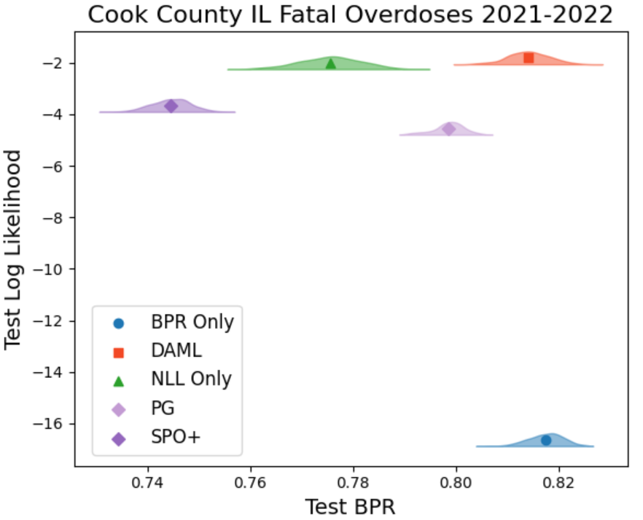
~70 more overdoses reached
Notes:
Finally, we present real-world results. Here we see the solution frontier for forecasting fatal opioid-related overdose in Chicago, Illinois’ Cook County. We see that Log-likelihood only produces high likelihood models with worse decision quality compared to BPR-only, and our Decision-aware objective offers a middle ground with higher quality solutions and high model likelihood. The roughly 4% increase in BPR, corresponds to interventions which would reach counties with approximately 70 more overdoses than if intervention were guided by likelihood alone.

Slide 9
