Slide 1
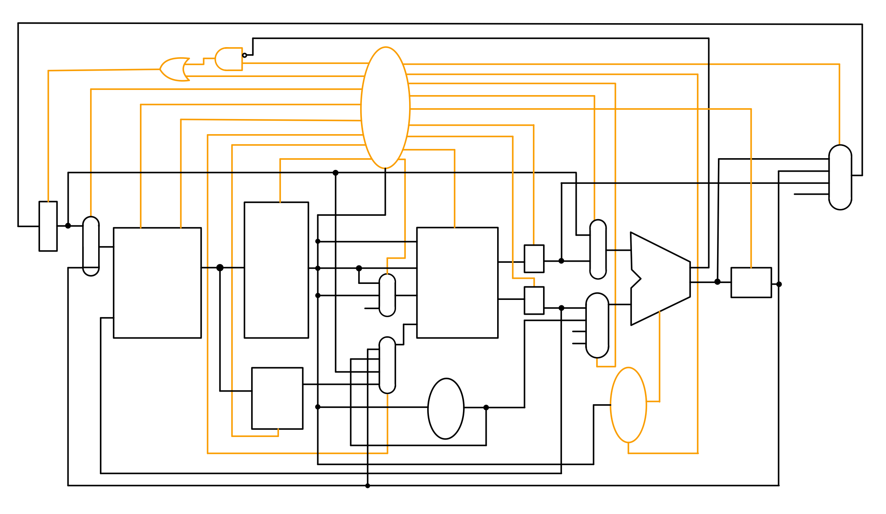
pc_write_not_cond
pc_src
pc_write
alu_op
i_or_d
alu_src_B
mem read
alu_src_A
Control
Unit
alu_write
mem write
A_write
mem to reg
B_write
mdr_write
reg_write
ir_write
reg_dst
alu_result
ALUOut
A
Target
opcode
ALUMux1
PCMux
PC
PC
Address
rs
Read1
ALU
Mem Data
Inst Reg
rt
Read
out1
A
A
ALUOut
Read2
bcond
Memory Mux
rd
1
ALUMux2
alu_result
ALUOut
0
Write Reg Mux
write reg
Read
out2
B
B
Write Data
2
2
imm
write data
1
Memory
ALUOut
Register File
0
immediate
PC
Write Data Mux
MemReg
Mem Reg
Imm Gen
immediate
ALU
Control
Unit
Branch_type

Slide 2
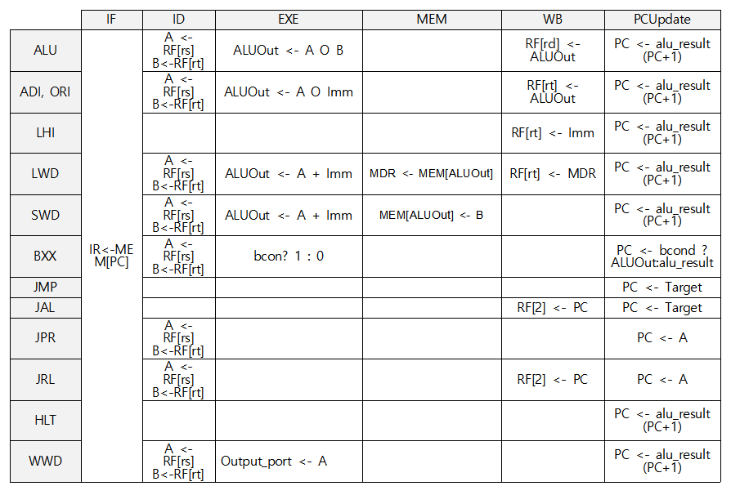
IF
ID
JPR
JMP
JRL
LHI, JAL
PC Update
EXE
BXX
LWD, SWD
WB
MEM

