Slide 1


bcond, jp
Is_stall
Hazard
Detection
Unit
ID_dest
IF_flush
rs
rt
opcode, funccode
ID_flush
opcode
WB
Control
Unit
MEM
WB
reg_write
0
EX
MEM
WB
hlt, wwd
alu_src_B
Is
bubble
Is
bubble
Is
bubble
Is
bubble
reg_write
alu_src_A
mem_read
mem_write
mem_to_reg
1
+
PC
PC
alu_op
read_out1
alu_result
M
U
X
read
data1
M
U
X
M
U
X
alu_out
M
U
X
rs
read1
EX_alu_out
EX_alu_out
MEM write_data
MEM_write
data
MEM_write
data
0
alu
result
rt
read2
bcond
=
alu_src_B
ALU
alu_out
address
read
data
data
M
U
X
read_out2
M
U
X
M
U
X
M
U
X
target
PC
address
Inst
MEM
dest
write
reg
alu_result
read
data2
EX_alu_out
EX_alu_out
MEM_write
data
0
write
data
write
data
Register File
MEM_write
data
B
Data
Memory
Insturction
Memory
MEM write_data
M
U
X
pc_src
2
dest
dest
rt
dest
rd
Imm Gen
reg_dst
immed
rs
read1
forward
rt
read2
read
out1
read
out2
A
B
+
ID_read1, 2
Forwarding
Unit
dest
rs, rt
ID/EX/MEM
reg_write
ID/EX/MEM
is_bubble

Slide 2
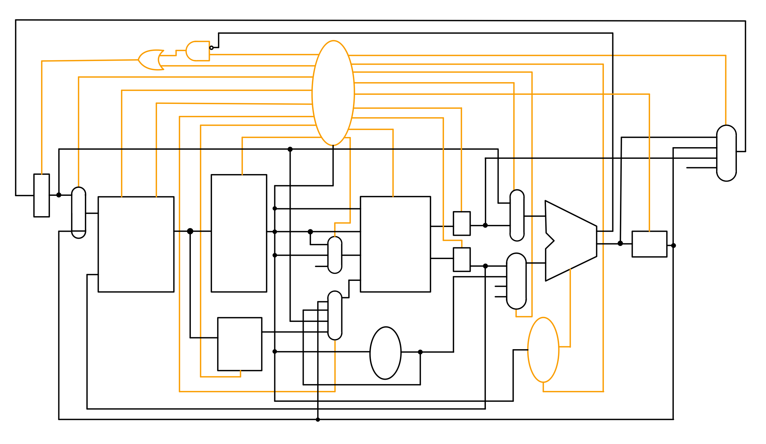
pc_write_not_cond
pc_src
pc_write
alu_op
i_or_d
alu_src_B
mem read
alu_src_A
Control
Unit
alu_write
mem write
A_write
mem to reg
B_write
mdr_write
reg_write
ir_write
reg_dst
alu_result
ALUOut
A
Target
opcode
ALUMux1
PCMux
PC
PC
Address
rs
Read1
ALU
Mem Data
Inst Reg
rt
Read
out1
A
A
ALUOut
Read2
bcond
Memory Mux
rd
1
ALUMux2
ALUOut
0
Write Reg Mux
write reg
Read
out2
B
B
Write Data
2
2
imm
write data
1
Memory
ALUOut
Register File
0
immediate
PC
Write Data Mux
alu_result
MemReg
Mem Reg
Imm Gen
immediate
ALU
Control
Unit
Branch_type

Slide 3
