Slide 1
Anonymous Head Counting in Lecture Theatres
Kieran Hitchcock

Slide 2
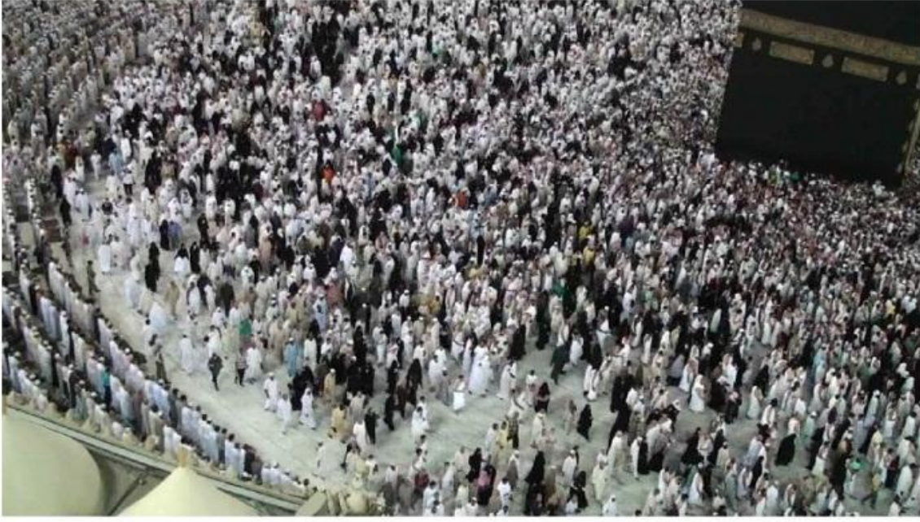
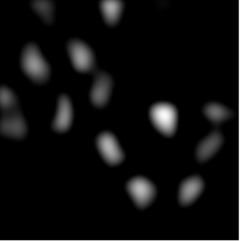
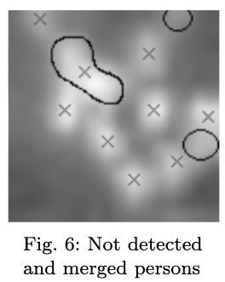
Background
People counting in crowds has been successfully implemented with colour cameras with accuracy up to 96% in large crowds [1]. However, colour cameras have problems in varying lighting conditions and do not preserve anonymity.
Low resolution thermal cameras do not record any identifying features. However, they are generally used with a top-down view to prevent ‘blob merging’ [2]. The top-down view would not capture large areas such as a lecture theatre.
This project looks to overcome these problems by using a single thermal camera with a front view of a lecture theatre to determine the number of people present.

Slide 3
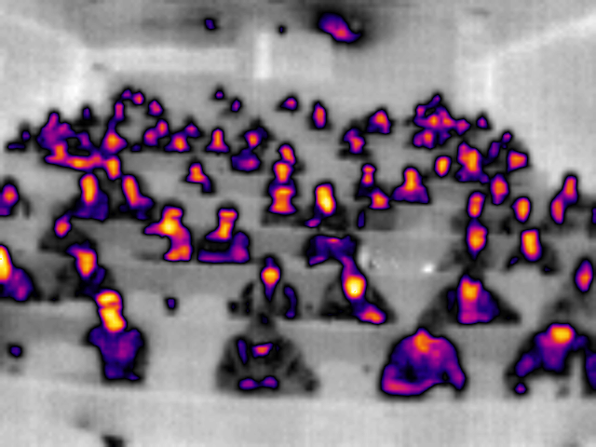
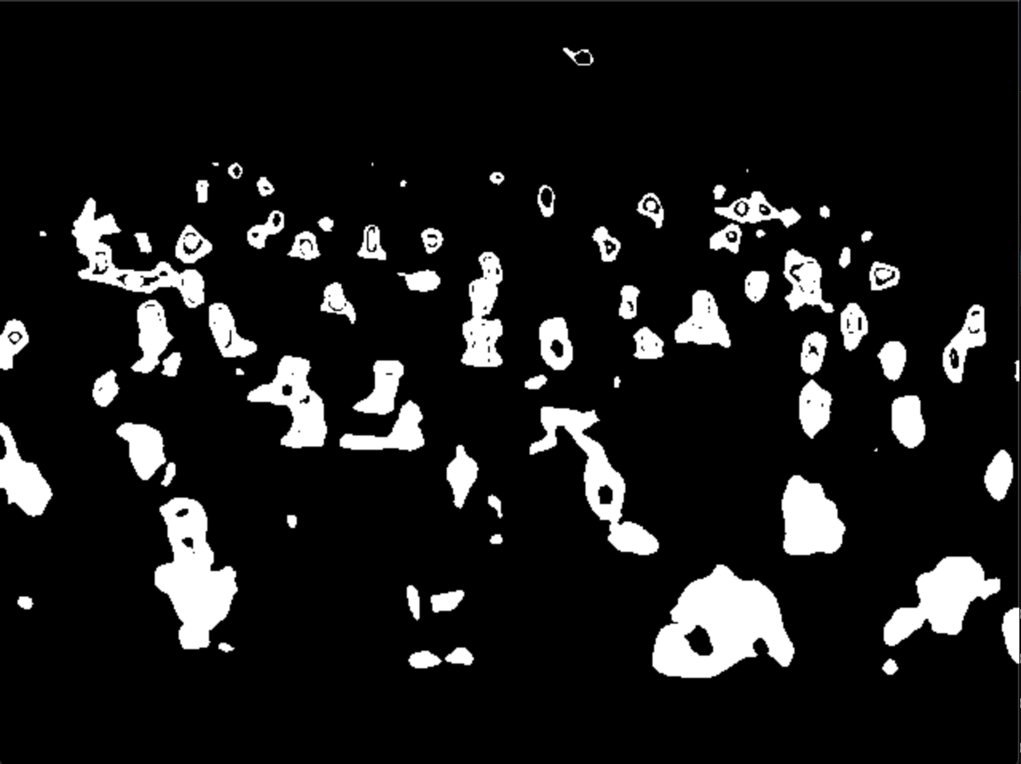
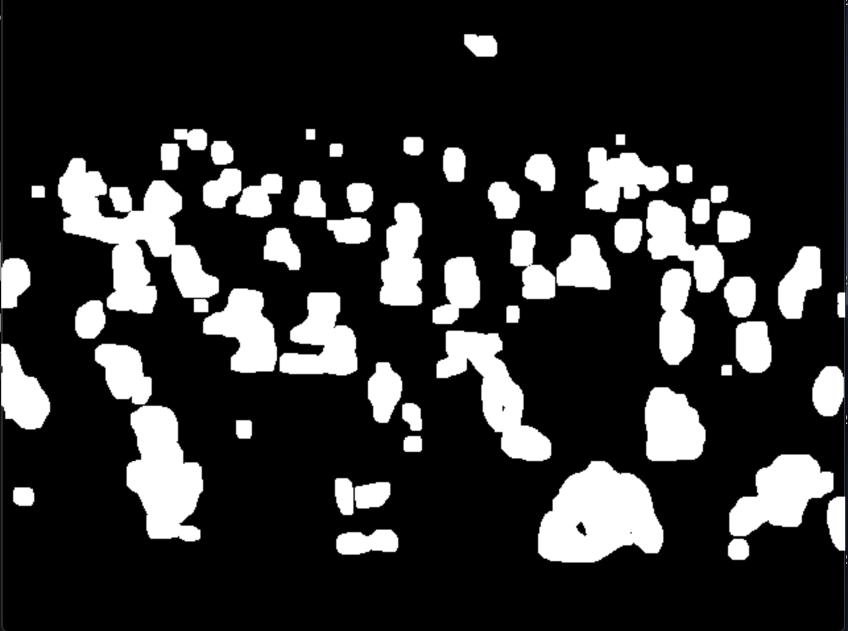
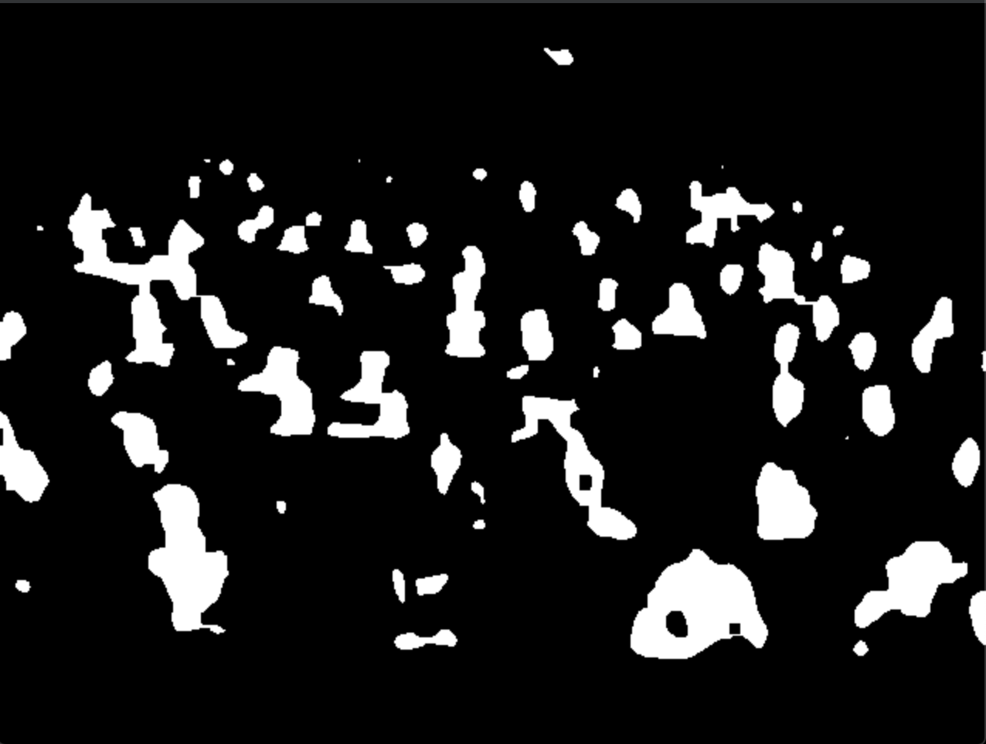

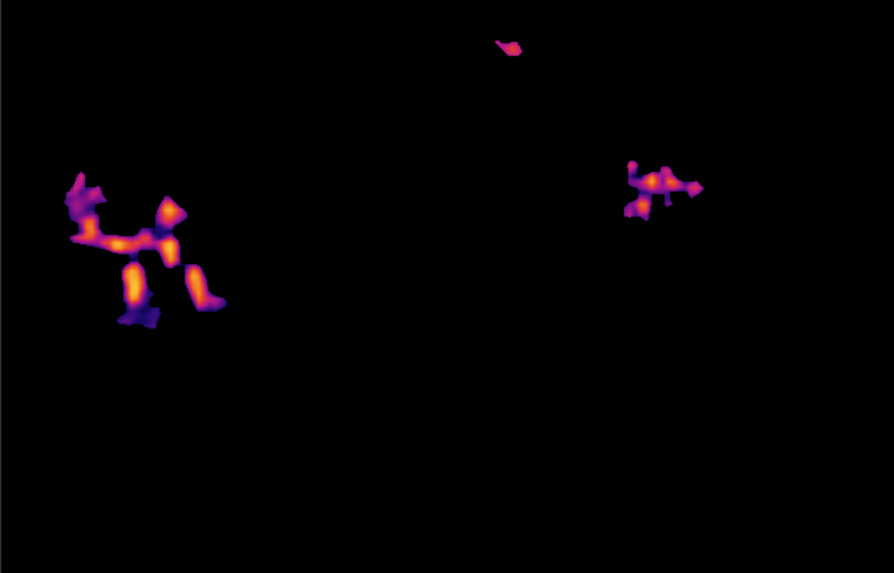
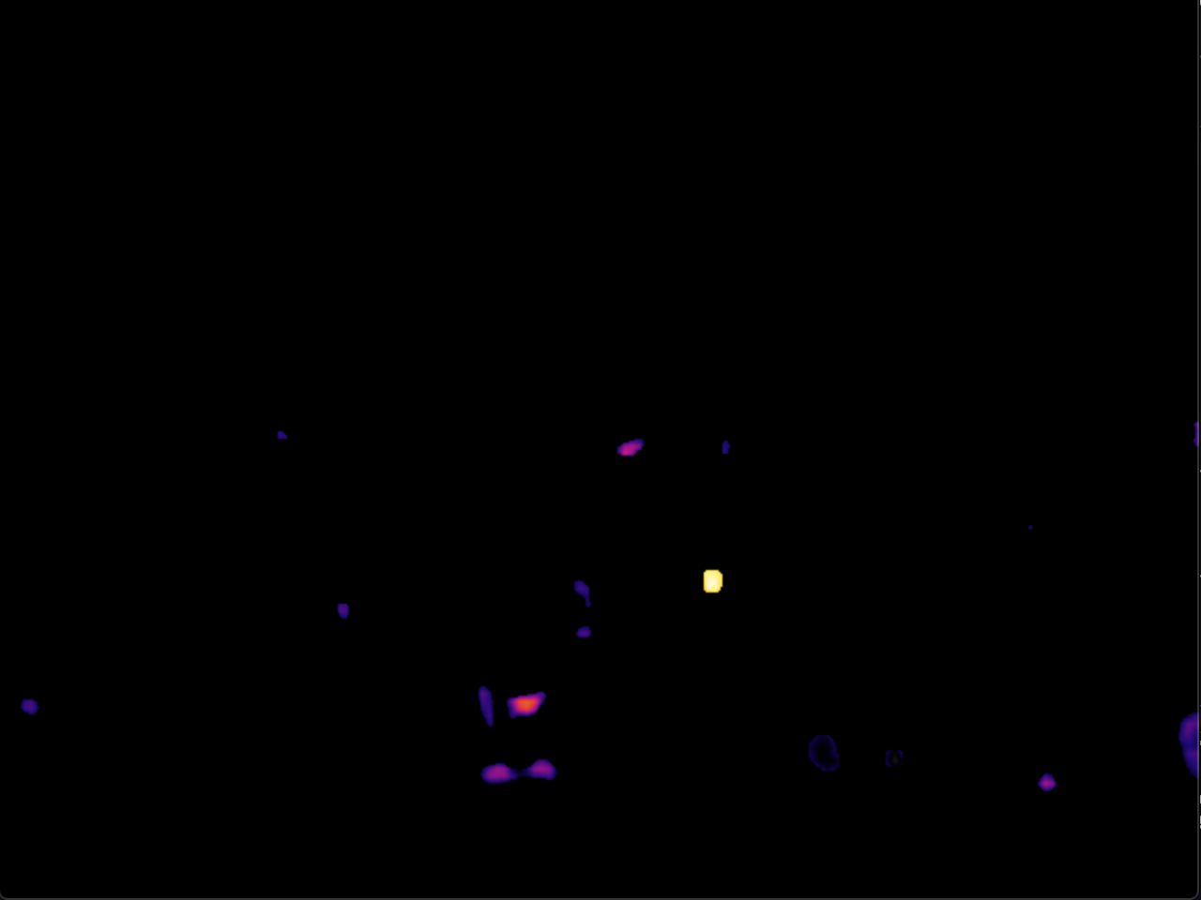

Method
Colour Mask
Thresholding (dependant on y-axis)
Dilation
Erosion
Contour Area Filtering (dependant on y-axis)
Laplacian (Contour Detection)
Missed Detections
False Detections
More Thresholding to come!
….

Slide 4

Conclusion
Currently, this method can detect 44/65 people correctly. However it misses 21 people and falsely detects 8 blobs as people.
Previous studies using low resolution thermal cameras have consistently achieved accuracy of up to 85% in a range of images [1].
Going forward, I will look to threshold the larger blobs to separate out individuals and remove small ‘noise’ blobs to get a more accurate count of people in the current image
For future research, I would look to implement a more robust detection method that could work on a range of different lecture theatres and crowds.

