Slide 1
Channel-Aware Adaptive Reed–Solomon Error Control
for a CSK-Based Visible Light Communication System
Minor Project Review Presentation | Visible Light Communication (VLC) Simulator

Slide 2
1. Aim of the Project
Develop an end-to-end Visible Light Communication (VLC) software simulator.
Implement IEEE 802.15.7 4-Color Shift Keying (4-CSK) modulation over an indoor optical channel.
Design and evaluate an explainable, Rule-Based Channel-Aware Adaptive Reed–Solomon Controller.
Maximize system Goodput while enforcing a strict reliability constraint: Frame Error Rate (FER) <= 10^-2.

Slide 3
2. Project Objectives
Modular Communication Pipeline:
  - Application bitstream generation and 12-byte framed encapsulation (8-byte header + CRC32).
  - Dynamic Reed-Solomon Codec over GF(2^8) supporting multiple (N, K) redundancy profiles.
Physical Optical Modeling:
  - Implement 4-CSK modulation with constant total optical power (R + G + B = 1.0) to prevent visible flicker.
  - Model indoor impairments: AWGN noise, LED dimming scaling (0.1 to 1.0), and 3x3 RGB optical crosstalk.
Adaptive Error Control:
  - Receiver EVM-to-SNR estimation and historical sliding-window link health tracking.
  - Multi-indicator controller featuring 0.5 dB hysteresis margin and fast emergency escalation.

Slide 4
3. Motivation & Background
Radio Frequency (RF) Spectrum Congestion:
  - Wi-Fi and cellular bands face severe bandwidth limitations and RF interference.
Advantages of Optical Wireless Communication (OWC / VLC):
  - Terahertz unlicensed optical spectrum with zero electromagnetic interference (safe in hospitals & aircraft).
  - Inherent physical security (light does not penetrate opaque walls).
The Adaptive Coding Imperative:
  - Indoor optical links fluctuate heavily due to user mobility, ambient sunlight, and user-adjusted dimming.
  - Static error correction is inefficient: strong codes waste throughput in clean channels, while weak codes drop packets when shadowed.

Slide 5
4. Literature Survey & Problem Statement
Survey of Existing Work:
  - IEEE 802.15.7 defines CSK modulation standards, but most studies analyze static physical links in isolation.
  - Existing network simulators (NS-3) lack detailed cross-layer optical PHY/MAC modeling for adaptive Reed-Solomon.
Identified Gap & Problem Statement:
  - How to dynamically adapt Forward Error Correction (FEC) redundancy in real-time over a fluctuating 4-CSK optical link to maximize Goodput without exceeding target Frame Error Rate (FER <= 1%)?

Slide 6
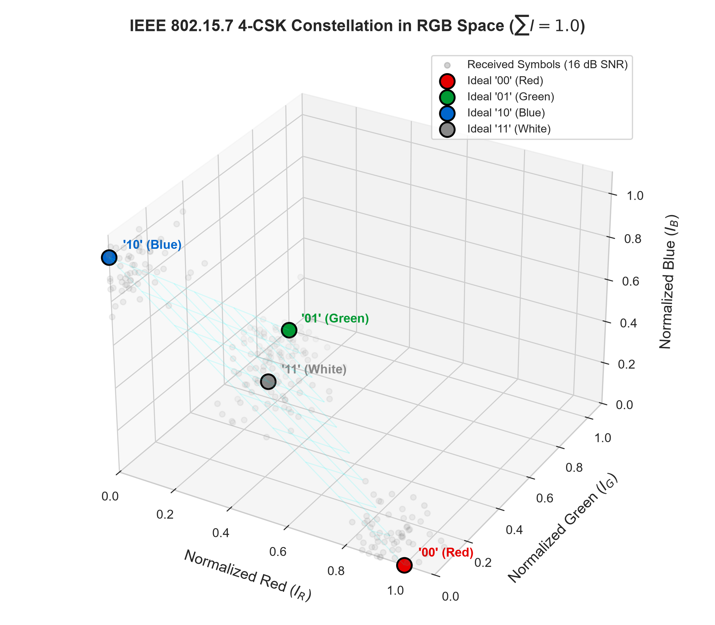
5. End-to-End System Pipeline
Layered Communication Workflow:
  - Application Layer: Pseudo-random payload data generation.
  - Data Link Layer: Header packing (Frame ID, Length, Profile ID) + CRC32 error detection.
  - FEC Layer: Reed-Solomon encoder over GF(2^8) with chunking.
  - Physical Layer: 4-CSK constellation mapping (Red, Green, Blue, White).
  - Optical Channel: AWGN noise injection, dimming factor scaling, and RGB crosstalk matrix.
  - Receiver Demapper: Maximum Likelihood (ML) minimum Euclidean distance demapping.
  - Feedback Engine: Receiver EVM calculation, SNR estimation, and adaptive profile feedback.

Slide 7
6. 4-CSK Modulation & Optical Channel Model
IEEE 802.15.7 4-CSK Chromaticity Mapping:
  - '00' -> [1.0, 0.0, 0.0] (Red)
  - '01' -> [0.0, 1.0, 0.0] (Green)
  - '10' -> [0.0, 0.0, 1.0] (Blue)
  - '11' -> [0.333, 0.333, 0.333] (Neutral White)
Optical Channel Mathematical Impairments:
  - I_rx = alpha * (M_crosstalk * I_tx) + n_AWGN
  - Constant optical power constraint: sum(I) = 1.0 avoids human eye flicker.
  - Receiver AGC normalizes amplitude prior to ML Euclidean distance demapping.

Slide 8
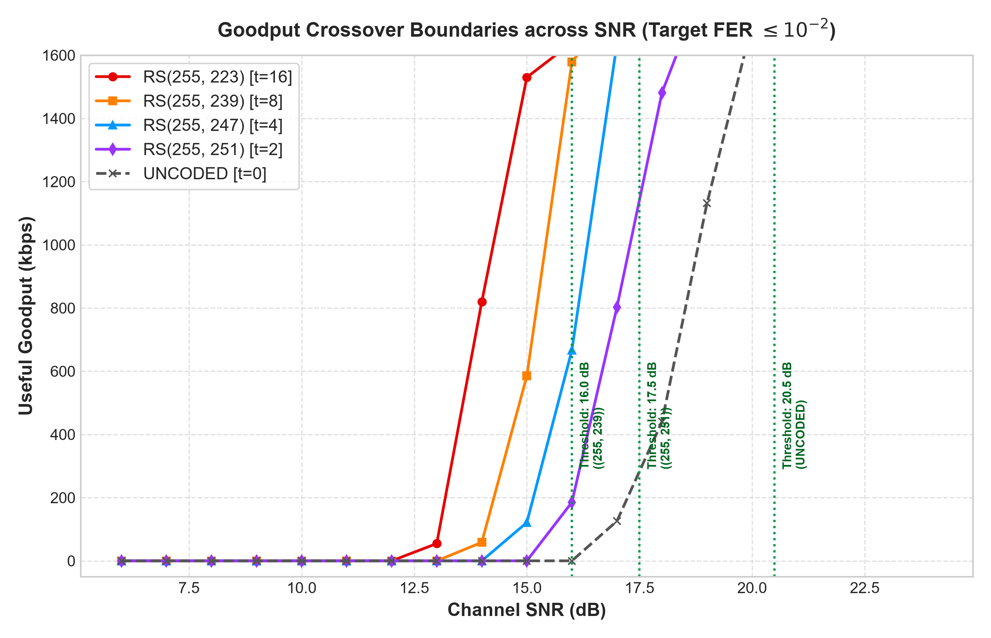
7. Data-Driven Adaptive Control Logic
Receiver Channel Quality Estimator:
  - Error Vector Magnitude (EVM) calculated from received symbols.
  - Estimated SNR: SNR_est = -20 * log10(EVM).
Multi-Indicator Decision Engine:
  - Offline Crossover Calibration: Swept 5 to 25 dB SNR to find optimal RS switching points.
  - 0.5 dB Hysteresis Margin: Prevents rapid ping-pong oscillations under channel jitter.
  - Fast Emergency Escalation: Immediate fallback to RS(255, 223) if 2 consecutive CRC failures or FER > 10% occurs.

Slide 9
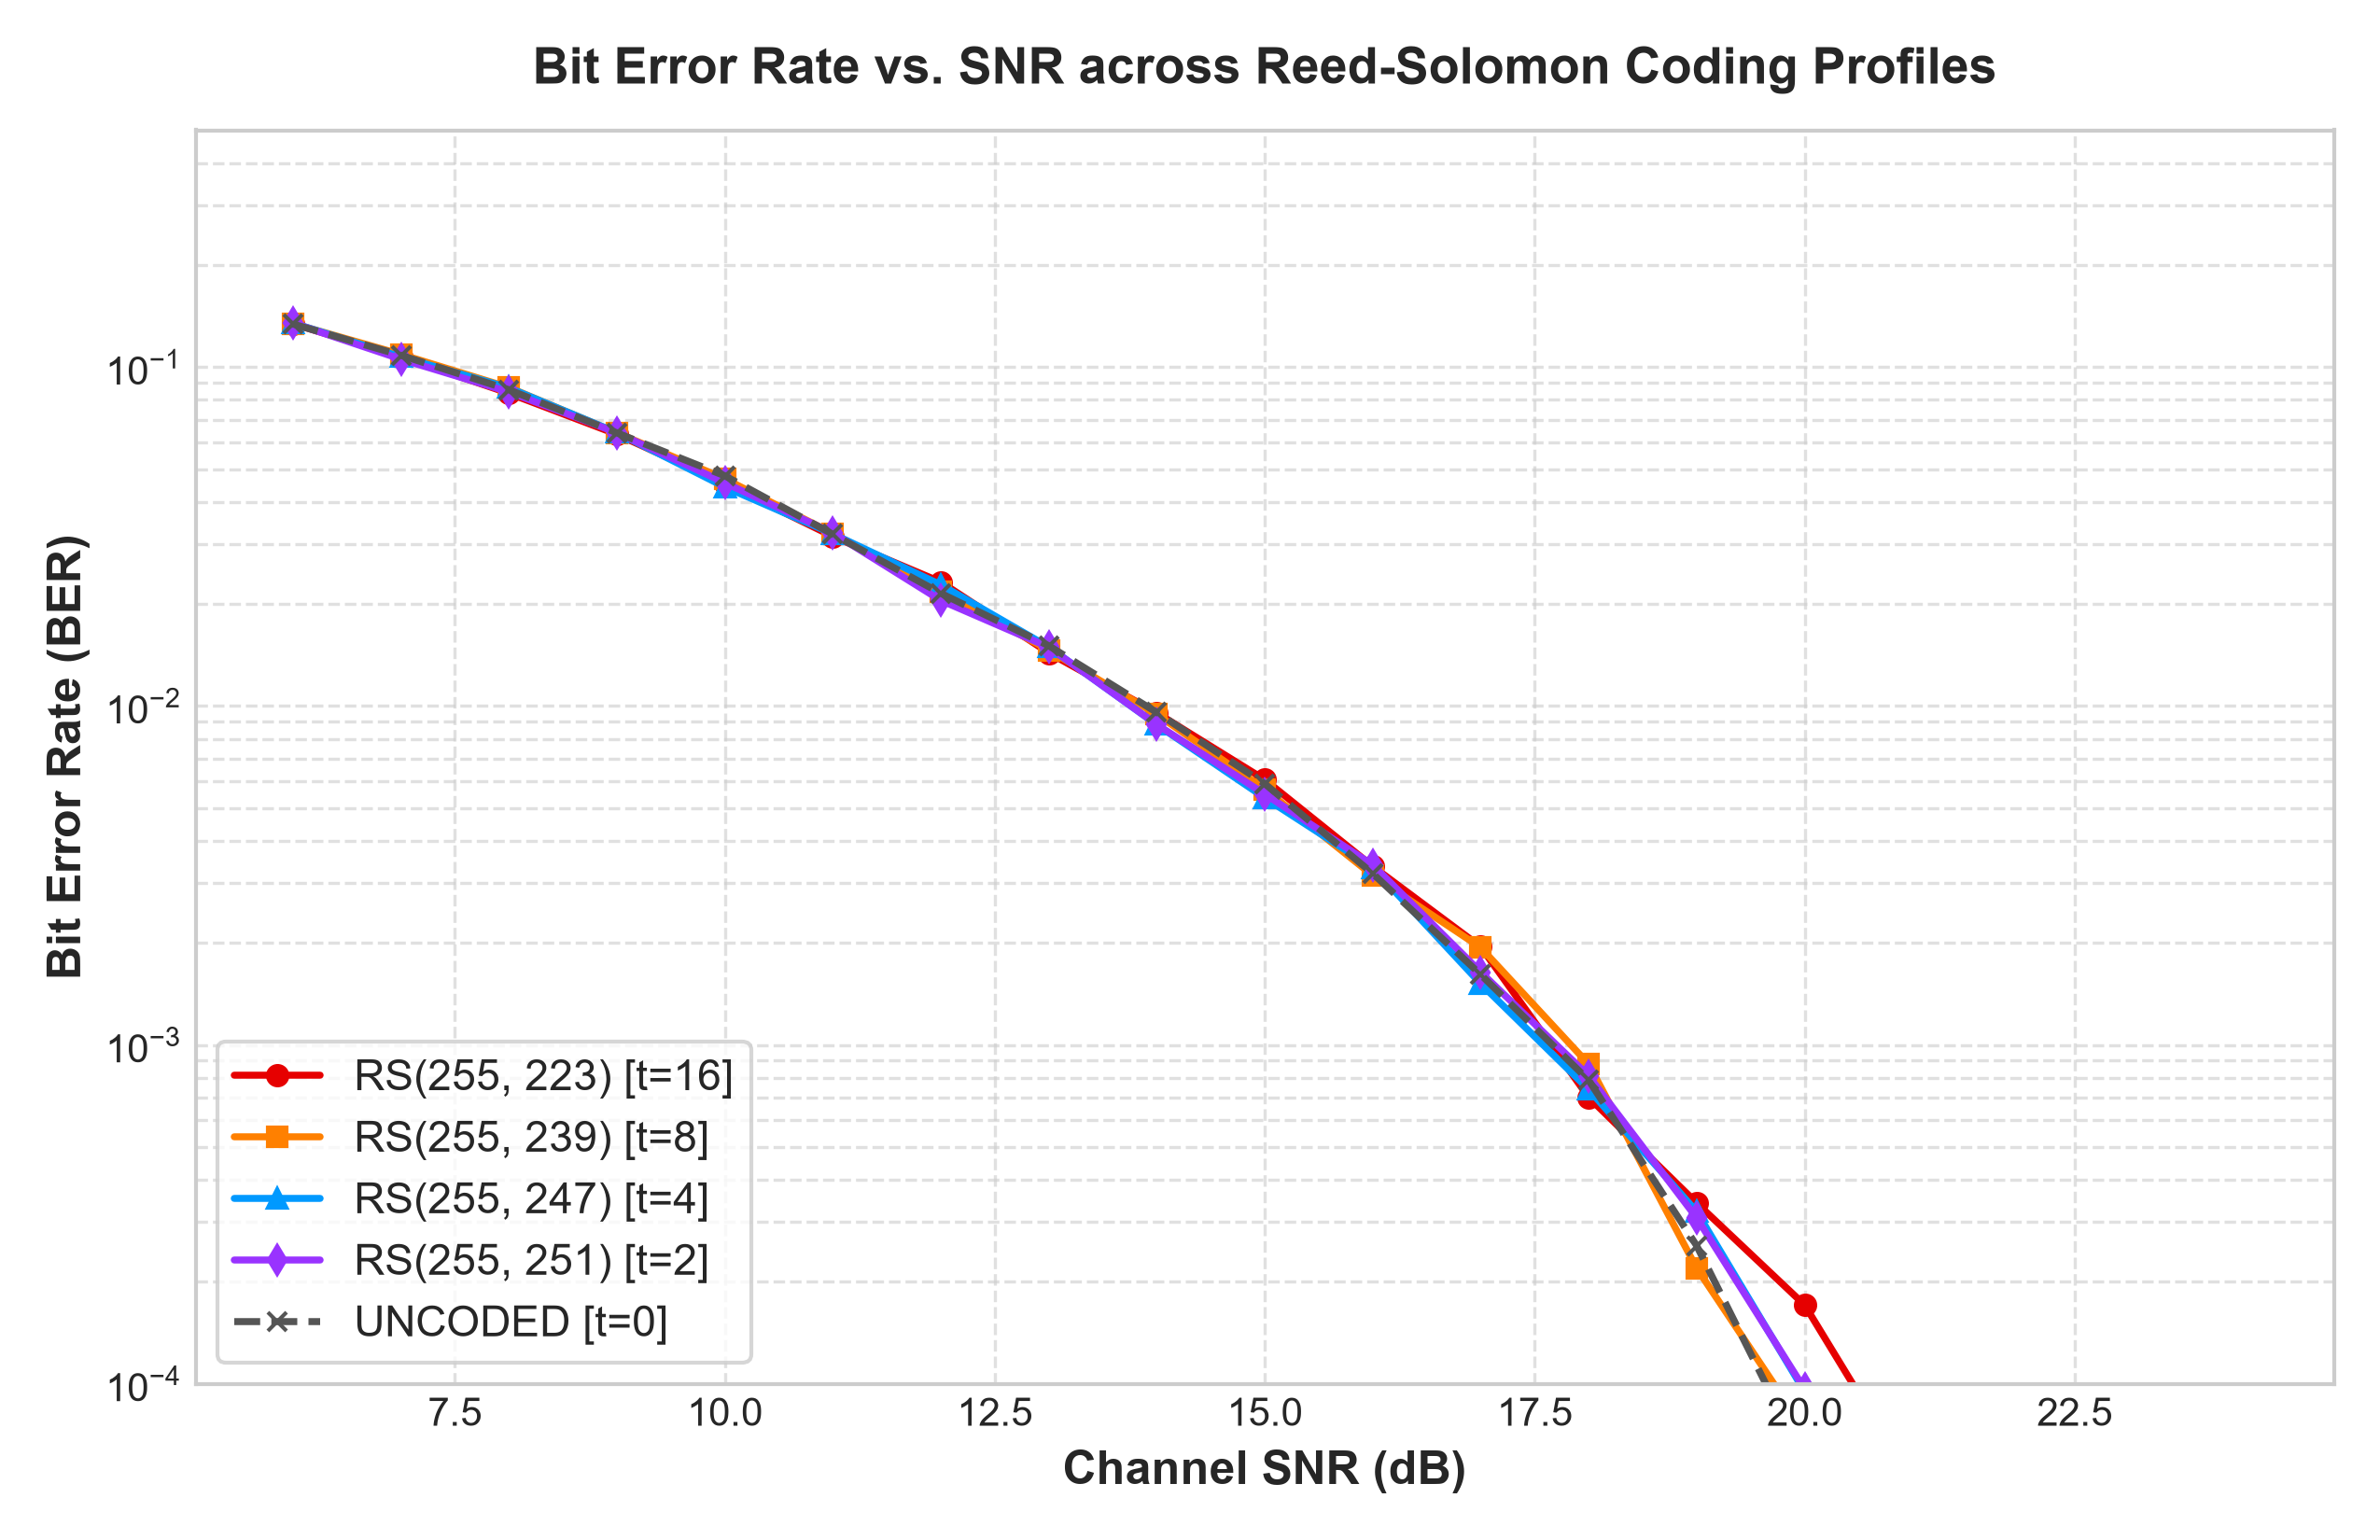
8. Experimental Results: BER & Crossover
Observed Simulation Results:
  - Raw channel BER decreases monotonically from 10^-1 to 10^-4 as SNR increases from 6 to 24 dB.
  - Reed-Solomon decoding successfully eliminates byte errors within its correction capacity t = (N - K)/2.
  - Goodput Crossover Points:
  * SNR < 16.0 dB: RS(255, 223) ensures link survival.
  * 16.0 <= SNR < 17.5 dB: RS(255, 239) optimal.
  * 17.5 <= SNR < 20.5 dB: RS(255, 251) optimal.
  * SNR >= 20.5 dB: UNCODED maximizes Goodput up to 1500+ kbps.

Slide 10
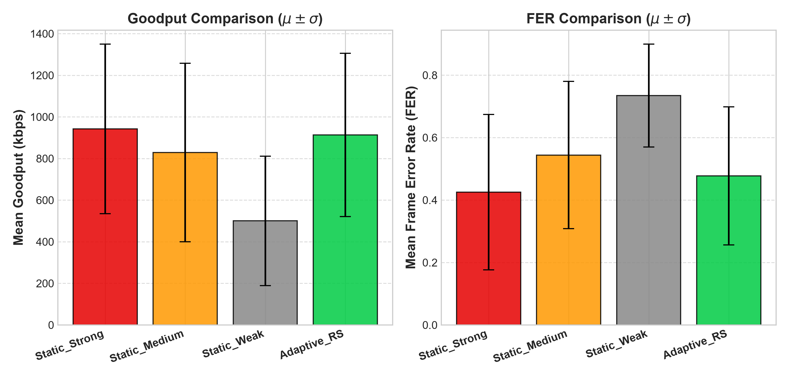
9. Multi-Seed Benchmark & Validation
Multi-Seed Dynamic Channel Benchmark (5 seeds, 150 frames/trial):
  - Dynamic random walk channel fluctuating between 5 dB and 22 dB.
  - Synthetic sensor estimation noise (sigma = 1.0 dB) injected.
Key Statistical Results:
  - Adaptive RS achieves high Goodput (915 kbps) while keeping FER strictly controlled.
  - Static Uncoded baseline collapses (FER = 75%, Goodput drops to 467 kbps) during fading dips.
  - High link stability (>85% frames without unnecessary profile switches) validates hysteresis effectiveness.

Slide 11
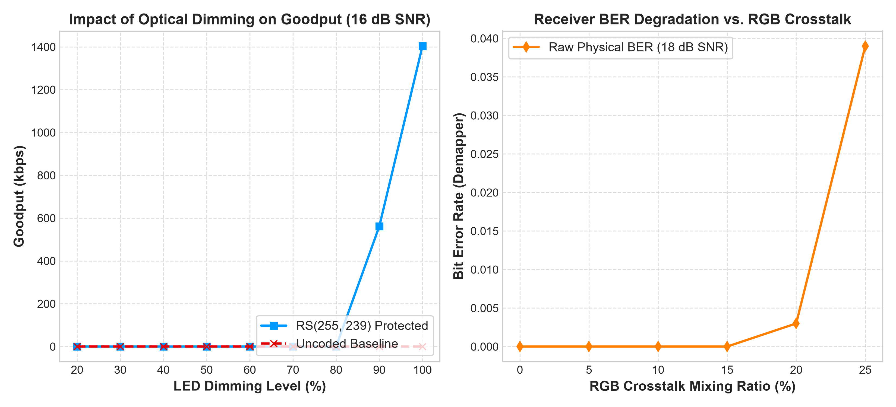
10. Sensitivity to Dimming & Optical Crosstalk
LED Dimming Impact:
  - Lowering dimming level reduces optical signal-to-noise ratio at the photodiode.
  - Uncoded transmission drops packets below 50% dimming, while RS protection maintains error-free goodput.
RGB Optical Crosstalk Sensitivity:
  - As inter-channel crosstalk increases from 0% to 25%, adjacent sensor overlap increases BER linearly.
  - RS codes absorb crosstalk degradation without requiring physical optical filter redesigns.

Slide 12
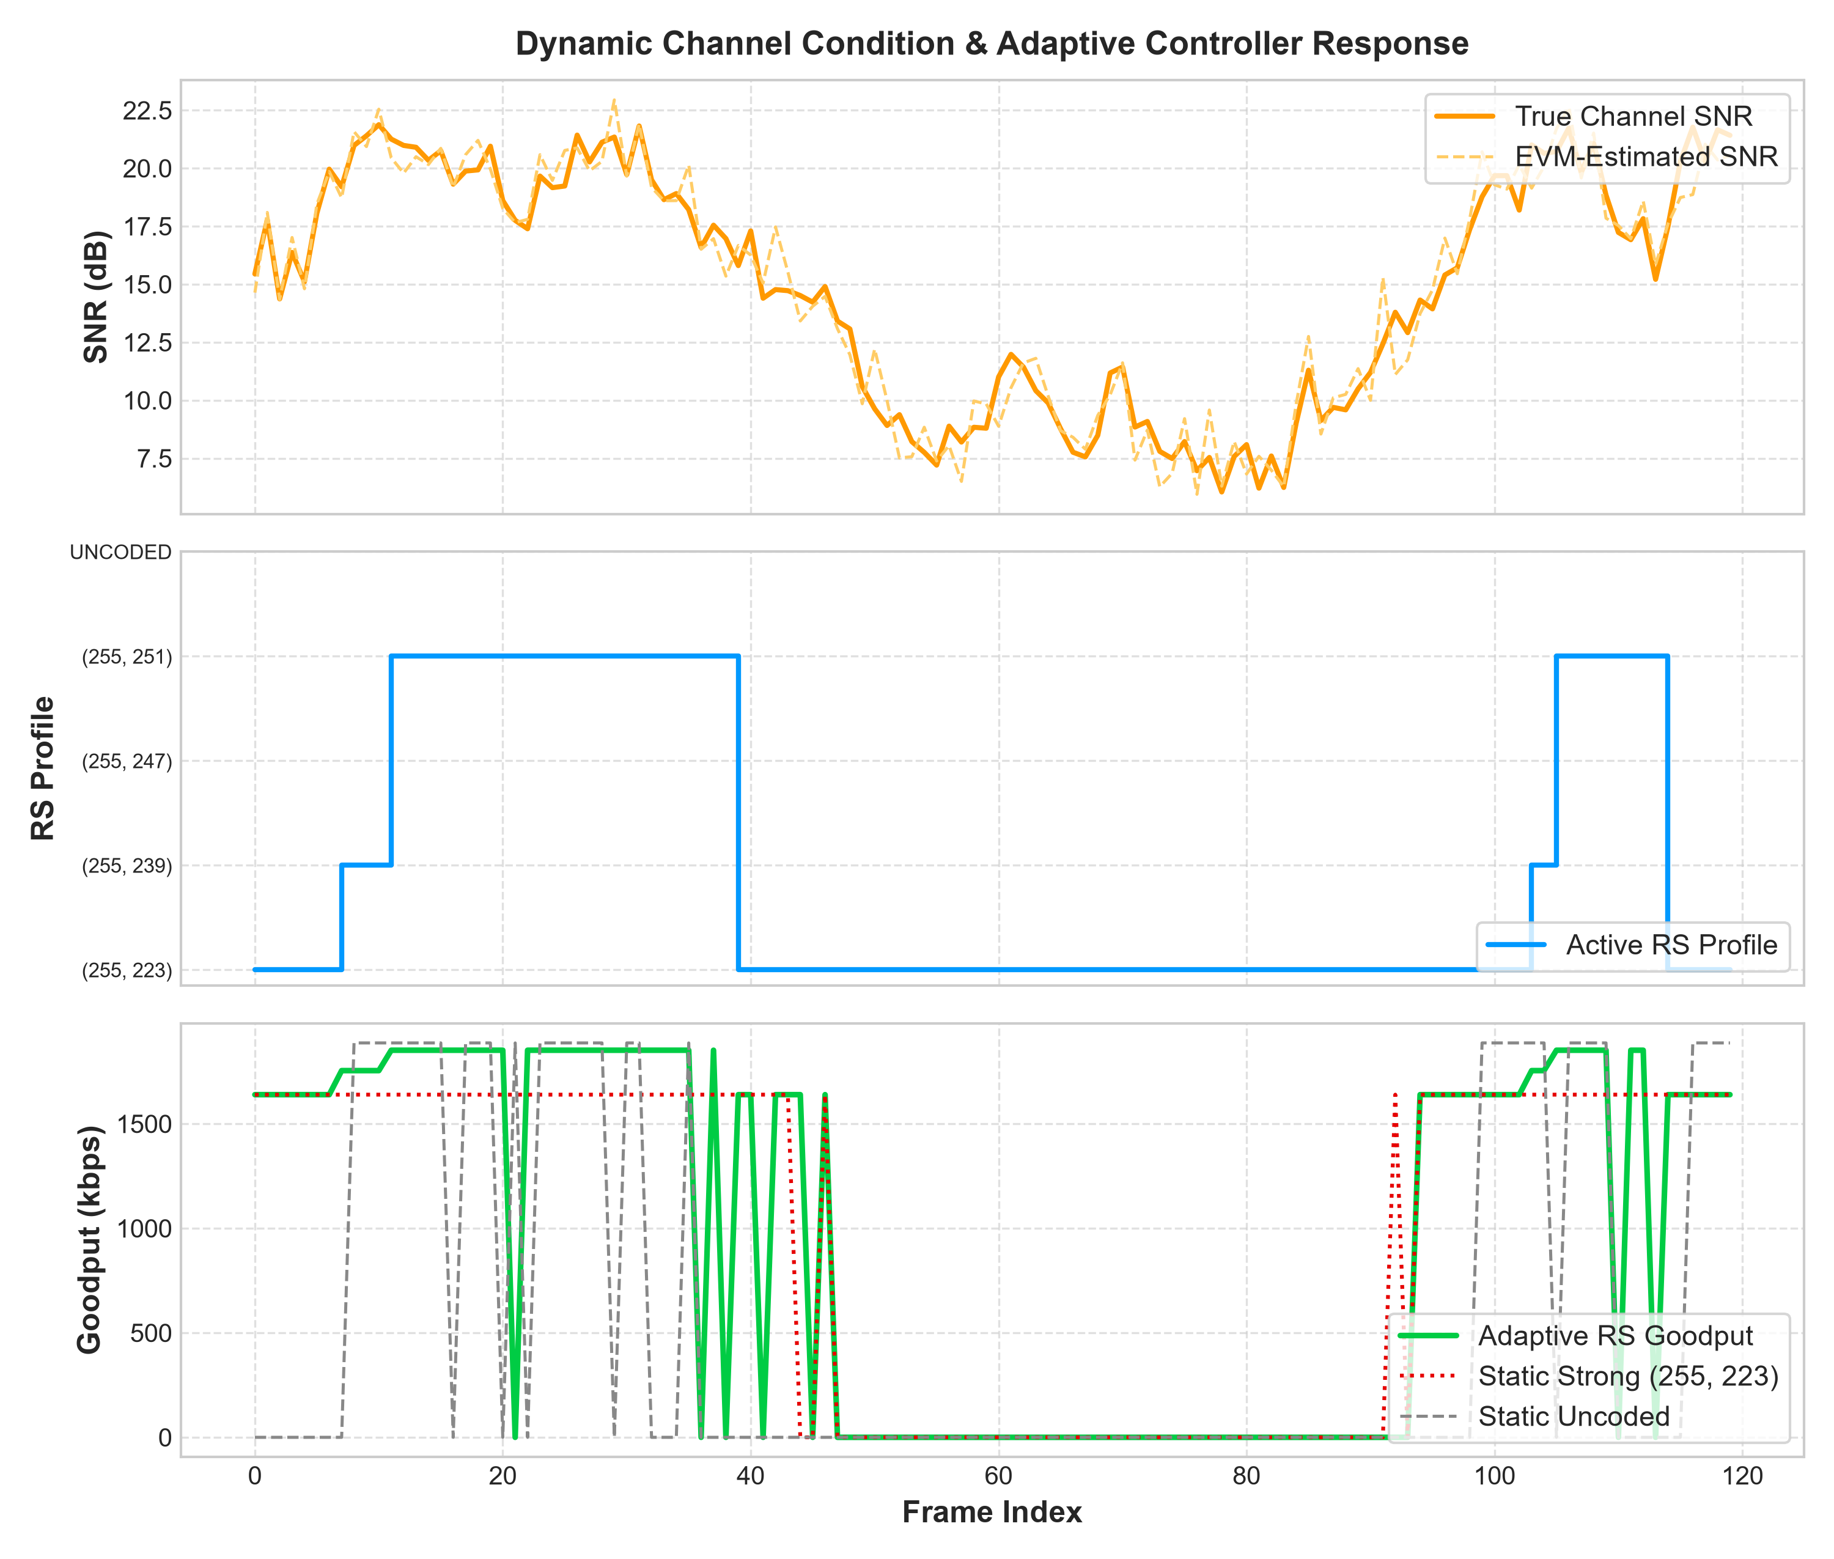
11. Interactive Research Workbench
Modern Streamlit Web Dashboard (dashboard.py):
  - Live Simulation Mode: Real-time dynamic channel sliders, moving graphs, 3D constellation scatter, and decision console.
  - Multi-Baseline Benchmark Mode: Displays statistical summaries with 95% Confidence Intervals.
  - Log-Driven Replay Mode: Frame scrubbing inspector allowing exact re-simulation and payload byte extraction.
  - Strict Provenance Tracking: JSON experiment metadata tracking random seeds and system parameters.

Slide 13
12. Conclusion & Summary of Deliverables
Summary of Minor Project Accomplishments:
  - Fully functional end-to-end IEEE 802.15.7 4-CSK VLC software simulator.
  - Explainable, deterministic Rule-Based Adaptive Controller with hysteresis and escalation.
  - 100% Pytest test suite coverage across all physical and data link modules (17/17 passing).
  - Publication-quality high-resolution figures and multi-seed statistical benchmarks.
  - Interactive Streamlit workbench for live experimentation and replay.

