Slide 1
Tolerating Slowdowns in Replicated State Machines using Copilots
Khiem Ngo, Siddhartha Sen, Wyatt Lloyd
Princeton University, Microsoft Research

Slide 2




Replicated State Machine (RSM)
Fault tolerant group of replicas that acts like a single machine that does not fail
RSMs are everywhere!
Distributed database, cloud storage, coordination services, …
Cloud Spanner

Slide 3
Fault Tolerance for High Availability
RSM
Client
RSM
Replica
a
b
c
d
e
√
√
√
√
√
e
d
c
b
a
Replica
e
d
c
b
a
Replica
c
b
a

Slide 4
Replicas can Slowdown instead of Fail
Many causes:
Misconfigurations
Partial hardware failures
Garbage collection events
…
Effect: Replica takes longer than usual to send responses

Slide 5
RSMs tolerate failures, not slowdowns

Slide 6

Slowdowns Hurt Availability
RSM
Client
RSM
Replica
d
e
√
√
e
d
c
b
a
Replica
e
d
c
b
a
Replica
e
d
c
b
a

Slide 7
We need slowdown tolerance!

Slide 8
Slowdowns Take Different Forms
Duration
Transient slowdowns: not handled in general
Long-term slowdowns: eventually detected, but need to tolerate between onset and end of reconfiguration
Severity
10ms additional delay or 80ms?
Scope
All processing paths or a subset?

Slide 9
Defining Slowdown Tolerance
“slow” replica = responses to messages take more than threshold time t over normal response time
An RSM is s-slowdown-tolerant if it is not slow despite s slow replicas
Replacing the s slowest replicas with normal replicas should not change performance much
This work’s focus: 1-slowdown-tolerance

Slide 10
No existing consensus protocol is 1-slowdown-tolerant

Slide 11
Multi-Paxos is Not 1-Slowdown-Tolerant
order
execute
reply
client
leader
replica
replica

Slide 12

Multi-Paxos is Not 1-Slowdown-Tolerant
order
execute
reply
client
leader
replica
replica

Slide 13
Multi-Paxos is Not 1-Slowdown-Tolerant
order
execute
reply
client
leader
Vulnerable to slowdowns when processing path goes through a single replica.
replica
replica

Slide 14
Copilot: First 1-Slowdown-Tolerant Protocol
order?
client
pilot
leader
replica
copilot
replica

Slide 15
Ordering: Use Two Logs
RSM
Pilot
e
d
c
b
a
Copilot
b’
e'
d’
c’
a'
Replica
?

Slide 16
Ordering: Combine Logs with Dependencies
RSM
Pilot
e
d
c
b
a
Copilot
b'
e'
d'
c'
a'
Replica

Slide 17
Ordering: Dependency Cycles
RSM
Pilot
e
d
c
b
a
Break cycles deterministically
Copilot
b'
e'
d'
c'
a'
Replica

Slide 18
Ordering: A Tricky Case
RSM
Pilot
e
d
c
b
a
Copilot
Possible ordering:
a, a’, b, c’, c
b'
e'
d'
c'
a'
Replica
c
b
a
c'
a'

Slide 19
Ordering: A Tricky Case
RSM
Pilot
e
d
c
b
a
Copilot
Possible ordering:
a, a’, b, c’, c
b'
e'
d'
c'
a'
Replica
b
a
Possible ordering:
a, a’, b, c’, d’
d'
c'
a'

Slide 20
Ordering: Same on All Replicas
RSM
Pilot
Compatibility check:
Only accept dependency if it cannot lead to multiple orders
e
d
c
b
a
Copilot
b'
e'
d'
c'
a'
Break cycles deterministically
Replica
b
a
d'
c'
a'

Slide 21
Copilot Protocol
order
exe
reply
fast path
regular path*
client
pilot
replica
copilot

Slide 22
Copilot Protocol
order
exe
reply
fast path
regular path*
client
pilot
replica
copilot

Slide 23
Copilot Protocol
order
exe
reply
fast path
regular path*
client
pilot
replica
copilot

Slide 24
Copilot Protocol: Dependencies?
RSM
Pilot
b
a
Solution: fast takeover the slow pilot’s ordering work!
c’ must wait for b
⇒ not 1-slowdown tolerant!
Copilot
c'
a'
Replica

Slide 25
Copilot Protocol: Summary
Proactive redundancy: two pilots process all commands
Use dependencies to combine ordering from two pilots
Compatibility check ensures same order on all replicas
Cycles broken by priority
Fast takeover to avoiding waiting on slow pilot

Slide 26
Optimizations
Ping-Pong Batching
Improve Copilot’s performance when both pilots are fast
Pilots propose compatible orderings and commit on fast path
Null Dependency Elimination
Improve Copilot’s performance when one pilot is slow
Allow a fast pilot to safely avoid waiting on commits from a continually slow pilot and thus avoid fast takeover

Slide 27
Evaluation
Tolerate slowdowns that are transient, have varying manifestations, have varying severity?
How does Copilot perform without slow replicas?
5-replica RSM, moderate load
Replicas and clients in the same datacenter
Baselines:
EPaxos
Multi-Paxos
Fast-View-Change (10 ms view-change timeout)

Slide 28
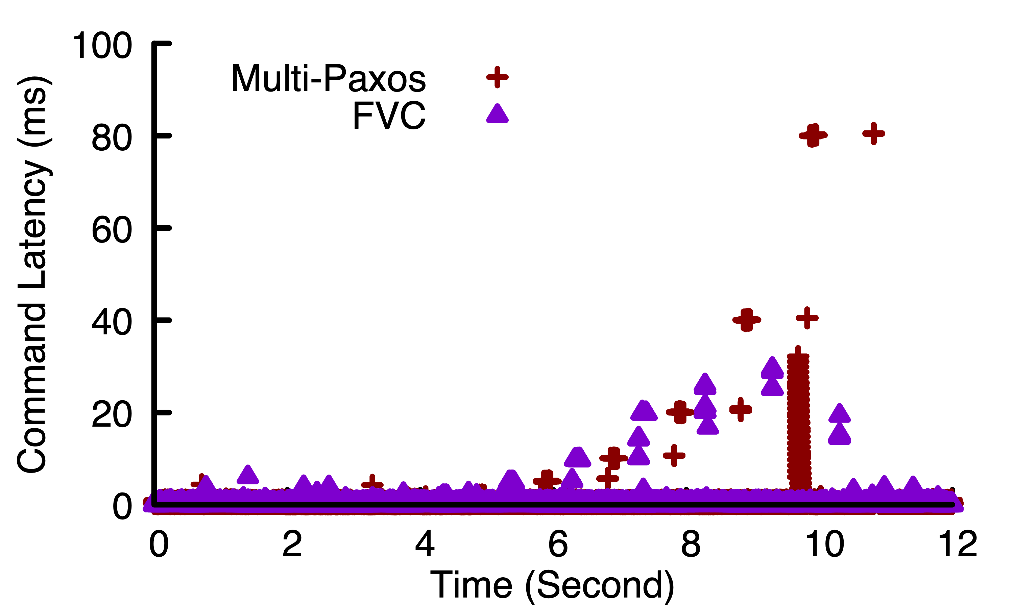
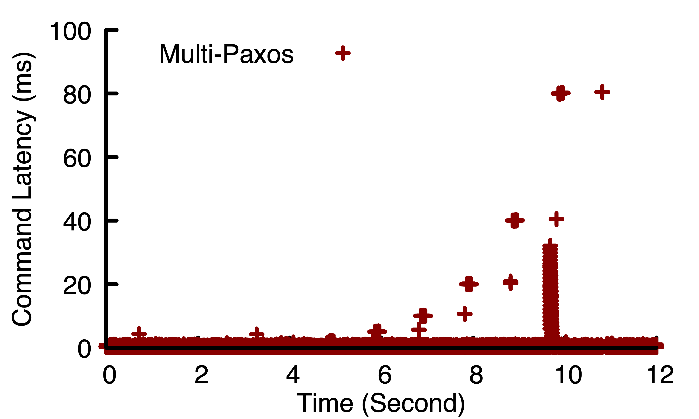
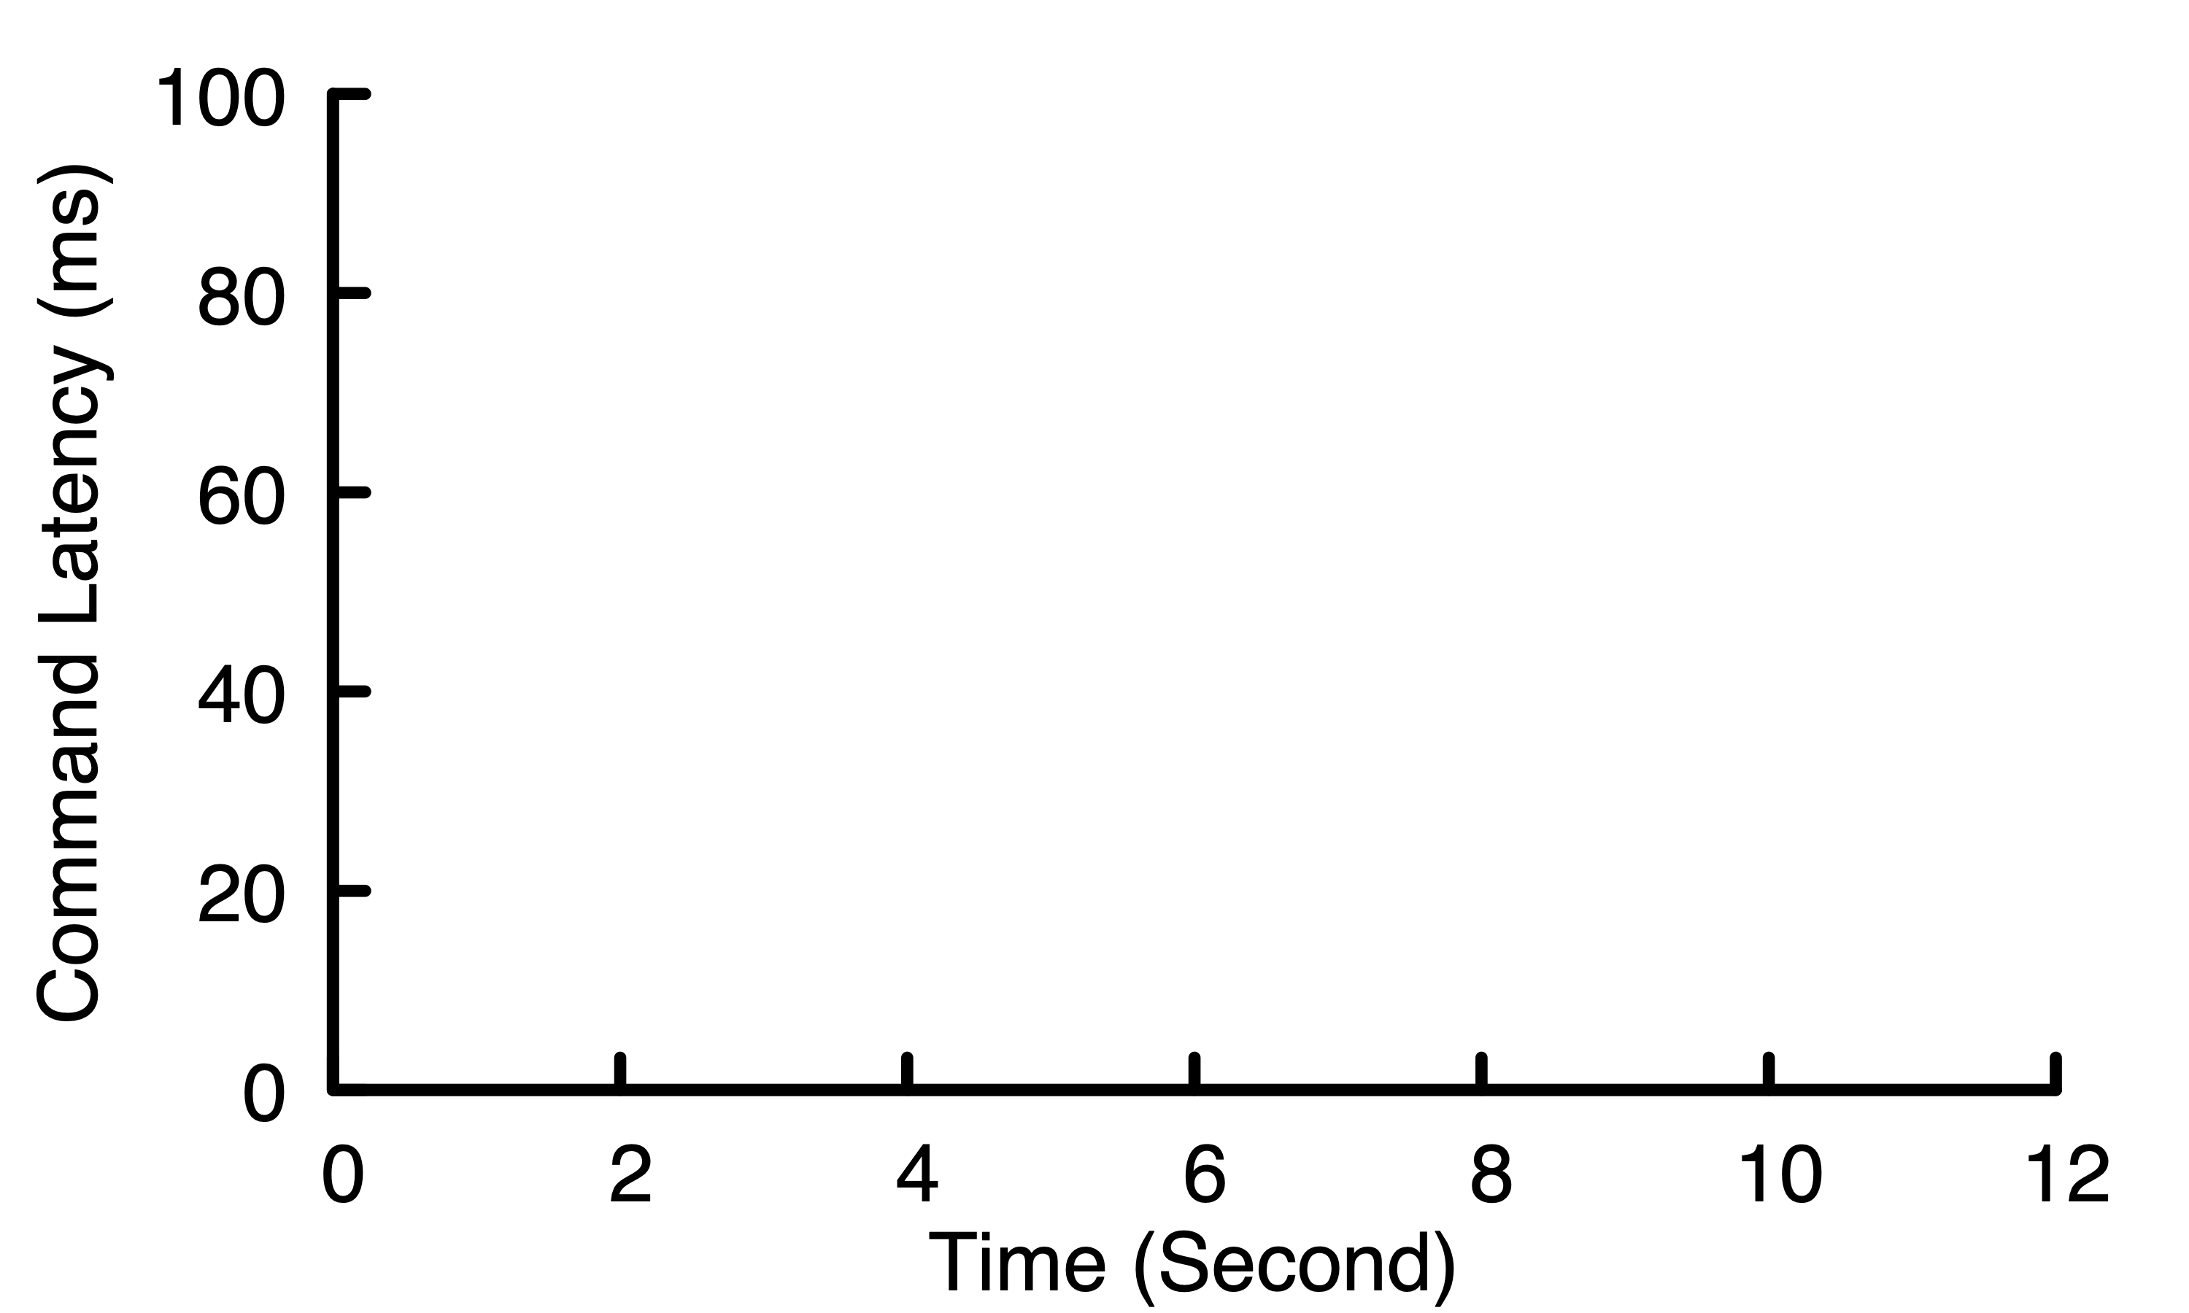
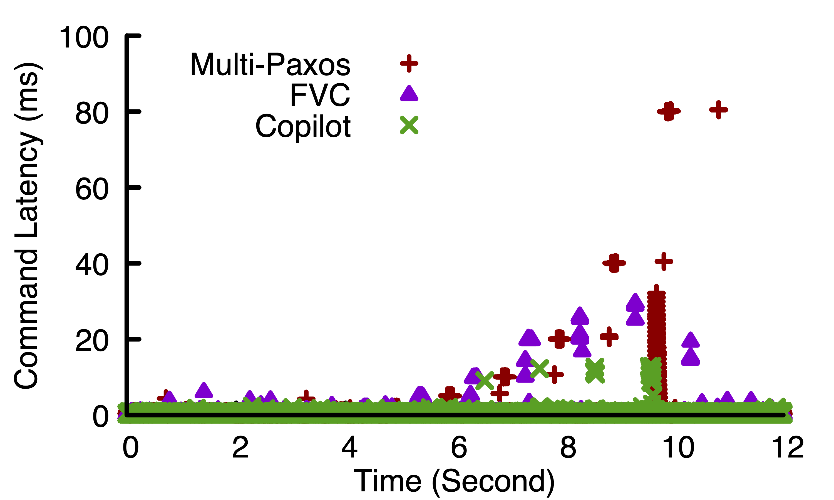
Copilot and Fast-View-Change Tolerate Transient Slowdowns
Not slowdown-tolerant
25 ms
12.5 ms

Slide 29
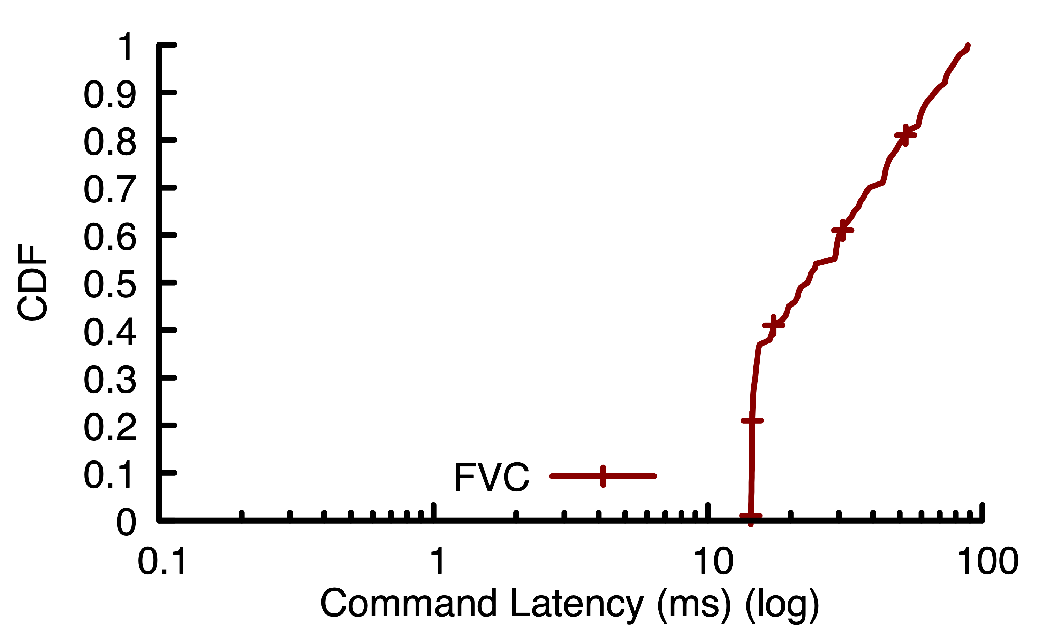
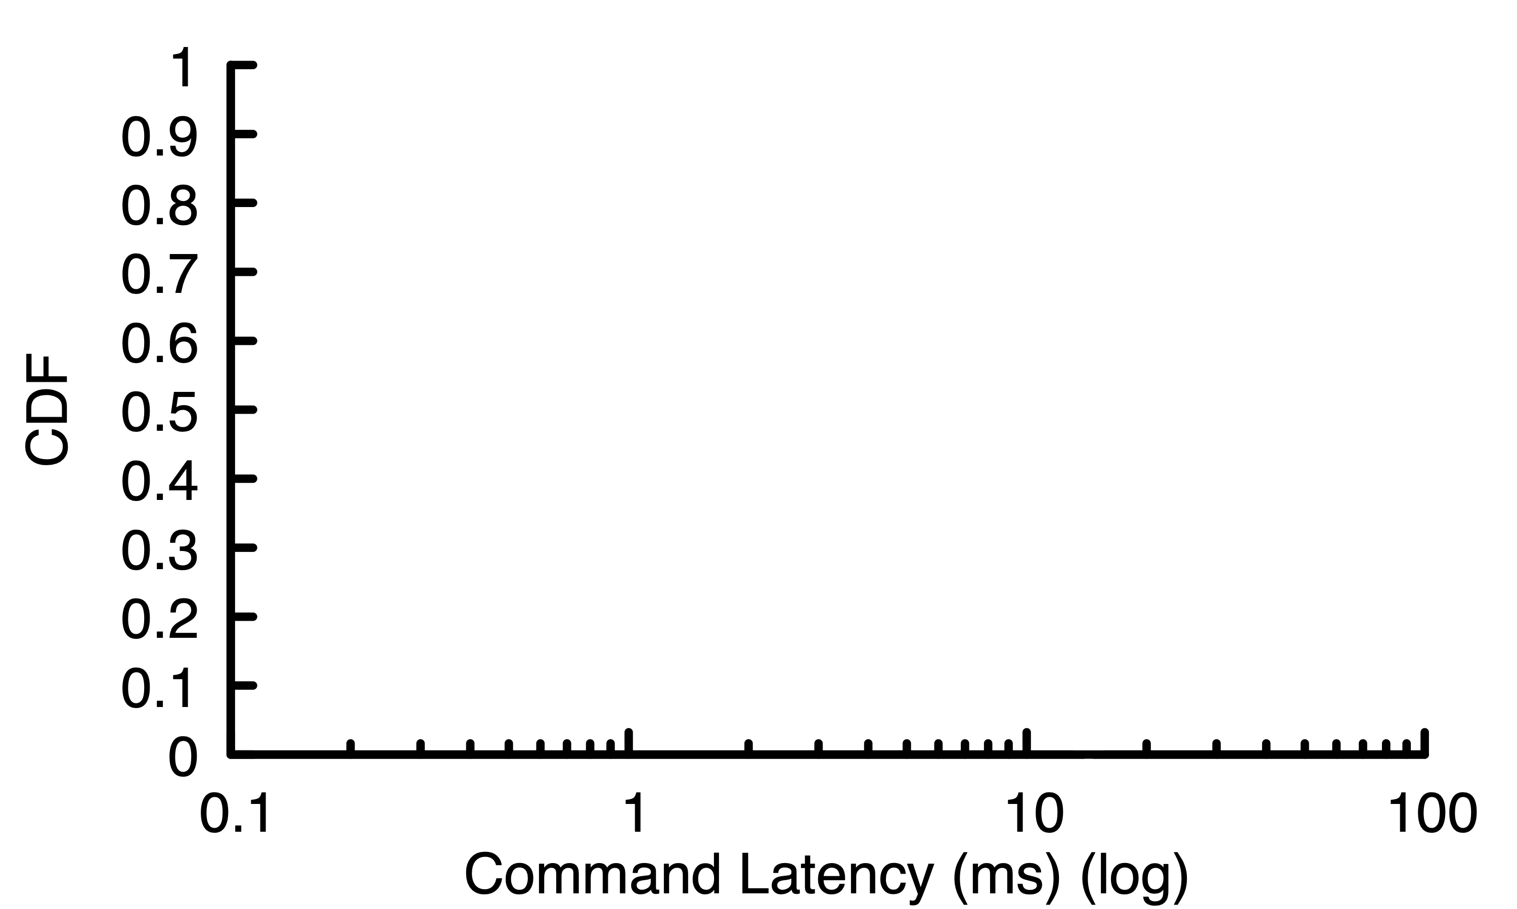
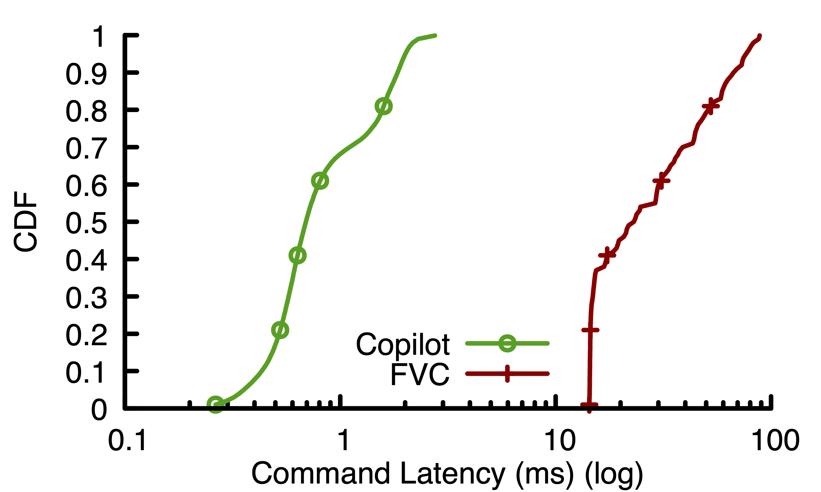
Only Copilot Tolerates Gradual Slowdown
40 ms

Slide 30
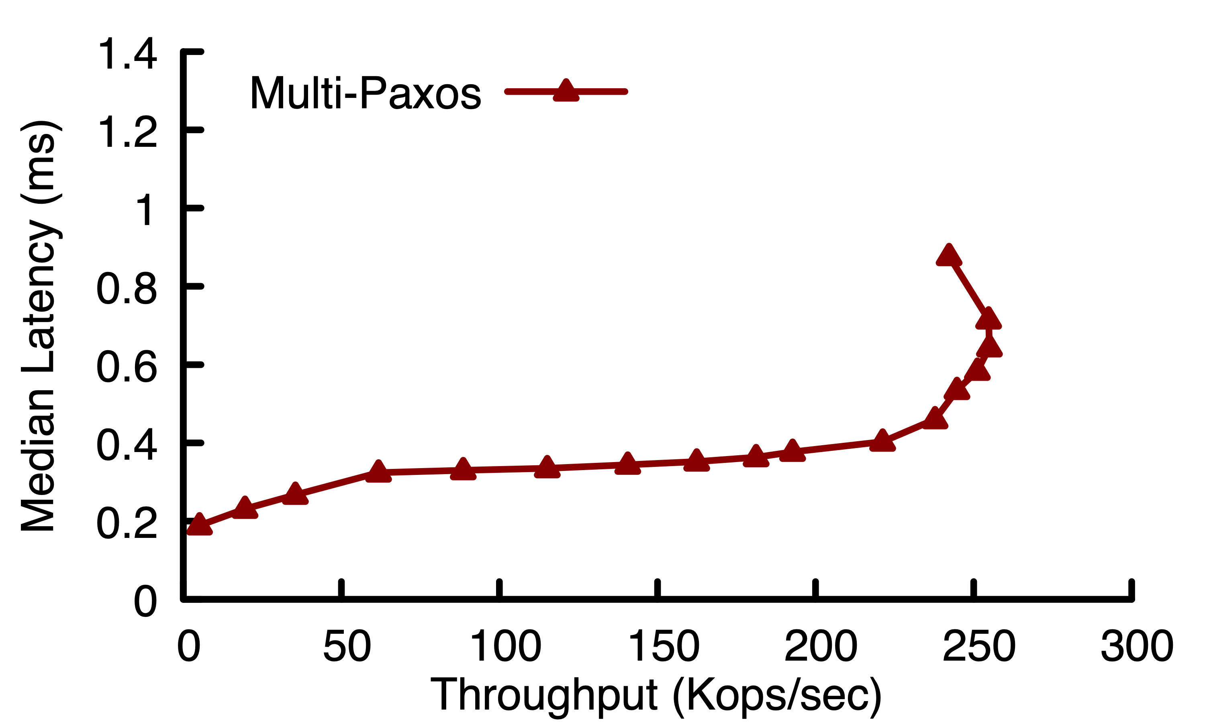
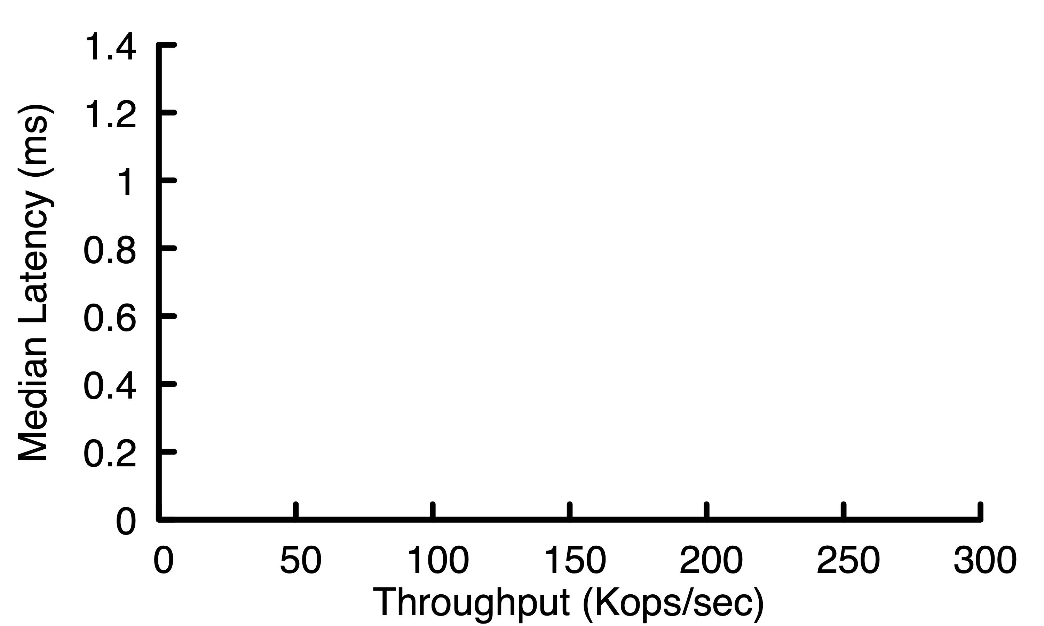
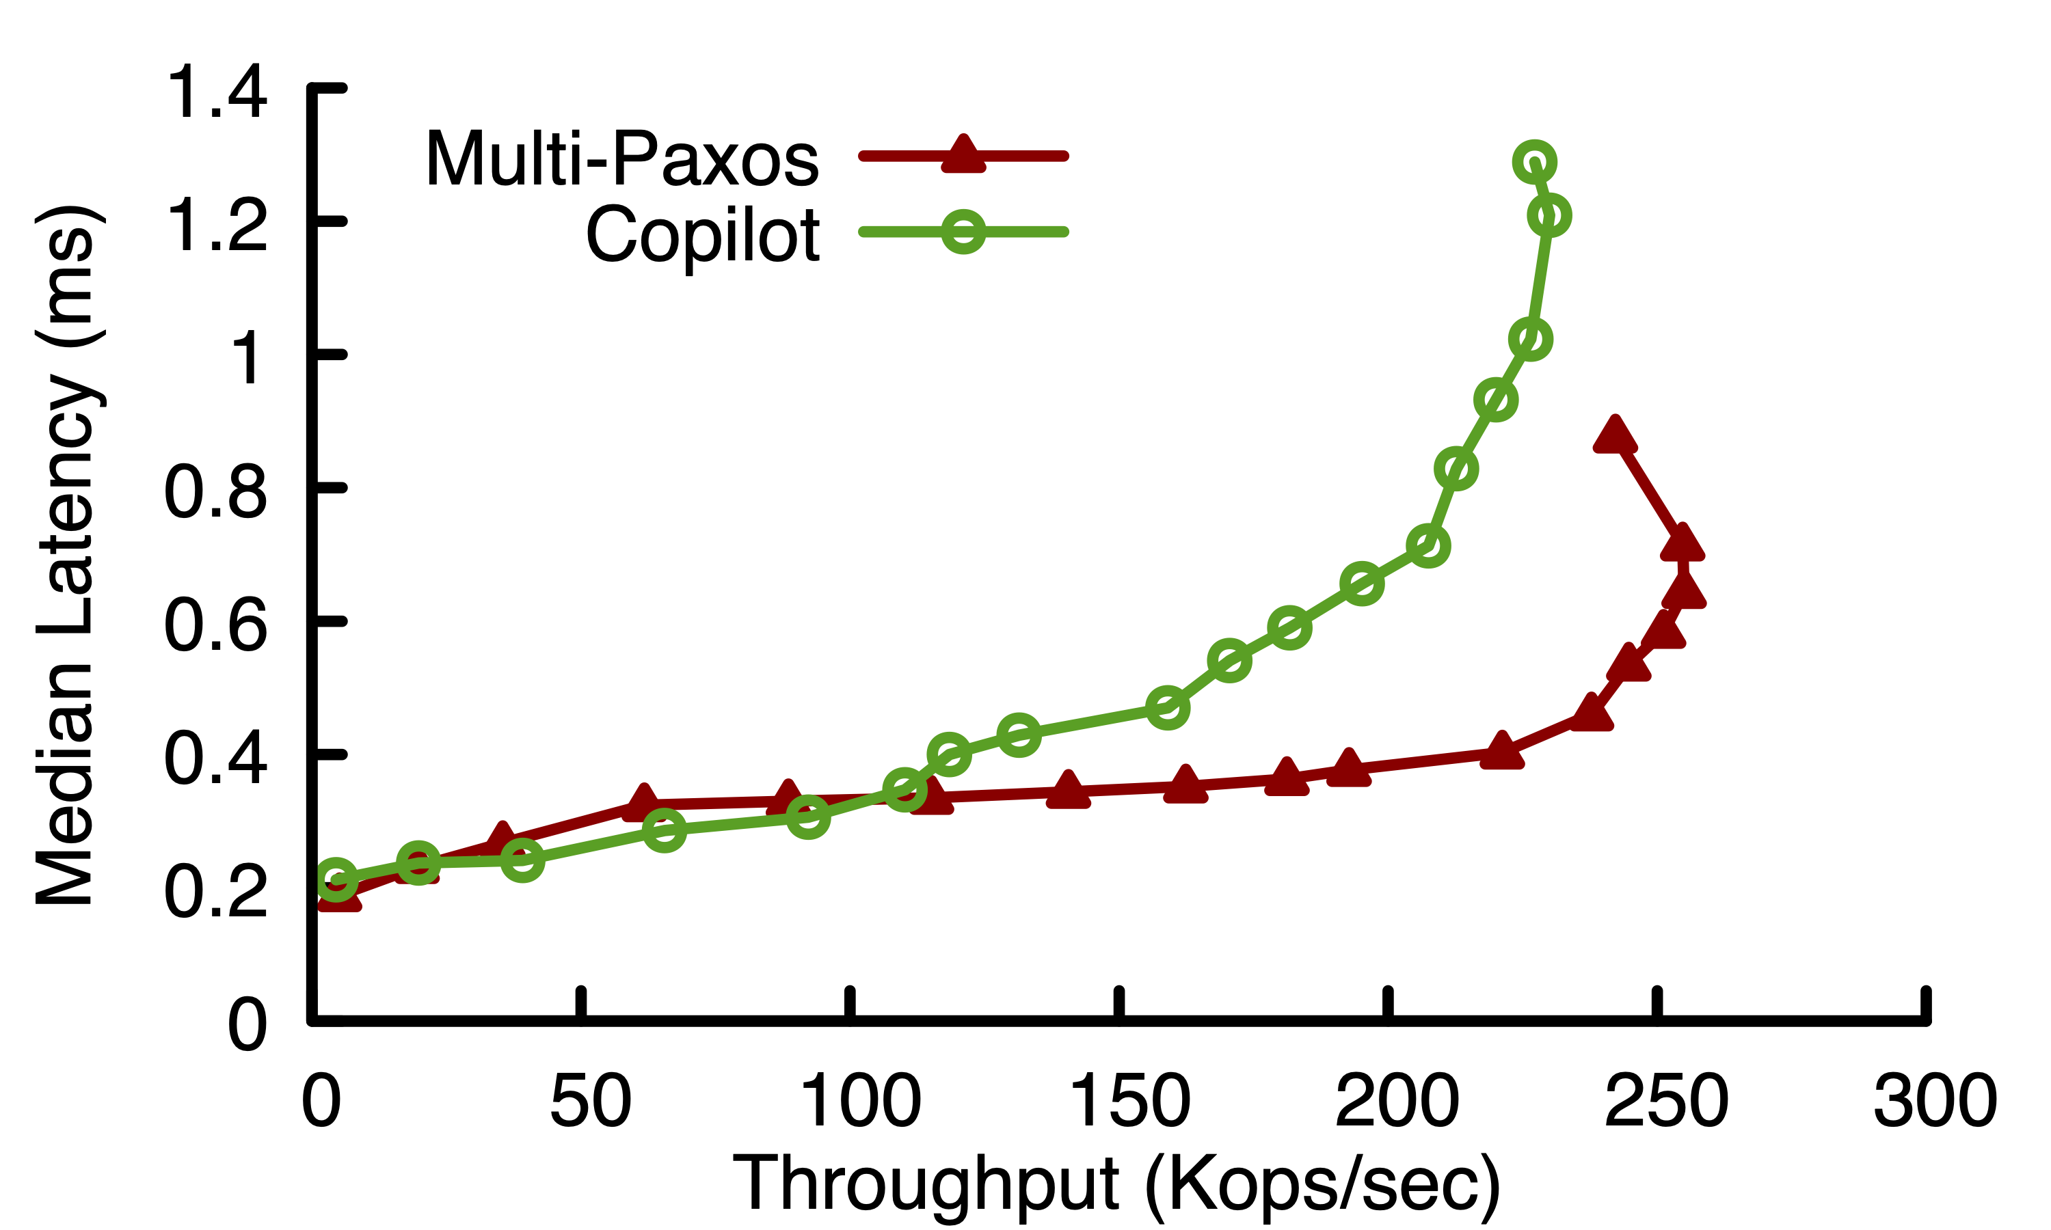
Performance Without Slow Replicas
8% lower throughput than Multi-Paxos
Comparable latency at low/moderate load

Slide 31
Conclusion
Contact Information:
Khiem Ngo khiem@princeton.edu
Slowdowns hurt availability, need s-slowdown-tolerant RSMs
Copilot: first 1-slowdown-tolerant protocol
Slowdown tolerance: proactive redundancy and fast takeovers
Optimizations: ping-pong batching and null dependency elimination
Copilot’s performance without slow replicas is competitive
Copilot is the only protocol that tolerates any one slowdown

