Slide 1
K2: Reading Quickly from Storage Across Many Datacenters
Khiem Ngo, Haonan Lu, Wyatt Lloyd
Princeton University

Slide 2

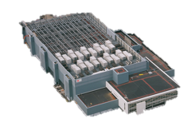
Web Services Span Across Datacenters
Large-scale services deploy across many datacenters

Slide 3
Web Services Span Across Datacenters
Medium-scale services often deploy across a few datacenters
(optionally) deploy across many datacenters

Slide 4

Deploying across many datacenters potentially reduces end-user latency
A Few
vs.
Many

Slide 5
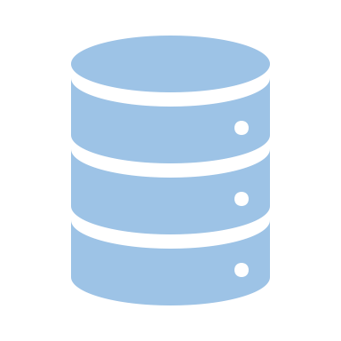

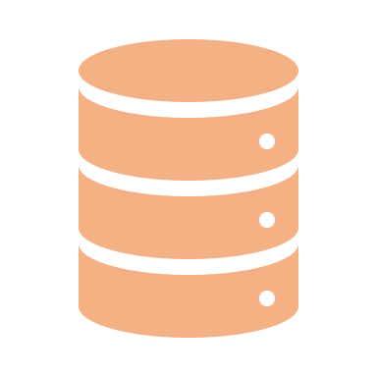
Deploying Across Many Datacenters Discourages Full Replication

Slide 6
Deploying Across Many Datacenters Necessitates Partial Replication

Slide 7
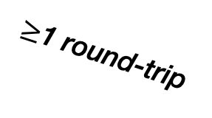
Naïve Partial Replication Hurts Latency
$≥$1 round-trip
Multiple round-trips lead to higher latency
Storage Guarantees Complicate Matters
vs. fully replicating across a few datacenters

Slide 8
K2: Partial Replication + Low Latency + Guarantees
Causal consistency, read-only and write-only transactions
Compatible with low latency
Suitable for many applications
K2 unlocks the low latency benefit of many datacenters for these strong guarantees

Slide 9
K2’s Design Goals
At most 1 round of non-blocking cross-datacenter requests
Latency no worse than fully replicating across a few datacenters
Often 0 cross-datacenter requests
Low latency for most requests

Slide 10
Replication Design
Metadata replication:
Fully replicate metadata
Partially replicate data
Constrained replication topology
Replicated write-only transaction algorithm
At most 1 cross-dc round
Non-blocking

Slide 11
Cache-Aware Read-only Transaction
Small cache in each datacenter
Maximize ability to reuse cached values
Ensure consistency and isolation
Often 0 cross-dc rounds

Slide 12
Evaluation
Does K2 provide read latency improvement?
Write latency, throughput, and staleness?
Emulate 6 datacenters spread around the world
Baselines
Replicas Across Datacenters (RAD)
PaRiS*

Slide 13
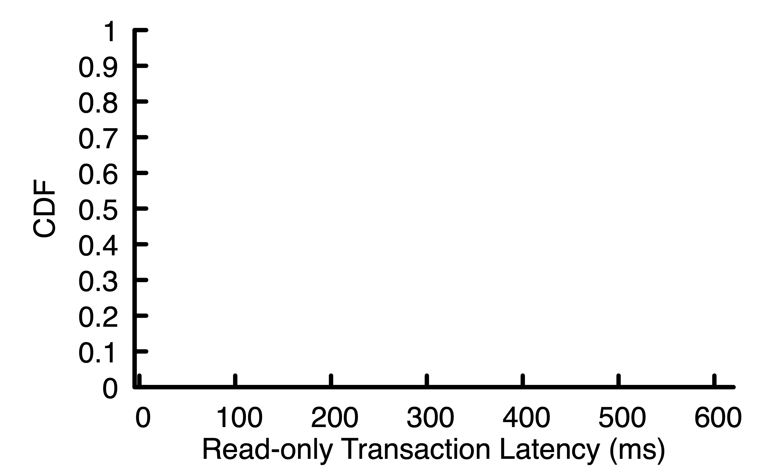
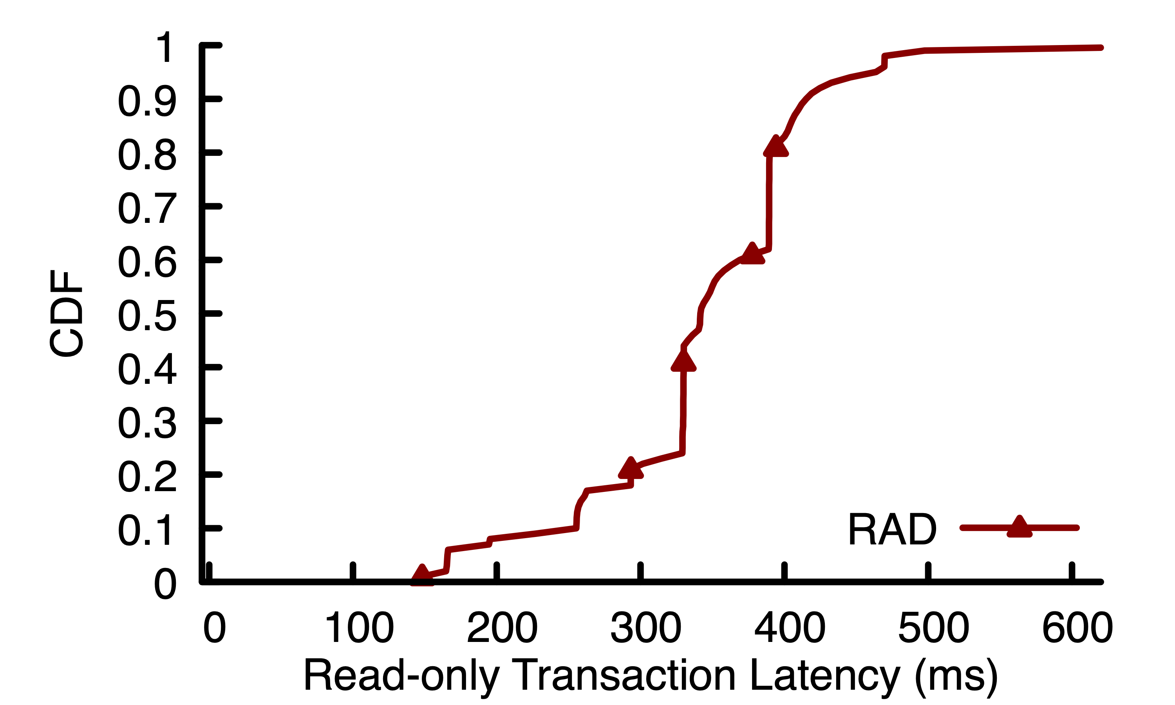
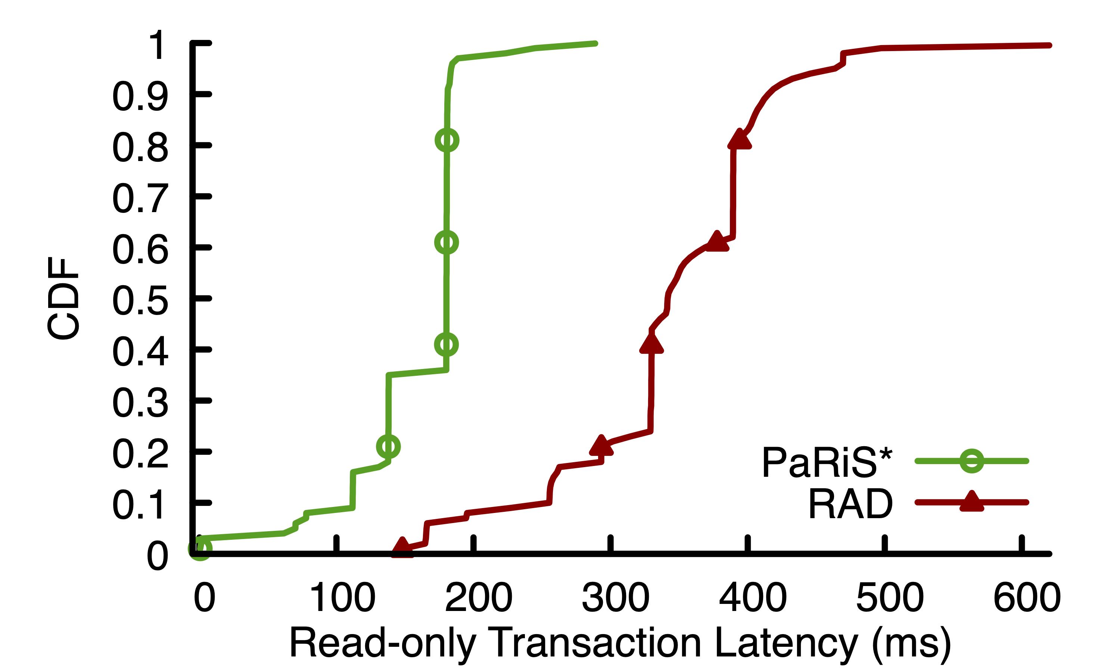
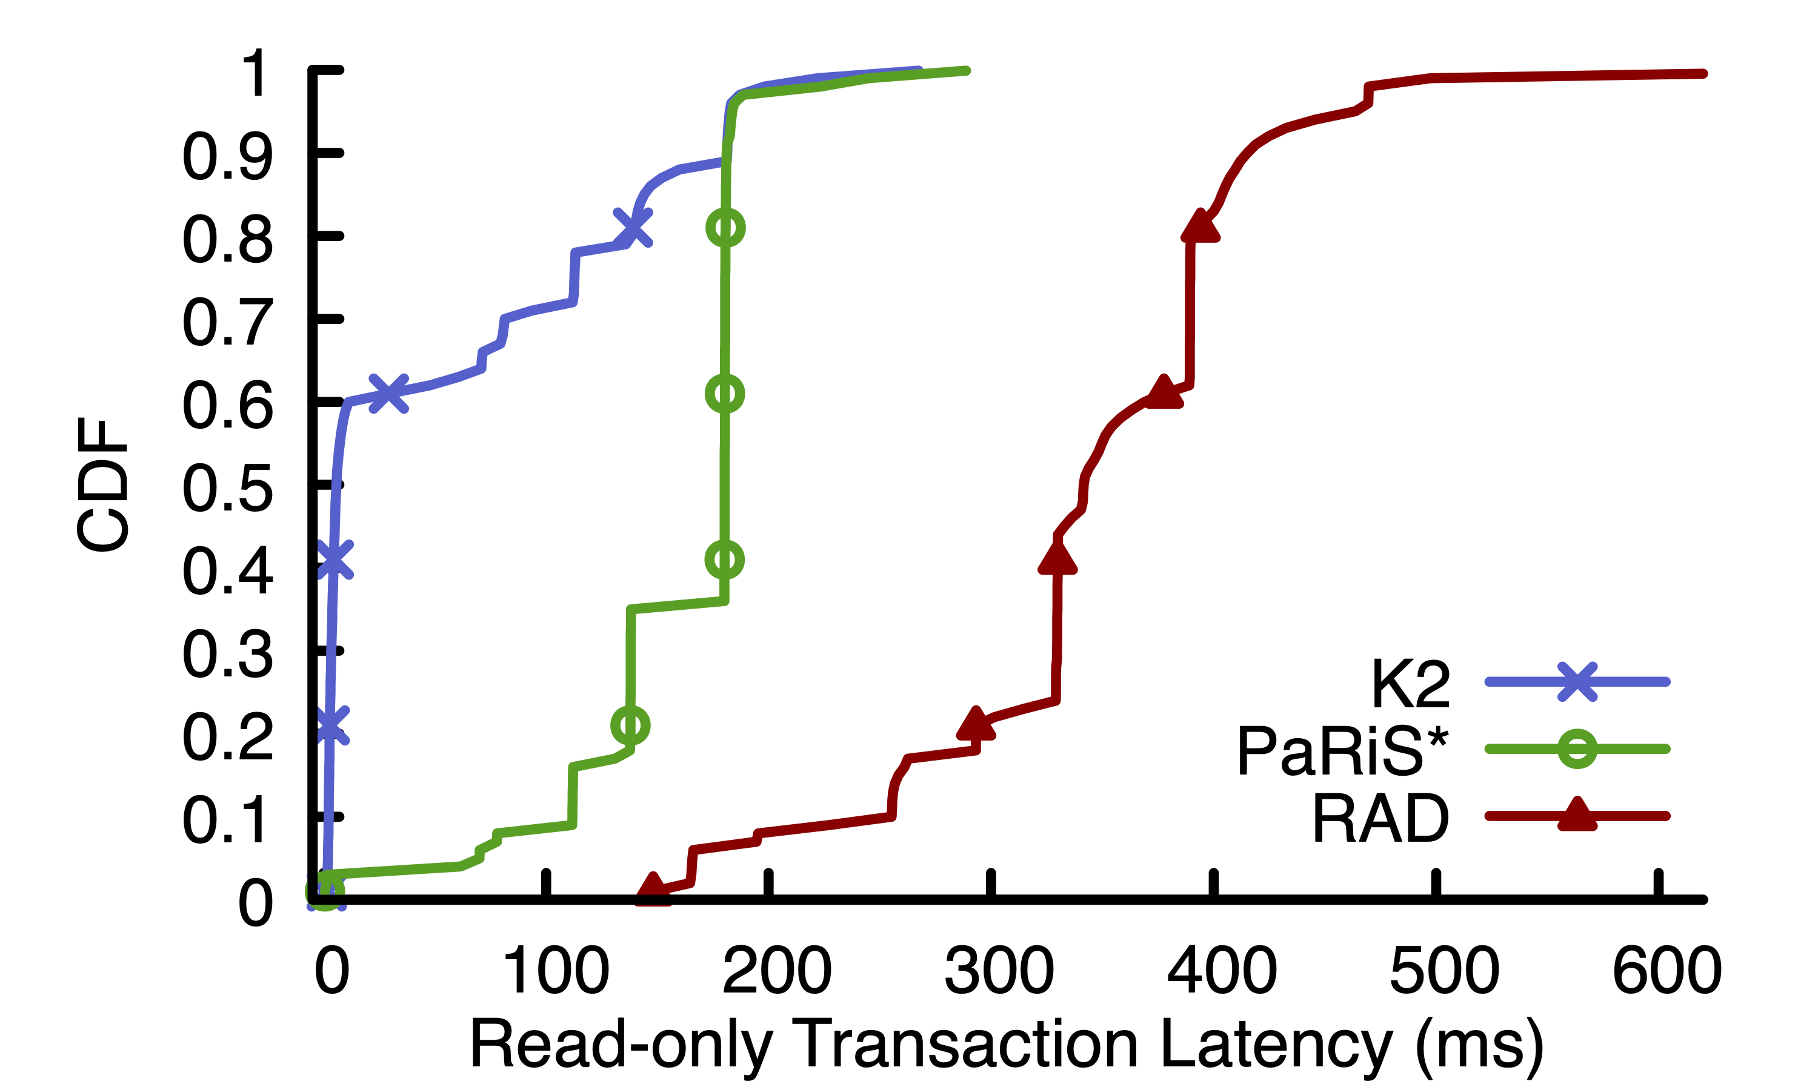
K2 Achieves Lower Latency
0 cross-dc rounds for 60% of txns
1 cross-dc round
2 cross-dc rounds

Slide 14
Conclusion
Contact Information:
Khiem Ngo khiem@princeton.edu
Realizing the low latency benefit of many datacenters is complicated by partial replication and storage guarantees
K2: partially-replicated storage system that unlocks low latency for the strong guarantees of
Causal consistency, read-only and write-only transactions
K2 has lower latency than the baselines in all settings

