Slide 1

Predicting Football Match Outcomes Using Machine Learning
Tran Ngoc Khiem

Slide 2
Project Objective
Create a simple machine learning model that can predict who will win a football match and estimate the total goals scored by both teams.
Enhance the accuracy of sports betting and fantasy football.
Contribute to analytical strategies in professional football teams.

Slide 3
Data Preprocessing and Feature Engineering
Gathering historical match data, team statistics, performance
Advanced preprocessing: Handling missing values, outlier detection.
Feature engineering: Creating new variables to enhance model accuracy.

Slide 4
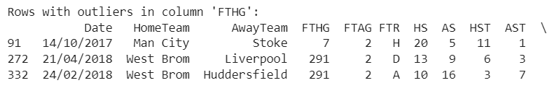
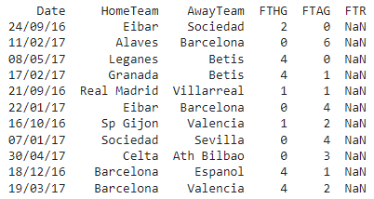

Problems with data
Extreme outliers
Na values
Home team is the same as the Away teamThe home
Negative goal

Slide 5
Feature engineering
Average Win Rates for Home and Away Teams: This metric highlights the winning frequency of teams in their home and away games, providing insight into their performance under different conditions.
Average Goals Scored by Home and Away Teams: This figure gives an average of the goals scored by teams, both when playing at home and away, offering a perspective on their offensive capabilities.
Winning Probabilities Based on Brokers' Betting Odds: This analysis uses the betting odds from brokers to calculate the likelihood of each team winning a match, providing a predictive insight based on market expectations.
Goal Ratio for On-Target Shots: This ratio is calculated by dividing the total number of goals scored by the total number of shots on target. It gives an efficiency score, indicating how often a team scores when they successfully hit the target.
Adjusted Win Rate: This measures the performance of teams specifically against each other, offering a more nuanced view of team capabilities by considering head-to-head history and performance.
Team's Attack Strength at Home and Away: This metric evaluates the offensive power of a team both in their home ground and during away matches, giving a clear picture of their attacking consistency and adaptability in different venues.

Slide 6

Train, validation and test set
2015-2021
2022
2023

Slide 7
Training model
Training the Top Three Models with Hyperparameter Tuning
Train set
Train top 5 models
Lazy predict
test set
Best model
Predicted values

Slide 8
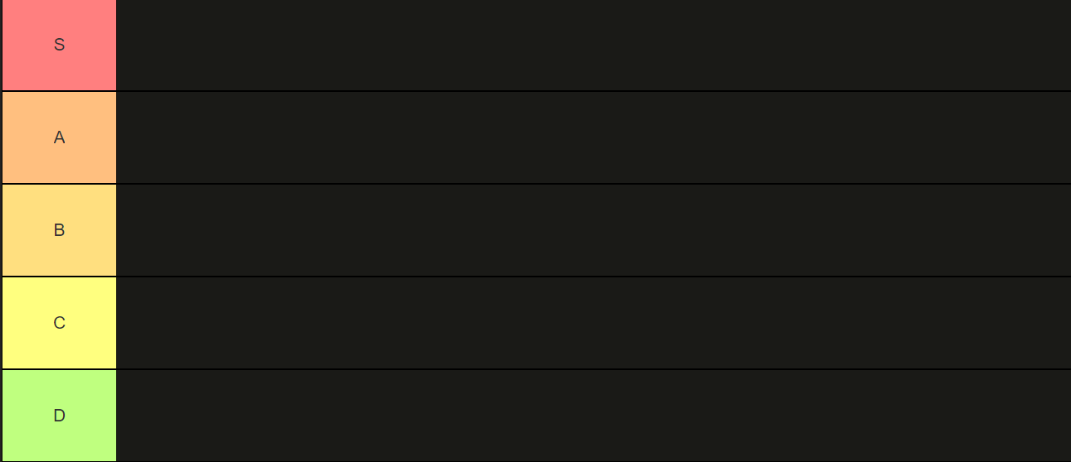
Best performing algorithm for classification task
XGBoost classifier, Bagging classifier
Random forest classifier, Extra tree classifier
Decision Tree classifier

Slide 9
Best performing algorithm for regression task
Poisson regressor, ElasticNet
Random forest regressor, XGB regressor
Extra tree regressor

