Slide 1
AMES HOUSING
Modeling Sale Price
Kade Higgins

Slide 2
Problem Statement
To identify the best model for predicting Sales Prices in Ames, Iowa.

Slide 3
About the data
Housing Data in Ames, IA
Descriptive Info related to Property
Ex. Overall Qual, Neighborhood, Fireplaces, Lot Shape, Yr Sold, etc
Null Values
Replaced with N/A, 0 as appropriate

Slide 4
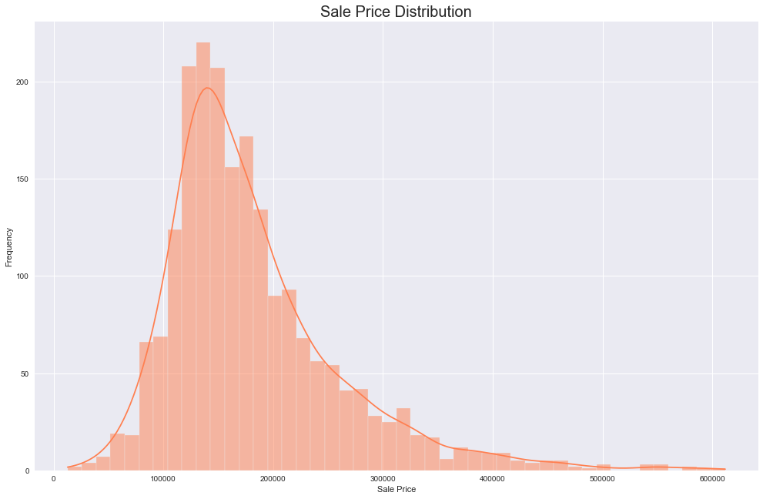
Exploratory Data Analysis
SAle price distribution
Notes:
Data is not normally distributed
Demonstrates Positive Skewness (Right Skewed)
https://www.statisticshowto.com/pearson-mode-skewness/

Slide 5
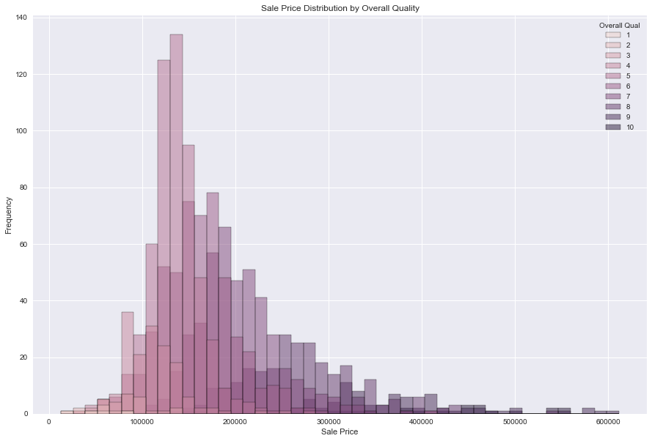
Exploratory Data Analysis
SAle price x
Overall Qual
Notes:
Data is not normally distributed
Demonstrates Positive Skewness (Right Skewed)
https://www.statisticshowto.com/pearson-mode-skewness/

Slide 6
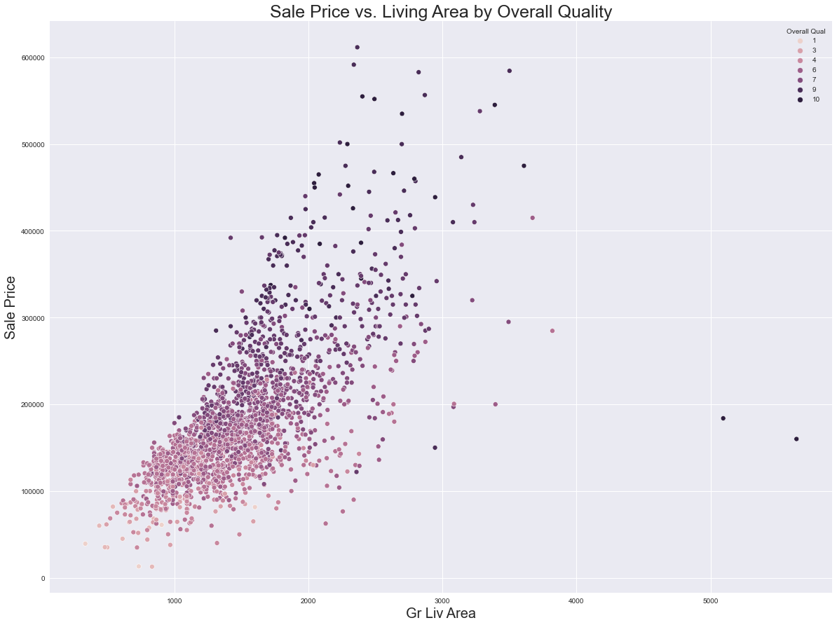
EDA
SAle price x
Living Area
Notes:
Clear Relationship between Living area and Sale Price
- Higher sqft homes not only tend to sell for more money, they also tend to be rated higher in terms of overall quality (shown by hue)

Slide 7
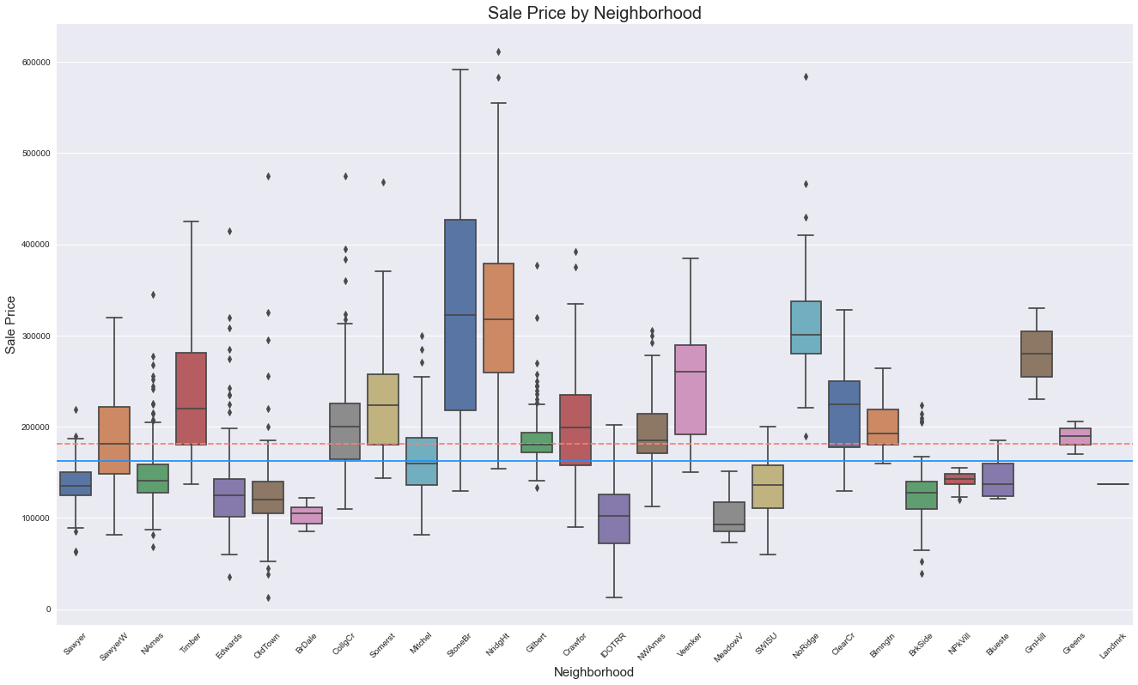
EDA sale price n.hood plots
Notes:
Red Dash is mean, Blue line is median
We can see that some neighborhoods have their nearly their whole distribution above the mean and median
(NoRidge, StoneBr, GrnHill)
while others (BrDale) are below both
Neighborhood will be a variable of interest in modeling

Slide 8
Model 1: Linear Regression
A simple univariate Linear Regression using ‘Overall Qual’ as the X variable:
66.2% Accuracy
RMSE: 45571.38
Y = 44318.64X - 89719.7
*our baseline
Notes:
About 64% of the variation in price can be explained by the Overall Qual value alone

Slide 9
Model 2
Logistic Regression
Three Variables (Overall Qual * Exter Qual, Gr Liv Area, Neighborhood)
  OHE on Neighborhood
  Standard Scaler + Logistic Regression
  0.58% Accuracy
  RMSE = 44139.14
Notes:
This one performed…..terribly, which I did not expect, SO

Slide 10
Model 2.5
Ridge
Three Variables (Overall Qual * Exter Qual, Gr Liv Area, Neighborhood)
  Swapped Logistic Regression out for Ridge
  Best Ridge Alpha: 20
  81.4% Accuracy
  RMSE = 33989.4
Notes:
This performs much better!

Slide 11
Model 3: a little of everything
This model keeps nearly all features, uses a pipeline to do OHE, StandardScaler, SelectKBest and Lasso
90.3% Accuracy
RMSE 24685.86
Best Alpha (10), chose 150 features
Notes:
This model utilized a column transformer to work on the categorical columns, StandardScaler to standardize data, SelectKBest
train.drop(columns=['PID', 'Id', 'Yr Sold', 'Misc Val', 'BsmtFin SF 2' ,'SalePrice', 'Misc Feature'])

Slide 12
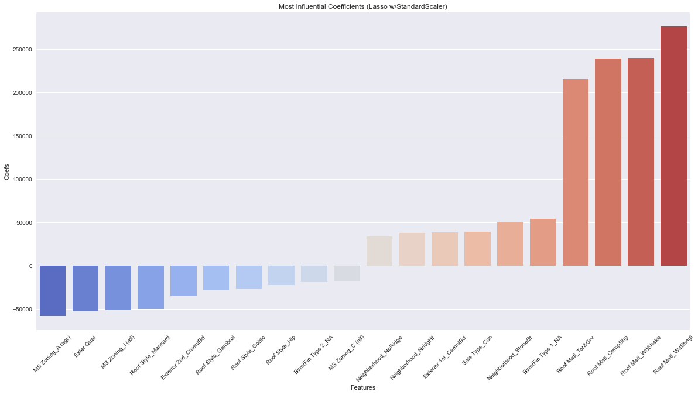
Plotting Model 3 Coefs
Notes:
Here we can see two that when taken with all the other features, Overall Qual doesn’t have as high an influence as we thought
We do see a few neighborhoods that are highly influential (NoRidge, StoneBr)
A lot of Roof material variables
Not what we expected, but these are related to Exter Quality or Overall Quality, which compose a homes appearance

Slide 13
Conclusions
Complex Model Outperforms Simpler Ones
But, not by much.
  Location is likely a very strong predictor of SalePrice, particularly in combination with variables related to quality
Next Time…
  Look at different models with a few variables each
  Our model 3 wasn’t a huge gain over model 2.5, despite using nearly all variables compared to 3
  Investigate collinearity, multicollinearity, possibly log transform the target

Slide 14
Thank You For Listening
I’m happy to answer any questions
Kade Higgins

