Slide 1
Capstone
Alcohol Overuse/Abuse and Self-Harm Mortality
Kade Higgins

Slide 2
But first … why so serious?
Self-harm / Intentional Injury Mortality rate significantly higher than other mortality categories
Has surpassed the mortality rate from Diabetes
Just as preventable as other mortality causes
Mortality burden is not equally distributed – some communities post exponentially higher self-injury mortality rates than others
Notes:
Overuse of alcohol is a factor in many diseases, and causal relationships have been established between harmful drinking and various mental/behavioral health disorders as well as incidence of infectious diseases such as TB and HIV/AIDS.
Surpassed Diabetes: https://injuryprevention.bmj.com/content/25/4/331

Slide 3
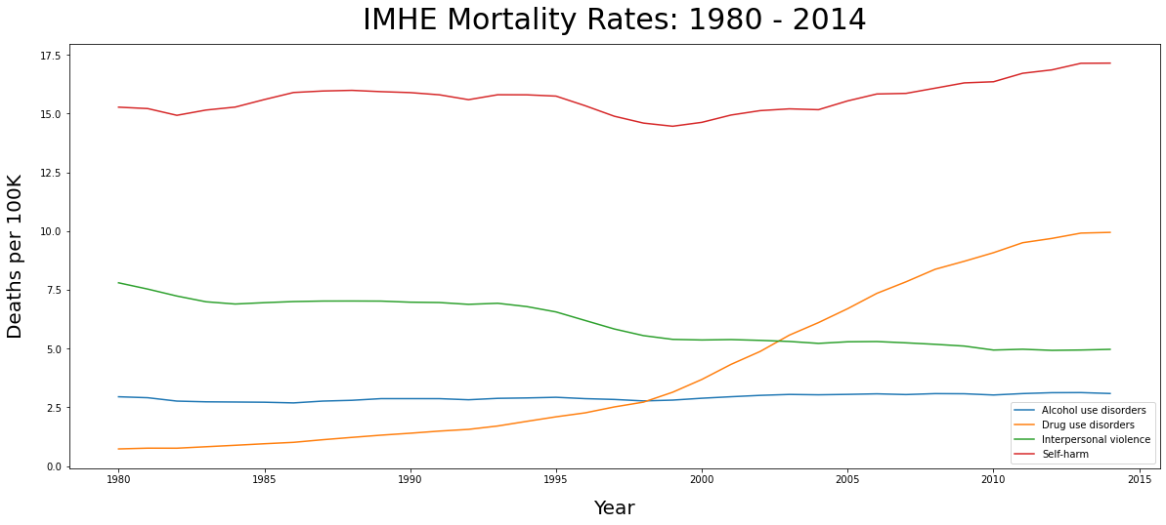
Exploratory Data Analysis The Graph that sparked my interest
Notes:
Keeping in mind that this is an average of all counties in the US across male/female rates, notice how it high it is compared to other causes
The opoid epidemic is, rightfully, getting the attention it deserves.
Perhaps because of stigma, we are unwilling to confront this equally devastating epidemic

Slide 4
The burden of booze
WHO - As many as 3 million deaths globally per year attributed to harmful alcohol use
Prevalence of heavy drinking/binge drinking has increased over time
Harmful alcohol use prevalence is also not equally distributed
Pro: LOTS of funding for alcohol related mortality
Notes:
Overuse of alcohol is a factor in many diseases, and causal relationships have been established between harmful drinking and various mental/behavioral health disorders as well as incidence of infectious diseases such as TB and HIV/AIDS.
Surpassed Diabetes: https://injuryprevention.bmj.com/content/25/4/331
DEFINITIONS
"Any" drinking is defined as at least one drink of any alcoholic bevarage in the past 30 days – var is age standardized prevalence of “any” drinkers
"Heavy" drinking is defined as the consumption, on average, of more than one drink per day for women or two drinks per day for men in the past 30 days - var is age standardized prevalence of heavy drinkers
"Binge" drinking is defined as the consumption of more than four drinks for women or five drinks for men on a single occasion at least once in the past 30 days – var is age standardized prevalence of binge drinkers
Proportion of Binge and Heavy refers to the proportion of all drinkers who are heavy or binge drinkers

Slide 5
Problem Statement
Deaths from self harm (i.e. suicide and other intentional injuries that result in death) far outpace other mortality categories in the IMHE dataset. Knowing that substance/alcohol abuse is a factor in many diseases and mental/behavioral health disorders, I will create supervised and unsupervised model(s) to that explore the relationships between mortality rate by self-harm and other variables such as sex, year, state, unemployment and the different levels of alcohol use/abuse.

Slide 6
Methodology
Find the Data
Clean
EDA & Visualization
Model – Univariate Regression
Model – Multivariate Regression
Unsupervised Learning – K-Means Clusters

Slide 7
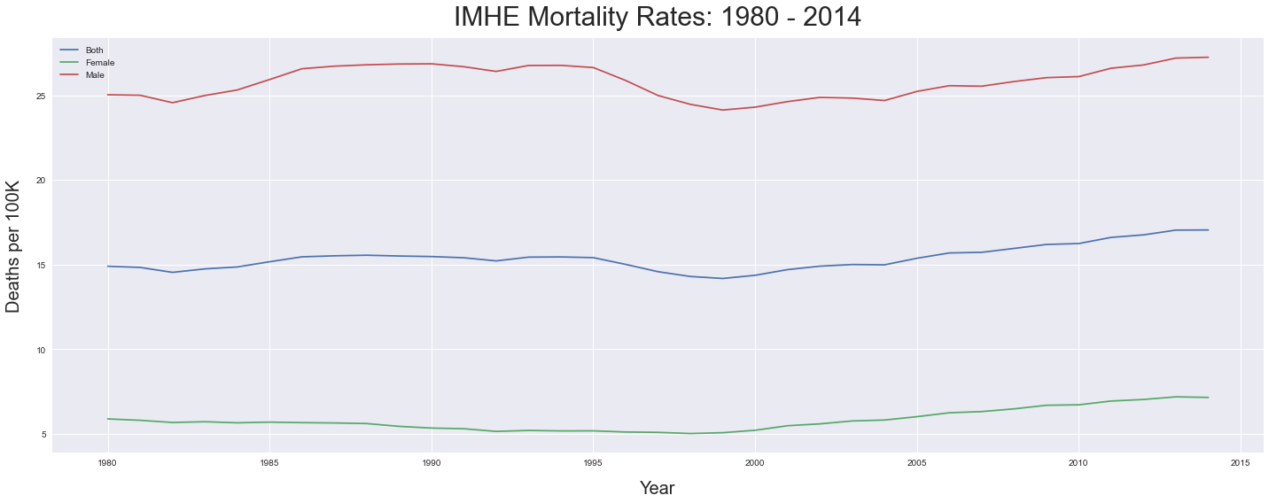
Self harm mortality yearly average by sex
Notes:
Here we can see that it is overwhelmingly men who are dying as a result of self-injurius behavior.
There’s an interesting dip in the late 90s, followed by an increase back to original levels.

Slide 8
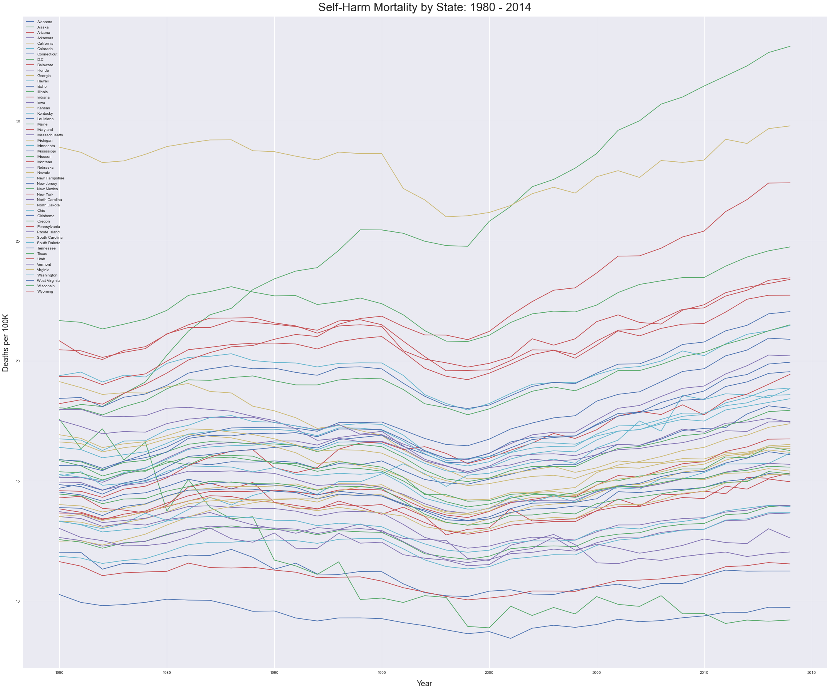
Yearly Average Self-Harm mortality by state
Notes:
While the lines and legends aren’t super visible, what this plot does a good job of is conveying that some states have a self-harm mortality rate that remains consistently low, while others decrease, while still others have drastic and outsized increases over time.
Clearly, there is some regionality to these rates
States with the highest self harm mortality rates include Nevada, Alaska, New Mexico, Whoming, Montana, Colorado and Oregon
Lots of states we think of as “rural” on the gulf coast don’t rank in the top half
The lowest 6 or 7 states were almost exclusively east coast states
California ranked in top 10 for women, but was much lower for men

Slide 9
Self-harm mortality points of interest
Average 15.66 per 100K between 1980 & 2014
Max mortality rate 162 per 100K
Female avg increased 5.89 – 7.16
Female max increased 16.71 to 36.15
Male avg increased 25.02 – 27.24
Male max increased 86.81 to 162.27
The highest mortality rates for both men and women are in the Kusilvak Census Area, Alaska (county FIPS 02158)
Notes:
Overuse of alcohol is a factor in many diseases, and causal relationships have been established between harmful drinking and various mental/behavioral health disorders as well as incidence of infectious diseases such as TB and HIV/AIDS.
Surpassed Diabetes: https://injuryprevention.bmj.com/content/25/4/331
On par with cancer:
In 2014, Alaska’s cancer mortality rate was 164.2 per 100K
https://www.cdc.gov/nchs/pressroom/sosmap/cancer_mortality/cancer.htm
Comporable to heart disease mortality:
https://www.cdc.gov/nchs/pressroom/sosmap/heart_disease_mortality/heart_disease.htm

Slide 10
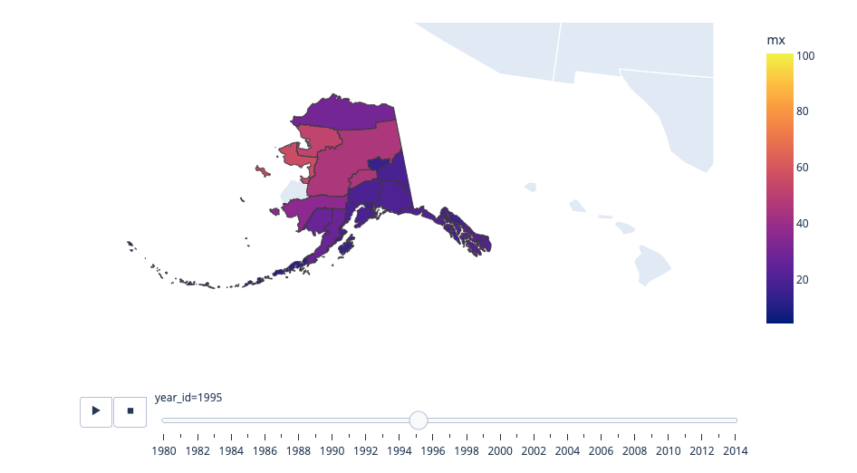
Self-Harm Mortality Alaska, 1995
Notes:
Clear Relationship between Living area and Sale Price
Higher sqft homes not only tend to sell for more money, they also tend to be rated higher in terms of overall quality (shown by hue)
That missing county is exactly where the high is – for whatever reason the geojson FIPS must have had a mismatch

Slide 11
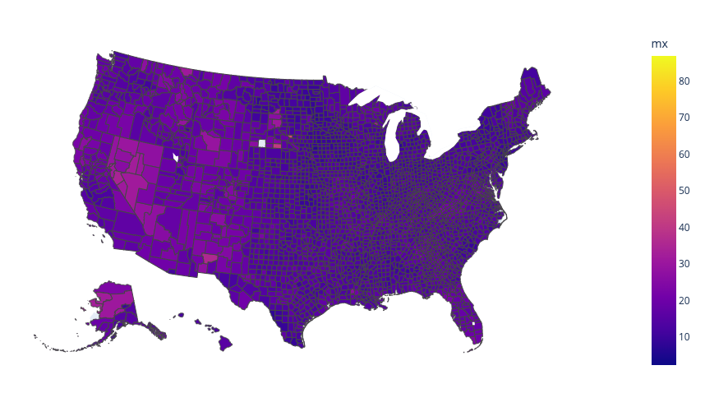
Self-Harm Mortality Alaska, 1995
Notes:
Both sexes, average of 1995

Slide 12
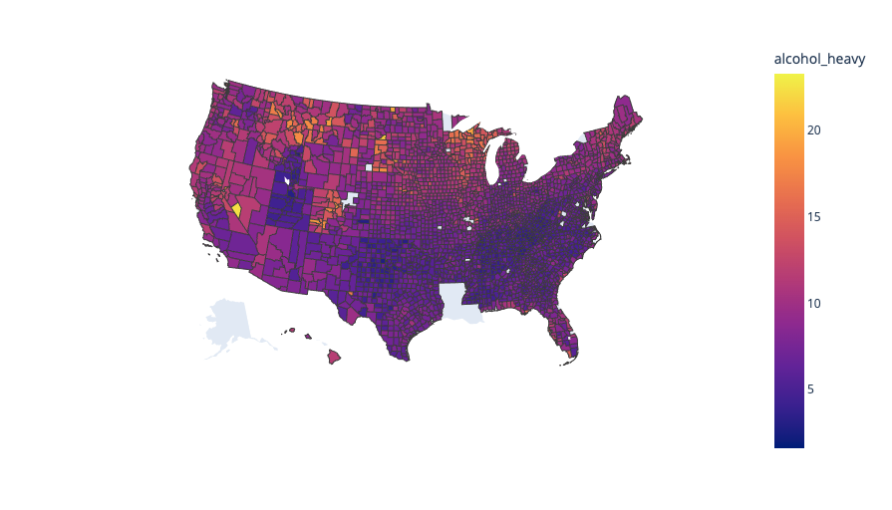
Heavy drinking prevalence
Notes:
Clear Relationship between Living area and Sale Price
- Higher sqft homes not only tend to sell for more money, they also tend to be rated higher in terms of overall quality (shown by hue)

Slide 13
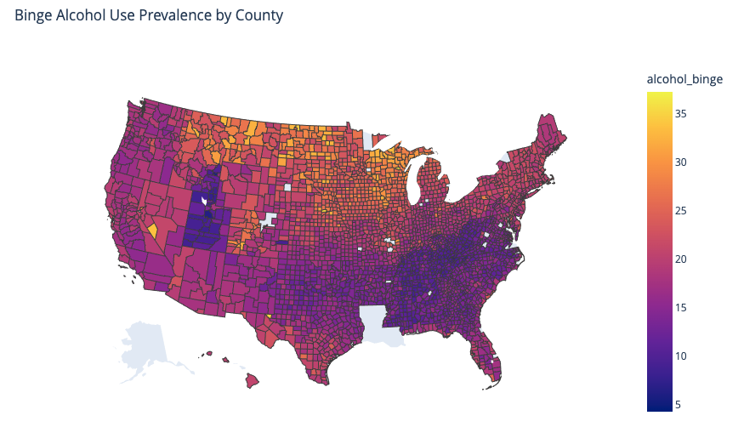
Binge drinking prevalence
Notes:
Clear Relationship between Living area and Sale Price
- Higher sqft homes not only tend to sell for more money, they also tend to be rated higher in terms of overall quality (shown by hue)

Slide 14
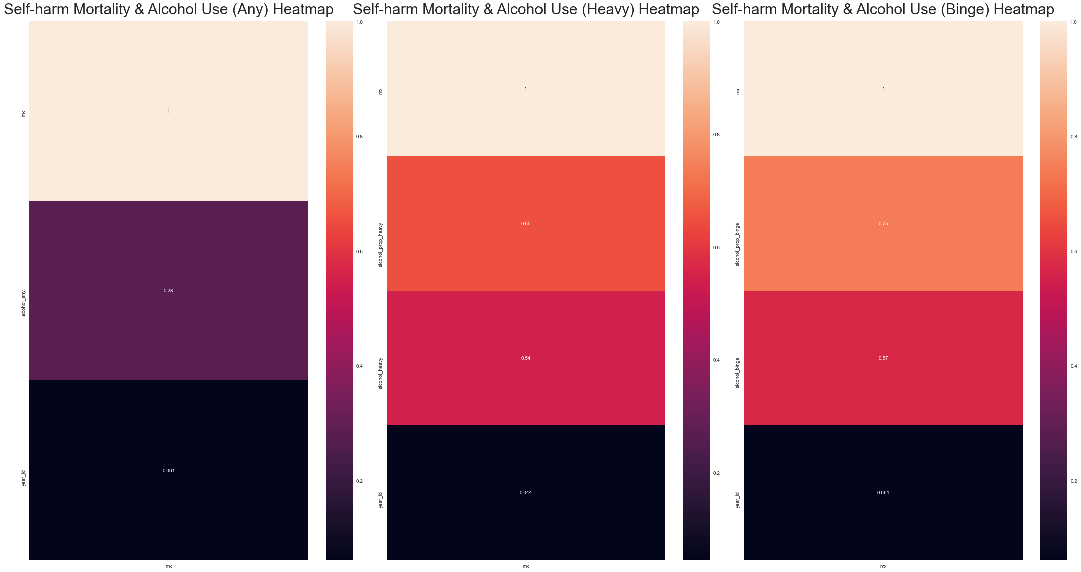
heatmap
Notes:
So here we see pretty significant correlations with mortality rate and heavy and binge alcohol use, with prop_binge having the highest correlation at 0.75.

Slide 15
Univariate Regression
Mortality rate vs. Proportion of Binge Drinkers had strongest accuracy score
RandomForest / Gboost tied
Test Accuracy: 0.73 Test
RMSE: 5.67

Slide 16
Multivariate Regression
Including sex and state with proportion binge drinkers returns high accuracy, low RMSE
GradientBoostRegressor wins out, only barely
If our univariate models represent our baseline (0.73), this improves
Test Accuracy: 0.87
RMSE: 3.9

Slide 17
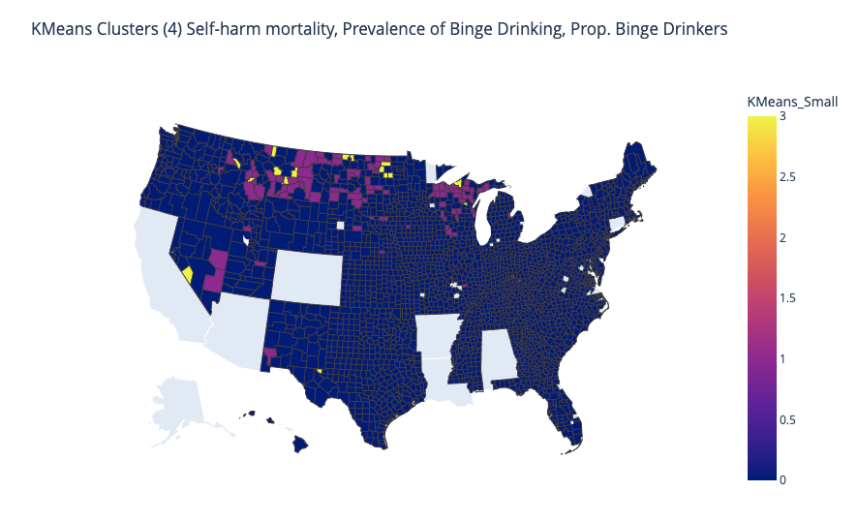
KMeans
Smaller Clusters were better (4)
Heavy / Binge clusters with mortality rate produce silhouette scores ~0.51
Including Labor Force and unemployment rate saw SIL score ~0.875 @ 4 clusters, ~0.73 @ 10 clusters
Unfortunately not all states were present across all variables – even with missing data, it is still worthwhile to identify clusters for targeted intervention
Notes:
Including unemployment_rate but not labor force returned a drastically lower silhouette score – suggesting that perhaps these related groups can be better categorized if you look at the size of the labor_force (itself a function of a county’s total population), rather than just unemployment alone
This would yield itself well to an urban/suburban/rural classification, although I could not find yearly classifications that fit my data for that

Slide 18
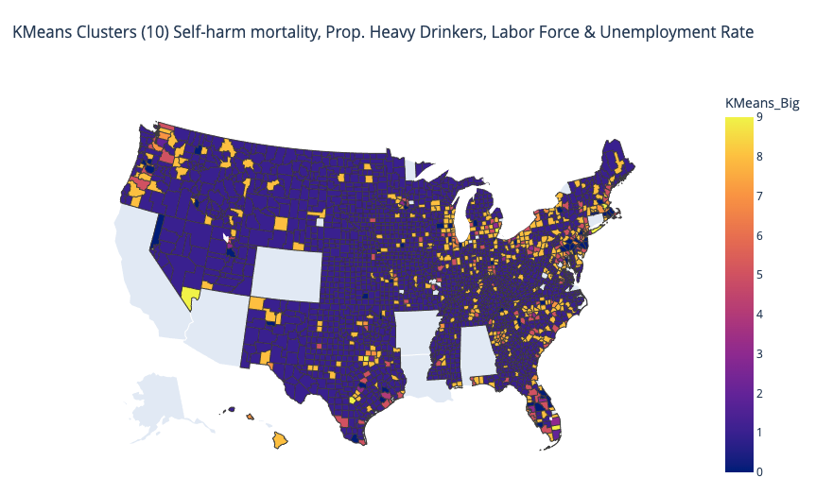
Kmeans Heavy Alcohol USe & unemployment
Notes:
SIL score 0.732 – these are very distinct clusters, making this a good model to target different areas with different interventions
Actually better than the 10 clusters with prop binge

Slide 19
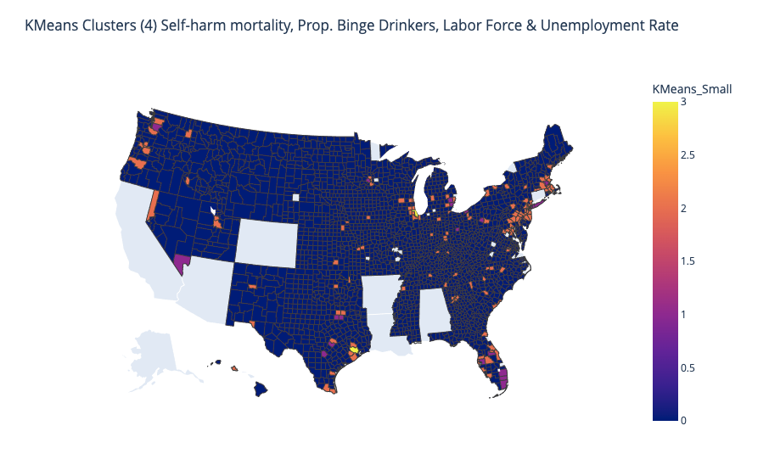
Kmeans Binge USe & unemployment (4 cluster)
Notes:
Including unemployment_rate but not labor force returned a drastically lower silhouette score – suggesting that perhaps these related groups can be better categorized if you look at the size of the labor_force (itself a function of a county’s total population), rather than just unemployment alone
This would yield itself well to an urban/suburban/rural classification, although I could not find yearly classifications that fit my data for that
SIL score 0.876

Slide 20
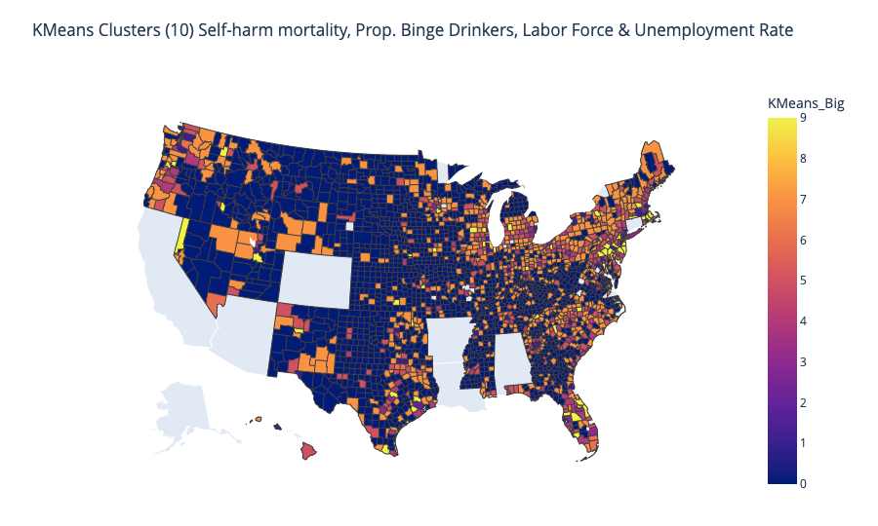
Kmeans Binge Use & unemployment (10 Cluster)
Notes:
Including unemployment_rate but not labor force returned a drastically lower silhouette score – suggesting that perhaps these related groups can be better categorized if you look at the size of the labor_force (itself a function of a county’s total population), rather than just unemployment alone
This would yield itself well to an urban/suburban/rural classification, although I could not find yearly classifications that fit my data for that
SIL Score 0.638

Slide 21
Conclusions
Multivariate Regression Models Outperform Single Variable Regression
K-Means Creates Meaningful Pockets of Similarly Afflicted Counties
Those interested in optimizing and more efficiently using public health research dollars can use these clusters to engage in regionally targeted intervention that addresses two mortality causes at once
In the Future
Get more complete data, build out streamlit app, , examine relationships between sunlight and self-harm mortality

Slide 22
Hotlines
If you or someone you know is struggling
National Suicide Prevention Lifeline: 800-273-8255
Crisis Text Line: Text ”Hello” to 741741
SAMHSA National Helpline (drug / alcohol abuse):
1-800-662-4357

Slide 23
Thank You For Listening
I’m happy to answer any questions
Kade Higgins

