Slide 1
Reddit NLP
Web Scraping & NLP Text Classification
Kade Higgins

Slide 2
Problem Statement
Did this subreddit text come from r/C_S_T or r/conspiracy?

Slide 3
Let’s Play a game!
”Am I missing something else going on?”
“Did time speed up after 9/11?”
“Is Our Whole Government Corrupt Or Is It Certain Networks?”
“Washington DC was staged just like Gorge Floyd”
Notes:
Q1 (Conspiracy)
Q2 (C_S_T)
Q3 (C_S_T)
Q4 (Conspiracy)

Slide 4
Methodology
Scrape r/C_S_T & r/conspiracy reddit threads
Clean (remove HTML, Lemmatize)
EDA & Visualization
Model - Naïve Bayes
Model – Logistic Regression
Notes:
Q1 (Conspiracy)
Q2 (C_S_T)
Q3 (C_S_T)
Q4 (Conspiracy)

Slide 5
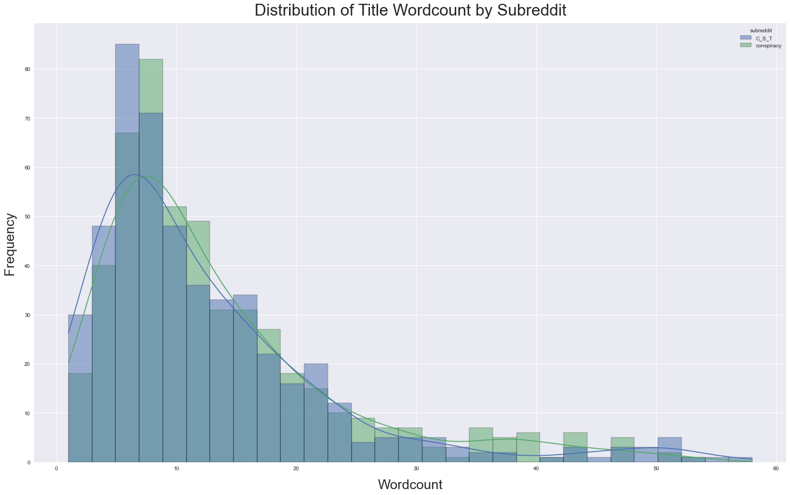
Exploratory Data Analysis Title Word Count
Notes:
Data is not normally distributed
Demonstrates Positive Skewness (Right Skewed)
https://www.statisticshowto.com/pearson-mode-skewness/

Slide 6
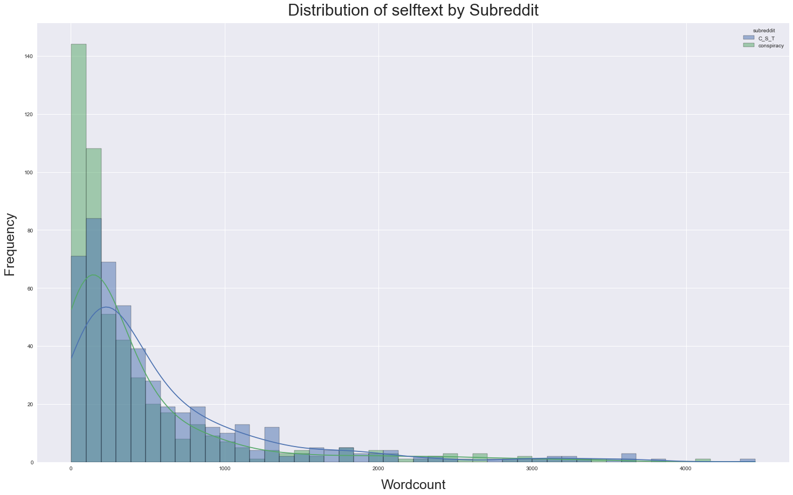
Exploratory Data Analysis SelfText Word Count
Notes:
Data is not normally distributed
Demonstrates Positive Skewness (Right Skewed)
https://www.statisticshowto.com/pearson-mode-skewness/

Slide 7
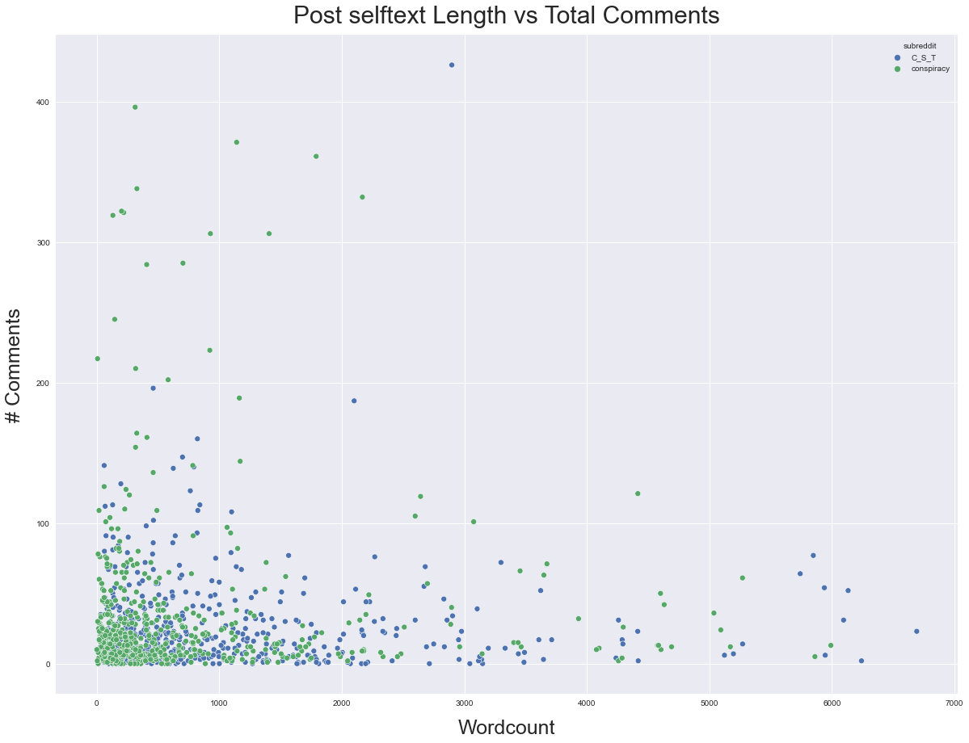
EDA Post Length vs. comments
Notes:
Clear Relationship between Living area and Sale Price
- Higher sqft homes not only tend to sell for more money, they also tend to be rated higher in terms of overall quality (shown by hue)

Slide 8
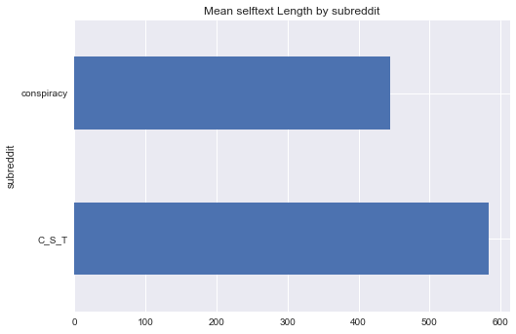
EDA avg Post Length

Slide 9
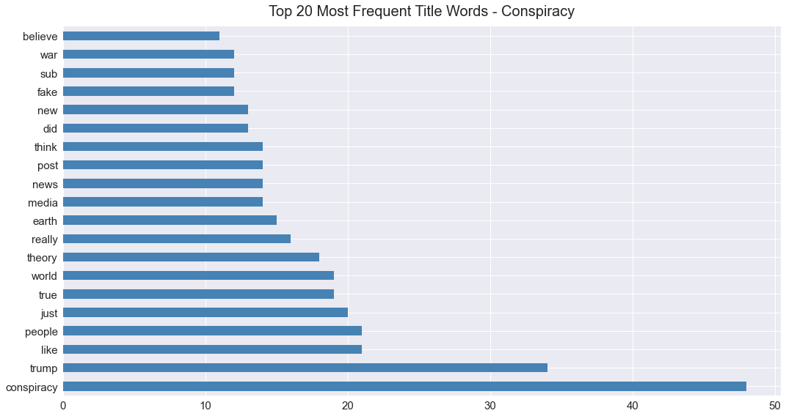
Conspiracy words

Slide 10
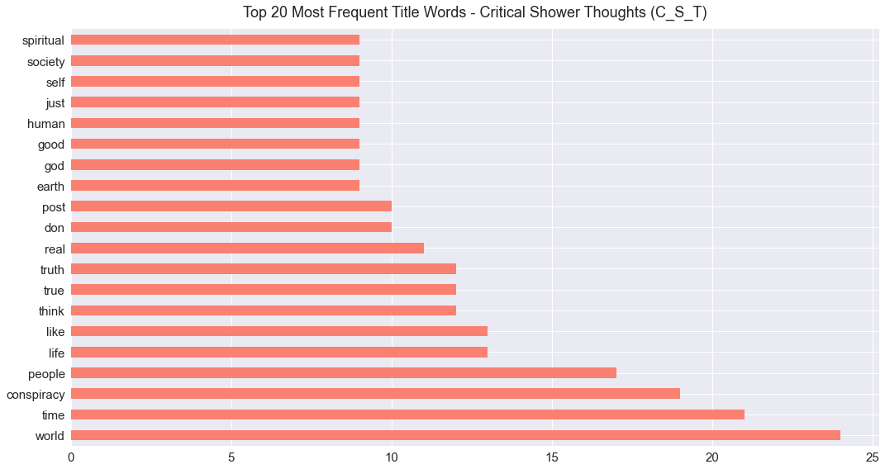
C_S_T Words

Slide 11
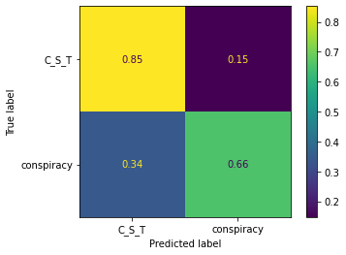
Model 1: Complement NB
CountVectorizer & Complement Naïve Bayes on selftext
0.94 Train / 0.76 Test
Balanced Accuracy Score: 0.76
**our baseline = 0.50
Notes:
True Neg: 0.85 (104)
False Pos: 0.15 (18)
False Neg: 0.34 (44)
True Pos = 0.66 (84

Slide 12
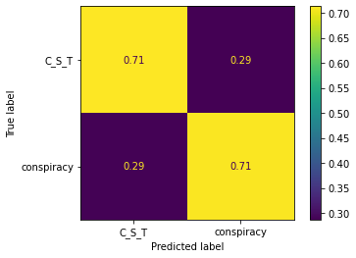
Logistic regression
Using TfidfVectorizer & Logistic Regression, the results were:
Best Params (max_iter=5_000, penalty='elasticnet', C=1.0, solver='saga', l1_ratio=0.65)
0.77 Train / 0.72 Test
Balanced Accuracy Score: 0.70
Notes:
True Neg: 0.71 (104)
False Pos: 0.29 (18)
False Neg: 0.0.29 (44)
True Pos = 0.71 (84

Slide 13
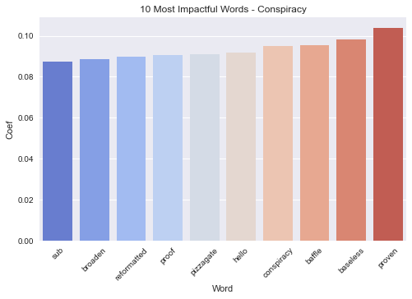
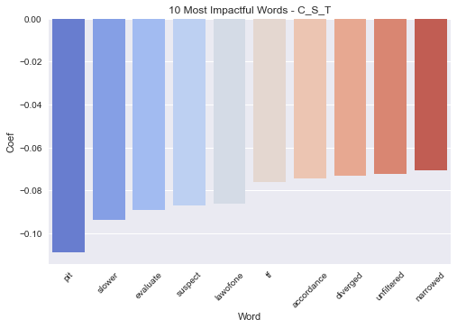
Notes:
Coefs are log odds since we did a logistic regression
So positive coefs increase the log odds of the test data being from Conspiracy, while negative coefs increase the log odds that the text is from Critical Shower Thoughts

Slide 14
Conclusions
Naïve Bayes Complement Wins!
With a slightly higher train/test, F1 & Baseline Accuracy scores
However, Logistic Regression might win out on an easier dataset. LR does typically have much more interpretable coefs
Next Time…
Combine variables like num_comments & score to see if they can increase the overall accuracy of the model.

Slide 15
Thank You For Listening
I’m happy to answer any questions
Kade Higgins

