Slide 1
PROJECT PPT
Elite Empressions
Presentation Highlights
Problem statement and abstract
Project plan and SRS
System analysis and design
Coding, testing, implementation
Future plans and conclusion
Printing Press E-Commerce & Order Management System
Prepared according to CAPOL601R01 Project Work & Viva Voce Guidelines
Submitted By – Himanshu Babu
React + Vite + Express + JWT + Passport + Order APIs
Course Code: CAPOL601R01
Programme: MCA – Semester 4
Register no: 24213110019
Candidate Mobile: 9559145724
Project Guide name: Dr. Vishnika Veni S
Guide Email id: vishnikaveni@cse.sastra.edu
Project Guide Mobile: 9952102224
Elite Empressions | Project Work Viva Voce Presentation

Slide 2
Introduction
Overview of the application and its purpose.
Project Overview
Why This Project Matters
Elite Empressions is a print-shop web application for browsing, customizing, and ordering print products.
The system combines customer ordering and admin-side order management in one connected workflow.
Products include visiting cards, flyers, packaging, T-shirts, mugs, invitations, stationery, and banners.
Traditional print ordering is often manual, fragmented, and slow.
Customers need preview, customization, pricing clarity, and smoother checkout.
Admins need one place to manage orders, files, statuses, and customer details.
Assignment 2 | Introduction and project context

Slide 3
Problem Statement
The current printing press workflow is inefficient for both customers and administrators.
Existing Gaps
Proposed Solution
Customers cannot always preview or personalize products before placing orders.
Design files, delivery details, and payment notes are often collected inconsistently.
Admins spend extra time tracking order status and production information manually.
A responsive storefront with guided product discovery and customization.
A unified cart and checkout flow for addresses, payments, and artwork uploads.
A secure admin dashboard to review, manage, and update the order lifecycle.
Assignment 2 | Problem definition

Slide 4
Abstract
Summary of the implemented application and its academic scope.
Abstract
Scope
The project delivers a web-based order management system for a printing press using React, Vite, and Express.
Customers can browse products, upload designs, manage cart items, save addresses, and place orders.
Admins can authenticate, view incoming orders, download uploads, and update order status.
The system demonstrates practical integration of frontend, backend, validation, persistence, and authentication modules.
Focuses on the core e-commerce workflow for a print service business.
Uses lightweight local storage and JSON-backed services for demonstration.
Designed so the current prototype can be extended into a production-ready solution later.
Assignment 1 | Project title and abstract

Slide 5
Software Project Plan
Development roadmap aligned to the review points in the guideline PDF.
Phase 1
Phase 2
Phase 3
Phase 4
1
2
3
4
Requirement study, project title, abstract, and problem analysis
UI routing, catalog, customization module, cart, and checkout
Order APIs, admin panel, auth flows, uploads, and persistence
Testing, debugging, documentation, and viva presentation
Review 1: analysis and planning | Review 2: design, coding, testing, implementation

Slide 6
Software Requirement Specification
Core functional and non-functional requirements of the application.
Functional Requirements
Non-Functional Requirements
Display product catalog with categories, images, prices, and detail pages.
Support customization preview, file upload, and order notes.
Maintain shared cart state with add, update, remove, and persistence.
Collect delivery details with address validation and city autocomplete.
Create orders and allow admin-side tracking and status updates.
Authenticate admins through email/password, OTP, and Google sign-in.
Responsive design for desktop and mobile.
Secure password hashing and JWT-based route protection.
Predictable cart and checkout behavior with real-time validation.
Reusable components and modular project structure.
Accessible labels, alt text, and professional visual design.
Fast local development and easy future scalability.
Assignment 2 | SRS

Slide 7
System Analysis
Use case view for customer ordering flow and admin order management.
Browse Products
Customize Product
Add to Cart
Customer
Admin
Place Order
Upload Design File
Track Status
Review Orders
Update Order Stage
Actors: Customer and Admin | Core artifacts: products, cart, orders, and uploaded files

Slide 8
Detailed Order Flow Diagram
Expanded customer-to-admin lifecycle for the Elite Empressions application.
Customer Journey
Diagram Highlights
Browse Products
→
Product Details
→
Customize and Upload
→
Cart and Checkout
The diagram traces the journey from browsing products to final operational order closure.
A clear handoff is shown between customer activity and admin-side processing.
The flow matches the implemented checkout, order API, and admin dashboard lifecycle.
↓
Create Order API
Admin Dashboard
Status Update
→
→
This makes the viva explanation more concrete than a generic use-case sketch.
The visual structure follows the real routing and processing behavior of the app.
Operations Journey
Expanded diagram view for viva explanation of complete order processing

Slide 9
Design - Front End
Representative interface structure based on the implemented React application.
Home
Products
Cart + Checkout
Admin
Hero banner
Product cards
Address form
Order table
Category grid
Detail routing
Payment options
Filters
Quick navigation
Add to cart feedback
Order summary
Status controls
React functional components, hooks, React Router, reusable UI cards, and shared context state

Slide 10
Design - Back End
Server architecture and data flow of the Express-based order management system.
Auth Routes
Controllers
users.json / orders.json
React Client
Order Routes
Services
Uploads Folder
The backend exposes REST APIs, validates payloads, stores development data locally, handles file uploads with Multer, and protects admin endpoints using JWT middleware.
Node.js + Express 5 + Passport Google OAuth + bcryptjs + Multer + Nodemailer

Slide 11
Detailed API and Architecture Diagram
Layered view of the frontend, API, service, and storage interactions.
Architecture Highlights
Frontend
API
Controllers
Services
Home
/api/auth
Auth
User Store
The layered architecture separates frontend screens, API routes, controller logic, and persistence services.
Auth and order concerns are split cleanly, improving maintainability and debugging clarity.
The diagram reflects the actual modules used in the Express backend and React frontend.
Products
/api/orders
Orders
Order Store
Customize
→
/api/admin
→
Validation
→
OTP Store
Cart
Uploads
Admin
↓
This structure is easy to explain in viva and maps directly to implemented files and routes.
It also shows readiness for later migration to a production database.
users.json
orders.json
uploads
Layered architecture slide for backend explanation in viva

Slide 12
Interface Design
Major customer and admin interfaces implemented in the project.
Customer Interfaces
Admin Interfaces
Home page with hero banner and category entry cards
Product list and detail pages with large images and gallery view
Customization page with upload preview and overlay support
Cart + checkout page with address book, payment, and order creation
Login and registration with email, mobile OTP, and Google options
Protected order dashboard with filters and metrics
Detailed order panel with line items, payment state, and file download
Status controls for New, Processing, Completed, and Cancelled orders
Assignment 3 | Interface design

Slide 13
Back End Design - Data Model
Logical structure of user, order, and OTP records.
User Record
Order Record
OTP Store
id
email
mobile
password (hashed)
provider
role
createdAt
orderId
customerName, phone, email
address fields
productName, quantity, price
uploadedFileURL
paymentStatus, orderStatus
lineItems, createdAt
mobile
otp
expiresAt
request throttle
temporary memory storage
Current implementation uses local persistence and is ready for future database migration

Slide 14
Sample Code - Cart State Management
Focused code snippet slide for the centralized cart logic used across listing, detail, and cart pages.
Centralized Context API plus reducer removed duplicate cart logic across pages.
Quantity changes are deterministic and always happen by plus or minus one.
localStorage persistence keeps the cart intact after refresh.
This solved the earlier inconsistent add-to-cart behavior.
Reducer-based cart flow
function addToCart(product) { if (item exists) { quantity = quantity + 1; } else { quantity = 1; } } function updateQuantity(id, action) { if (action === 'increment') quantity += 1; if (action === 'decrement' && quantity === 1) remove item; else quantity -= 1; }
Assignment 3 | Code snippet focused on reliable cart behavior

Slide 15
Sample Code - Authentication and OTP
Focused code snippet slide for email login, mobile OTP, and backend verification flow.
Backend OTP handlers
Frontend detection flow
POST /auth/send-otp validate mobile otp = random 6 digits saveOtpForMobile(mobile, otp) sendOtpSms(mobile, otp) POST /auth/verify-otp verifyOtpForMobile(mobile, otp) find or create user issue JWT token
if (identifier includes '@') { loginType = 'email'; show password field; } else if (identifier is numeric) { loginType = 'mobile'; show OTP flow; } Google button -> /api/auth/google
Assignment 3 | Code snippets for authentication logic

Slide 16
Sample Code - Order Processing
Focused code snippet slide for the checkout-to-order backend flow and status lifecycle.
Order lifecycle used in admin panel: New -> Processing -> Completed or Cancelled.
Uploaded PDF, PNG, and JPG files are linked with the order for admin access.
Payment status is derived from selected payment method during checkout.
This code connects customer checkout directly to business operations.
POST /api/orders
parse lineItems validate customer + address + payment calculate quantity and total price set paymentStatus = Pending or Paid create uploadedFileURL create order record send admin notification return created order
Assignment 3 | Code snippet focused on order creation and status management

Slide 17
Testing
Validation and debugging coverage considered during development.
Testing Types
Debugging Highlights
Unit testing of address validation, OTP payload checks, and cart quantity logic
Integration testing of checkout to order API, admin fetch, and order status updates
Form validation for name, phone, email, pincode, and file uploads
Fixed inconsistent cart state and quantity increments across pages
Resolved address persistence issues after delete and refresh
Corrected Google OAuth and OTP route wiring and stale-server conflicts
Assignment 3 | Testing and validation

Slide 18
Implementation, Problems Faced, and Lessons Learnt
Key outcomes and learnings collected during development.
Implementation Outcome
Problems and Lessons
Built a working storefront with shared cart, checkout, and order placement flow
Integrated backend APIs for order creation, uploads, authentication, and admin management
Delivered a modular project structure with reusable components and maintainable logic
State must be centralized to prevent duplicate cart logic and inconsistent behavior
Clear server logs and route verification reduce time spent debugging auth issues
Validation and persistence logic are as important as the visible UI in e-commerce flows
Assignment 3 | Implementation review

Slide 19
Future Plans
Enhancements planned beyond the current implemented scope.
Enhancement Areas
Expected Benefits
Migrate local JSON stores to MongoDB or PostgreSQL
Integrate Razorpay or Stripe for real payments
Add advanced design editor tools and saved templates
Introduce analytics, invoice generation, and dispatch integration
Better scalability and production readiness
Improved customer trust with secure online payments
Stronger personalization and conversion rates
More efficient day-to-day operations for the print business
Assignment 3 | Future plans

Slide 20
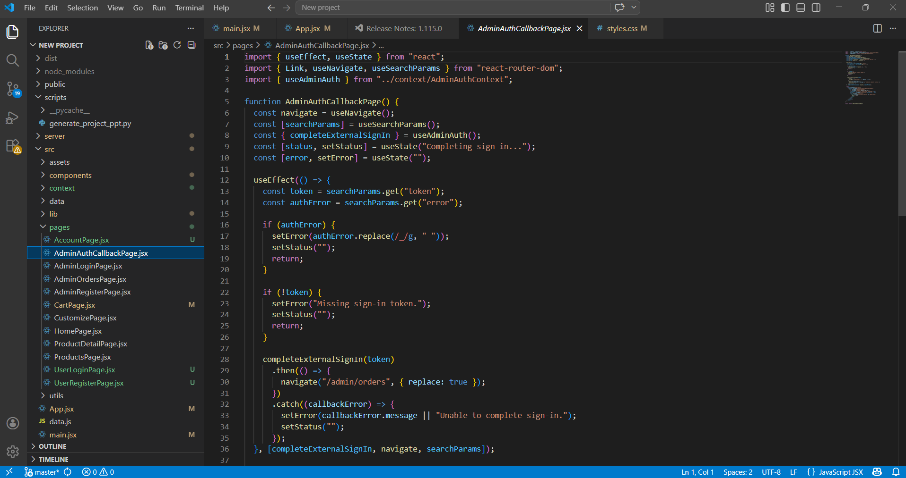
Code Snippets

Slide 21
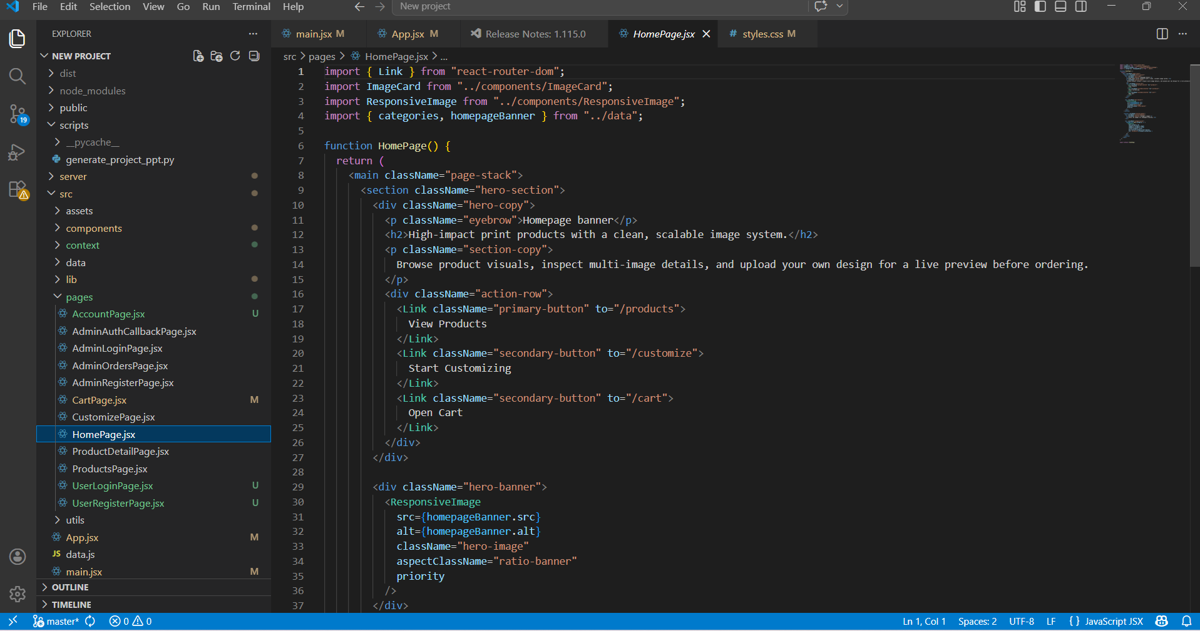
Code Snippets

Slide 22
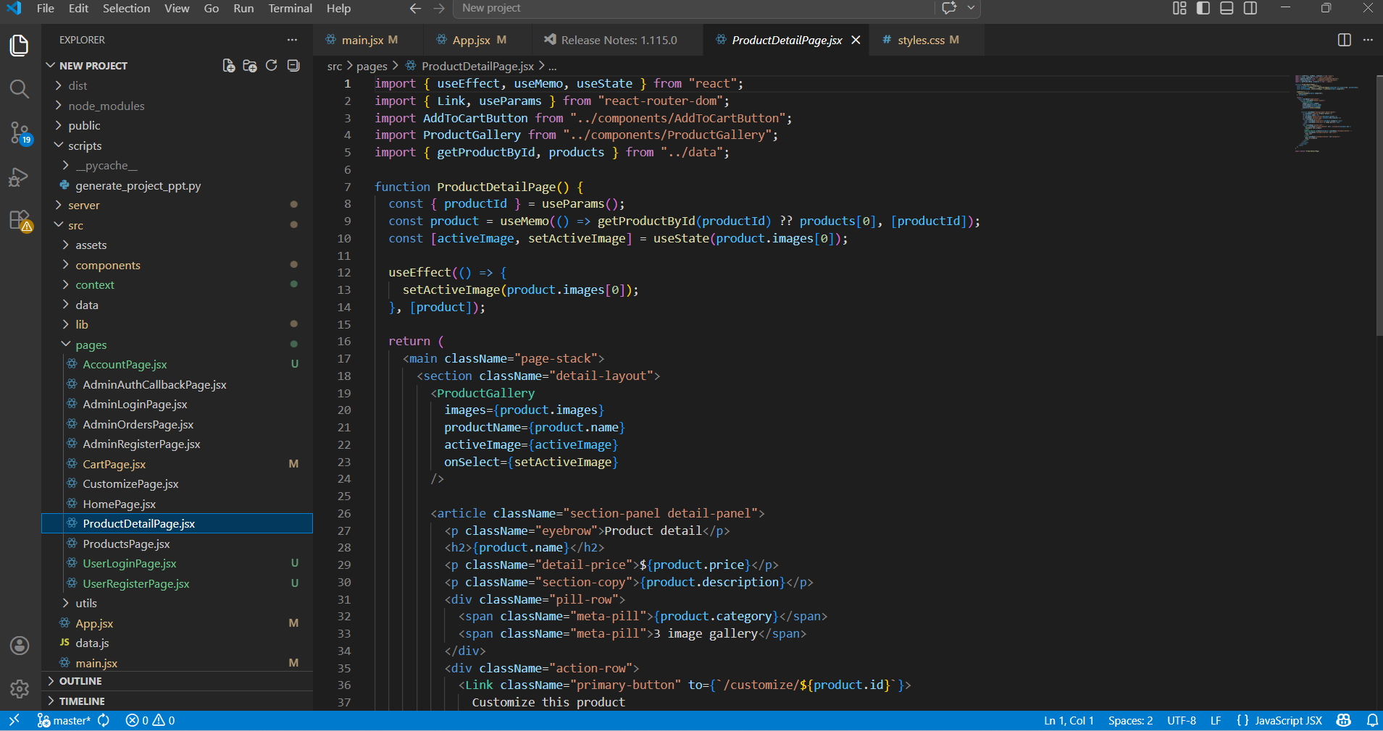
Code Snippets

Slide 23
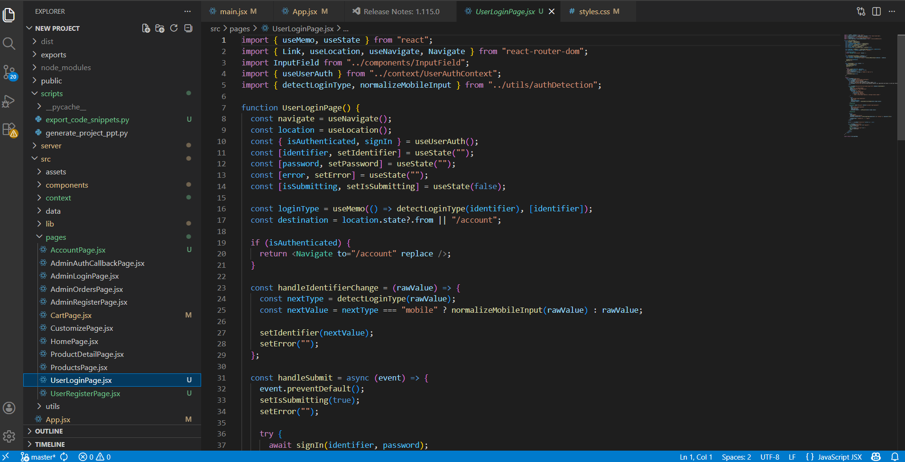
Code Snippets

Slide 24
Conclusion
References
Elite Empressions demonstrates a complete digital workflow for a modern printing press: product discovery, customization, cart and checkout, order creation, file handling, and admin-side order tracking.
CAPOL601R01 Project Work & Viva Voce Guidelines PDF
Elite Empressions source code and application modules
React, Vite, Express, Passport, and JWT documentation
The project satisfies the guideline structure for analysis, design, coding, testing, implementation, future scope, and final presentation.
Thank you
Prepared for project work viva voce review

