Slide 1

Anti–Money Laundering and Transaction Monitoring
Case Study: Kim & Lee
Khin Chan Thar

Slide 2












Understanding Anti-Money Laundering (AML)
Step 1. Placement
Step 2. Layering
Step 3. Integration
Collection of Dirty Money
Dirty Money is introduced into the economy via bank deposits. Smaller deposits below the threshold levels are made to subvert reporting.
Bank deposits pass through multiple domestic and off-shore transactions, making it cumbersome for the authorities to follow the audit trail.
The laundered criminal proceeds get legitimate originals and are integrated into banks and financial institutions as clean money ready for use.
AML refers to set of laws, regulations, and procedures designed to prevent criminals from disguising illegally obtained funds as legitimate income.
Financial institutes use Know Your Customer (KYC) and Customer Due Diligence (CDD) to verify identities and monitor activity, reporting potential suspicious transactions to authorities.

Slide 3
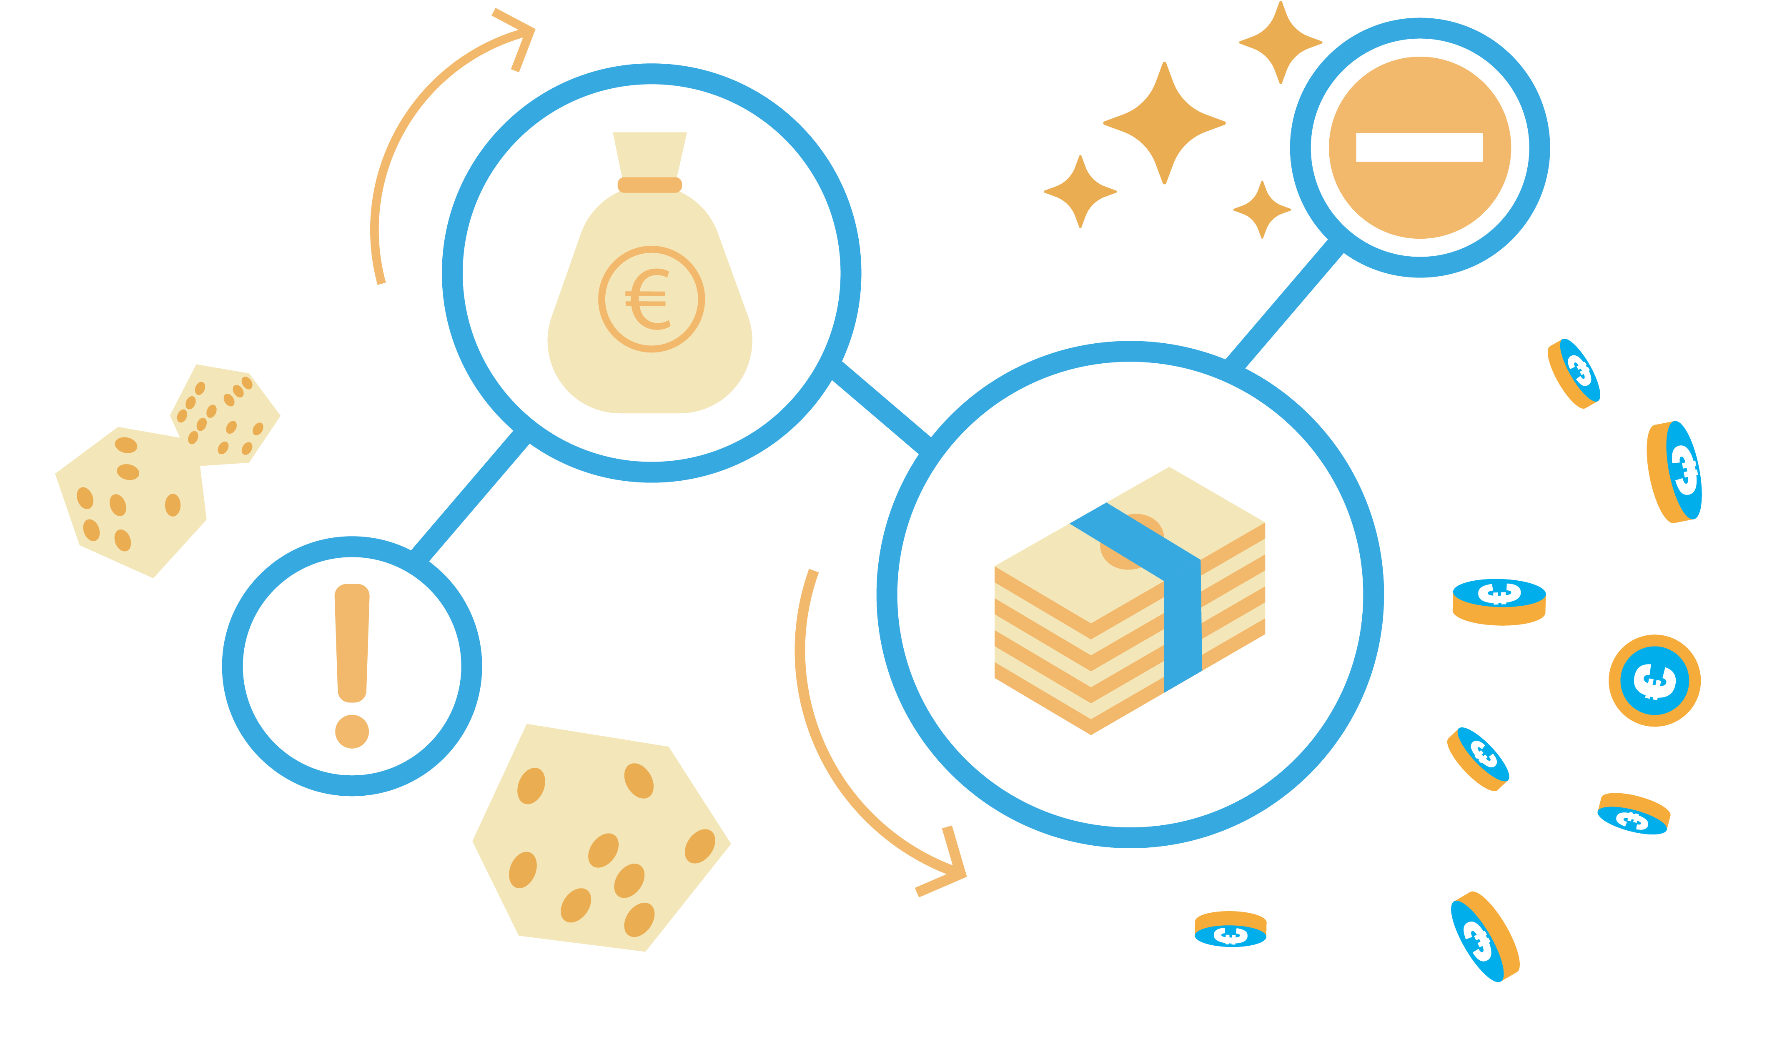
How Transaction Monitoring Works
Transaction monitoring is based on a risk-based approach which uses a series of interconnected methods to detect suspicions financial activity and ensure compliance.
Core functions:
1. Data Collection and Integration
4. Pattern detection and analysis
Gather transaction data that contains key transactions from banking systems, payment processors and outside service providers.
The system is used to identify odd or abnormal behavior like high activity or sizable client withdraws that deviate from the customer’s typical transaction patterns or behavior.
7. Suspicious activity Reporting
2. Transaction screening
5. Alert generation
The appropriate regulatory bodies get a Suspicious Activity Report or Suspicious Transaction Report if a transaction is verified to be suspicious. This report contains comprehensive details based on the investigation.
Each transaction is screened against predefined rules, risk criteria and external watchlists.
The system generates an alert and sends to investigators for further investigation when a transaction is flagged as suspicious which is either due to anomalies or specific transaction monitoring rules.
3. Risk-based scoring
Each transaction is assigned a risk score based on the factors like customer risk profiles and transaction history. This prioritizes transactions that need a closer investigation which ensures that high-risk transactions are flagged for review.
8. Continuous monitoring and improvement
6. Investigation and Case Management
Feedback loops and continuous monitoring make sure that the system adjusts to new threats. Conduct periodic audits of procedures and systems to refine detection and to ensure to meet regulatory standards .
The investigative team reviews the alerted transaction by gathering more information like account history and parties involved.

Slide 4
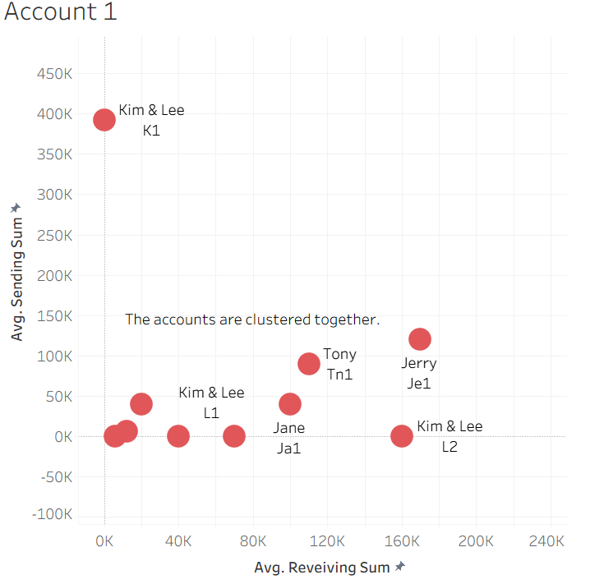
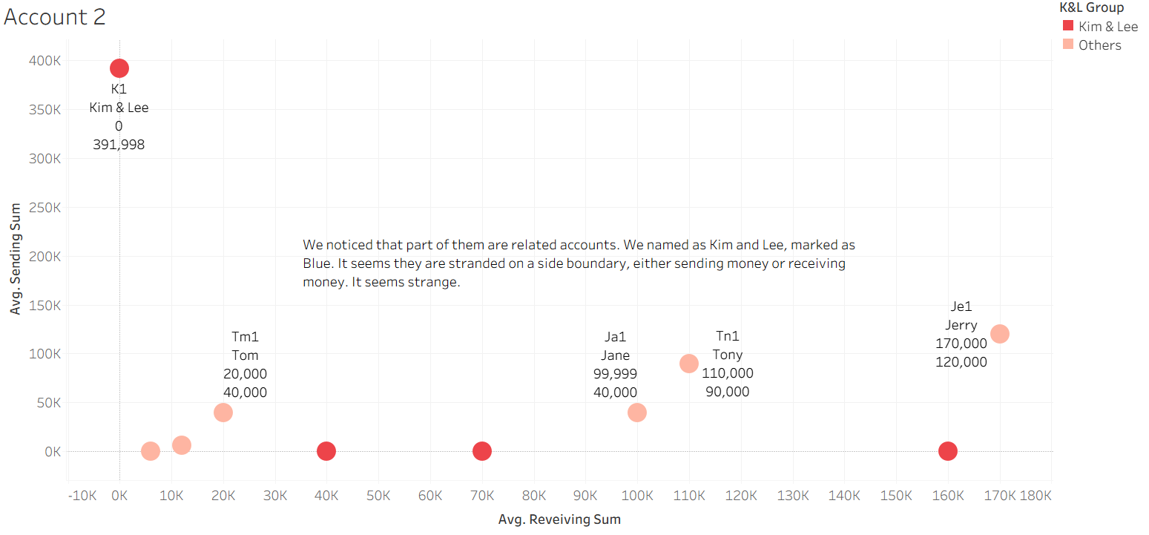
Investigating Kim & Lee’s Transaction Network
Red

Slide 5
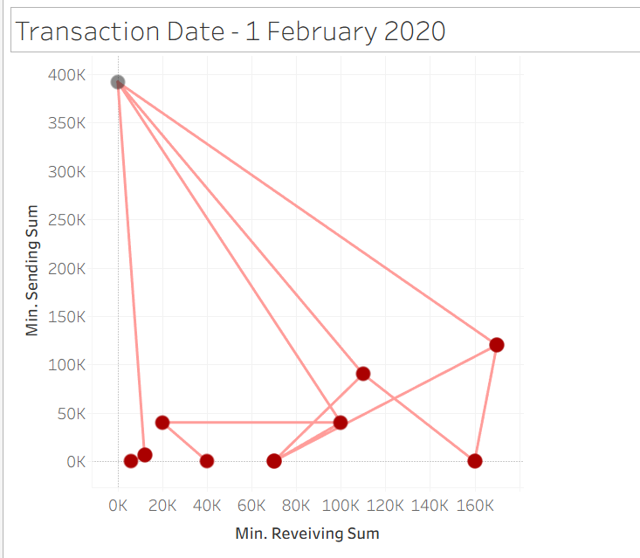
Total Funds Sent and Received
Kim & Lee
Notes:
Anti-Money Laundering (AML) checks use averages (means or moving averages) to establish a stable and representative baseline of a customer's normal financial behavior, which then allows for the detection of deviations or anomalies. Using sums alone would be less effective for several reasons:

Slide 6
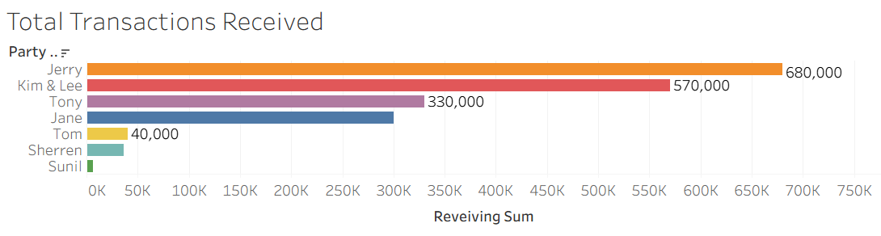
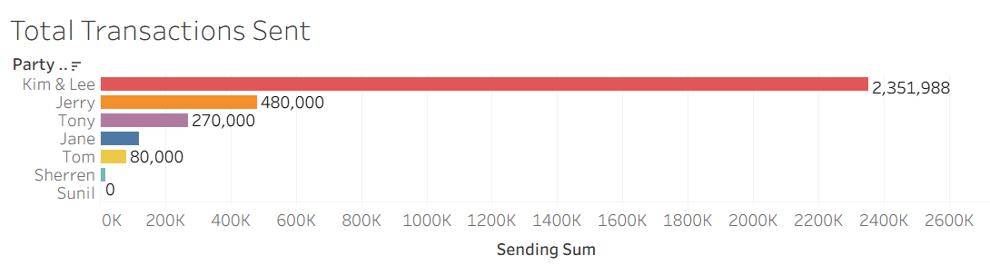
Total Amount Send & Received

Slide 7
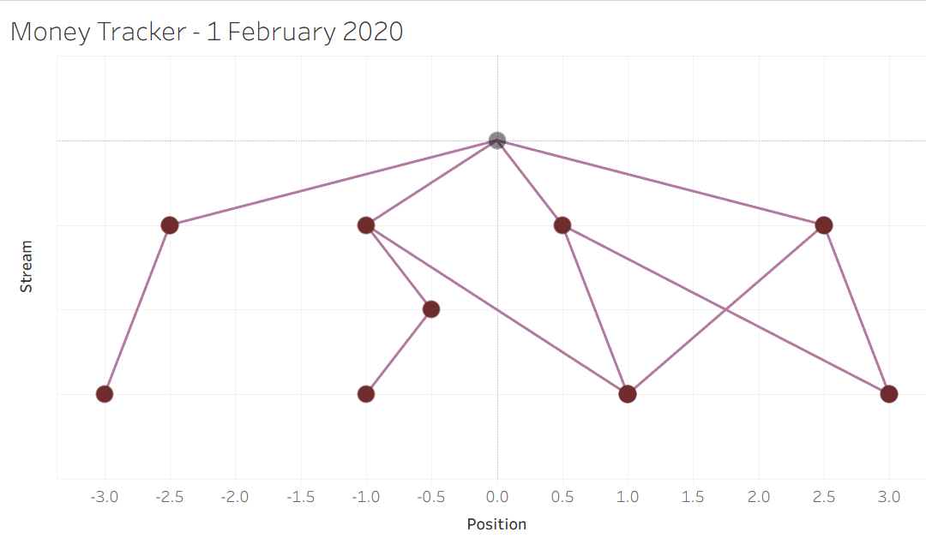
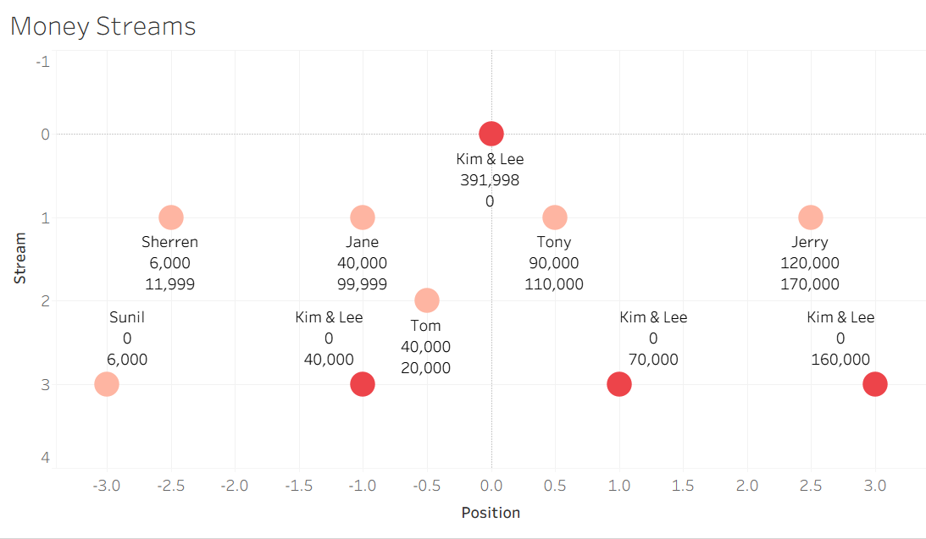
Money Flow
Kim & Lee
Jane
Tony
Jerry
Sherren
Tom
Sunil
Kim & Lee
Kim & Lee
Kim & Lee

Slide 8
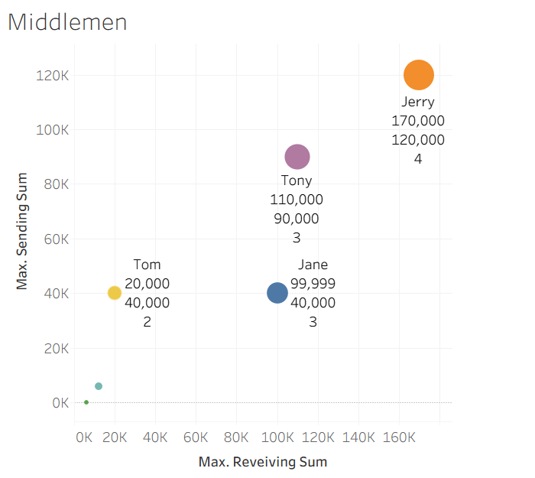
Identifying the Middlemen
Jerry is the middleman who handled the highest total, followed by Tony and Jane.
Party Name | Transaction Count
Jerry | 4
Tony | 3
Jane | 3
Tom | 2
Sherren | 3
Sunil | 1

Slide 9

Thank You

