Slide 1
Navigating Volatility: Portfolio Hedging with Nvidia and QQQ
By: Khin Chan Thar

Slide 2
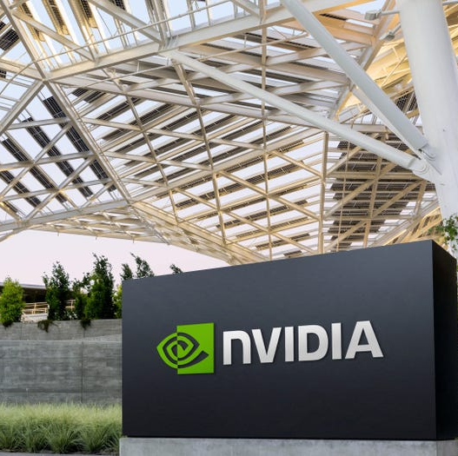
Nvidia (NVDA)
Leading semiconductor company driving AI and graphics innovation
World leader in GPUs for gaming, data centres, and AI workloads.
Expanding into AI chips, autonomous driving and cloud computing.
NVDA has become the backbone of the AI bloom, with its chips powering large language models (LLMs) and generative AI platforms
High Growth potential but also volatile, often trading at premium valuations due to AI demand.
Notes:
Our primary asset is Nvidia. As we know, Nvidia has become the backbone of the AI boom, with its chips powering Large Language Models and generative AI platforms. It is the world leader in GPUs for gaming and data centers. While it offers high growth potential, it often trades at premium valuations and is highly volatile due to fluctuating AI demand."

Slide 3

Invesco QQQ Trust (QQQ)
The Nasdaq-100 Index, which includes the 100 largest non-financial companies listed on Nasdaq.
Heavy exposure to tech giants like Apple, Microsoft, Amazon and Nvidia
QQQ is often used as a proxy for the US tech sector performance, making it a popular choice for growth-oriented investors
Provides diversification within tech, but is still concentrated in high-beta stocks, meaning it can swing sharply with market sentiment.
Notes:
"To hedge this volatility, I selected the Invesco QQQ Trust. This ETF tracks the Nasdaq-100 and serves as a proxy for the US tech sector. It provides diversification with exposure to giants like Apple and Microsoft. However, it is important to note that QQQ is still concentrated in high-beta stocks, meaning it can swing sharply with market sentiment."

Slide 4
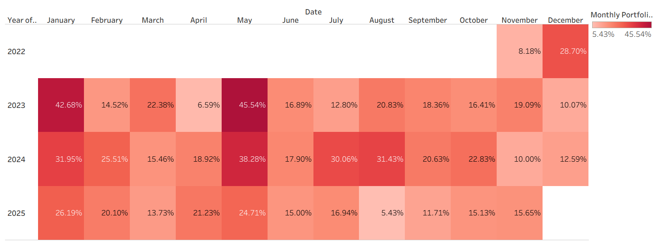
Monthly Return Heatmap
In May 2023, NVIDIA made several major announcements related to generative AI, data center products, and strategic partnerships, highlighted by the release of its blockbuster first-quarter fiscal 2024
Peak months are Jan (42.66%), May (45.54%)
Strong starts in 2023 (42.68%) and 2024 (31.96%) — could reflect new capital inflows or strategic positioning
May is exceptionally strong across all years, which may indicate an opportunity or favourable market cycle.
2024 most consistent high returns, possibly due to favourable macro or effective hedging
Notes:
the historical behavior of the portfolio
Looking at this heatmap, we see distinct seasonal trends. The peak months for returns are historically January and May. For example, May 2023 was exceptionally strong , driven by Nvidia’s major announcements regarding generative AI and data center products. Conversely, 2024 has shown the most consistent high returns so far, likely due to favorable macro conditions."
Q1 spikes from Jan to Mar suggest early-early year momentum is a recurring opportunity The heatmap supports your recommendation — dynamic hedging likely activated during flat periods to preserve capital.

Slide 5
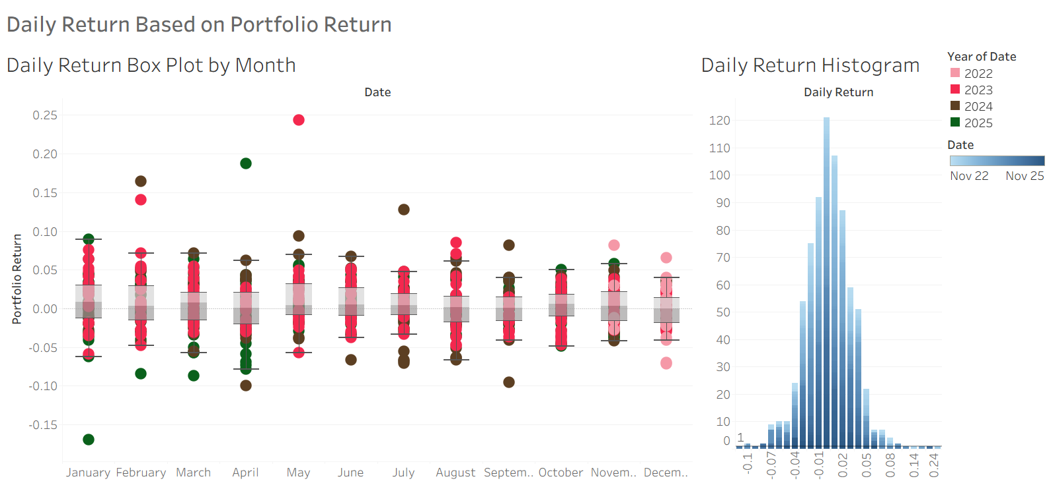
Jan is widespread with return, high variability
May consistently show strong performance with dense clusters of high positive returns
June narrower spread lower median show weaker monthly returns
Centered around zero between -0.02 and +0.02, indicating it’s a normal distribution
A peak near zero means that it experiences small daily changes
May is a consistent outperformer across both monthly and daily views
June shows lower volatility and weaker returns
Daily return distribution is stable, but outliers in March, April, and November warrant deeper investigation
2025 shows a tighter clustering, hinting at a more risk-managed or conservative strategy.
Notes:
Left tail returns are as low as -0.17, indicating downside risk
Right tail returns are up +0.17 fewer but notable which means high monthly spikes like may 2023

Slide 6
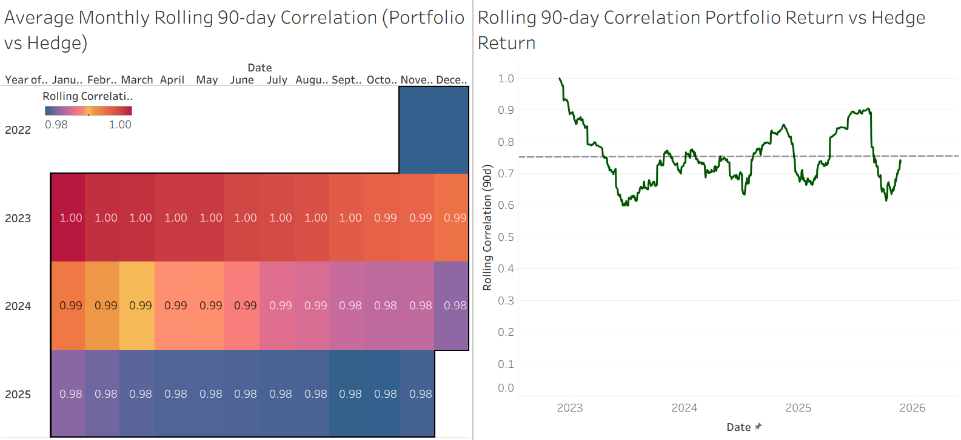
Correlation oscillates between 0.6 and 1.0, with most values clustering above 0.9.
2022 slightly lower correlation in Jan-Jun suggesting mild divergence early on
2023-2026 shows uniformly high correlation
While the average is high, the line dips below 0.9 multiple times, indicating temporary decoupling
Correlation oscillates between 0.6 and 1, with most values clustering above 0.9
Rolling 90-day correlation fluctuates between approximately 0.65 and 1.00 over the past three years.
Use static hedging when the regime is stable and correlation is reliably high.
Switch to dynamic hedging if dashboard and rolling beta indicate regime drift, lower correlation, or increased market shocks.
Monitor sustained deviation from the average correlation closely; long downward trends call for a reevaluation of hedge instrument selection.

Slide 7
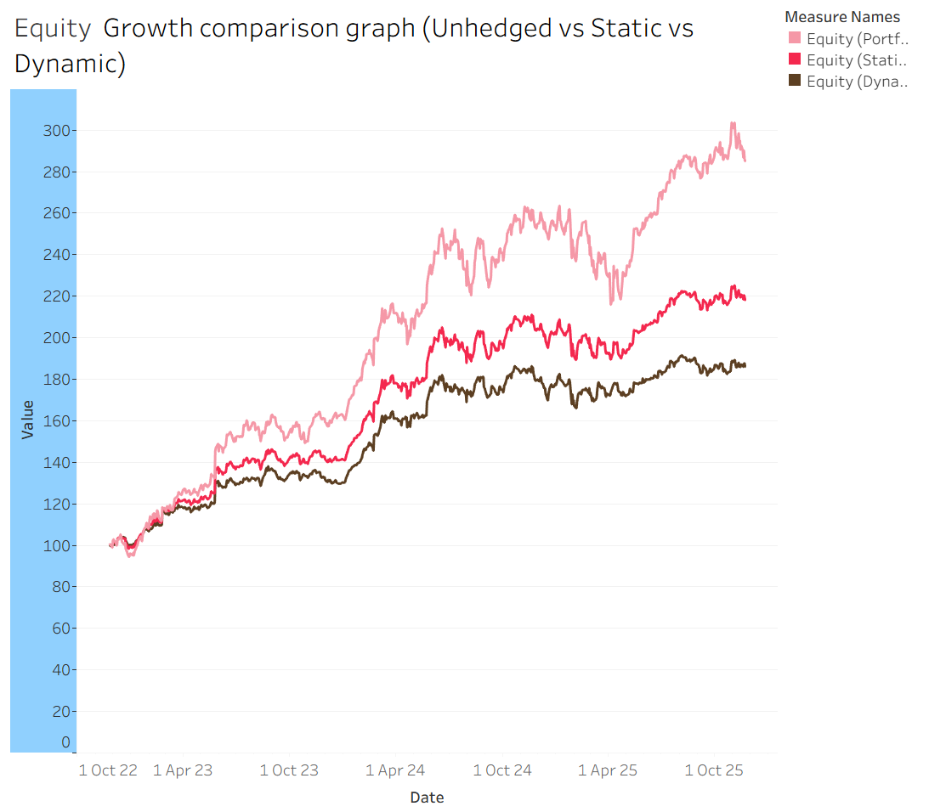
Unhedged vs Static Hedge: ~75-point gap.
Unhedged vs Dynamic Hedge: ~100-point gap.
Static vs Dynamic Hedge: ~25-point gap.
Unhedged strategy leads in performance but may suffer in downturns. Dynamic hedge trails but likely cushions drawdowns.
Static Hedge as a balanced option delivers moderate growth with some protection, ideal for medium-risk
In bullish conditions, hedged strategies usually underperform, so their value emerges during volatility or correlations.

Slide 8
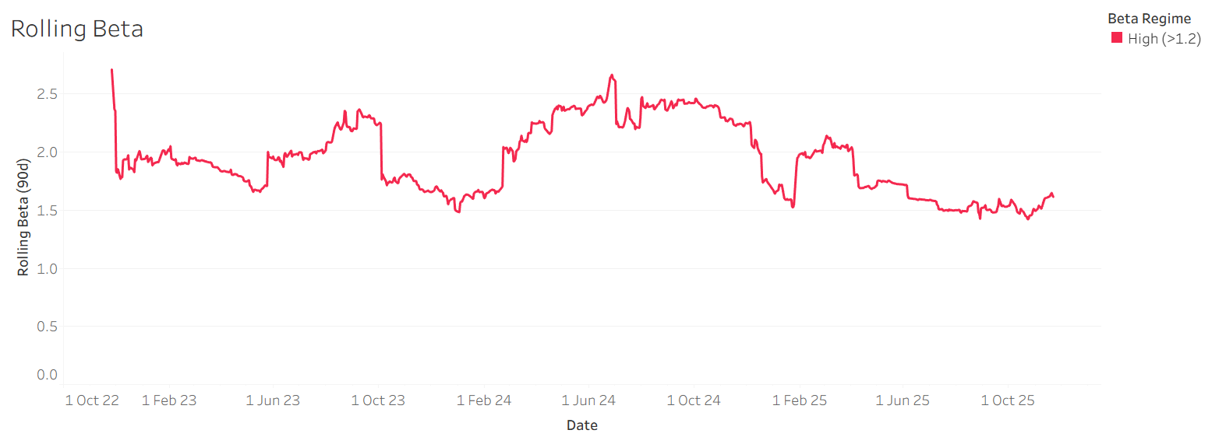
Beta oscillates between 0.6 and 2.5, showing a significant shift in portfolio behaviour.
Most of the graph lies in the high beta zone, shaded red, which indicates elevated market sensitivity.
Peaks above 2.0 show periods of aggressive exposure or amplified volatility.
High beta periods require tighter risk controls or hedging to avoid drawdowns
Can consider dynamic hedging to modulate beta exposure based on market signals
Drops in beta suggest periods where Nvidia starts decoupling or stabilizing relative to QQQ, making static hedging less efficient and dynamic hedging optimal.

Slide 9
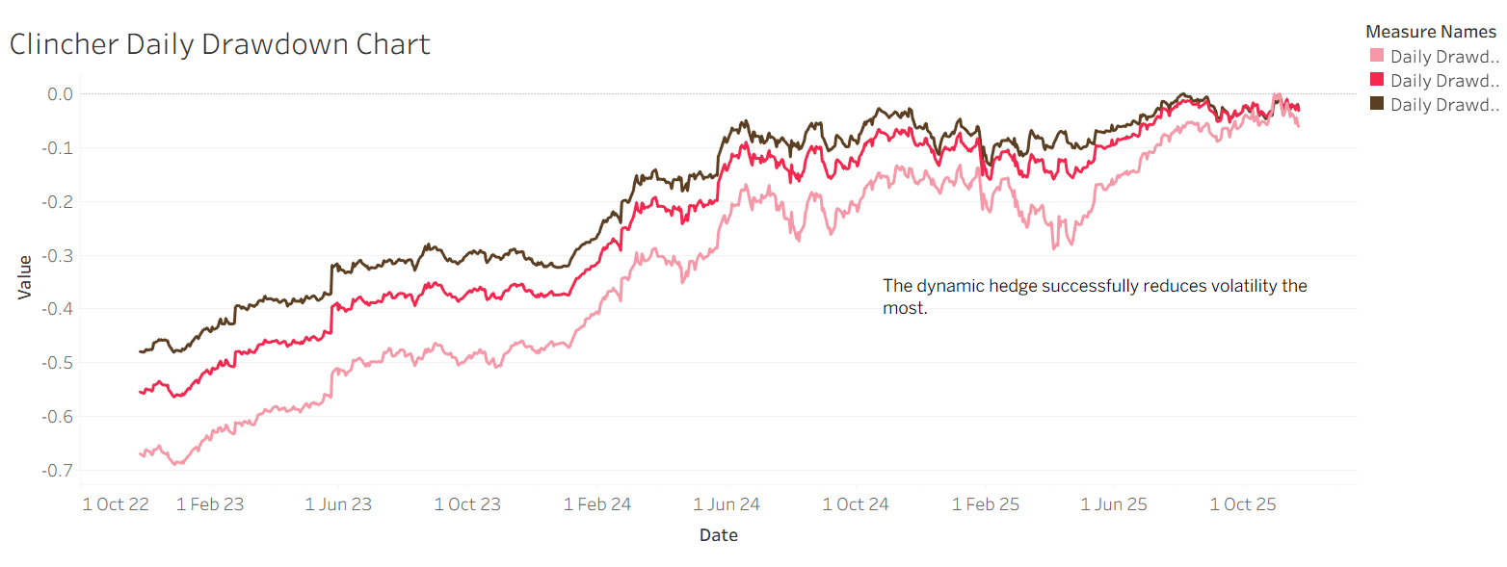
Dynamic hedge wins on volatility control for capital preservation
Static hedge offers the middle ground, which is better than no hedge but less responsive than dynamic strategies
Unhedged strategy carries the highest risk. Suitable only when aggressive growth outweighs drawdown concerns.

Slide 10
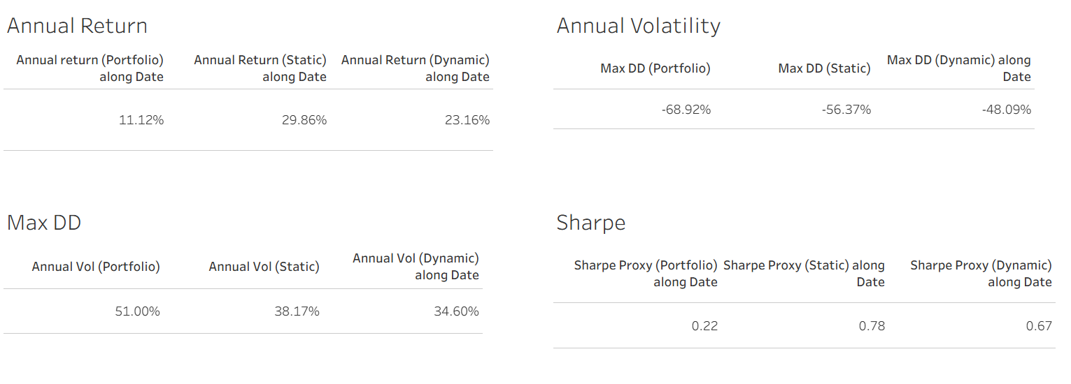
KPI
Notes:
Static Hedge leads in return and Sharpe, offering the best risk-adjusted performance.
Dynamic Hedge minimizes drawdown and volatility, making it the most defensive.
Portfolio (Unhedged) has the lowest Sharpe and highest risk — suitable only for aggressive strategies.

Slide 11
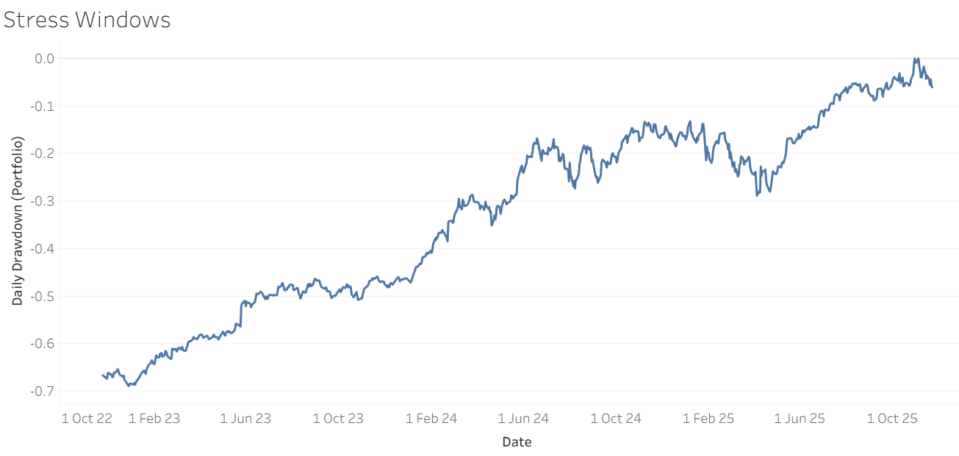
Gradual upward movement toward 0, with intermittent volatility.
Several dips suggest recurring stress windows, though none as deep as the initial drawdown.
Approaches 0, indicating full recovery or new equity highs. Portfolio resilience improves over time due to favourable market conditions

Slide 12
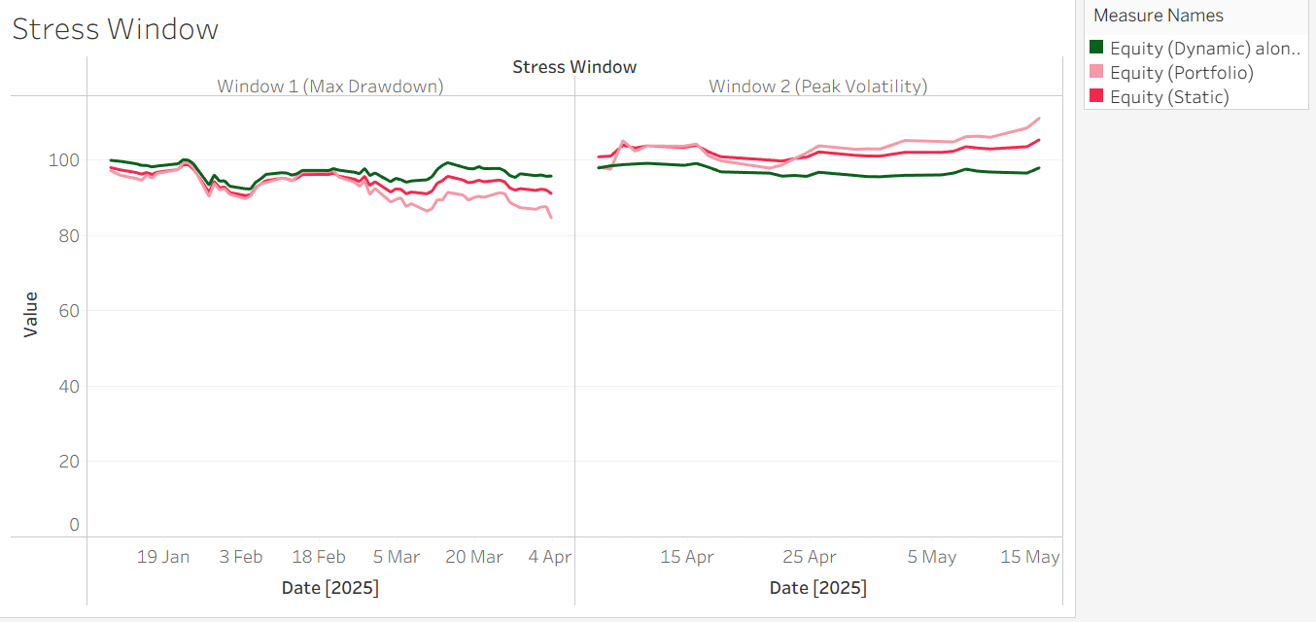
Portfolio is the most volatile, sharpest decline in value
Static Hedge is moderately cushioned but still reactive to market stress
Dynamic hedge is the least affected which shows resilience and quicker stabilization
Portfolio shows erratic movements, sensitive to the market
Static Hedge shoes smoother trajectory but still reactive
Dynamic hedge is most stable, with minimal fluctuations
Dynamic hedge excels in both stress regimes
Static hedge offers partial defense but lacks adaptability
Unhedged strategy is highly exposed, which is only suitable for aggressive risk-tolerant strategies.

Slide 13
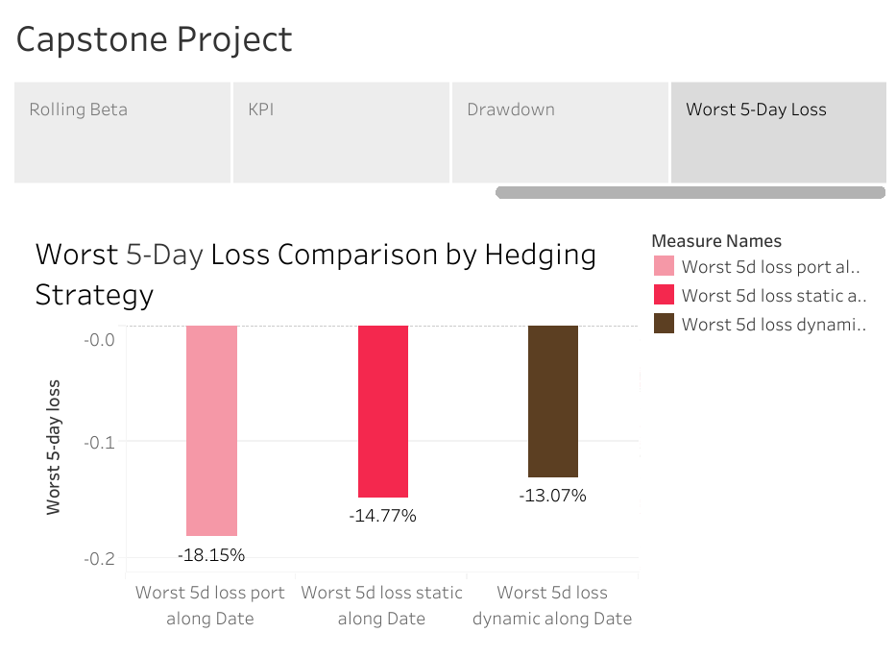
Dynamic hedge is the most protective during peak short-term loss by over 5 per cent compared to unhedged
Static Hedge offers moderate defence, but still trails behind in stress resilience
Unhedged portfolio is highly vulnerable in these situations, with the steepest loss

Slide 14
Recommendations
Statistic Hedge is optimal for investors seeking a balance between return and risk (e.g., Pension Funds, Endowments).
Dynamic Hedge is preferable for risk-averse investors or during high-beta regimes where capital preservation is the absolute priority (e.g., funds near distribution, highly leveraged portfolios).
Use dynamic hedging when there is macro uncertainty or increased beta (over 1.2), as determined by the Rolling Beta dashboard.
Use beta dashboards and rolling correlation to track hedge performance in real time and serve as a regime change warning system.
When the 90-day correlation is low or unstable, think about layering techniques like protective puts, as this provides better protection against the quick and abrupt shocks that rolling beta strategies frequently miss.
Notes:
For Balanced Investors (e.g., Pension Funds): The Static Hedge is optimal. It balances return and risk effectively.
For Risk-Averse Investors: The Dynamic Hedge is preferable. It is the best choice when capital preservation is the absolute priority, such as for funds near distribution.
Implementation: I recommend using the Rolling Beta dashboard (specifically when beta exceeds 1.2) to trigger dynamic hedging. Furthermore, if the 90-day correlation dips significantly, we should consider layering in protective puts to guard against shocks that beta strategies might miss.

Slide 15
Thank You

