Slide 1

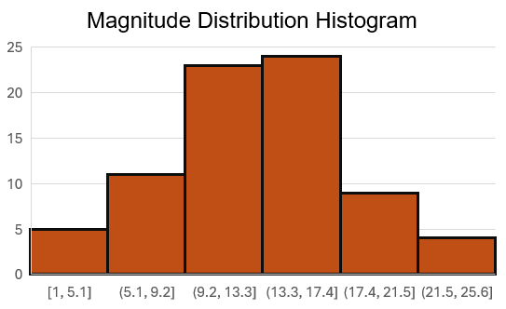

Myanmar earthquake tracker
Location:
Magnitude:
Depth:
Time:
Summary stats
Total earthquakes since March 1, 2025: 30
Strongest earthquake date: March 31, 2025
Average magnitude: 5.3
Number of cities impacted:
Notes:
Questions:
How do I calculate the average magnitude? Rolling average?

