Slide 1

UNIVERSITY OF COMPUTER SUTDIES, PATHEIN
Presented Report on
Blood Bank System
Group( 5 )
February,2023
Supervised:
Dr. Myat Thiri Khaing & Daw Yu Yu Khaing

Slide 2

WELCOME TO OUR BLOOD BANK

Slide 3

WELCOME TO OUR BLOOD BANK

Slide 4

Presented By
Ma Su Myat Thiri VCS-2
Ma May Thandar Htun(leader) VCS-9
Ma Kyi Phyu Oo VCS-14

Slide 5

Project Contents
Introduction
Objectives
System Specifications
Entity Relationship Diagram
Use Case Diagram
UML Class Diagram
Level 0 Diagram
Create and Call Stored Procedure
Using Trigger
Technologies
Conclusion
References

Slide 6

BLOOD BANK SYSTEM
INTRODUCTION
Our blood bank system is a web-based platform that streamlines and optimizes the entire blood donation cycle, providing a reliable and secure online platform for managing the process.
Our blood bank system has a user-friendly interface and advanced features.
It represents a significant step forward in the field of blood management and has the potential to make a real difference in the lives of those in need.

Slide 7

OBJECTIVES
To streamline blood donation process through online accessibility
To increase donor awareness through online campaigns and outreach
To secure the security of sensitive information related to blood donation and transition

Slide 8

SYSTEM SPECIFICATION
Software requirements
Operation System-Microsoft Window 11
Require Software-Vs code or Sublime text
Hardware requirements
Processor -Intel(R) Core(TM) i7-10510U CPU @ 1.80GHz 2.30 GHz
RAM -8GB
Hard disk -Support 1000GB

Slide 9

TECHNOLOGIES
HTML(Hyper Text Markup Language)
CSS (Cascading Style Sheets)
JavaScript
PHP
Web server: XAMPP

Slide 10
Entity Relationship Diagram
blood_type
Total
Blood
donor_name
donor_id
view
email
username
password
receive_id
request
Admin
receiver_name
donor_blood
Donor
Receiver
email
manage
donor_about
receiver_blood
donation_date
Donate Blood
Search Blood
Blood Bank
receiver_about
blood_id
donor_id
blood_type
receiver_id

Slide 11
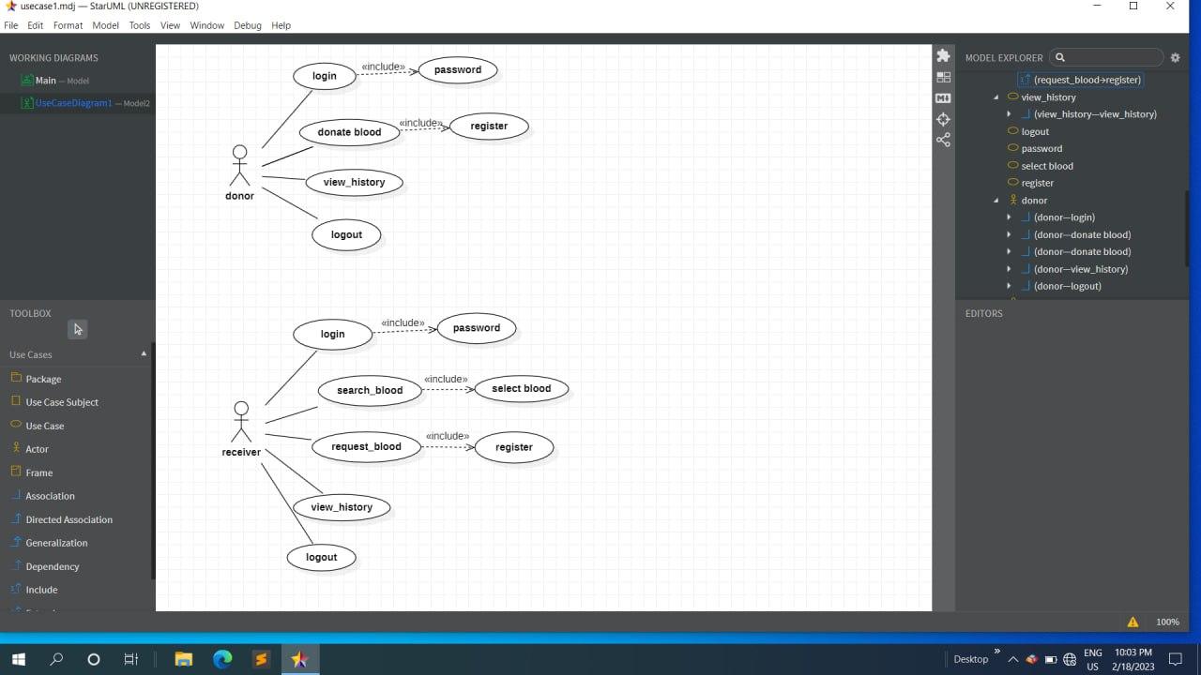
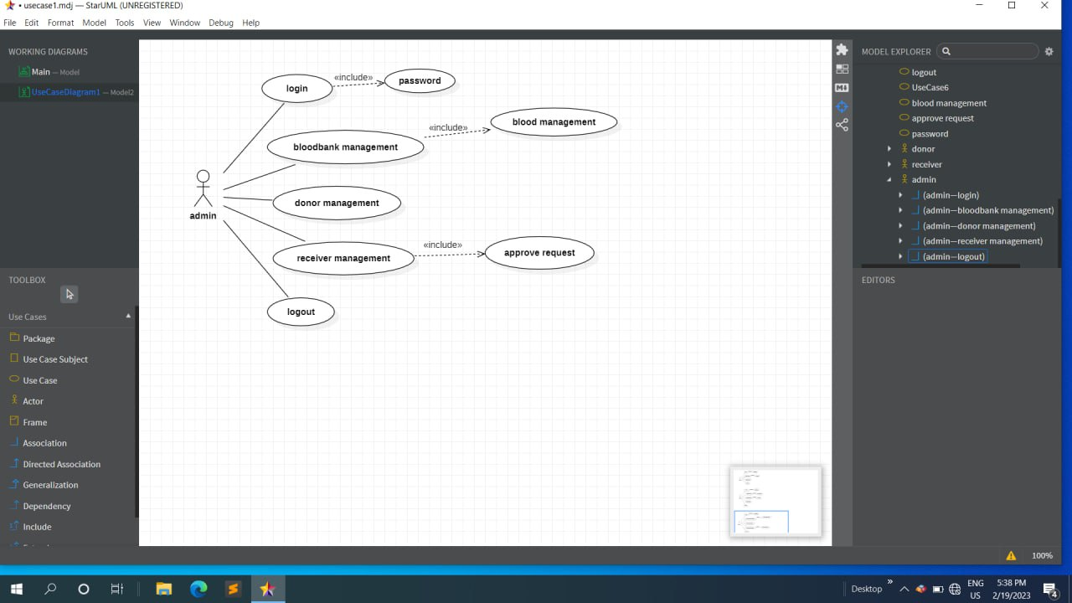
Use Case Diagram

Slide 12
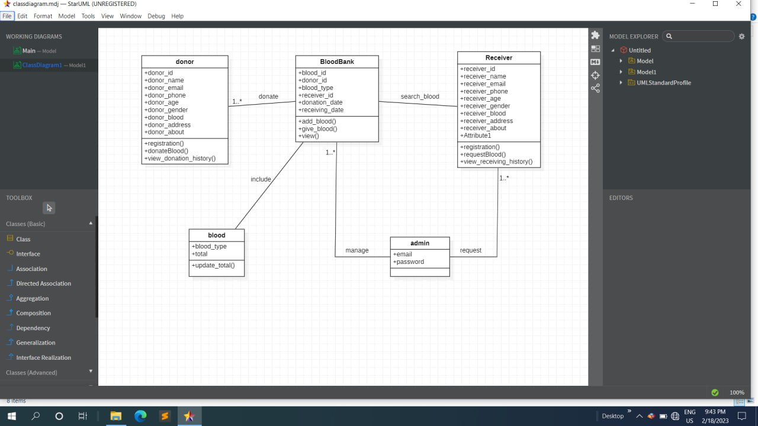
UML Class Diagram

Slide 13
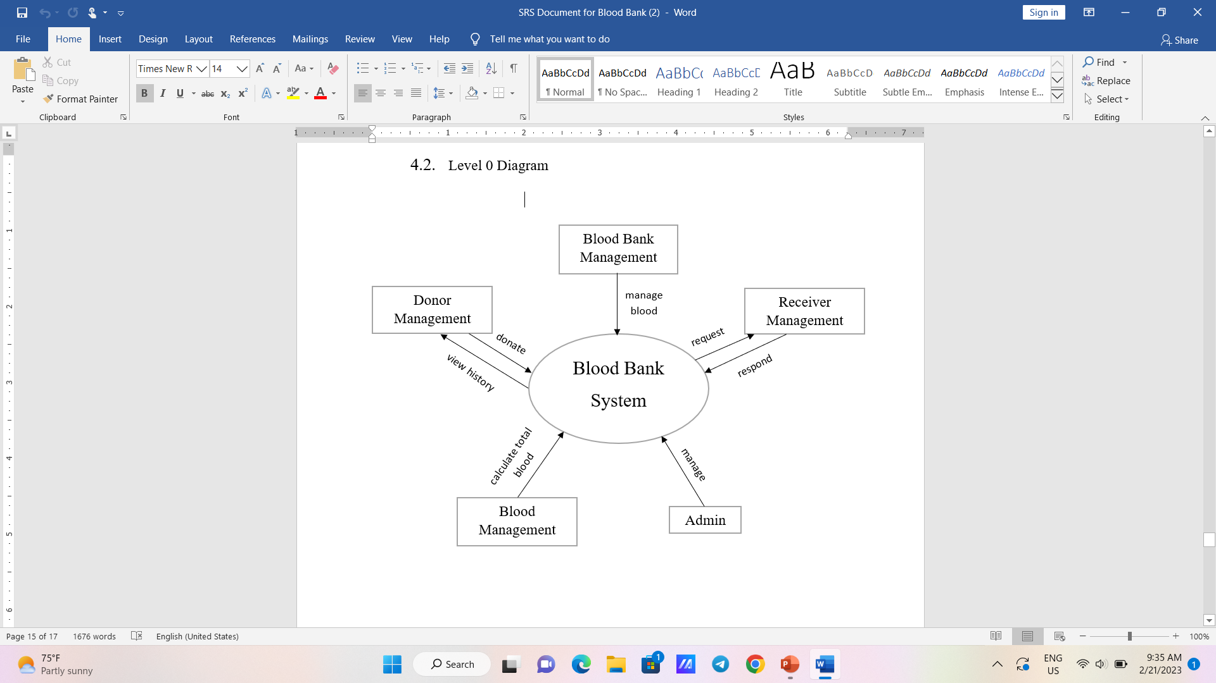
Level 0 Diagram

Slide 14
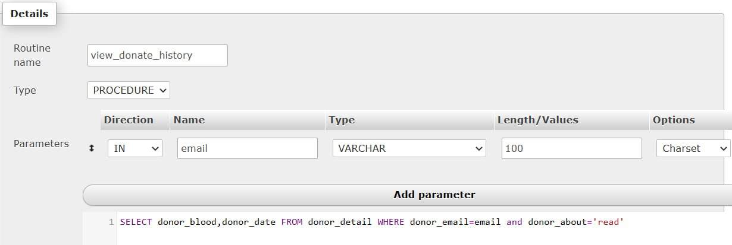
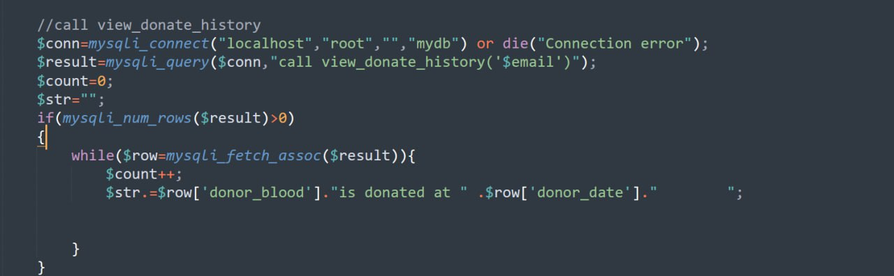
Create and Call Stored Procedure

Slide 15
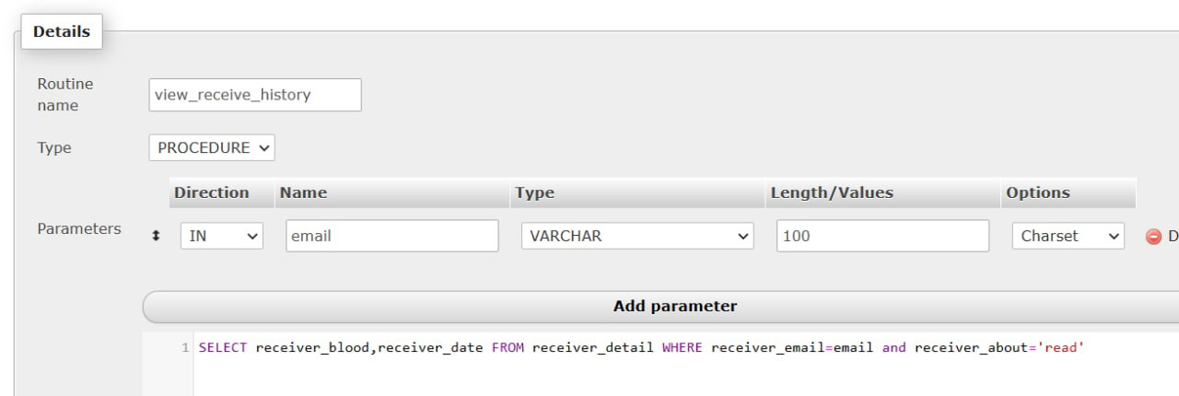
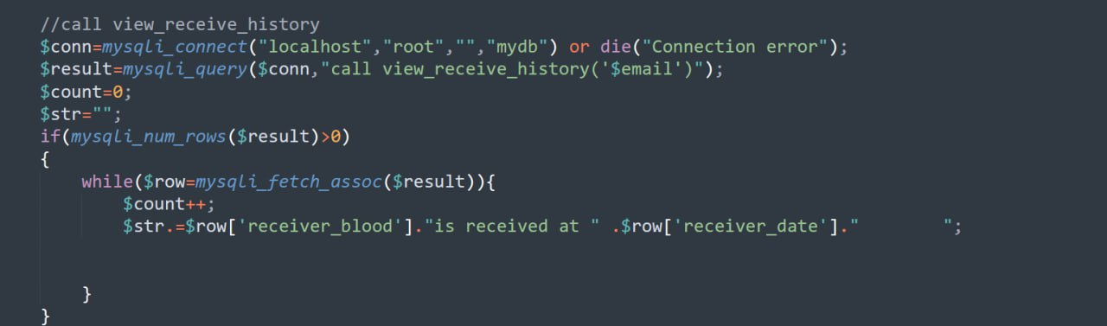

Slide 16
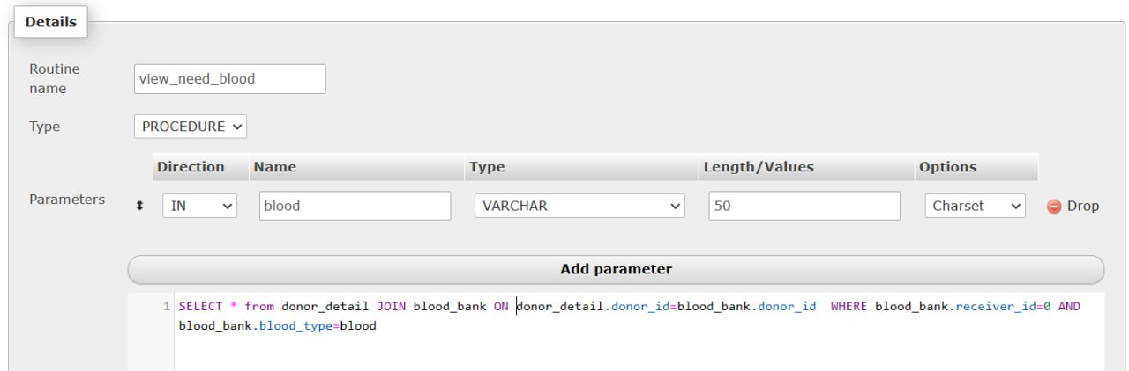
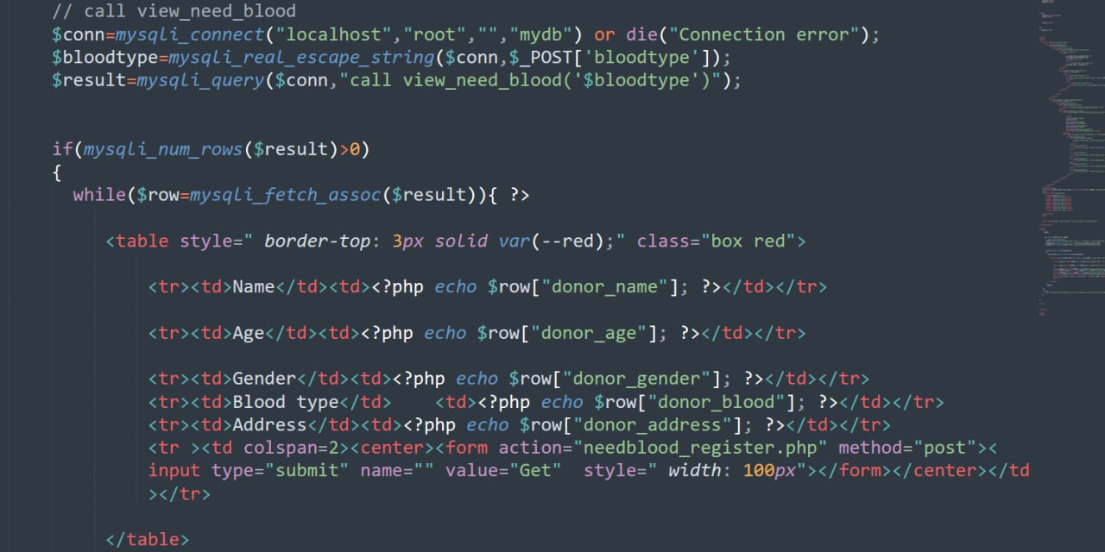

Slide 17
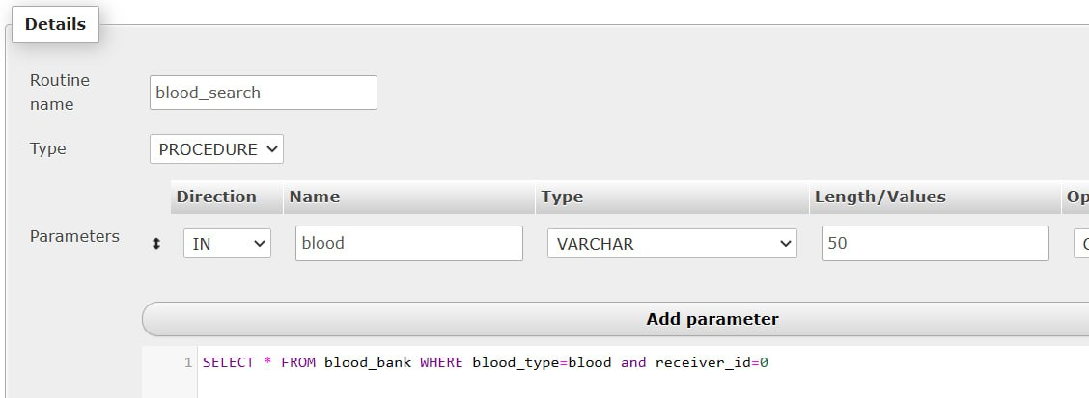
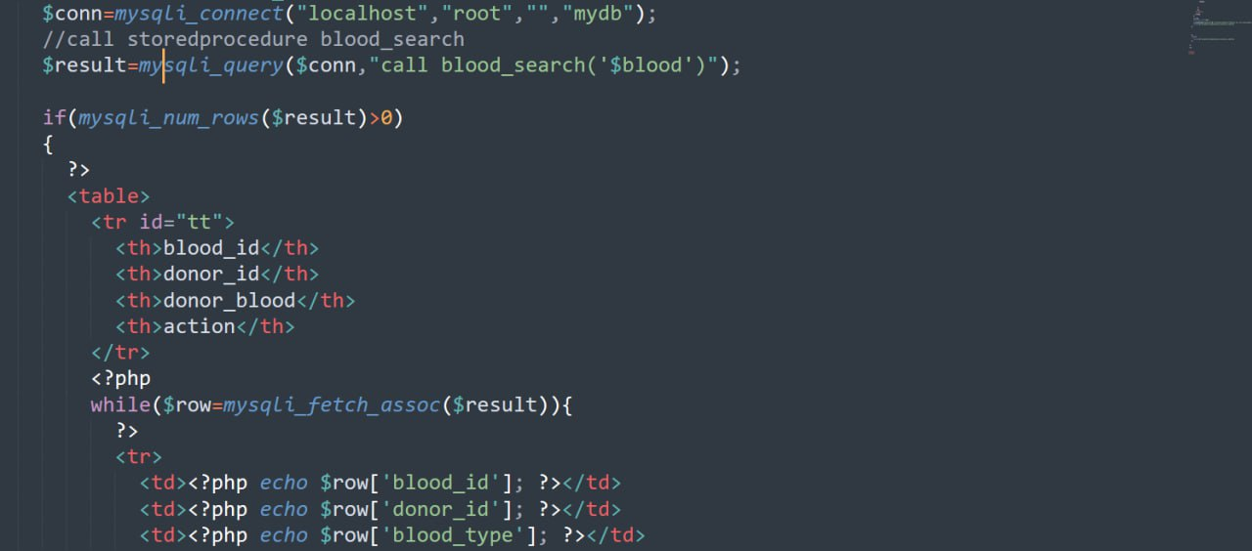

Slide 18
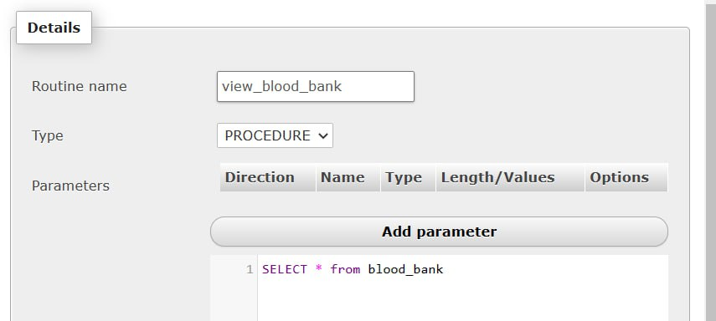
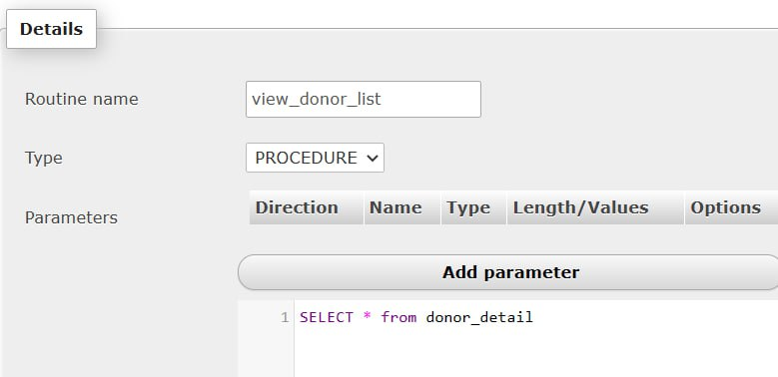
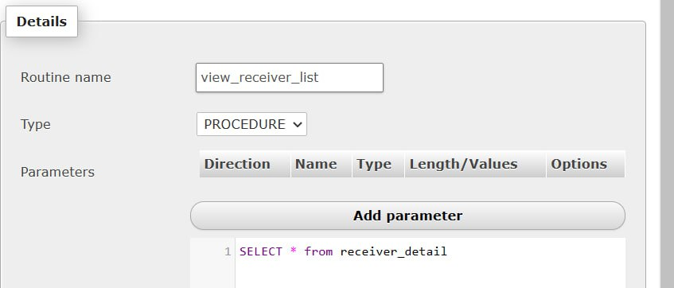

Slide 19
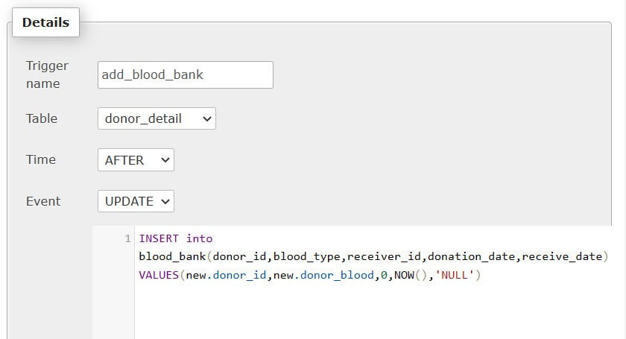
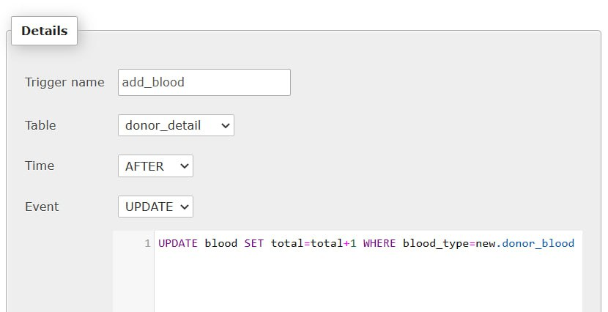
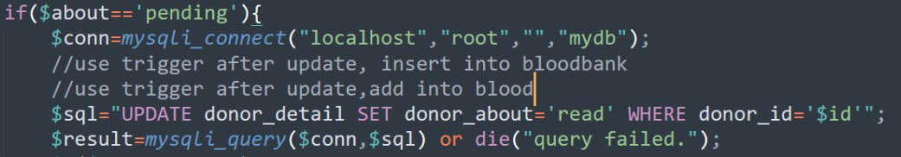
Using Trigger

Slide 20
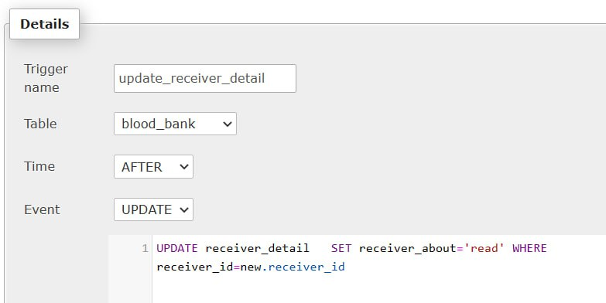
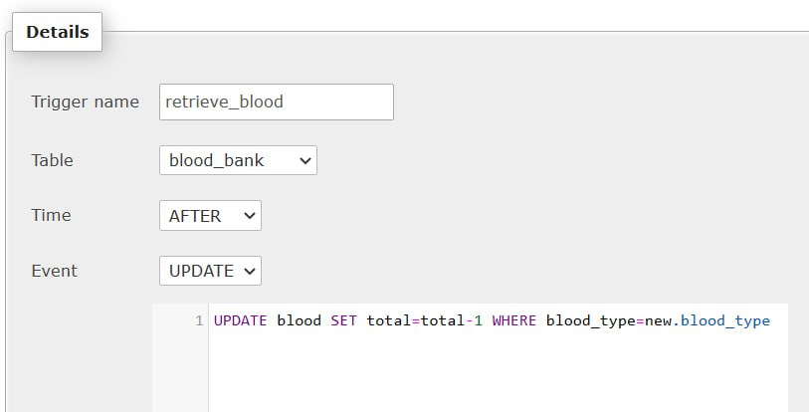
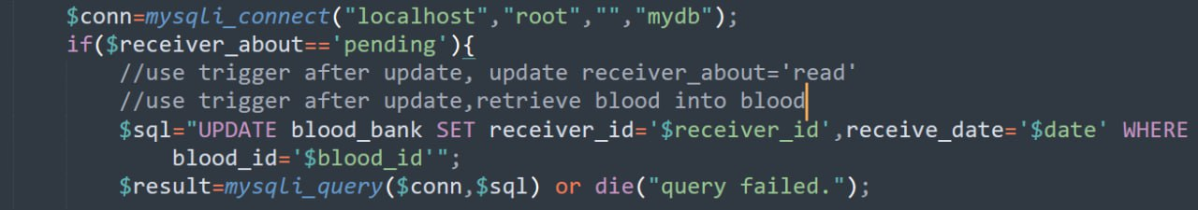

Slide 21

CONCLUSION
An online blood bank system is essential for managing and distributing blood donations effectively.
The system helps administrators manage the blood donation process by streamlining tasks.
Users can easily find and request blood donations, making the process more efficient and effective.
The system streamlines the blood donation process and improves the experience for both donors and patients.
The positive impact of the system can be significant, potentially saving lives and positively impacting communities.

Slide 22
REFERENCES
HTML,CSS, JavaScript tutorials from https://www.w3schools.com/
Lecture Notes from Beginning PHP 5.3 by Matt Doyle
Rajib Mall, “Fundamentals of Software Engineering”, Fourth Edition, 2014
Iron Sommerville, “Software Engineering”, Global Edition, 10th edition, 2016
Roger. S. Pressman, “Software Engineering, A Practitioner’s Approach”, 9th edition, 2015
Database System Concepts 7th Edition

