Slide 1
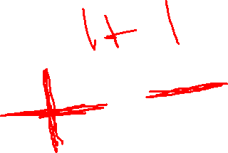
Overview chapter 4
Iterative circuits
Binary adders
Full adder
Ripple carry
Unsigned Binary subtraction
Binary adder-subtractors
Signed binary numbers
Signed binary addition and subtraction
Overflow
Binary multiplication
Other arithmetic functions
Design by contraction

Slide 2
4-1 Iterative Combinational Circuits
Arithmetic functions
Operate on binary vectors
Use the same subfunction in each bit position
One can design a functional block for the subfunction and repeat it to obtain functional block for overall function
Iterative array - a array of interconnected cells (1-D or 2-D arrays)
Notes:
So far we dealt with logic operations such as AND, OR, etc. These operations work on a bit per bit basis. E.g. A+B had the meaning A OR B
Now we are talking about arithmetic operations: addition, subtraction, multiplication. E.g. when we write A+B is Add A to B. Notice the different meaning of the “+” sign. For addition, the representation A can be a word (multi bit or a vector)
These are very important in digital systems and knowing how to implement these are essential to design any digital system.

Slide 3
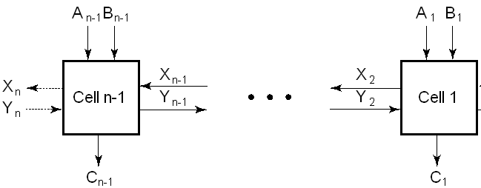
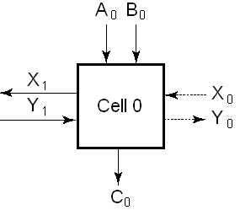
Block Diagram of a 1D Iterative Array
Example: n = 32
Number of inputs = ?
Truth table rows = ?
Equations with up to ? input variables
Equations with huge number of terms
Design impractical!
Iterative array takes advantage of the regularity to make design feasible: Divide and Conquer!
array
single cell
Notes:
Number of Inputs = 66
Truth Table Rows = 2⁶⁶
Equations with up to 66 variables

Slide 4
4-2 Binary Adders
Binary addition used frequently
Addition Development:
Full-Adder (FA), a 3-input bit-wise addition functional block,
Ripple Carry Adder, an iterative array to perform binary addition, and
Carry-Look-Ahead Adder (CLA), a hierarchical structure to improve performance (check in Wikipedia).
Single bit
Vector
Improved
adder

Slide 5
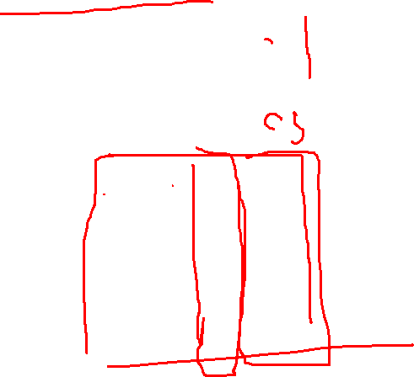
Functional Block: Half-Adder
A 2-input, 1-bit width binary adder that performs the following computations:
A half adder adds two bits to produce a two-bit sum
The sum is expressed as a sum bit , S and a carry bit, C
The half adder can be specified as a truth table for S and C ⇒
X
0
0
1
1
+ Y
+ 0
+ 1
+ 0
+ 1
C S
0 0
0 1
0 1
1 0
X
Y
C
S
0
0
0
0
0
1
0
1
1
0
0
1
1
1
1
0

Slide 6

Implementations: Half-Adder
The most common half adder implementation is:
S
=
X
⊕
Y
C
=
X
⋅
Y
X
S
Y
C

Slide 7

Logic Optimization: Full-Adder
Full-Adder Truth Table:
Full-Adder K-Map:
A
B
Ci
Co
S
0
0
0
0
0
Ci
A
+B
Co S
0
0
1
0
1
0
1
0
0
1
0
1
1
1
0
1
0
0
0
1
1
0
1
1
0
1
1
0
1
0
1
1
1
1
1
S
B
Co
B
1
1
1
0
1
3
2
0
1
3
2
A
1
1
A
1
1
1
4
5
7
6
4
5
7
6
Ci
C
S
=
A
B
C_{i}
+
A
B
C_{i}
+
A
B
C_{i}
+
A
B
C_{i}
C_{o}
=
A
B
+
A
C_{i}
+
B
C_{i}

Slide 8
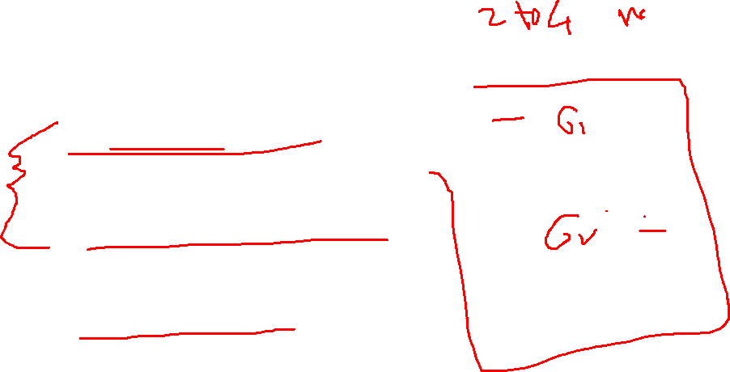
Implementation: Full Adder
A_{i}
B_{i}
Full Adder Schematic for bit i
with
G = generate (=AB) and
P = propagate (=A⊕B)
C_{i+1} = G_{i} + P_{i} · C_{i}
or: Co= (G = Generate) OR (P =Propagate AND C_{i} = Carry In)
G_{i}
S_{i} =(A_{i} ⊕B_{i})⊕C_{i}
Co = AB + (A⊕B)C_{i}
or C_{i+1} = A_{i}B_{i} + (A_{i}⊕B_{i} )C_{i}
P_{i}
C_{i}
C_{i+1}
S_{i}

Slide 9
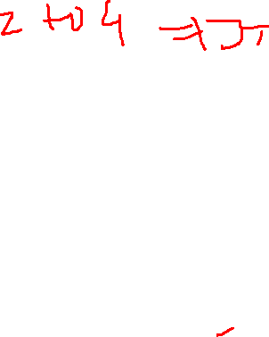
Binary Adders
To add multiple operands, we “bundle” logical signals together into vectors and use functional blocks that operate on the vectors
Example: 4-bit ripple carry adder: Adds input vectors A(3:0) and B(3:0) to get a sum vector S(3:0)
Note: carry out of cell i becomes carry in of cell i + 1
Description
Subscript
Name
3 2 1 0
Carry In
0 1 1 0
C_{i}
Augend
1 0 1 1
A_{i}
Addend
0 0 1 1
B_{i}
Sum
1 1 1 0
S_{i}
Carry out
0 0 1 1
C_{i+1}

Slide 10
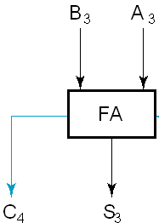
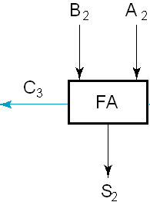

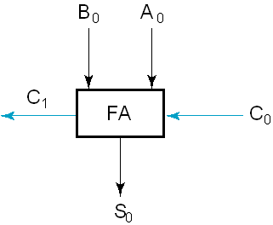
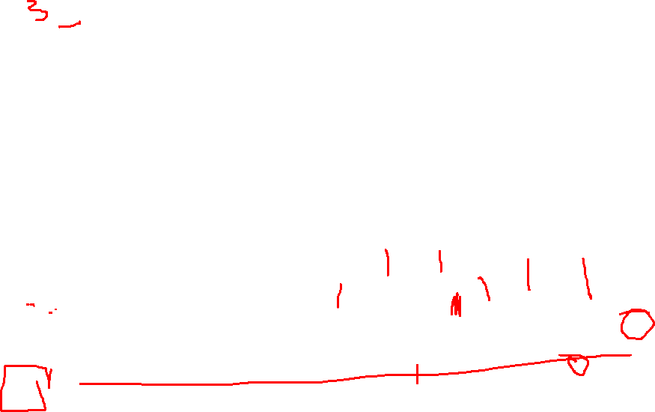
4-bit Ripple-Carry Binary Adder
A four-bit Ripple Carry Adder made from four 1-bit Full Adders:
Slow adder: many delays from input to output
B_{i}
A_{i}
C_{i+1}
FA
C_{i}
S_{i}
Notes:
Example: 1111 + 0001 = 10000

Slide 11
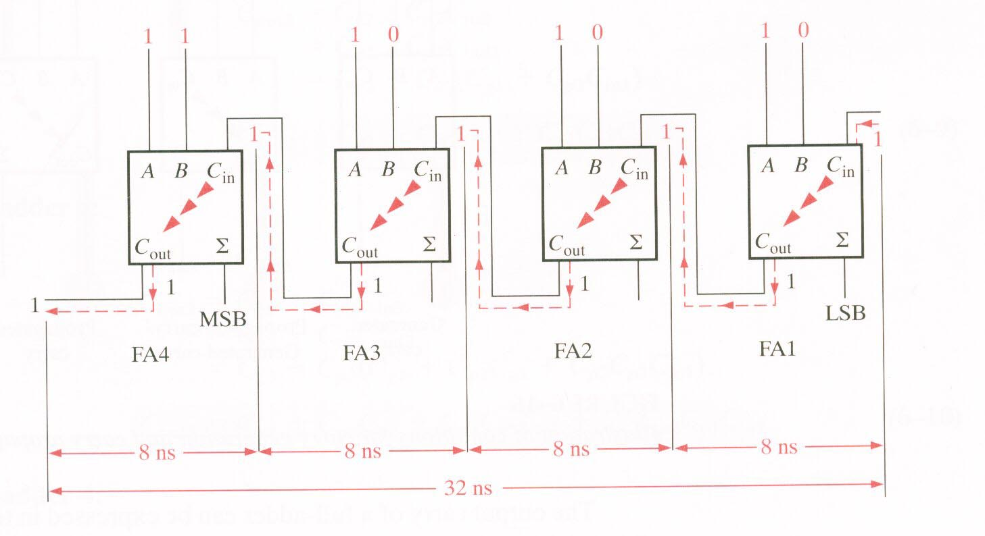
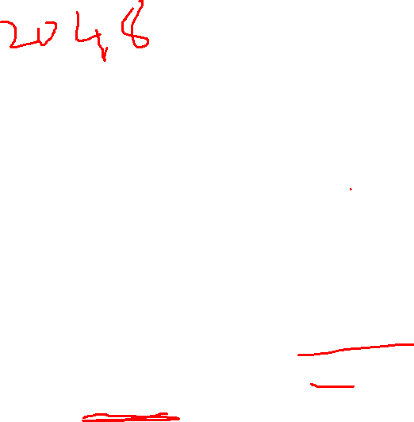
Ripple Carry Adder

Slide 12

Delay of a Full Adder
Assume that AND, OR gates have 1 gate delay and the XOR has 2 gate delays
Delay of the Sum and Carry bit:
S_{i}
=
A_{i}
⊕
B_{i}
⊕
C_{i}
A_{i}
B_{i}
G_{i}
S₀
=
A₀
⊕
B₀
⊕
C₀
2 delays
2+2=4 delays
P_{i}
C_{i+1}
=
A_{i}
B_{i}
+
(
A_{i}
⊕
B_{i}
)
C_{i}
C_{i}
C₁
=
A₀
B₀
+
(
A₀
⊕
B₀
)
C₀
@2
C_{i+1}
@3
S_{i}
2+2=4 delays

Slide 13

Delay of the Carry
C₂
=
A₁
B₁
+
(
A₁
⊕
B₁
)
C₁
A_{i}
B_{i}
@2
@4
G_{i}
@?
@?
C₃
=
A₂
B₂
+
(
A₂
⊕
B₂
)
C₂
P_{i}
@2
@6
C_{i}
@7
@8
C₄
: delay 8+2 = 10
C_{i+1}
S_{i}
For n stage: delay of C_{n}: 2n+2 delays!
and S_{n}: 2n+4 (=@C_{n} + 2)
The bottleneck is the delay of the carry.
Notes:
@5 adnd @6
Each FA adds 2 gate dealys to the carry!

Slide 14

Delay in a Ripple-carry adder
Example: 4-bit adder (n=4)
@0
@0
@8
@6
@4
@10
@8
@6
@4
@10
One problem with the addition of binary numbers is the length of time to propagate the ripple carry from the least significant bit to the most significant bit.
Example: 32-bit Ripple-carry has a unit gate delay of 1ns.
What is the total delay of the adder?
What is the max frequency at which it can be clocked?
Notes:
32 bit means n=31; Thus delay of S31= 2xn+4=32+4=66 delays or 66 ns
Freq: 1/66ns= 15.2MHz

Slide 15
Carry Lookahead Adder
Uses a different circuit to calculate the carry out (calculates it ahead), to speed up the overall addition
Requires more complex circuits.
Trade-off: speed vs. area (complexity, cost)

Slide 16
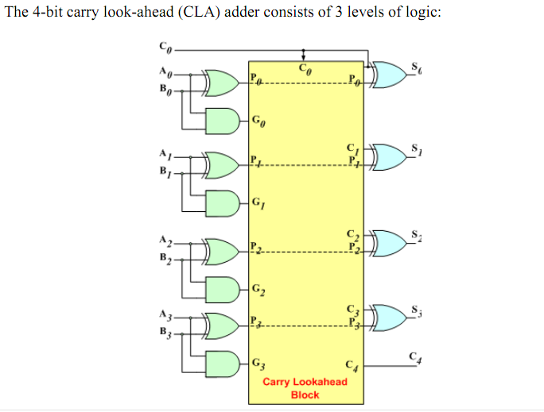

CLA 4 bit

Slide 17
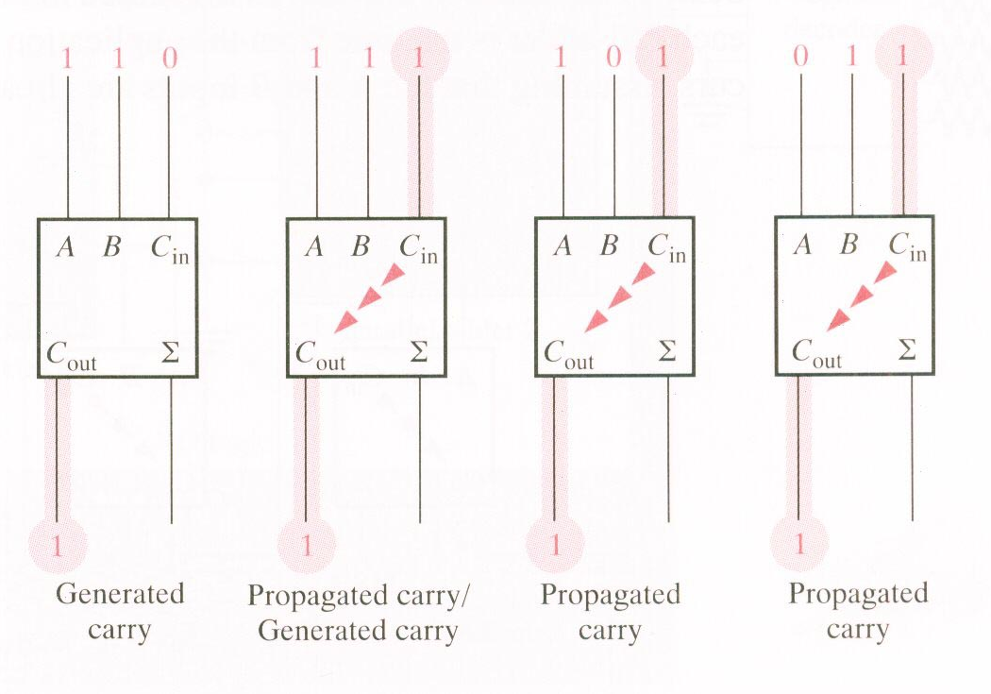


CLA Cases

Slide 18
Carry Look-Ahead Adder
Based of the analysis, we can now develop expressions for the output carry, C_{out}, of each full-adder stage for the 4-bit example.
Full-adder 1:
C_{out1} = C_{g1} + C_{p1}C_{in1}
Full-adder 2:
C_{in2} = C_{out1}
C_{out2} = C_{g2} + C_{p2}C_{in2}
= C_{g2} + C_{p2}C_{out1}
= C_{g2} + C_{p2}(C_{g1} + C_{p1}C_{in1})
C_{out2} = C_{g2} + C_{p2}C_{g1}+ C_{p2}C_{p1}C_{in1}

Slide 19

Carry Look-Ahead Adder
Full-adder 3:
C_{in3} = C_{out2}
C_{out3} = C_{g3} + C_{p3}C_{in3}
= C_{g3} + C_{p3}C_{out2}
= C_{g3} + C_{p3} (C_{g2} +C_{p2}C_{g1}+C_{p2}C_{p1}C_{in1})
C_{out3} = C_{g3} + C_{p3}C_{g2} + C_{p3}C_{p2}C_{g1}+C_{p3}C_{p2}C_{p1}C_{in1}
Full-adder 4:
C_{in4} = C_{out3}
C_{out4} = C_{g4} + C_{p4}C_{in4}
= C_{g4} + C_{p4}C_{out3}
= C_{g4} + C_{p4}(C_{g3} + C_{p3}C_{g2}+C_{p3}C_{p2}C_{g1}+C_{p3}C_{p2}C_{p1}C_{in1})
C_{out4} = C_{g4} + C_{p4}C_{g3}+C_{p4}C_{p3}C_{g2}+C_{p4}C_{p3}C_{p2}C_{g1}+C_{p4}C_{p3}C_{p2}C_{p1}C_{in1}

Slide 20
Carry Look-Ahead Adder
Notice that in each of these expressions, the output carry for each full-adder stage is dependent only on the initial input carry (C_{in1}), the C_{g} and C_{p} functions of that stage, and the C_{g} and C_{p} functions of preceding stages.
Since each of the C_{g} and C_{p} functions can be expressed in terms of the A and B inputs to the full-adders.
All the output carries are immediately available (except for gate delays) and you do not have to wait for a carry to ripple though all the stages before a final result is achieved.

Slide 21
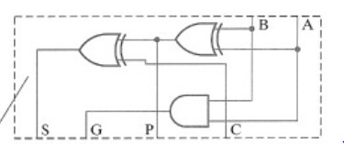
PFA generates G and P
4-bit Implementation
@6
@6
@6
@4
C2= G1 + P1G0 + P1P0 C0
@4
C3= G2 + P2G1 + P2P1G0 + P2P1P0 C0

Slide 22
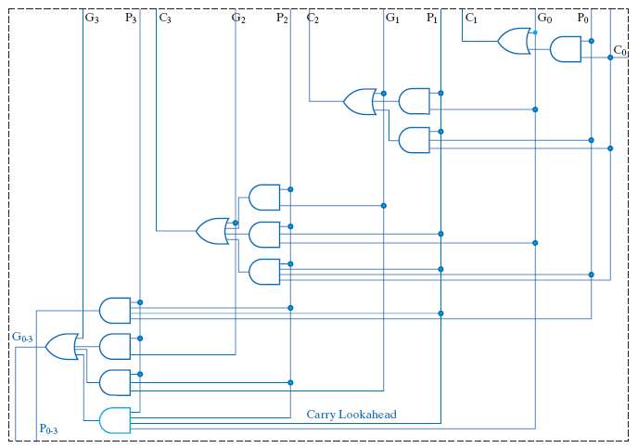
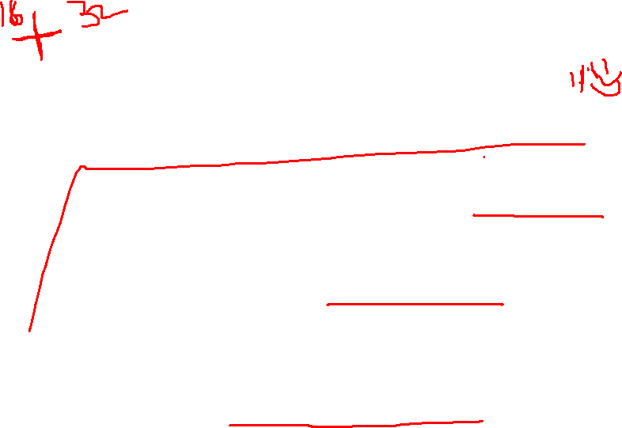
PFA generates G and P
4-bit Implementation
@6
@6
@6
@4
@4
@4
C₁ = G₀ + P₀ C₀
C2= G1 + P1G0 + P1P0 C0
Carry lookahead logic
@4
C3= G2 + P2G1 + P2P1G0 + P2P1P0 C0

Slide 23

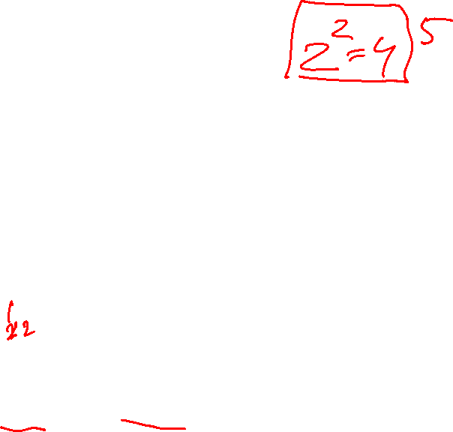
a. Unsigned Subtraction
M
-N
Minuend
Subtrahend
Result
Examples:
4-bit numbers
borrow
1001 - 0111
0100 - 0111
0
1
M 9
-N 7
2
4
7
13!
0010
1101
Wrong answer!

Slide 24
Unsigned Subtraction (cont)
What happened with the previous example:
We had to borrow a “1” which corresponds to 2⁴.
Thus we actually added 2⁴ or 2^{n}:
To get the correct answer we need to subtract the previous answer from 2^{n}:
(N-M is magnitude) plus add the (-) minus sign:
M-N+2^{n}.
2^{n} – (M-N+2^{n}) = N-M
1 0100 - 0111 1101
10000 2⁴ - 1101
(-)0011 = (-)3

Slide 25

Unsigned Subtraction: Algorithm
Algorithm:
Subtract the subtrahend N from the minuend M (M-N)
If no end borrow occurs, then M > N, and the result is a non-negative number and correct.
If an end borrow occurs, the M < N and the difference M - N + 2^{n} is subtracted from 2^{n}, and a minus sign is appended to the result:
Examples:
2^{n} -(M - N + 2^{n} )= N-M
End borrow: needs correction
1 0101 - 1000 1101
0 1000 - 0101 0011
5
8
13!
16
-13
3
M 8
-N 5
3
10000 - 1101
(-)0011
2⁴
correct
answer
2’s complement

Slide 26
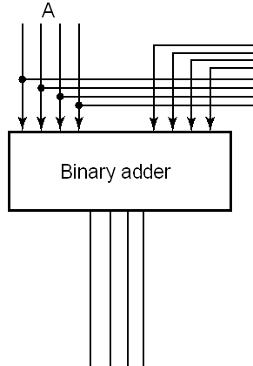
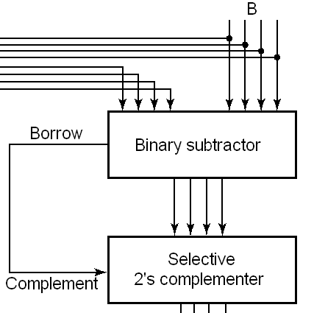
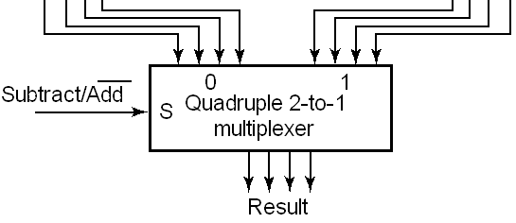
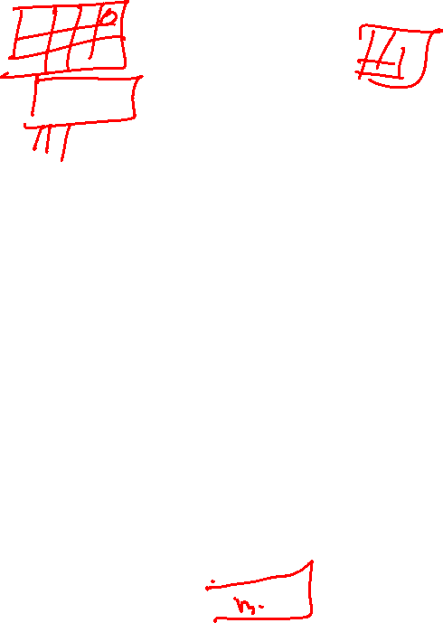
Unsigned Adder – Subtractor
To do both unsigned addition and unsigned subtraction requires:
Complex circuits!
→ Introduce complements as an approach to simplify the circuit (see next)
B

Slide 27

4-3 b. Complements
Two type of complements:
Diminished Radix Complement of N
Defined as (r^{n} - 1) – N, with n = number of digits or bits
1’s complement for radix 2
Radix Complement
Defined as r^{n} - N
2’s complement in binary
As we will see shortly, subtraction is done by adding the complement of the subtrahend
If the result is negative, takes its 2’s complement

Slide 28
Binary 1's Complement
For r = 2, N = 0111 0011₂, n = 8 (8 digits):
(r^{n} – 1) = 256 -1 = 255₁₀ or 11111111₂
The 1's complement of 01110011₂ is then:
11111111
– 01110011
10001100
Since the 2^{n} – 1 factor consists of all 1's and since 1 – 0 = 1 and 1 – 1 = 0, the one's complement is obtained by complementing each individual bit (bitwise NOT).
r^{n} – 1
- N
1’s compl

Slide 29
Binary 2's Complement
For r = 2, N = 0111 0011₂, n = 8 (8 digits), we have:
(r^{n} ) = 256₁₀ or 100000000₂
The 2's complement of 01110011 is then:
100000000 – 01110011 10001101
Note the result is the 1's complement plus 1:
r^{n}
- N
2’s compl
01110011
10001100
+ 1
10001101
Invert bit-wise
2’s complement

Slide 30
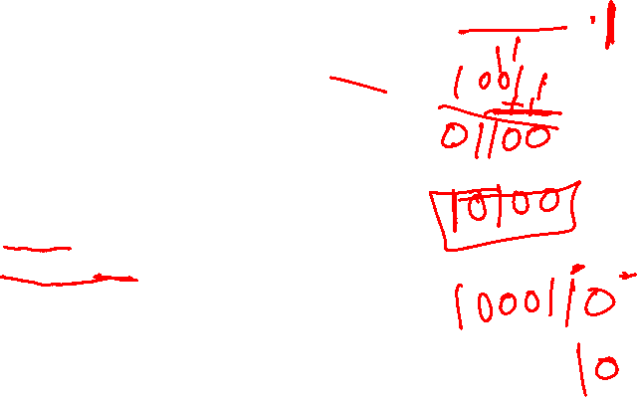

Alternate 2’s Complement Method
Given: an n-bit binary number, beginning at the least significant bit and proceeding upward:
Copy all least significant 0’s
Copy the first 1
Complement all bits thereafter.
2’s Complement Example:
10010100
Copy underlined bits:
100
and complement bits to the left:
01101100

Slide 31
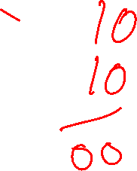
3-3c. Subtraction with 2’s Complement
For n-digit, unsigned numbers M and N, find M − N in base 2: Algorithm
Add the 2's complement of the subtrahend N to the minuend M:
M + (2^{n} − N) = M − N + 2^{n}

Slide 32
3-3c. Subtraction with 2’s Complement
Thus one calculates M + (2^{n} − N) = M − N + 2^{n}
Two possibilities:
If M > N, the sum produces end carry r^{n} which is discarded; from above, M - N remains, which is the correct answer.
If M < N, the sum does not produce an end carry and, from above, is equal to
M − N + 2^{n} can we rewritten as 2^{n} − ( N − M ), which is 2's complement of ( N − M ).
Thus, to obtain the result − (N – M) , take the 2's complement of the sum and place a − to its left:
2^{n} − [2^{n} − ( N − M )] = N-M and place a minus sign in front: - (N-M)

Slide 33
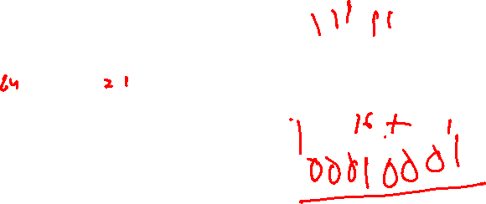
Unsigned 2’s Complement Subtraction Example 1
Find 01010100₂ – 01000011₂
01010100 01010100
–01000011 + 10111101
00010001
Discard carry
1
84
-67
17
2’s comp
The carry of 1 indicates that no correction of the result is required

Slide 34

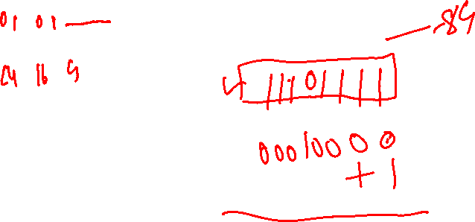
Unsigned 2’s Complement Subtraction Example 2
Find 01000011₂ – 01010100₂
01000011 01000011
– 01010100 + 10101100
11101111
00010001
The carry of 0 indicates that a correction of the result is required.
Result = – (00010001)
0
67
-84
-17
2’s comp
2’s comp

Slide 35
Exercise
Do the following subtraction of the following unsigned numbers, using the 2’s complement method:
100011 – 10001
100011 - 110110
Notes:
1) 35-17 = 18
2) 35-54 = -19

Slide 36
Example
carry out
1
35
-17
18
100011
- 10001
100011
- 010001
100011
2’s compl.
+101111
010010

Slide 37
4-4 Binary Adder-Subtractors
Using 2’s complement, the subtraction becomes an ADDITION.
This leads to much simpler circuit than the previous one where we needed both an ADDER and SUBTRACTOR with selective 2’s complementer and multiplexer

Slide 38
4-4 Binary Adder-Subtractors
Using 2’s complement, the subtraction becomes an ADDITION.
This leads to much simpler circuit than the previous one where we needed both an ADDER and SUBTRACTOR with selective 2’s complementer and multiplexer

Slide 39
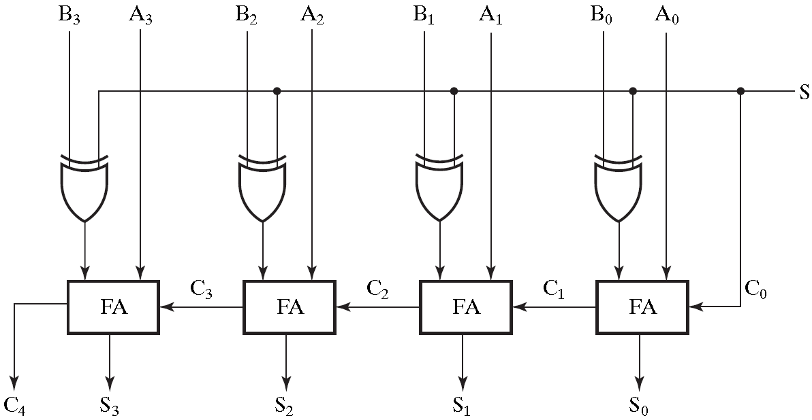
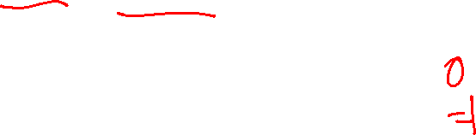
2’s Complement Adder/Subtractor
Subtraction can be done by addition of the 2's Complement.
1. Complement each bit (1's Complement.)
2. Add 1 to the result.
The circuit shown computes A + B and A – B:
For S = 1, subtract, the 2’s complement of B is formed by using XORs to form the 1’s comp and adding the 1 applied to C₀.
For S = 0, add, B is passed through unchanged

Slide 40
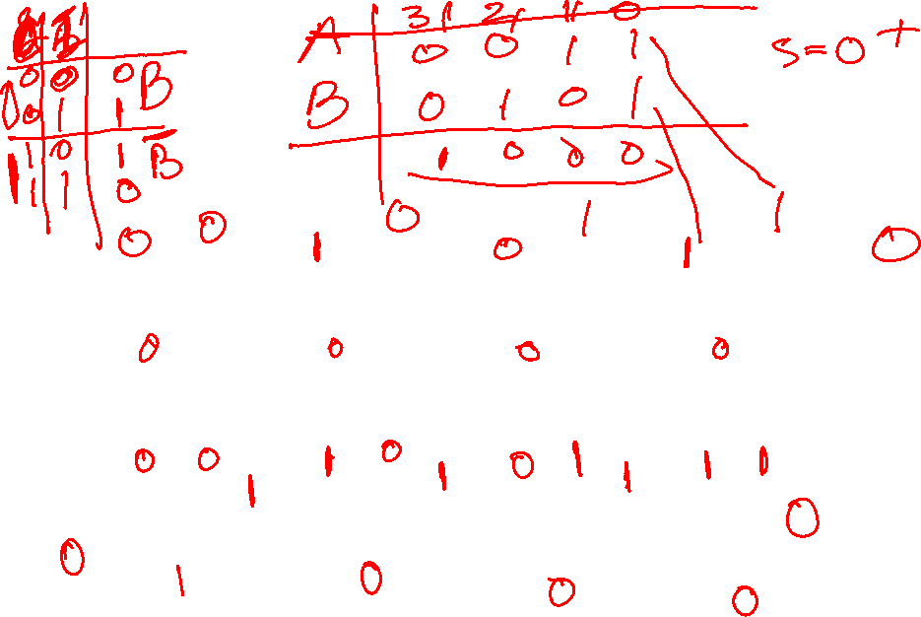

Slide 41
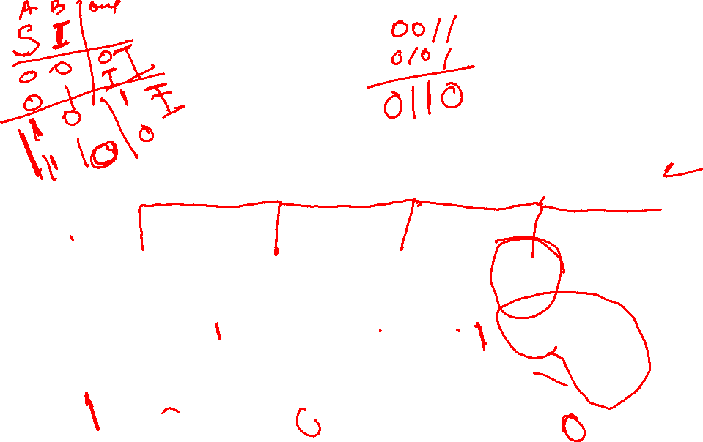
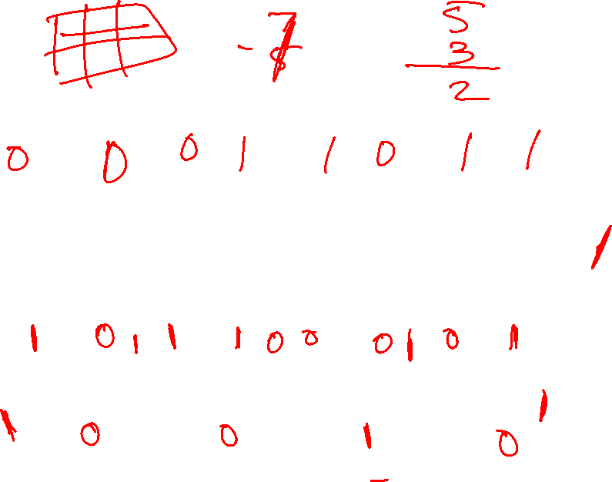

Slide 42
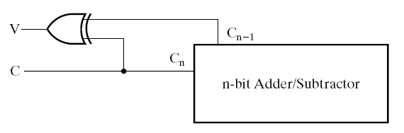



Slide 43
Signed Binary Numbers
So far we focused on the addition and subtraction of unsigned numbers.
For SIGNED numbers:
How to represent a sign (+ or –)?
One need one more bit of information.
Two ways:
Sign + magnitude
Signed-Complements
Thus:
Positive number are unchanged
Negative numbers: use one of the above methods

Slide 44
Signed 2’s complement system
Positive numbers are unchanged
Negative numbers: take 2’s complement
Example for 4-bit word:
0 0000
+1 0001
+2 0010
+3 0011
+4 0100
+5 0101
+6 0110
+7 0111
-1 1111
-2 1110
-3 1101
-4 1100
-5 1011
-6 1010
-7 1001
-8 1000
0 indicates positive and 1 negative numbers
7 positive numbers and 8 negative ones
Notes:
Notice that for negative numbers, e.g. 1101 = -3= -8 + 5

Slide 45

2’s Complement Arithmetic
Addition: Simple rule
Represent negative number by its 2’s complement. Then, add the numbers including the sign bits, discarding a carry out of the sign bits (2's complement):
Indeed, e.x. M+(-N) → M + (2^{n}-N)
If M ≥ N: (M-N) + 2^{n} ignore carry out: M-N is the answer in two’s complement)
If M ≤ N: (M-N) + 2^{n} = 2^{n} – (N-M) which is 2’s complement of the (negative) number (M-N): -(N-M).
Subtraction: M-N → M + (2^{n}-N)
Form the complement of the number you are subtracting and follow the rules for addition.

Slide 46
Signed 2’s Complement Examples
Example 1: 1101 + 0011
Example 2: 1101 - 0011
Example 3: (5 – 11)₁₀ (using 2’s compl.)
Notes:
Example 1: -3 + 3=0. Result is 0000. The carry out of the MSB is discarded.
Example 2: -3 -3=-6; Complement 0011 to 1101 and add. Result is 1010. The carry out of the MSB is discarded.
Example 3: 5-11: 00101; takes 2’s complement of 11 (01011) = 10101; add 00101+10101= 11010 (Result) which is equal to -6

Slide 48
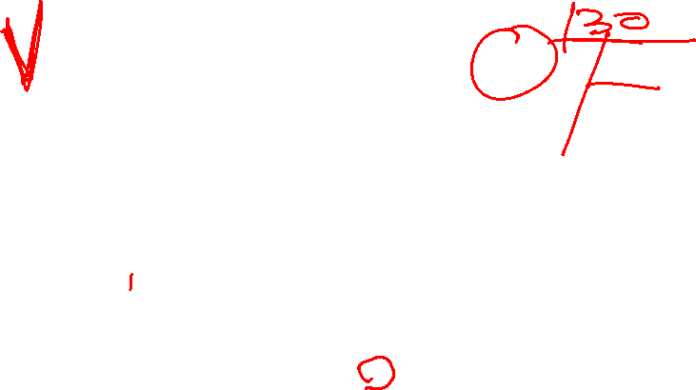
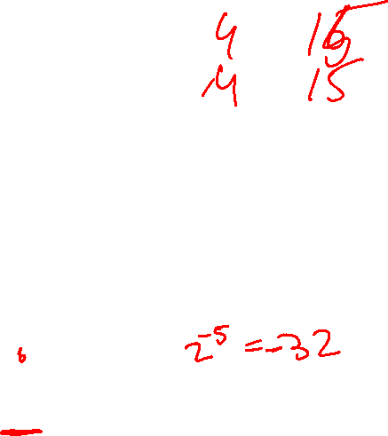
Overflow Detection
Overflow occurs if n + 1 bits are required to contain the result from an n-bit addition or subtraction.
In computers there is a fixed no. of bits (e.g. n bits)
Overflow can occur for:
Addition of two operands with the same sign
Subtraction of operands with different signs
For a n-bit signed number the max numbers are:
Min-Max positive no:0 to (2^{n-1} – 1)
Most negative no: -2^{n-1} to -1
Example of 6-bit signed no: Max Pos no is 2⁵-1 or 31; Most negative no. is -2⁵=-32
If the result of the addition or subtraction is outside this range, overflow will occur. Example of 6-bit numbers:
18+15=33, or -17-21=-38 (<-32)
No overflow in cases: 18-15, or 17-21 (within the range).

Slide 49

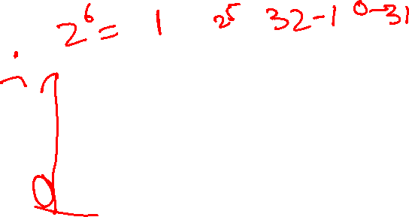
Overflow examples (continued)
carries
0 1 1 1 1 0
0 1 0 0 1 0
+0 0 1 1 1 1
1 0 0 0 0 1
1 1 0 0 0 0
0 1 0 0 1 0
+1 1 0 0 0 1
0 0 0 0 1 1
18
+15
33
18
- 15
3
-31!
3
wrong answer
due to overflow
correct answer
no overflow
Overflow occurs when the carry-in into the sign bit (most left bit) is different from the carry-out of the sign bit.

Slide 50

Overflow Detection
Simplest way to implement overflow V = C_{n} ⊕ C_{n - 1}
C_{n} C_{n-1}
0 1 1 1 1 0
0 1 0 0 1 0
+0 0 1 1 1 1
1 0 0 0 0 1

Slide 51
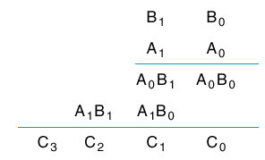
Binary Multipliers
Look at combinational circuit to do this

Slide 52
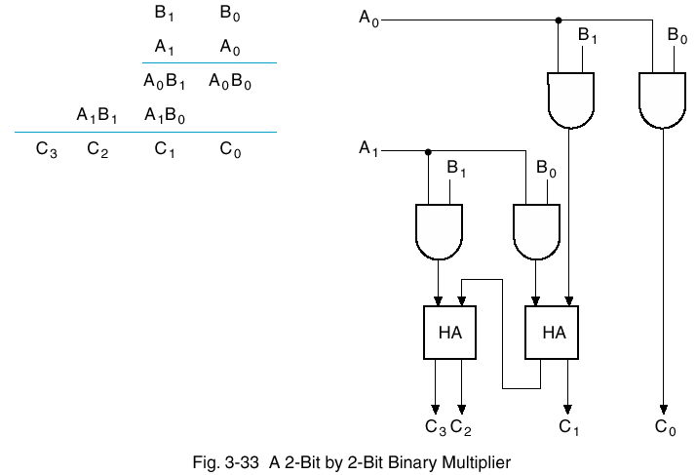
Combinational Multiplier
AND computes A₀ B₀
Half adder computes sum. Will need FA for larger multiplier.

Slide 53
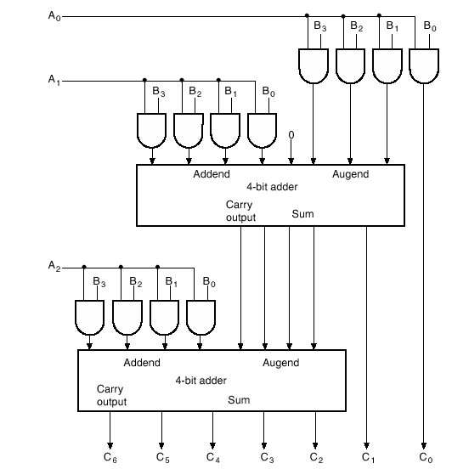
Larger Multiplier

Slide 54
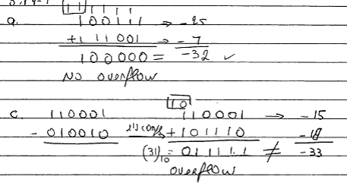
Exercise
Perform the following operations. The binary numbers have a sign in the left most bit and if negative they in in 2’s complement.
Indicate if overflow occurs
100111+111001
110001-010010

Slide 55
4-5 Other Arithmetic Functions
Convenient to design the functional blocks by contraction - removal of redundancy from circuit to which input fixing has been applied
Functions
Incrementing and Decrementing
Multiplication by Constant
Division by Constant
Zero Fill and Extension
Multiplication

Slide 56
Design by Contraction
Contraction is a technique for simplifying the logic in a functional block to implement a different function
The new function must be realizable from the original function by applying rudimentary functions to its inputs
Contraction is treated here only for application of 0s and 1s (not for X and X)
After application of 0s and 1s, equations or the logic diagram are simplified.

Slide 57
Incrementing & Decrementing
Incrementing
Adding a fixed value to an arithmetic variable
Fixed value is often 1, called counting (up)
Examples: A + 1, B + 4
Functional block is called incrementer
Decrementing
Subtracting a fixed value from an arithmetic variable
Fixed value is often 1, called counting (down)
Examples: A - 1, B - 4
Functional block is called decrementer

Slide 58
Multiplication/Division by 2^{n}
B
B
B
B
(a) Multiplication by 4=(100)₂
Shift left by 2
(b) Division by 4=(100)₂
Shift right by 2
Remainder preserved
3
2
1
0
0
0
C
5
C
4
C
3
C
2
C
1
C
0
B
3
B
2
B
1
B
0
0
0
Example:
Multiply M=10001 (17) by 2 (10)_{2:}
Divide M by 2:
C
3
C
2
C
1
C
0
C
2
1
C
2
2
10001
100010
Shift one bit to the left and add 0 to the right
= 34
10001
01000.1
Shift one bit to the right and add 0 on the left
=8.5

