Slide 1
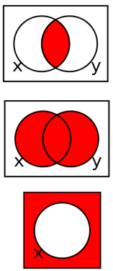
Chapter 2
Combinational Logic Circuits
Binary Logic and Gates
Boolean Algebra
A
F
B

Slide 2
Please Read Ch-2 From Book

Slide 3
Overview Chapter 2
Binary Logic and Gates
Boolean Algebra
Standard Forms
Two-Level Optimization
Map Manipulation
Other Gate Types
Exclusive-OR Operator and Gates
High-Impedance Outputs
Notes:
In this chapter we will introduce logic gates which are the simplest logic elements. However, they form the foundation of more complex blocks which will be discussed in later chapters.
We will also discuss the mathematical tools that are required to design, analyze and simplify logic function (Boolean Algebra): optimization techniques

Slide 4
2-1 Binary Logic and Gates
Binary logic deals with binary variables (i.e. can have two values, “0” and “1”)
Binary variables can undergo three basic logical operators AND, OR and NOT:
AND is denoted by a dot (·)
OR is denoted by a plus (+).
NOT is denoted by an overbar ( ¯ ), a single quote mark (') after the variable.

Slide 5
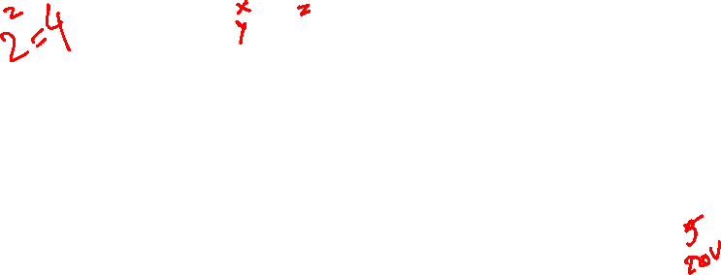
Operator Definitions and Truth Tables
Truth table - a tabular listing of the values of a function for all possible combinations of values on its arguments
Example: Truth tables for the basic logic operations:
AND
OR
X | Y | Z = X+Y
0 | 0 | 0
0 | 1 | 1
1 | 0 | 1
1 | 1 | 1
NOT
X
Y
Z = X·Y
X
Z
=
X
0
0
0
0
1
0
1
0
1
0
1
0
0
1
1
1

Slide 6
Boolean Operator Precedence
The order of evaluation in a Boolean expression is:
1.
Parentheses
2.
NOT
3.
AND
4.
OR
Consequence: Parentheses appear around OR expressions
Example: F = A(B + C)(C + D)

Slide 7
Logic Gates
In the earliest computers, switches were opened and closed by magnetic fields produced by energizing coils in relays. The switches in turn opened and closed the current paths.
Later, vacuum tubes that open and close current paths electronically replaced relays.
Today, transistors are used as electronic switches that open and close current paths.

Slide 8
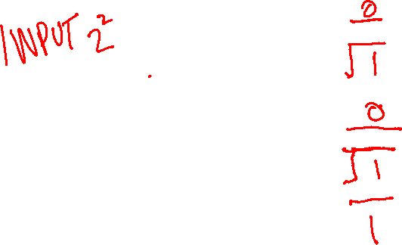
Logic Gate Symbols and Behavior
Logic gates have special symbols:
And waveform behavior in time as follows:

Slide 9

Gate Delay
In actual physical gates, if one or more input changes causes the output to change, the output change does not occur instantaneously.
The delay between an input change(s) and the resulting output change is the gate delay denoted by t_{G}:
1
Input
0
t_{G}
t_{G}
t_{G} = 0.3 ns
1
Output
0
0
0.5
1
1.5
Time (ns)

Slide 10

Logic Diagrams and Expressions
Example: Alarm system for a dorm room
“The alarm should go off when the door opens OR when the door is closed AND the motion detector goes off.
Inputs: “A” door A=1 (open door), B=0 (closed)
“B” motion detector, B=1 (motion detected)
Output: F
F = A + A.B
Logic Diagram
A
F
B

Slide 11
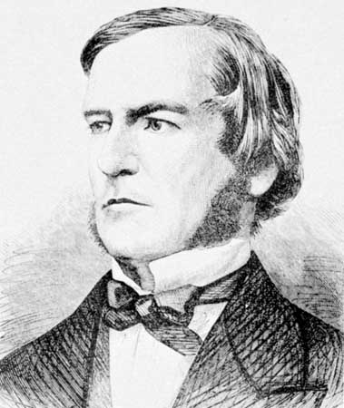

2-2 Boolean Algebra
George Boole,
Mathematician (self-taught),
Professor of Mathematics of then Queen's College, Cork in Ireland)
(Encycl. Brittannica online: http://www.britannica.com/)

Slide 12
2-2 Boolean Algebra
Boolean algebra deals with binary variables and a set of three basic logic operations: AND (.), OR (+) and NOT ( ) that satisfy basic identities
Basic identities
1.
X
+ 0
=
X
2.
X
. 1
=
X
Existence 0 and 1 or
operations with 0 and 1
3.
X
1
1
4.
X
. 0
0
+
=
=
5.
X + X
=
X
6.
X . X
=
X
Idempotence
7.
X + X
=
1
8.
X . X
=
0
Existence complements
9.
X = X
Involution
Replace “+” by “.”, “.” by +,
“0” by “1” and “1’’ by”0”
Dual
Notes:
Boolean algebra deals with binary variables and a set of three basic logic operations: AND, OR and NOT which satisify a set of basic identities

Slide 13
Boolean Algebra
Boolean Theorems of multiple variables
10.
X + Y
=
Y + X
Commutative
11.
XY
=
YX
12.
(X + Y)
+
Z
=
X + (Y
+
Z)
Associative
13.
(XY)
Z
=
X(Y
Z )
14.
X (Y+
Z)
=
XY
+
XZ
Distributive
15.
X
+ YZ
=
(X + Y)
(X + Z)
16.
X + Y
=
X . Y
DeMorgan’s
17.
X . Y
=
X + Y
Dual
Notes:
Boolean algebra deals with binary variables and a set of three basic logic operations: AND, OR and NOT which satisify a set of basic identities

Slide 14
Example: Boolean Algebraic Proof
A + A·B = A (Absorption Theorem)
Proof Steps Justification (identity or theorem)
A + A·B
= A · 1 + A · B (Operation with 1)
= A · ( 1 + B) (Distributive Law)
= A · 1 (Operation with 1)
= A

Slide 15

Exercise
Simplify Y+X’Z+XY’ or B+A’C+AB’ using Boolean algebra
Justification
Y+X’Z+XY’
(COMMUTATIVE Property)
= Y+XY’+X’Z
(Distributive)
=(Y+X)(Y+Y’) + X’Z
(Existence compl.)
=(Y+X).1 + X’Z
= Y+X+X’Z
(0peration with 1)
(Distributive)
=Y+(X+X’)(X+Z)
(Existence compl.)
=Y+1.(X+Z) = X+Y+Z
(Operation with 1)
X+Y+Z =A + B +C

Slide 16
Complementing Functions
Use DeMorgan's Theorem to complement a function:
1. Interchange AND and OR operators
Complement each constant value and literal
Notes:
F = (x + y’ + z)(‘x + y + z)

Slide 17

Example: DeMorgan’s theorem
Exercise: find G
G = UX(Y+VZ)
F = AB + C (E+D)
Find F
F = AB + C (E+D)
F = AB . C (E+D)
Answer:
= U’+X’ + Y’V’+Y’Z’
F = (A+B) .(C + (E+D))
G
F = (A+B) .(C + E.D)
Notes:
Answer: G’ = (UX)’ + (Y+VZ)’
= U’+X’ + Y’(V’+Z’)
= U’+X’ + Y’V’+Y’Z’

Slide 18
Exercise
Example: Complement G = (a + bc)d + e
G =
Notes:
G' = ((a (b' + c'))+ d ) e' = (a (b' + c') + d) e'

Slide 19
Other useful Theorems
Dual
XY + XY = Y
Minimization
(X + Y)(X + Y) = Y
X + XY = X
Absorption
X(X + Y) = X
X + XY = X + Y
Simplification
X(X + Y) = XY
XY + XZ + YZ = XY + XZ
Consensus
(X + Y)( X + Z)(Y + Z) = (X + Y)( X + Z)
Notes:
Consensus:
xy + x’z + yz = xy + x’z + yz( x+x’)
= xy(1+z) + x’z(1+y)
= xy + x’z

Slide 20
Proof the Consensus Theorem
AB + AC + BC = AB + AC (Consensus Theorem)
Proof Steps Justification (identity or theorem)
AB + AC + BC
= AB + AC + 1 · BC operation 1
= AB +AC + (A + A) · BC existence
=
AB + AC + ABC + ABC distributive
= AB + ABC + AC + ABC commutative
= AB(1+C) + AC(1+B) distributive
= AB.1 + AC.1 operation with 1
= AB + AC operation with 1
Notes:
Justification 1: 1 . X = X
Justification 2: X + X’ = 1
= AB + A’C + ABC + A’BC X(Y + Z) = XY + XZ (Distributive Law)
= AB + ABC + A’C + A’BC X + Y = Y + X (Commutative Law)
= AB . 1 + ABC + A’C . 1 + A’C . B X . 1 = X, X . Y = Y . X (Commutative Law)
= AB (1 + C) + A’C (1 + B) X(Y + Z) = XY +XZ (Distributive Law)
= AB . 1 + A’C . 1 = AB + A’C X . 1 = X

Slide 21
General Strategies
Use idempotency to eliminate terms:
Complimentarily or existence complements:
Absorption:
Adsorption:
DeMorgan:
Consensus:
X + X
=
X
X . X
=
X
X + X
=
1
X . X
=
0
X + XY = X
X(X + Y) = X
X + XY = X + Y
X(X + Y) = XY
X + Y
=
X . Y
X . Y
=
X + Y
XY + XZ + YZ = XY + XZ
(X + Y)( X + Z)(Y + Z) = (X + Y)( X + Z)

Slide 22
2-3 Standard (Canonical) Forms
It is useful to specify Boolean functions in a form that:
Allows comparison for equality.
Has a correspondence to the truth tables
Canonical Forms in common usage:
Sum of Products (SOP), also called Sum or Minterms (SOM)
Product of Sum (POS), also called Product of Maxterms (POM)

Slide 23
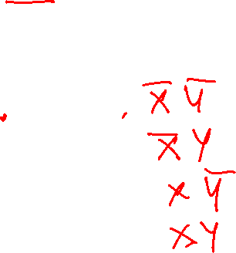
Minterms
Minterms are AND terms with every variable present in either true or complemented form.
Example: Two variables (X and Y)produce 2 x 2 = 4 minterms:
Given that each binary variable may appear normal (e.g., x) or complemented (e.g., ), there are 2^{n} minterms for n variables.
X Y
X
Y
X
Y
X
Y
x

Slide 24
Maxterms
Maxterms are OR terms with every variable in true or complemented form.
There are 2^{n} maxterms for n variables.
Example: Two variables (X and Y) produce 2 x 2 = 4 combinations:
X
+
Y
X
+
Y
X
+
Y
X
+
Y

Slide 25
Maxterms and Minterms
Examples: Two variable minterms and maxterms.
The index above is important for describing which variables in the terms are true and which are complemented.
Index | Minterm | Maxterm
0 (00) | x y | x + y
1 (01) | x y | x + y
2 (10) | x y | x + y
3 (11) | x y | x + y

Slide 26

Purpose of the Index
For Minterms:
“1” in the index means the variable is “Not Complemented” and
“0” means the variable is “Complemented”.
For Maxterms:
“0” means the variable is “Not Complemented” and
“1” means the variable is “Complemented”.

Slide 27

Index Examples – Four Variables
Index Binary Minterm Maxterm
i Pattern m_{i} M_{i}
0 0000
1 0001
3 0011
5 0101
7 0111
10 1010
13 1101
15 1111
a
b
c
d
a
b
c
d
?
+
+
+
Notice: the variables are in alphabetical order in a standard form
?
a
b
c
d
a
b
c
d
a
+
b
+
c
+
d
?
a
+
b
+
c
+
d
a
b
c
d
a
+
b
+
c
+
d
a
b
c
d
?
a
+
b
+
c
+
d
Relationship between min and MAX term?
M
=
m
m
=
M
i
i
i
i
Notes:
M1 = a + b + c + d’
m3 = a’ b’ c d
m7 = a’ b c d
M 13 = a’ + b’ + c + d’

Slide 28
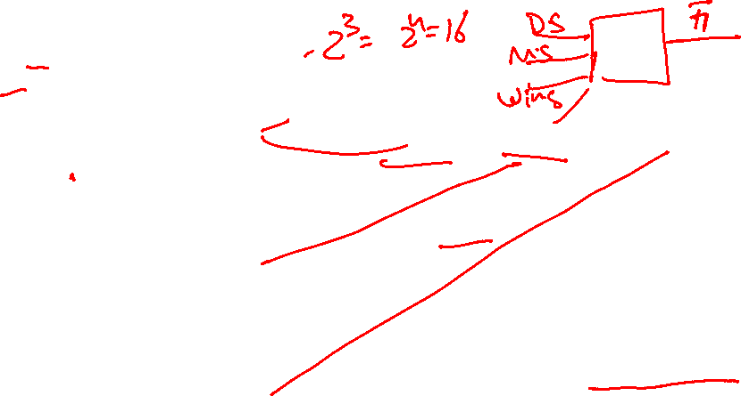
Implementation of a function with minterms
Function F1(x,y,z) defined by its truth table:
x y z
index
F₁
0 0 0
0
0
0 0 1
1
1
F1 = x’ y’ z + x y’ z’ + x y z
0 1 0
2
0
0 1 1
3
0
Thus F1 = m1 + m4 + m7
1 0 0
4
1
1 0 1
5
0
1 1 0
6
0
Short hand notation: F1 =Σ_{m} (1,4,7)
1 1 1
7
1
also called, little m notation

Slide 29
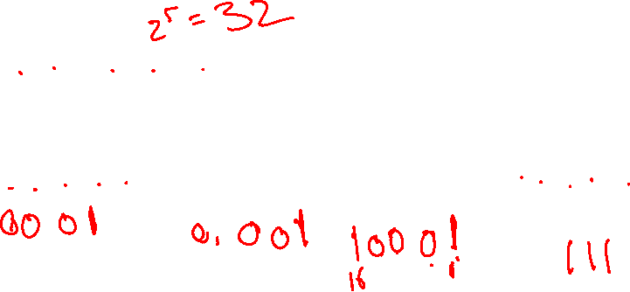
Minterm Function Example
F(A, B, C, D, E) = m₂ + m₉ + m₁₇ + m₂₃
F(A, B, C, D, E) write in standard form:
Sum of Product (SOP) expression:
F = Σm(2, 9, 17, 23)
A’B’C’DE’ + A’BC’D’E + AB’C’D’E + AB’CDE
m₂
m₉
m₁₇
m₂₃
Notes:
F(A,B,C,D,E) = A’B’C’DE’ + A’BC’D’E + AB’C’D’E + AB’CDE

Slide 30

Converting a function into a SOP form: F(A,B,C) = A+B’C
Write the function as a canonical SOP (with minterms)
There are three variables, A, B, and C which we take to be the standard order.
To add the missing variables:
“ANDing” any term that has a missing variable with a term 1=( X + X’).
F=A+B’C = A(B+B’)(C+C’) + B’C(A+A’)
= ABC + ABC’ + AB’C + AB’C’ + AB’C + A’B’C
= ABC + ABC’ + AB’C + AB’C’ + A’B’C
= m7 + m6 + m5 + m4 + m1
= m1 + m4 + m5 + m6 + m7
Notes:
F = A(B + B’)(C + C’) + (A + A’) B’ C
= ABC + ABC’ + AB’C + AB’C’ + AB’C + A’B’C
= ABC + ABC’ + AB’C + AB’C’ + A’B’C
= m7 + m6 + m5 + m4 + m1 = m1 + m4 + m5 + m6 + m7

Slide 31

Expressing a function with Maxterms
Start with the SOP: F1(x,y,z) =m1 + m4 + m7
Thus its complement F1can be written as
F1 = m0 +m2 +m3 + m5 + m6 (missing term of F1)
Apply deMorgan’s theorem on F1:
(F1 = (m0 +m2 +m3 + m5 + m6)
= m0.m2.m3.m5.m6
= M0.M2.M3.M5.M6
= Π_{M}(0,2,3,5,6)
Thus the Product of Sum terms (POS):
also called, Big M notation
F
=
(x
+
y
+
z)
·(x
+
y
+
z)·(x
+
y
+
z
)
1
·(
x
+
y
+
z
)·(
x
+
y
+
z)

Slide 32
Canonical Product of Maxterms
Any Boolean Function can be expressed as a Product of Sums (POS) or of Maxterms (POM).
For an expression, apply the second distributive law , then “ORing” terms missing variable x with a term equal to 0=(x.x’) and then applying the distributive law again.
F(A,B,C)= A+A’B’
Apply the distributive law:
F= A+A’B’ = (A+A’)(A+B’)
= 1.(A+B’)
F= A+B’+CC’
Add missing variable C:
= (A+B’+C)(A+B’+C’)
= M₂.M₃

Slide 33

Alternatively: use Truth Table
For the function table, the maxterms used are the terms corresponding to the 0's.
F(A,B,C)= A+A’B’
A B C F
0 0 0
0 0 1
0 1 0
0 1 1
1 0 0
1 0 1
1 1 0
1 1 1
1
1
0
0
1
1
1
1
M₂
F = M₂.M₃
M₃
= (A+B’+C)(A+B’+C’)

Slide 34
Function Complements
The complement of a function expressed as a sum of minterms is constructed by selecting the minterms missing in the sum-of-product canonical forms.
Alternatively, the complement of a function expressed by a Sum of Products form is simply the Product of Sums with the same indices.
Example: Given
F
(
x
,
y
,
z
)
=
Σ
(
1
,
3
,
5
,
7
)
m
F
(
x
,
y
,
z
)
=
Σ
(
0
,
2
,
4
,
6
)
m
F
(
x
,
y
,
z
)
=
Π
(
1
,
3
,
5
,
7
)
M

Slide 35

A Simplification Example
Simplify F
Writing the minterm expression:
F = A’ B’ C + A B’ C’ + A B C’ + AB’C + ABC
Simplifying using Boolean algebra:
F =
Notes:
F = A’ B’ C + A (B’ C’ + B C’ + B’ C + B C)
= A’ B’ C + A[B’(C’+C) +B(C’+C)]
= A’ B’ C + A[B’.1+B.1]
= A’ B’ C + A.1
= A’ B’ C + A
= B’C + A

Slide 36
2-4 Circuit Optimization
Goal: To obtain the simplest implementation for a given function
Optimization requires a cost criterion to measure the simplicity of a circuit
Distinct cost criteria we will use:
Literal cost (L)
Gate input cost (G)
Gate input cost with NOTs (GN)
Notes:
Other possible criteria: Speed
Power consumption
Size and cost

Slide 37

Literal Cost
Literal – a variable or its complement
Literal cost – the number of literal appearances in a Boolean expression corresponding to the logic circuit diagram
Examples (all the same function):
F = BD + AB’C + AC’D’ L = 8
F = BD + AB’C + AB’D’ + ABC’ L =
F = (A + B)(A + D)(B + C + D’)( B’ + C’ + D) L =
Which solution is best?
Notes:
2nd Literal Cost = 11
3rd Literal Cost = 10
The first solution is best NOTE: all these represent the same function: f=Sum m(5,7,8,10,11,12,13,15)

Slide 38
Gate Input Cost
Gate input costs - the number of inputs to the gates in the implementation corresponding exactly to the given equation or equations. (G - inverters not counted, GN - inverters counted)
For SOP and POS equations, it can be found from the equation(s) by finding the sum of:
all literal appearances
the number of terms excluding single literal terms,(G) and
optionally, the number of distinct complemented single literals (GN).
Example:
F = BD + A C + A G = 8, GN = 11
F = BD + A C + A + AB G = , GN =
F = (A + )(A + D)(B + C + )( + + D) G = , GN =
Which solution is best?
B
C
D
B
B
D
C
B
D
B
C
Notes:
G = 15, GN = 18 (second value includes inverter inputs)
G = 14, GN = 17
1st solution is best

Slide 39

Cost Criteria (continued)
A
Example:
F = A B C + A’B’C’
L = 6 G = 8 GN = 11
F = (A +C’)(B’+ C)(A’+B)
L = 6 G = 9 GN = 12
Same function and same literal cost
But first circuit has better gate input count and better gate input count with NOTs
Select it!
B
C
F
A
B
C
F
Notes:
Proof: ABC+A’B’C’ =(A+C’)(B’+C)(A’+B)
Start with right expression:
(A+C’)(B’+C)(A’+B)
=(AB’+AC+B’C’)(A’+B)
=(AC+B’C’)(A’+B) (consensus)
=A’B’C’+ABC

Slide 40
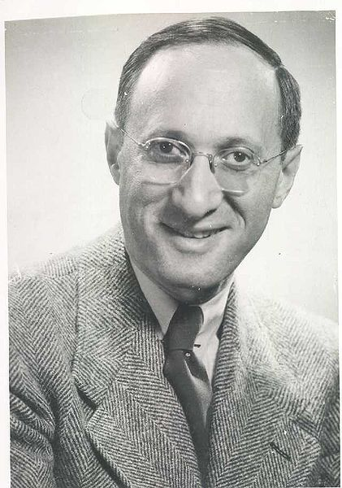
Karnaugh Maps (K-maps)
Maurice Karnaugh (October 4, 1924) is an American physicist, who introduced the Karnaugh map while working at Bell Labs
Source: http://en.wikipedia.org/wiki/File:Eugeneguth.jpg

Slide 41
Karnaugh Maps (K-map)
A K-map is a collection of squares
Each square represents a minterm
The collection of squares is a graphical representation of a Boolean function
Adjacent squares differ in the value of one variable
Alternative algebraic expressions for the same function are derived by recognizing patterns of squares
The K-map can be viewed as
A reorganized version of the truth table
A topologically-warped Venn diagram as used to visualize sets in algebra of sets

Slide 42
Two Variable Maps
Truth Table of F(x,y)
y = 0
y = 1
K-map
x y F
0 0 0 m0
0 1 1 m1
0 0 m2
1 1 1 m3
m
₀ =
m
₁ =
x = 0
x
y
x
y
x = 1
m
₂ =
m
₃ =
x
y
x
y
y = 0
y = 1
x = 0
0
1
x = 1
0
1
F= m1 +m3 = x’y + xy = (x+x’)y = y

Slide 43
K-Map Function Representation
Example: G(x,y) = xy’ + x’y + xy
Simplify using theorems:
G = x (y’+y) + x’y = x.1 +x’y = x + x’y = x + y
Simplify using K-map: cover adjacent cells
G
y = 0
y = 1
x = 0
0
1
x = 1
1
1

Slide 44
Three Variable Maps
A three-variable K-map:
Where each minterm corresponds to the product terms:
Note that if the binary value for an index differs in one bit position, the minterms are adjacent on the K-Map
yz=00
yz=01
yz=11
yz=10
x=0
m₀
m₁
m₃
m₂
x=1
m₄
m₅
m₇
m₆
yz=00
yz=01
yz=11
yz=10
x=0
x
y
z
x
y
z
x
y
z
x
y
z
x=1
x
y
z
x
y
z
x
y
z
x
y
z

Slide 45
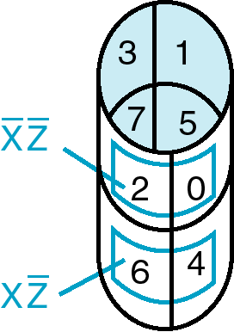
Three variable K-map
y z
x
y
0
1
3
2
x
4
5
7
6
z

Slide 46
Example Functions
By convention, we represent the minterms of F by a "1" in the map and a “0” otherwise
Example:
Example:
y
F
0
3
1
1
1
2
x
4
7
6
1
5
1
z
y
G
0
1
3
2
x
4
5
7
6
z
Notes:
F=XY’+X’Y
G=XZ’+YZ

Slide 47
Example: Combining Squares
y
Example: Let
Applying the Minimization Theorem three times:
Thus the four terms that form a 2 × 2 square correspond to the term "y".
0
3
2
1
1
1
x
4
5
7
6
1
1
z
m2 +m3 +m6 +m7
F
(
x
,
y
,
z
)
=
x
y
z
+
x
y
z
+
x
y
z
+
x
y
z
=
yz
+
y
z
=
y

Slide 48
Three Variable Maps
Use the K-Map to simplify the following Boolean function
y
0
1
3
2
x
4
5
7
6
z
F(x,
y,
z)
= ?
Notes:
F = z + x’y
F = Z + X’Y

Slide 49
Four-Variable Maps
Variables A,B,C and D
C
0
1
3
2
4
5
7
6
B
12
13
15
14
A
8
9
11
10
D
Notice: only one variable changes for adjacent boxes

Slide 50
Four-Variable Maps
Example F= =∑_{m} (0,2,3,5,6,7,8,10,13,15)
C
0
1
3
2
1
1
1
4
5
1
7
1
6
1
12
13
15
14
B
1
1
A
8
9
11
10
1
1
D
F= BD + A’C + B’D’

Slide 51
Four-Variable Map Simplification
F(W,
X,
Y,
Z)
=
Σ
(0,
2,4,5,6,7,
8,10,13,15
)
m
0
1
3
2
4
5
7
6
12
13
15
14
B
A
8
9
11
10
D
F=
Notes:
F = XZ + X'Z‘ + w’x
’
1
1
1
1
X
Y
Z
W
1
1
1
1
1
1
F= XZ + W’X + X’Z’
1
1
1
1
X
Y
Z
W
1
1
1
1
1
1
F= XZ + W’Z’ + X’Z’

Slide 52
2-5 Map Manipulation: Systematic Simplification
A Prime Implicant is a product term obtained by combining the maximum possible number of adjacent squares in the map into a rectangle with the number of squares a power of 2.
A prime implicant is called an Essential Prime Implicant if it is the only prime implicant that covers (includes) one or more minterms.
Prime Implicants and Essential Prime Implicants can be determined by inspection of a K-Map.

Slide 53
Example of Prime Implicants
Find ALL Prime Implicants
CD
ESSENTIAL Prime Implicants
C
C
B
D
B
D
1
1
1
1
1
1
BD
1
1
BD
1
1
B
B
1
1
1
1
A
A
1
1
1
1
1
1
1
1
A
B
D
D
AD
Minterms covered by single prime implicant
B
C

Slide 54
Optimization Algorithm
Find all prime implicants.
Include all essential prime implicants in the solution
Select a minimum cost set of non-essential prime implicants to cover all minterms not yet covered

Slide 55
Previous example: Minimum SOP
Pick all Essential Prime Implicants: B’D’, BD
Add non essential prime implicants: CD (o B’C), AD (or AB’)
CD
B
D
C
1
1
1
1
1
B
F= B’D’+BD +CD+AD
1
1
A
1
1
1
1
AD
D

Slide 56
Selection Rule Example
Simplify F(A, B, C, D) given on the K-map.
Selected
Essential
C
C
1
1
1
1
1
1
1
1
1
1
1
1
B
B
1
1
A
A
1
1
1
1
D
D
Minterms covered by essential prime implicants
Minterm covered by one prime implicant
F = ?
Notes:
F= A’B+A’CD+AC’D+B’C’D’

Slide 57
Exercise
Find all prime, essential implicants for:
Give the minimized SOP implementation
C
B
A
D
Notes:
Prime Implicants are AB, B C' D', A' C' D', A' B' D', A' B' C, A' C D, B C D.

Slide 58
Don't Cares in K-Maps
Sometimes a function table or map contains entries for which it is known:
the input values for the minterm will never occur, or
The output value for the minterm is not used
In these cases, the output value need not be defined
Instead, the output value is defined as a “don't care”
By placing “don't cares” ( an “x” entry) in the function table or map, the cost of the logic circuit may be lowered.
Example 1: A logic function having the binary codes for the BCD digits as its inputs. Only the codes for 0 through 9 are used. The six codes, 1010 through 1111 never occur, so the output values for these codes are “x” to represent “don’t cares.”

Slide 59
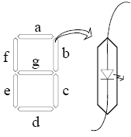
Don’t care example
WXYZ | Digit | a | b
0000 0001 0010 0011 0100 0101 0110 0111 1000 1001 1010 1011 1100 1101 1110 1111 | 0 1 2 3 4 5 6 7 8 9 - | 1 0 1 1 0 1 1 1 1 1 X X X X X X | 1 1 1
a=Σ_{m}(0,2,3,5,6,7,8,9)+ Σ d(10,11,12,13,14,15)
BCD code on a seven segment display:
Y
1
1
1
1
1
1
X
X
X
X
X
outputs
W
1
1
X
X
a b c d… g
?
Z
W X Y Z
Input (BCD)
a=?
Notes:
F=W+Y+XZ+X’Z’

Slide 60
Find SOP for segment “a”
a=Σ_{m}(0,2,3,5,6,7,8,9)+ Σ d(10,11,12,13,14,15)
a=?
Y
1
1
1
1
1
1
X
X
X
X
X
W
1
1
X
X
Z
Notes:
F=W+Y+XZ+X’Z’

Slide 61
Product of Sums Example
Find the optimum POS solution:
Hint: Use F’ and complement it to get the result.
Notes:
F' = B' D' + A' B
F = (B + D)(A + B')

Slide 62
Product of Sums Example
Find the optimum POS solution:
C
Find prime implicants for F’
0
x
1
0
A’B, B’D’, A’C’;
x
0
0
x
F’=A’B + B’D’+A’C’
B
1
1
1
1
Use DeMorgan’s to find F as POS
A
0
1
1
0
Thus F=(A+B’) (B+D) (A+C)
D
Notes:
F' = B' D' + A' B
F = (B + D)(A + B')

Slide 63
Exercises with don’t cares
F(A,B,C,D)=Σ_{m}(2,5,8,10,13,14) +Σd(0,1,6)
Write F as minimized SOP:
F=
Write F as minimized POS
F=
Notes:
F= CD’+B’D’+BC’D
And F’=CD+B’D+BC’D’, thus (e.g. DeMorgan):
F=(C’+D’)(B+D’)(B’+C+D)
1
1
1
1
1
1
X
X
X

Slide 64
Exercise: Design a 2-bit comparator
Design a circuit that has two 2–bit numbers N1 and N2 as inputs, and generates three outputs to indicate if N1<N2, N1=N2 and N1>N2.
Design the circuit as minimized SOP
(N1=N2)
N1=AB
N2=CD
A
F1
F2
F3
B
N1
N2
(N1<N2)
C
(N1>N2)
D
Notes:
See Katz, Ex. 2.3.4 (P75; 1st ed)

Slide 65
Design a 2-bit comparator - Solution

Slide 66
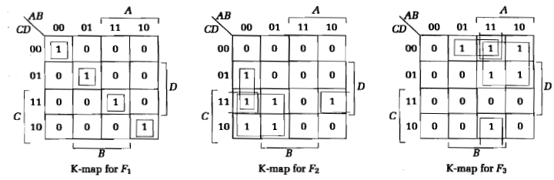
Design a 2-bit comparator - Solution

Slide 67

2-8 Other Gate Types
Why?
Easier to implement on a chip than the AND, OR gates
Convenient conceptual representation
A
B
A
B
(Intel)

Slide 68
Other Gate Types: overview
A
A
B
A
B
A
B
A
B
A B BUF NAND NOR XOR XNOR
0 0 0 1 1 0 1
0 1 0 1 0 1 0
1 0 1 1 0 1 0
1 1 1 0 0 0 1

Slide 69
Buffer
A buffer is a gate with the function F = X:
In terms of Boolean function, a buffer is the same as a connection!
So why use it?
A buffer is an electronic amplifier used to improve circuit voltage levels and increase the speed of circuit operation.
X
F

Slide 70
NAND Gates
X
Y
Z
The NAND gate is the natural implementation for CMOS technology in terms of chip area and speed.
Universal gate - a gate type that can implement any Boolean function.
The NAND gate is a universal gate:
NOT implemented with NAND:
AND implemented with NAND gate:
OR using NAND:
Notes:
NOT: A=B and OUT=(AB)’
NAND: AND + NOT
NOR: DeMorgan’s: (A+B) = (A+B)’’= (A’B’)’

Slide 71
NOR Gates
A
B
Similary as the NAND gate, the NOR gate is a Universal gate
Universal gate - a gate type that can implement any Boolean function.
With a NOR gate one can implement
A NOT
An AND
An OR
Notes:
NOT: A=B and OUT=(A+B)’
OR: NOR+ NOT
NAND : DeMorgan’s: (AB) = (AB)’’= (A’+B’)’

Slide 72
2-9 Exclusive OR/ Exclusive NOR
The eXclusive OR (XOR) function is an important Boolean function used extensively in logic circuits:
Adders/subtractors/multipliers
Counters/incrementers/decrementers
Parity generators/checkers
The eXclusive NOR function (XNOR) is the complement of the XOR function
XOR and XNOR gates are complex gates (built from simpler gates, such as AND, Not, etc).

Slide 73
Truth Tables for XOR/XNOR
XOR
The XOR function means:
X OR Y, but NOT BOTH
The XNOR function also known as the equivalence function, denoted by the operator ≡
XNOR
X
Y
X
⊕
Y
X
Y
(X
⊕
Y)
or X
≡
Y
0
0
0
0
0
1
0
1
1
0
1
0
1
0
1
1
0
0
1
1
0
1
1
1
Notes:
Because it is defined as X Y + X’ Y’ that equals 1 if and only if X = Y implying X is equivalent to Y.

Slide 74
XOR Implementations
The simple SOP implementation uses the following structure:
A NAND only implementation is:
X
X
⊕
Y
=
X
Y
+
X
Y
X
Y
Y
X
X
Y
Y
Notes:
Prove: XY’+X’Y = (XX’+XY’+YY’+X’Y)= X(X’+Y’) +Y(X’+Y’) =X.(XY)’+Y(XY)’
=[(X.(XY)’)’.(Y(XY)’)’]’’
Nand: Verify
(((XY)’.X)’. ((XY)’.Y)’)’
= ((XY)’.X)+((XY)’.X)
=(X’+Y’)X + (X’+Y’)Y
=XY’+X’Y

Slide 75
Odd and Even Functions
The odd and even functions on a K-map form “checkerboard” patterns.
The 1s of an odd function correspond to minterms having an index with an odd number of 1s.
The 1s of an even function correspond to minterms having an index with an even number of 1s.
Implementation of odd and even functions for greater than four variables as a two-level circuit is difficult, so we use “trees” made up of :
2-input XOR or XNORs
3- or 4-input odd or even functions

Slide 76
Example: Odd Function Implementation
+
+
Design a 3-input odd function F = X Y Z with 2-input XOR gates
Factoring, F = (X Y) Z
The circuit:
+
+
X
Y
F
Z

Slide 77
Example: 4-Input Function Implementation
Design a 4-input odd function F = W X Y Z with 2-input XOR and XNOR gates
Factoring, F = (W X) (Y Z)
The circuit:
+
+
+
+
+
+
W
X
F
Y
Z

Slide 78
Parity Generators and Checkers
In Chapter 1, a parity bit added to n-bit code to produce an n + 1 bit code:
Add odd parity bit to generate code words with even parity
Add even parity bit to generate code words with odd parity
Use odd parity circuit to check code words with even parity
Use even parity circuit to check code words with odd parity

Slide 79
Parity Generators and Checkers
Example: n = 3. Generate even parity code words of length four with odd parity generator:
Check even parity code words of length four with odd parity checker
Operation: (X,Y,Z) = (0,0,1) gives (X,Y,Z,P) = (0,0,1,1) and E = 0. If Y changes from 0 to 1 between generator and checker, then E = 1 indicates an error.
X
0
0
1
Y
0
1
0
0
1
X
E
Y
Z
1
1
Error
P
=1
P
Z

Slide 80
2-10 Hi-Impedance Outputs
Logic gates introduced thus far
have 1 and 0 output values,
cannot have their outputs connected together, and
transmit signals on connections in only one direction.
Three-state (or Tri-state) logic adds a third logic value, Hi-Impedance (Hi-Z), giving three states: 0, 1, and Hi-Z on the outputs.
What is a Hi-Z value?
The Hi-Z value behaves as an open circuit
This means that, looking back into the circuit, the output appears to be disconnected.

Slide 81
The Tri-State Buffer
Symbol
For the symbol and truth table, IN is the data input, and EN, the control input.
For EN = 0, regardless of the value on IN (denoted by X), the output value is Hi-Z.
For EN = 1, the output value follows the input value.
Variations:
Data input, IN, can be inverted
Control input, EN, can be inverted
by addition of “bubbles” to signals.
IN
OUT
EN
Truth Table
EN
IN
OUT
0
X
Hi-Z
1
0
0
1
1
1
OUT= IN.EN

Slide 82
Tri-State Logic Circuit
Data Selection Function: If s = 0, OL = IN0, else OL = IN1
Performing data selection with 3-state buffers:
Since EN0 = S and EN1 = S, one of the two buffer outputs is always Hi-Z plus the last row of the table never occurs.
IN0
EN0
OL
OL= IN0.S’ + IN1.S
S
IN1
EN1

Slide 83
Exercise
Implement a gate with two three-state buffers and two inverters:
F = X Y=XY’+X’Y
⊕
X
EN0=Y’
F
Y
X’
EN1=Y

Slide 84
Other usage of Tristate buffers
Tristate bus connecting multiple chips:
from bus
Processor
To bus
EN1
Shared bus
Memory
from bus
To bus
EN2
Video
from bus
To bus
EN3

