Slide 1
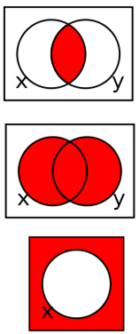
Chapter 3
Combinational Logic Circuits
Gate-Level Minimization
A
F
B

Slide 2
Please Read Ch-3 From Book

Slide 3
Overview Chapter 3
Map Manipulation
Other Gate Types
Exclusive-OR Operator and Gates
High-Impedance Outputs
Nand Nor Implementaions
Notes:
In this chapter we will introduce logic gates which are the simplest logic elements. However, they form the foundation of more complex blocks which will be discussed in later chapters.
We will also discuss the mathematical tools that are required to design, analyze and simplify logic function (Boolean Algebra): optimization techniques

Slide 4
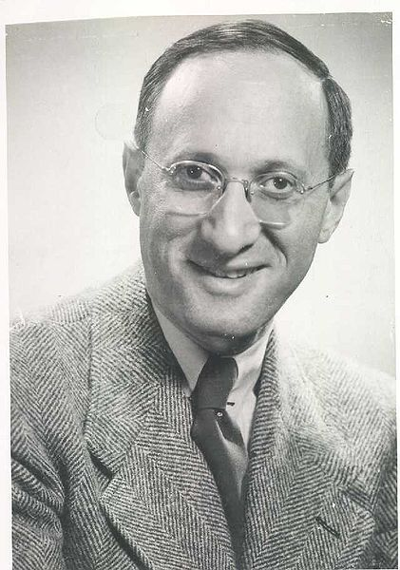
Karnaugh Maps (K-maps)
Maurice Karnaugh (October 4, 1924) is an American physicist, who introduced the Karnaugh map while working at Bell Labs
Source: http://en.wikipedia.org/wiki/File:Eugeneguth.jpg

Slide 5
Karnaugh Maps (K-map)
A K-map is a collection of squares
Each square represents a minterm
The collection of squares is a graphical representation of a Boolean function
Adjacent squares differ in the value of one variable
Alternative algebraic expressions for the same function are derived by recognizing patterns of squares
The K-map can be viewed as
A reorganized version of the truth table
A topologically-warped Venn diagram as used to visualize sets in algebra of sets

Slide 6
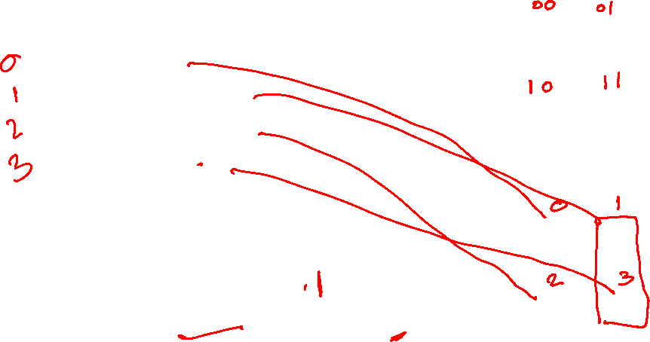
Two Variable Maps
Truth Table of F(x,y)
y = 0
y = 1
K-map
x y F
0 0 0 m0
0 1 1 m1
0 0 m2
1 1 1 m3
m
₀ =
m
₁ =
x = 0
x
y
x
y
x = 1
m
₂ =
m
₃ =
x
y
x
y
y = 0
y = 1
x = 0
0
1
x = 1
0
1
F= m1 +m3 = x’y + xy = (x+x’)y = y

Slide 7

K-Map Function Representation
Example: G(x,y) = xy’ + x’y + xy
Simplify using theorems:
G = x (y’+y) + x’y = x.1 +x’y = x + x’y = x + y
Simplify using K-map: cover adjacent cells
G
y = 0
y = 1
x = 0
0
1
x = 1
1
1

Slide 8

Three Variable Maps
A three-variable K-map:
Where each minterm corresponds to the product terms:
Note that if the binary value for an index differs in one bit position, the minterms are adjacent on the K-Map
yz=00
yz=01
yz=11
yz=10
x=0
m₀
m₁
m₃
m₂
x=1
m₄
m₅
m₇
m₆
yz=00
yz=01
yz=11
yz=10
x=0
x
y
z
x
y
z
x
y
z
x
y
z
x=1
x
y
z
x
y
z
x
y
z
x
y
z

Slide 9

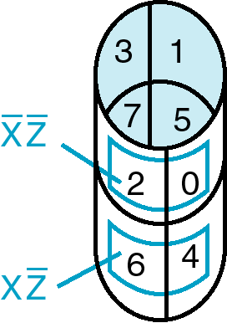
Three variable K-map
y z
x
y
0
1
3
2
x
4
5
7
6
z

Slide 10

Example Functions
By convention, we represent the minterms of F by a "1" in the map and a “0” otherwise
Example:
Example:
y
F
0
3
1
1
1
2
x
4
7
6
1
5
1
z
y
G
0
1
3
2
x
4
5
7
6
z
Notes:
F=XY’+X’Y
G=XZ’+YZ

Slide 11
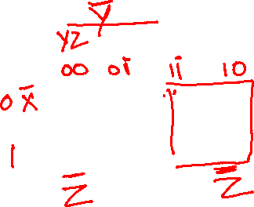
Example: Combining Squares
y
Example: Let
Applying the Minimization Theorem three times:
Thus the four terms that form a 2 × 2 square correspond to the term "y".
0
3
2
1
1
1
x
4
5
7
6
1
1
z
m2 +m3 +m6 +m7
F
(
x
,
y
,
z
)
=
x
y
z
+
x
y
z
+
x
y
z
+
x
y
z
=
yz
+
y
z
=
y

Slide 12
Three Variable Maps
Use the K-Map to simplify the following Boolean function
y
0
1
3
2
x
4
5
7
6
z
F(x,
y,
z)
= ?
Notes:
F = z + x’y
F = Z + X’Y

Slide 13
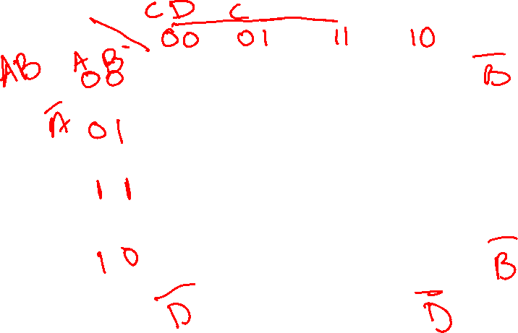
Four-Variable Maps
Variables A,B,C and D
C
0
1
3
2
4
5
7
6
B
12
13
15
14
A
8
9
11
10
D
Notice: only one variable changes for adjacent boxes

Slide 14
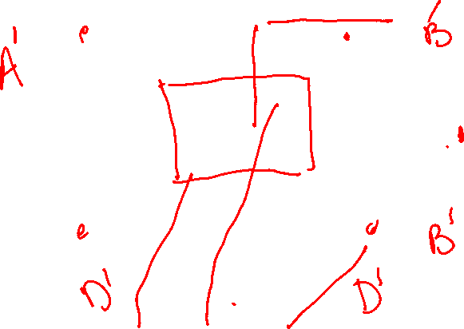
Four-Variable Maps
Example F= =∑_{m} (0,2,3,5,6,7,8,10,13,15)
C
0
1
3
2
1
1
1
4
5
1
7
1
6
1
12
13
15
14
B
1
1
A
8
9
11
10
1
1
D
F= BD + A’C + B’D’

Slide 15
Four-Variable Map Simplification
F(W,
X,
Y,
Z)
=
Σ
(0,
2,4,5,6,7,
8,10,13,15
)
m
0
1
3
2
4
5
7
6
12
13
15
14
B
A
8
9
11
10
D
F=
Notes:
F = XZ + X'Z‘ + w’x
’
1
1
1
1
X
Y
Z
W
1
1
1
1
1
1
F= XZ + W’X + X’Z’
1
1
1
1
X
Y
Z
W
1
1
1
1
1
1
F= XZ + W’Z’ + X’Z’

Slide 16
2-5 Map Manipulation: Systematic Simplification
A Prime Implicant is a product term obtained by combining the maximum possible number of adjacent squares in the map into a rectangle with the number of squares a power of 2.
A prime implicant is called an Essential Prime Implicant if it is the only prime implicant that covers (includes) one or more minterms.
Prime Implicants and Essential Prime Implicants can be determined by inspection of a K-Map.

Slide 17

Example of Prime Implicants
Find ALL Prime Implicants
CD
ESSENTIAL Prime Implicants
C
C
B
D
B
D
1
1
1
1
1
1
BD
1
1
BD
1
1
B
B
1
1
1
1
A
A
1
1
1
1
1
1
1
1
A
B
D
D
AD
Minterms covered by single prime implicant
B
C

Slide 18
Optimization Algorithm
Find all prime implicants.
Include all essential prime implicants in the solution
Select a minimum cost set of non-essential prime implicants to cover all minterms not yet covered

Slide 19
Previous example: Minimum SOP
Pick all Essential Prime Implicants: B’D’, BD
Add non essential prime implicants: CD (o B’C), AD (or AB’)
CD
B
D
C
1
1
1
1
1
B
F= B’D’+BD +CD+AD
1
1
A
1
1
1
1
AD
D

Slide 20
Selection Rule Example
Simplify F(A, B, C, D) given on the K-map.
Selected
Essential
C
C
1
1
1
1
1
1
1
1
1
1
1
1
B
B
1
1
A
A
1
1
1
1
D
D
Minterms covered by essential prime implicants
Minterm covered by one prime implicant
F = ?
Notes:
F= A’B+A’CD+AC’D+B’C’D’

Slide 21
Exercise
Find all prime, essential implicants for:
Give the minimized SOP implementation
C
B
A
D
Notes:
Prime Implicants are AB, B C' D', A' C' D', A' B' D', A' B' C, A' C D, B C D.

Slide 22
Don't Cares in K-Maps
Sometimes a function table or map contains entries for which it is known:
the input values for the minterm will never occur, or
The output value for the minterm is not used
In these cases, the output value need not be defined
Instead, the output value is defined as a “don't care”
By placing “don't cares” ( an “x” entry) in the function table or map, the cost of the logic circuit may be lowered.
Example 1: A logic function having the binary codes for the BCD digits as its inputs. Only the codes for 0 through 9 are used. The six codes, 1010 through 1111 never occur, so the output values for these codes are “x” to represent “don’t cares.”

Slide 23
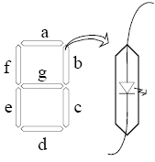

Don’t care example
WXYZ | Digit | a | b
0000 0001 0010 0011 0100 0101 0110 0111 1000 1001 1010 1011 1100 1101 1110 1111 | 0 1 2 3 4 5 6 7 8 9 - | 1 0 1 1 0 1 1 1 1 1 X X X X X X | 1 1 1
a=Σ_{m}(0,2,3,5,6,7,8,9)+ Σ d(10,11,12,13,14,15)
BCD code on a seven segment display:
Y
1
1
1
1
1
1
X
X
X
X
X
outputs
W
1
1
X
X
a b c d… g
?
Z
W X Y Z
Input (BCD)
a=?
Notes:
F=W+Y+XZ+X’Z’

Slide 24

Find SOP for segment “a”
a=Σ_{m}(0,2,3,5,6,7,8,9)+ Σ d(10,11,12,13,14,15)
a=?
Y
1
1
1
1
1
1
X
X
X
X
X
W
1
1
X
X
Z
Notes:
F=W+Y+XZ+X’Z’

Slide 25
Find SOP for segment “a”
a=Σ_{m}(0,2,3,5,6,7,8)+ Σ d(1,9,10,11,12,13,14)
a=?
Y
1
1
1
X
1
1
1
X
X
X
X
W
1
X
X
X
Z
Notes:
F=W+Y+XZ+X’Z’

Slide 26
Product of Sums Example
Find the optimum POS solution:
Hint: Use F’ and complement it to get the result.
Notes:
F' = B' D' + A' B
F = (B + D)(A + B')

Slide 27

Product of Sums Example
Find the optimum POS solution:
C
Find prime implicants for F’
0
x
1
0
A’B, B’D’, A’C’;
x
0
0
x
F’=A’B + B’D’+A’C’
B
1
1
1
1
Use DeMorgan’s to find F as POS
A
0
1
1
0
Thus F=(A+B’) (B+D) (A+C)
D
Notes:
F' = B' D' + A' B
F = (B + D)(A + B')

Slide 28
Exercises with don’t cares
F(A,B,C,D)=Σ_{m}(2,5,8,10,13,14) +Σd(0,1,6)
Write F as minimized SOP:
F=
Write F as minimized POS
F=
Notes:
F= CD’+B’D’+BC’D
And F’=CD+B’D+BC’D’, thus (e.g. DeMorgan):
F=(C’+D’)(B+D’)(B’+C+D)
1
1
1
1
1
1
X
X
X

Slide 29
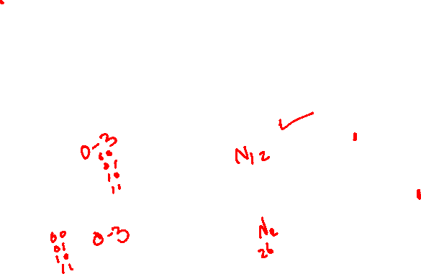
Exercise: Design a 2-bit comparator
Design a circuit that has two 2–bit numbers N1 and N2 as inputs, and generates three outputs to indicate if N1<N2, N1=N2 and N1>N2.
Design the circuit as minimized SOP
(N1=N2)
N1=AB
N2=CD
A
F1
F2
F3
B
N1
N2
(N1<N2)
C
(N1>N2)
D
Notes:
See Katz, Ex. 2.3.4 (P75; 1st ed)

Slide 30
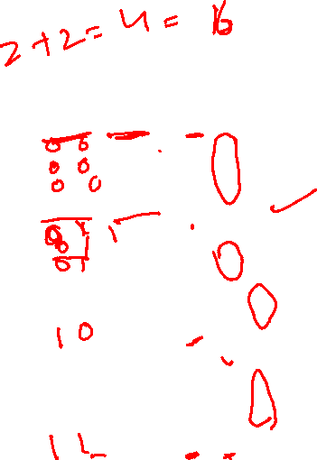
Design a 2-bit comparator - Solution

Slide 31
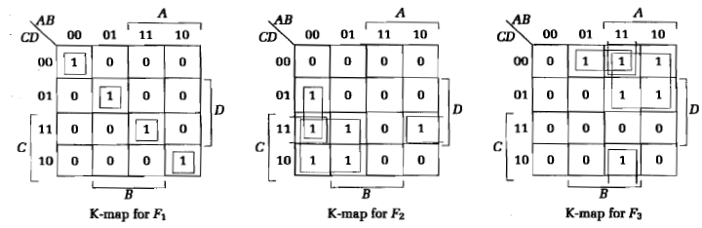

Design a 2-bit comparator - Solution

Slide 32


Other Gate Types
Why?
Easier to implement on a chip than the AND, OR gates
Convenient conceptual representation
A
B
A
B
(Intel)

Slide 33

Other Gate Types: overview
A
A
B
A
B
A
B
A
B
A B BUF NAND NOR XOR XNOR
0 0 0 1 1 0 1
0 1 0 1 0 1 0
1 0 1 1 0 1 0
1 1 1 0 0 0 1

Slide 34

Buffer
A buffer is a gate with the function F = X:
In terms of Boolean function, a buffer is the same as a connection!
So why use it?
A buffer is an electronic amplifier used to improve circuit voltage levels and increase the speed of circuit operation.
X
F

Slide 35
NAND Gates
X
Y
Z
The NAND gate is the natural implementation for CMOS technology in terms of chip area and speed.
Universal gate - a gate type that can implement any Boolean function.
The NAND gate is a universal gate:
NOT implemented with NAND:
AND implemented with NAND gate:
OR using NAND:
Notes:
NOT: A=B and OUT=(AB)’
NAND: AND + NOT
NOR: DeMorgan’s: (A+B) = (A+B)’’= (A’B’)’

Slide 36
NOR Gates
A
B
Similary as the NAND gate, the NOR gate is a Universal gate
Universal gate - a gate type that can implement any Boolean function.
With a NOR gate one can implement
A NOT
An AND
An OR
Notes:
NOT: A=B and OUT=(A+B)’
OR: NOR+ NOT
NAND : DeMorgan’s: (AB) = (AB)’’= (A’+B’)’

Slide 37

Exclusive OR/ Exclusive NOR
The eXclusive OR (XOR) function is an important Boolean function used extensively in logic circuits:
Adders/subtractors/multipliers
Counters/incrementers/decrementers
Parity generators/checkers
The eXclusive NOR function (XNOR) is the complement of the XOR function
XOR and XNOR gates are complex gates (built from simpler gates, such as AND, Not, etc).

Slide 38
Truth Tables for XOR/XNOR
XOR
The XOR function means:
X OR Y, but NOT BOTH
The XNOR function also known as the equivalence function, denoted by the operator ≡
XNOR
X
Y
X
⊕
Y
X
Y
(X
⊕
Y)
or X
≡
Y
0
0
0
0
0
1
0
1
1
0
1
0
1
0
1
1
0
0
1
1
0
1
1
1
Notes:
Because it is defined as X Y + X’ Y’ that equals 1 if and only if X = Y implying X is equivalent to Y.

Slide 39
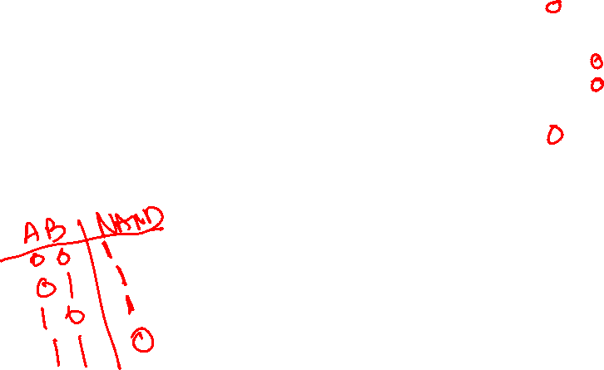
XOR Implementations
The simple SOP implementation uses the following structure:
A NAND only implementation is:
X
X
⊕
Y
=
X
Y
+
X
Y
X
Y
Y
X
X
Y
Y
Notes:
Prove: XY’+X’Y = (XX’+XY’+YY’+X’Y)= X(X’+Y’) +Y(X’+Y’) =X.(XY)’+Y(XY)’
=[(X.(XY)’)’.(Y(XY)’)’]’’
Nand: Verify
(((XY)’.X)’. ((XY)’.Y)’)’
= ((XY)’.X)+((XY)’.X)
=(X’+Y’)X + (X’+Y’)Y
=XY’+X’Y

Slide 40

Odd and Even Functions
Incompletely specified function in the truth table is interpreted as Incompletely specified function in the truth table is interpreted as Incompletely specified function in the truth table is interpreted as.
The 1s of an odd function correspond to minterms having an index with an odd number of 1s.
The 1s of an even function correspond to minterms having an index with an even number of 1s.
Implementation of odd and even functions for greater than four variables as a two-level circuit is difficult, so we use “trees” made up of :
2-input XOR or XNORs
3- or 4-input odd or even functions

Slide 41
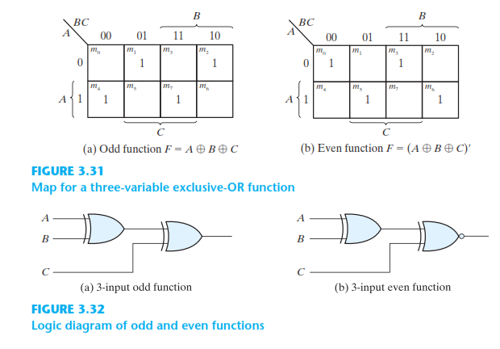

Odd and Even Functions

Slide 42
Example: Odd Function Implementation
+
+
Design a 3-input odd function F = X Y Z with 2-input XOR gates
Factoring, F = (X Y) Z
The circuit:
+
+
X
Y
F
Z

Slide 43

Example: 4-Input Function Implementation
Design a 4-input odd function F = W X Y Z with 2-input XOR and XNOR gates
Factoring, F = (W X) (Y Z)
The circuit:
+
+
+
+
+
+
W
X
F
Y
Z

Slide 44
Parity Generators and Checkers
In Chapter 1, a parity bit added to n-bit code to produce an n + 1 bit code:
Add odd parity bit to generate code words with even parity
Add even parity bit to generate code words with odd parity
Use odd parity circuit to check code words with even parity
Use even parity circuit to check code words with odd parity

Slide 45
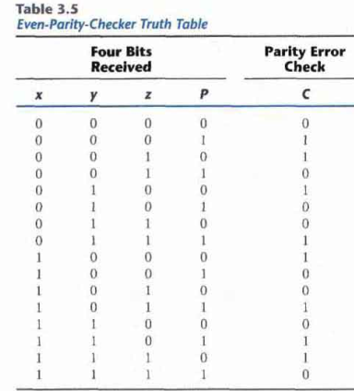
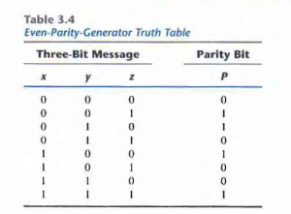
Parity Generators and Checkers

Slide 46
Parity Generators and Checkers
Example: n = 3. Generate even parity code words of length four with odd parity generator:
Check even parity code words of length four with odd parity checker
Operation: (X,Y,Z) = (0,0,1) gives (X,Y,Z,P) = (0,0,1,1) and E = 0. If Y changes from 0 to 1 between generator and checker, then E = 1 indicates an error.
X
0
0
1
Y
0
1
0
0
1
X
E
Y
Z
1
1
Error
P
=1
P
Z

Slide 47
Hi-Impedance Outputs
Logic gates introduced thus far
have 1 and 0 output values,
cannot have their outputs connected together, and
transmit signals on connections in only one direction.
Three-state (or Tri-state) logic adds a third logic value, Hi-Impedance (Hi-Z), giving three states: 0, 1, and Hi-Z on the outputs.
What is a Hi-Z value?
The Hi-Z value behaves as an open circuit
This means that, looking back into the circuit, the output appears to be disconnected.

Slide 48
The Tri-State Buffer
Symbol
For the symbol and truth table, IN is the data input, and EN, the control input.
For EN = 0, regardless of the value on IN (denoted by X), the output value is Hi-Z.
For EN = 1, the output value follows the input value.
Variations:
Data input, IN, can be inverted
Control input, EN, can be inverted
by addition of “bubbles” to signals.
IN
OUT
EN
Truth Table
EN
IN
OUT
0
X
Hi-Z
1
0
0
1
1
1
OUT= IN.EN

Slide 49
Tri-State Logic Circuit
Data Selection Function: If s = 0, OL = IN0, else OL = IN1
Performing data selection with 3-state buffers:
Since EN0 = S and EN1 = S, one of the two buffer outputs is always Hi-Z plus the last row of the table never occurs.
IN0
EN0
OL
OL= IN0.S’ + IN1.S
S
IN1
EN1

Slide 50
Exercise
Implement a gate with two three-state buffers and two inverters:
F = X Y=XY’+X’Y
⊕
X
EN0=Y’
F
Y
X’
EN1=Y

Slide 51
Other usage of Tristate buffers
Tristate bus connecting multiple chips:
from bus
Processor
To bus
EN1
Shared bus
Memory
from bus
To bus
EN2
Video
from bus
To bus
EN3

Slide 52
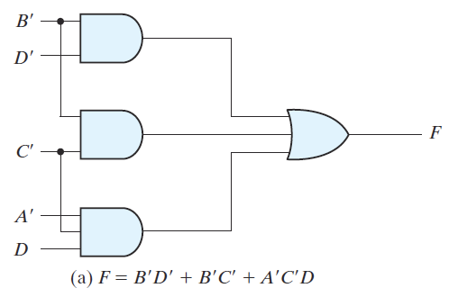
Boolean function implementation
convert Boolean function expression into logic circuit
Example: F = B'D' + B'C' + A'C'D

Slide 53
AND-OR implementation
any Boolean function can be represented using only AND, OR, and NOT gates
why?
sum-of-minterms and sum-of-product forms can be directly converted into two-level AND-OR implementation

Slide 54
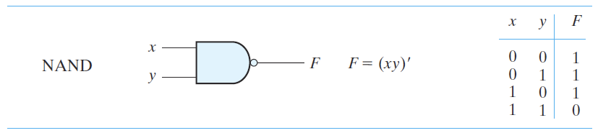
NAND implementation
NAND gates are easy to fabricate
any Boolean function can be represented using only NAND gates
why?
answer in the next 2 slides

Slide 55

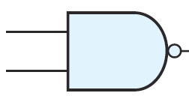


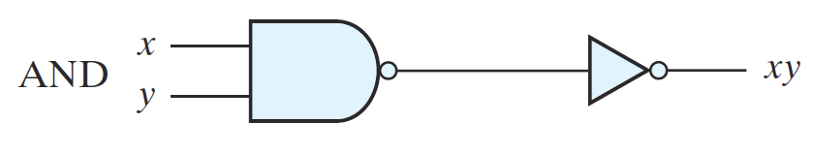
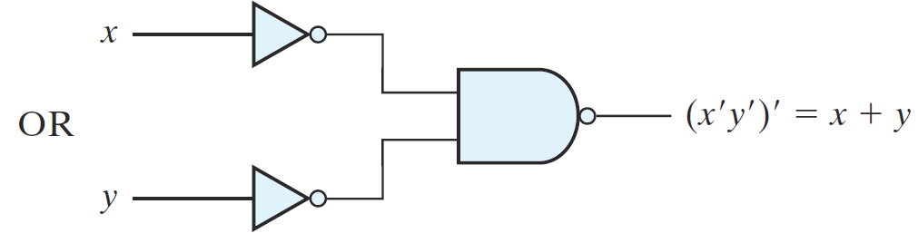
NAND implementation (contd.)‏
AND, OR, and NOT gates can represented using NAND gates

Slide 56
NAND implementation (contd.)‏
any Boolean function can be represented using only AND, OR, and NOT gates
AND, OR, and NOT gates can represented using NAND gates
Then?
NAND is a universal gate.

Slide 57
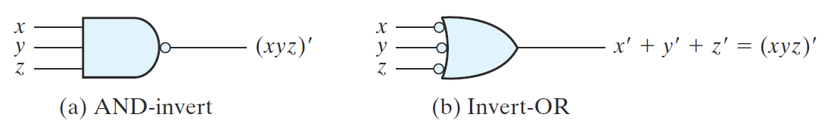
how to get a NAND implementation
first, note that NAND gate can be:
start with AND-OR implementation
insert pairs of bubbles (NOT gates)‏
works with alternating levels of AND and OR gates: AND-OR, AND-OR-AND-OR, etc.

Slide 58
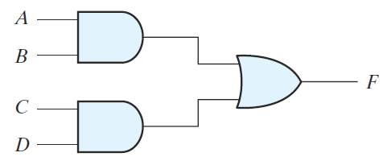
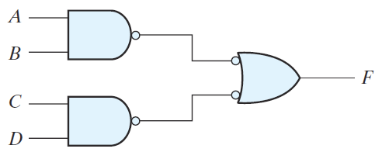
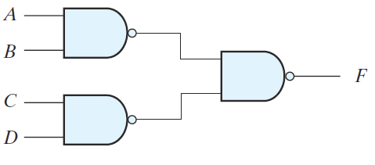
how to get a NAND implementation (contd.)‏

Slide 59
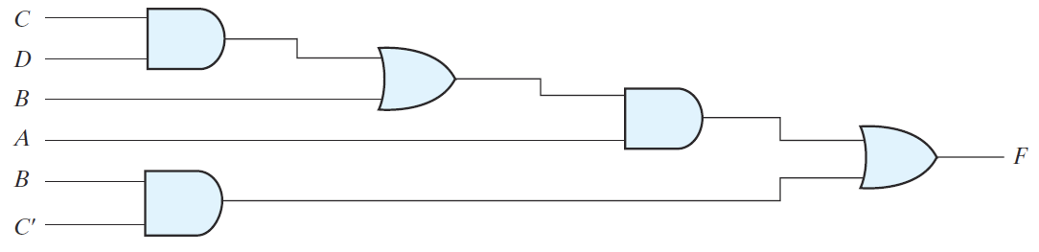
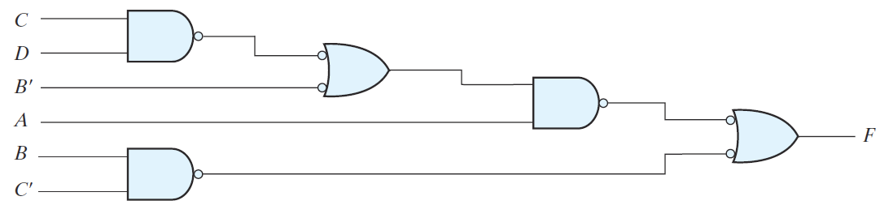
how to get a NAND implementation (contd.)‏

Slide 60
other two-level implementations
8 degenerate (AND-AND) : one operation
8 nondegenerate
AND-AND AND-OR AND-NAND AND-NOR
OR-AND OR-OR OR-NAND OR-NOR
NAND-AND NAND-OR NAND-NAND NAND-NOR
NOR-AND NOR-OR NOR-NAND NOR-NOR
which ones are duals?
which ones are equivalent?

Slide 61
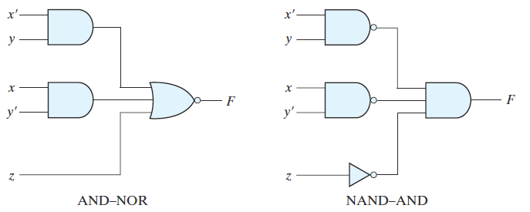
AND-NOR, NAND-AND
how to get AND-NOR of a function?
F' in sum-of-products (AND-OR)‏
F in AND-NOR

Slide 62
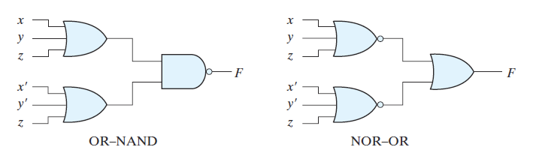
OR-NAND, NOR-OR
how to get OR-NAND of a function?
F' in product-of-sums (OR-AND)‏
F in OR-NAND

Slide 63
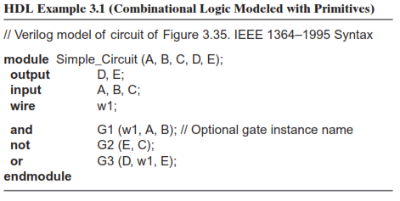
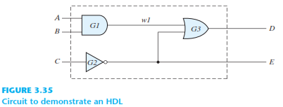
HARDWARE DESCRIPTION LANGUAGE

