Slide 1
Instrutions
Read Chapter and 4 from Text

Slide 2
Combinational Logic

Slide 3
Combinational Circuits
A combinational logic circuit has:
A set of m Boolean inputs,
A set of n Boolean outputs, and
n switching functions, each mapping the 2^{m} input combinations to an output such that the current output depends only on the current input values
A block diagram:
Combinatorial
Logic
Circuit
m Boolean Inputs
n Boolean Outputs

Slide 4
Design Procedure
Specification
Write a specification for the circuit if one is not already available
Formulation
Derive a truth table or initial Boolean equations that define the required relationships between the inputs and outputs, if not in the specification
Apply hierarchical design if appropriate
Optimization
Apply 2-level and multiple-level optimization
Draw a logic diagram or provide a netlist for the resulting circuit using ANDs, ORs, and inverters

Slide 5
Design Procedure
Technology Mapping
Map the logic diagram or netlist to the implementation technology selected
Verification
Verify the correctness of the final design manually or using simulation

Slide 6
Design Example
Specification
BCD to Excess-3 code converter
Transforms BCD code for the decimal digits to Excess-3 code for the decimal digits
BCD code words for digits 0 through 9: 4-bit patterns 0000 to 1001, respectively
Excess-3 code words for digits 0 through 9: 4-bit patterns consisting of 3 (binary 0011) added to each BCD code word
Implementation:
multiple-level circuit
NAND gates (including inverters)

Slide 7
Design Example (continued)
Formulation
Conversion of 4-bit codes can be most easily formulated by a truth table
Variables - BCD: A,B,C,D
Variables - Excess-3 W,X,Y,Z
Don’t Cares - BCD 1010 to 1111

Slide 8
Design Example (continued)
C
C
Optimization
2-level using K-maps
W = A + BC + BD
X = C + D + B
Y = CD +
Z =
z
y
1
1
1
1
0
1
3
2
0
1
3
2
1
1
1
1
4
5
7
6
B
4
5
7
6
B
X
X
X
X
X
X
X
X
A
12
13
15
14
A
12
13
15
14
1
X
X
1
X
X
B
B
C
D
8
9
11
10
8
9
11
10
D
D
C
D
D
x
C
C
w
1
1
1
0
1
3
2
0
1
3
2
1
1
1
1
4
5
7
6
B
4
5
7
6
B
X
X
X
X
X
X
X
X
A
12
13
15
14
A
12
13
15
14
1
X
X
1
1
X
X
8
9
11
10
8
9
11
10
D
D

Slide 9
Design Example (continued)
Optimization (continued)
Multiple-level using transformations W = A + BC + BD X = C + D + B Y = CD + Z = G = 7 + 10 + 6 + 0 = 23
Perform extraction, finding factor:
T₁ = C + D W = A + BT₁ X = T₁ + B Y = CD + Z = G = 2 + 1 + 4 + 7 + 6 + 0 = 19
B
B
C
D
C
D
D
B
C
D
C
D
D

Slide 10
Design Example (continued)
Optimization (continued)
Multiple-level using transformations T₁ = C + D W = A + BT₁ X = T₁ + B Y = CD + Z = G = 19
An additional extraction not shown in the text since it uses a Boolean transformation: ( = C + D = ):
W = A + BT₁ X = T₁ + B Y = CD + Z = G = 2 +1 + 4 + 6 + 4 + 0 = 16!
B
C
D
C
D
D
C
D
T₁
B
T₁
T₁
D

Slide 11

Design Example (continued)
W = A + BT₁ X = T₁ + B Y = CD + Z =
B
T₁
Technology Mapping
Mapping with a library containing inverters and 2-input NAND, 2-input NOR, and 2-2 AOI gates
T₁
D
A
W
B
X
C
Y
D
Z

Slide 12
Beginning Hierarchical Design
To control the complexity of the function mapping inputs to outputs:
Decompose the function into smaller pieces called blocks
Decompose each block’s function into smaller blocks, repeating as necessary until all blocks are small enough
Any block not decomposed is called a primitive block
The collection of all blocks including the decomposed ones is a hierarchy
Example: 9-input parity tree (see next slide)
Top Level: 9 inputs, one output
2nd Level: Four 3-bit odd parity trees in two levels
3rd Level: Two 2-bit exclusive-OR functions
Primitives: Four 2-input NAND gates
Design requires 4 X 2 X 4 = 32 2-input NAND gates

Slide 13
Hierarchy for Parity Tree Example
X
0
X
1
X
2
9-Input
X
3
odd
X
Z
4
O
X
function
5
X
X
A
6
0
0
3-Input
X
7
A
odd
X
X
1
B
8
1
function
O
(a) Symbol for circuit
X
A
2
2
X
3
A
A
0
3-Input
0
3-Input
X
A
odd
B
A
odd
B
Z
4
1
function
O
1
function
O
O
X
A
A
5
2
2
X
A
6
0
3-Input
X
A
odd
B
7
1
function
O
X
A
8
2
(b) Circuit as interconnected 3-input odd
function blocks
A
0
A
B
1
O
A
2
(c) 3-input odd function circuit as
interconnected exclusive-OR
blocks
(d) Exclusive-OR block as interconnected
NANDs

Slide 14
Reusable Functions
Whenever possible, we try to decompose a complex design into common, reusable function blocks
These blocks are
verified and well-documented
placed in libraries for future use

Slide 15
Top-Down versus Bottom-Up
A top-down design proceeds from an abstract, high-level specification to a more and more detailed design by decomposition and successive refinement
A bottom-up design starts with detailed primitive blocks and combines them into larger and more complex functional blocks
Design usually proceeds top-down to known building blocks ranging from complete CPUs to primitive logic gates or electronic components.
Much of the material in this chapter is devoted to learning about combinational blocks used in top-down design.

Slide 16
NAND Mapping Example

Slide 17
NOR Mapping Example
A
A
B
B
2
1
X
C
F
C
3
F
D
D
E
E
(a)
A
(b)
B
C
F
D
E
(c)

Slide 18
Verification
Verification - show that the final circuit designed implements the original specification
Simple specifications are:
truth tables
Boolean equations
HDL code
If the above result from formulation and are not the original specification, it is critical that the formulation process be flawless for the verification to be valid!

Slide 19
Basic Verification Methods
Manual Logic Analysis
Find the truth table or Boolean equations for the final circuit
Compare the final circuit truth table with the specified truth table, or
Show that the Boolean equations for the final circuit are equal to the specified Boolean equations
Simulation
Simulate the final circuit (or its netlist, possibly written as an HDL) and the specified truth table, equations, or HDL description using test input values that fully validate correctness.
The obvious test for a combinational circuit is application of all possible “care” input combinations from the specification

Slide 20
Verification Example: Simulation
Simulation procedure:
Use a schematic editor or text editor to enter a gate level representation of the final circuit
Use a waveform editor or text editor to enter a test consisting of a sequence of input combinations to be applied to the circuit
This test should guarantee the correctness of the circuit if the simulated responses to it are correct
Short of applying all possible “care” input combinations, generation of such a test can be difficult

Slide 21
Verification Example: Simulation
Enter BCD-to-Excess-3 Code Converter Circuit Schematic
AOI symbol not available

Slide 22
Verification Example: Simulation
Enter waveform that applies all possible input combinations:
Are all BCD input combinations present? (Low is a 0 and high is a one)
Notes:
Yes, 0000 through 1001 are present.

Slide 23
Verification Example: Simulation
Run the simulation of the circuit for 120 ns
Do the simulation output combinations match the original truth table?
Notes:
Yes, the output combinations 0011 through 1100 occur in response to 0000 through 1001, respectively.

Slide 24
Functions and Functional Blocks
The functions considered are those found to be very useful in design
Corresponding to each of the functions is a combinational circuit implementation called a functional block.
In the past, functional blocks were packaged as small-scale-integrated (SSI), medium-scale integrated (MSI), and large-scale-integrated (LSI) circuits.
Today, they are often simply implemented within a very-large-scale-integrated (VLSI) circuit.

Slide 25
Rudimentary Logic Functions
Functions of a single variable X
Can be used on the inputs to functional blocks to implement other than the block’s intended function
T
A
BLE 4-1
Functions of
One
V
a
ria
b
le
X
F
= 0
F
= X
F
=
X
F = 1
0
0
0
1
1
1
0
1
0
1

Slide 26
Multiple-bit Rudimentary Functions
Multi-bit Examples:
A wide line is used to represent a bus which is a vector signal
In (b) of the example, F = (F₃, F₂, F₁, F₀) is a bus.
The bus can be split into individual bits as shown in (b)
Sets of bits can be split from the bus as shown in (c) for bits 2 and 1 of F.
The sets of bits need not be continuous as shown in (d) for bits 3, 1, and 0 of F.
A
F
A
3
3
2
1
F
1
2
4
4
2:1
F(2:1)
2
F
0
F
0
F
1
1
A
0
(c)
F
0
A
(a)
(b)
3
4
3,1:0
F(3), F(1:0)
F
(d)

Slide 27
Enabling Function
Enabling permits an input signal to pass through to an output
Disabling blocks an input signal from passing through to an output, replacing it with a fixed value
The value on the output when it is disable can be Hi-Z (as for three-state buffers and transmission gates), 0 , or 1
When disabled, 0 output
When disabled, 1 output

Slide 28
Decoding
A n-bit binary code can represent up to m=2^{n} elements:
m elements n-bit binary code
Decoding - the conversion of an n-bit input code to an m-bit output code with n ≤ m ≤ 2^{n} such that each valid code word produces a unique output code
encoding
(ex. 256 alpha-num. chars)
decoding
(ex. 8-bit ASCII code)
D0
D1
:
:
Dm-1
A0
:
:
An-1
n-2^{n}
decoder
m-elements
≤ 2^{n}
n bits

Slide 29
Decoder examples
BCD to 7-segment decoder:
Binary to ASCII.
a
b
c
:
:
g
a
BCD
code
b
decoder
Address decoder in a memory:
Example: 4Mbit DRAM
No. of memory positions: 2²²
This requires 22 address bits:
N row address bits (ex. 11)
M column addr bit (ex. 11)
The address bits are decoded into actual memory locations
Row
Decoder
1
1
MATRIX OF
Row
MEMORY
address
CELLS
N
N
one cell
2
1
2
M
Read
Column decoder
Write
Control
1
M
Out In
Column address
Data
Notes:
D0=A1’A0’
D1=A1’A0
D2=A1A0’
D3-A1A0

Slide 30



2-to-4 line decoder
Table:
A
1
A
0
D
0
D
D
2
D
3
0
1
2
3
D0
D1
D2
D3
1
A0
A1
0
1
2-4 line
Decoder
?
0
0
1
0
0
0
0
1
0
1
0
0
1
0
0
0
1
0
1
1
0
0
0
1
Logic expressions:
only one of the inputs is active
D
=
A
A
0
1
0
D
1
=
A
1
A
0
minterms
D
2
=
A
1
A
0
D
3
=
A
1
A
0
Notes:
D0=A1’A0’
D1=A1’A0
D2=A1A0’
D3-A1A0

Slide 31
2-to-4 Line Decoder circuit
A
0
A
1
D
0
=
A
1
A
0
D
1
=
A
1
A
0
D
2
=
A
1
A
0
D
3
=
A
1
A
0
Notice that the outputs of the decoder correspond to the minterms: Di=mi

Slide 32
Decoder Expansion
Larger decoders can be realized by implementing each minterm using a single AND gate:
However for large decoders this requires multiple input AND gates which is not always feasible.
Better to use a hierarchical approach: build larger ones from smaller decoders.
Approach:
Output AND gates have only 2 inputs and implement the minterms.
The output AND gates are driven by two decoders with their numbers of inputs either equal or differing by 1.

Slide 33
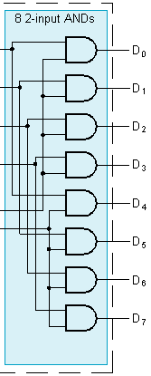
Decoder Expansion - Example 1
3-to-8-line decoder
Number of output ANDs = 8
Number of inputs: 3
A’1A’0
A2’A1’A0’
A0
A1
2-4
Decoder
A’1A0
A2’A1’A0
A1’A0
A2’A1A0’
D0
D1
D2
D3
A’1A’0
A1A0
A2’A1A0
A0
A1
2-4
Decoder
A’1A0
A2
A’2
A2A1’A0’
AA0’
A2
A1A0
1-to-2
decoder
A2A1A0
3-to-8 decoder

Slide 34
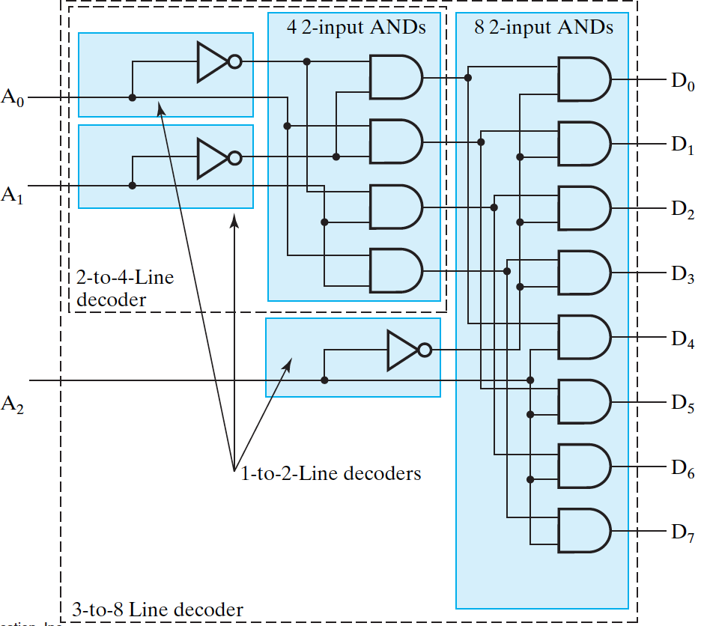
Further Decoder Expansion of Example 1

Slide 35
Rule for building large decoders
k-to-2^{k} decoder:
One needs 2^{k} output AND gates
If k can be divided by 2:
use two k/2-to-2^{k/2} decoders
If k cannot divided by 2:
use a (k+1)/2 and
use a (k-1)/2 decoder.
Previous example: 3-to-8 decoder (k=3):
Use a 2-to-4 and a 1-to-2 decoder

Slide 36
Example : build a 4-to-16 decoder
How many 2-input output AND gates?
Which smaller decoders to use?
Draw the circuit.
Notes:
16 output AND gates
K=4 thus k/2=2: one can use two 2-to-4 decoders

Slide 37
4-to-16 decoder
Use two 2-to-2² decoders
A3’A2’A1’A0’
D0
D1
D2
D3
D4
:
:
A1’A0’
A3’A2’A1’A0
D0
D1
D2
D3
A0
A1
A1’A0
2-4
Decoder
A1A0’
A3’A2’A1A0
A1A0
A3’A2A1’A0’
D0
D1
D2
D3
A3’A2’
A2
A3
A3’A2
2-4
Decoder
A3A2
D14
D15
A3A2A1A0’
A3A2A1A0

Slide 38
Decoder Expansion - Exercise 2
5-to-32-line decoder
Number of output ANDs = ?
Number of inputs to decoders driving output ANDs = ?
Which decoders to use to drive the output ANDs?
Block diagram:
Notes:
Output NANDs: 32
Inputs: 5
Which decoders to use to drive the NAND gates: 3-to-8 and a 2-to-4 decoder

Slide 39
5-to-32-line decoder
A2’A1’A0’
D0
D1
D2
D3
D4
D7
:
:
A4’A3’
A2’A1’A0’
D0
D1
D2
D3
D7
A4’A3’
A2’A1’A0
A0
A1
A2
A2’A1’A0
3-8
Decoder
D0
D1
D2
D3
A4’A4’
A3
A4
A3’A2
2-4
Decoder
A4A3
D30
D31
A4A3
A2A1A0

Slide 40
Decoder Expansion - Example 2
7-to-128-line decoder
Number of output ANDs = ?
Number of inputs to decoders driving output ANDs = ?
Closest possible split to equal
Notes:
Number of output ANDs = 128
Number of inputs to decoders driving output ANDs = 7
Closest possible split to equal
4-to-16-line decoder
3-to-8-line decoder

Slide 41
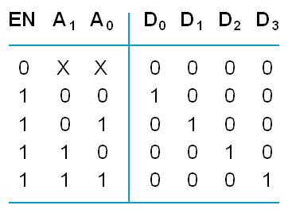
Decoder with Enable
Extra input EN:
If EN = 1: act as a regular decoder
If EN=0, all outputs are 0
See truth table below for function
D0
D1
D2
D3
A0
A1
0
1
2-4
Decoder
EN

Slide 42
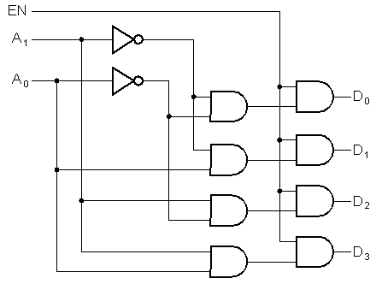
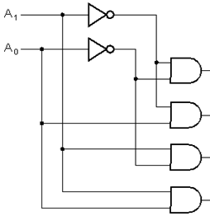
Decoder with Enable: circuit
EN
Extra set
of ands
D0
D1
D2
D3
A0
A1
0
1
2-4
Decoder
EN
Regular decoder
If one considers EN an input, in that case the circuit can be viewed as distributing value of signal EN(=IN) to 1 of 4 outputs: called a demultiplexer:
0
1
2
3
D0
D1
D2
D3
EN=IN
Demux
1 0
A1 A0

Slide 43


Example: Sprinkler System
Design the sprinkler valve controller
Description:
The system has 8 different zones
Only one value is on at one time (to maintain the pressure)
A microcontroller is used to control the valves:
However the processor has only 4 outputs
Lets program the microcontroller to indicate which of the 8 valves should be opened, using a binary representation.
Notes:
From Text by F. Vahid, page 71.

Slide 44

Sprinkler System
We can use a 3-to-8 decoder with enable input controlled by the microprocessor
D0=A2’A1’A0’.EN
D1=A2’A1’A0.EN
a
b
c
d
A0
A1
A2
0
1
2
D0
D1
D2
D3
D7
Micro-
controller
3-8
Decoder
EN
D7=A2A1A0.EN
When EN=0, all valves are off

Slide 45
Combinational Logic Implementation - Decoder and OR Gates
Implement m functions of n variables with:
Sum-of-minterms expressions
One n-to-2^{n}-line decoder
m OR gates, one for each output

Slide 46
Example
Design and implement a majority function F(ABC) using a 3-to-8 decoder
Truth table:
Minterms:
F=Σm(3,5,6,7)
Implementation using decoder:
A B C F
0 0 0 0
0 0 1 0
0 1 0 0
0 1 1 1
1 0 0 0
1 0 1 1
1 1 0 1
1 1 1 1
Indicate MSB, LSB
A
B
C
0
1
2
3
4
5
6
7
2
1
0
F
Notes:
Σm(3,5,6,7)
Thus use a 3-to-8 decoder with OR gate

Slide 47
Exercise
Implement the functions using a 3-to-8 decoder:
F₂(ABC)=Σ_{m} (0,2,3,5,6,7)
F₃=AB’ + BC
F₄(ABC)= A + B + C’
Notes:
For F2: implement F2’=m(1,4): OR and INV= NOR gate with as inputs m1 and m4
F3= AB’+BC = AB’(C+C’)+BC (A+A’) = m5 + m4 + m7 + m3
F4=A+B+C’: now F4’=A’B’C=m1 Thus F4=m1’ (otherwise F4=m0+m2+m3+m4+m5+m6+m7)

Slide 48
Answer
For F2(ABC)=Σm (0,2,3,5,6,7) implement
F2’=m(1,4): OR and INV= NOR gate with m1 and m4 as inputs.
F3= AB’+BC = AB’(C+C’)+BC (A+A’)
= m5 + m4 + m7 + m3
F4=A+B+C’:
now F4’=A’B’C=m1 Thus F4=m1’ (needs an inverter);otherwise: F4=m0+m2+m3+m4+m5+m6+m7

Slide 49
Exercise
Implement the function F using a 2-to-4 decoder and two tri-state buffers
F=C(AB+A’B’)

Slide 50
Exercise - solution
Implement the function F using a 2-to-4 decoder and two tri-state buffers
F=C(AB+A’B’) = ABC + A’B’C
B
C
1
0
0
1
2
3
B’C
BC
F
A

Slide 51
Exercise
Can you also implement F using a 2-to-4 decoder with enable input and an OR gate?
F=C(AB+A’B’)

Slide 52
Exercise - solution
1. Using a 2-to-4 decoder with enable input and an OR gate:
F=C(AB+A’B’) = ABC + A’B’C
EN
A’B’
AB
A
B
1
0
0
1
2
3
F
EN
C

Slide 53
Exercise
Can you also implement F using a 2-to-4 decoder with enable input and an NOR gate?
F=C(AB+A’B’)

Slide 54
Exercise - solution
1. Using a 2-to-4 decoder with enable input and a NOR gate:
F=C(AB+A’B’)=C.(A⊕B)
xnor
F=C(AB’+A’B)=C .(A⊕B)
xor
EN
A
B
1
0
0
1
2
3
A’B
AB’
F
EN
C

Slide 55
Encoding
m elements n-bit binary code
D0
D1
:
:
Dm-1
A0
:
:
An-1
m-elements
≤ 2^{n}
encoder
n output
bits
encoding
decoding
D0
D1
:
:
Dm-1
A0
:
:
An-1
2-to-4
decoder
m-elements
≤ 2^{n}
n bits

Slide 56
Encoding
Typically, an encoder converts a code containing exactly one bit that is 1 to a binary code corresponding to the position in which the 1 appears: ex. D1=1 → output 0001
Examples: Octal-to-Binary encoder
Other examples?
0
1
0
0
0
D0
D1
:
:
Dm-1
0
1
2
3
m-1
0
1
2
n-1
A0
:
:
An-1
1
0
0
0
encoder
Notes:
Examples: Hex-to-Binary encoder
Decimal to BCD encoder
Decimal to binary encoder
ASCI to binary
Grades (ABCDF) to binary: A, B, C, D, F to 3 bit binary code

Slide 57
Example: A decimal-to-BCD encoder
D9
D8
D7
D0
encoder
A3
A2
A1
A0
9
8
7
6
0
3
2
1
0
1
2
3
4
5
6
7
8
9
0
A decimal-to-BCD encoder
Inputs: 10 bits corresponding to decimal digits 0 through 9, (D₀, …, D₉)
Outputs: 4 bits with BCD codes
Function: If input bit Di is a 1, then the output (A₃, A₂, A₁, A₀) is the BCD code for i,

Slide 58
Truth table of the decimal-to-BCD encoder
D9 D8 D7 D6 D5 D4 D3 D2 D1 D0
0 0 0 0 0 0 0 0 0 1
0 0 0 0 0 0 0 0 1 0
0 0 0 0 0 0 0 1 0 0
0 0 0 0 0 0 1 0 0 0
0 0 0 0 0 1 0 0 0 0
0 0 0 0 1 0 0 0 0 0
0 0 0 1 0 0 0 0 0 0
0 0 1 0 0 0 0 0 0 0
0 1 0 0 0 0 0 0 0 0
1 0 0 0 0 0 0 0 0 0
A3 A2 A1 A0
0 0 0 0
0 0 0 1
0 0 1 0
0 0 1 1
0 1 0 0
0 1 0 1
0 1 1 0
0 1 1 1
1 0 0 0
1 0 0 1
From table:
A3 = D8 + D9
A2 = D4 + D5 + D6 + D7
A1 = D2 + D3 + D6 + D7
A0 = D1 + D3 + D5 + D7 + D9
We made use of the fact that only one input can be “1” at one time
Notes:
Note is no button is pushed: the output will also be 0000! Ths would be the same as if D0 was pushed. One can add a valid signal V that is 1 if a button is pushed and 0 if none is pushed: add an actra row with all inputs 00000000 and V=0
V=D0+D1+D2+…D9
What happens when two buttons are pushed? E.g. D1 and D2 together: From the expression one notices that now A0=A1=1 and A2=A3=0 (0011) which is the same as if D3 were pushed!

Slide 59
Priority Encoder
If more than one input value is 1, then the encoder just designed does not work.
An encoder that can accept all possible combinations of input values and produce a meaningful result is a priority encoder.
Among the 1s that appear, it selects the most significant input position (or the least significant input position) containing a 1 and responds with the corresponding binary code for that position.
D0
D1
D2
D3
0
1
2
3
1
0
A1
A0
?
To
μprocessor
V

Slide 60
Priority Encoder Example
Priority encoder with 5 inputs (D₄, D₃, D₂, D₁, D₀) - highest priority is given to most significant 1 present - Code outputs A2, A1, A0 and V where V indicates at least one 1 present.
No. of Min-terms/Row | Inputs |  |  |  |  | Outputs
 | D4 | D3 | D2 | D1 | D0 | A2 | A1 | A0 | V
1
1
2
4
8
16
0 0 0 0 0
X X X 0
0 0 0 0 1
0 0 0 1
0 0 0 1
0
1
0 0 1 1
0
X
1
0 0 1 X X
0 1 0 1
0 1 X X X
0 1 1 1
1 X X X X
1 0 0 1
Notes:
Go over table explaining how entries were obtained, particularly those containing Xs

Slide 61
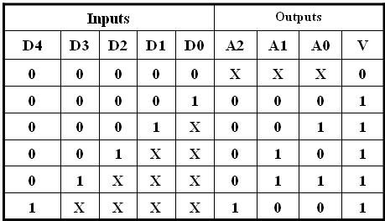
Priority Encoder Example (continued)
One can use a K-map to get equations, but can be read directly from table and manually optimized if careful:
A2 = D4
D4
D4
D3
A1 = D3 + D2
= F1, F1 = (D3 + D2)
D4
A0 =
V =

Slide 62
Priority Encoder Example (continued)
Could use a K-map to get equations, but can be read directly from table and manually optimized if careful:
A2 = D4
D4
D4
D3
A1 = D3 + D2
= F1, F1 = (D3 + D2)
D4
D4
D4
D3
D2
A0 = D3 + D1 = (D3 + D1)
D4
D2
V = D4 + F1 + D1 + D0

Slide 63
Exercise: design a 4 input priority encoder with active low inputs
Table:
D0
D1
D2
D3
0
1
2
3
1
0
A1
A0
D3 D2 D1 D0 A1 A0 V
?
1 1 1 1
x x 0
V
1 1 1 0
0 0 1
1 1 0 x
0 1 1
1 0 x x
1 0 1
0 x x x
1 1 1
Expressions:
A1 = D3.D2’ + D3’ = D2’ + D3’
A0 = D3D2D1’ + D3’ = D2.D1’ + D3’
V = (D3.D2.D1.D0)’
Notes:
Table:
D3 D2 D1 D0 A1 A0 V
0 x x x 1 1 1
0 x x 1 0 1
1 0 x 0 1 1
1 1 0 0 0 1
0 0 0 0 x x 0

Slide 64
Selecting (multiplexers)
Selecting of data or information is a critical function in digital systems and computers
Circuits that perform selecting have:
A set of n information inputs from which the selection is made
A set of k control (select) lines for making the selection
A single output
I0
I1
I2
I3
In-1
0
1
2
3
:
:
n-1
n ≤ 2^{k} inputs
OUT
k-1 .. 1 0
Sk-1..S1 S0
k select lines

Slide 65
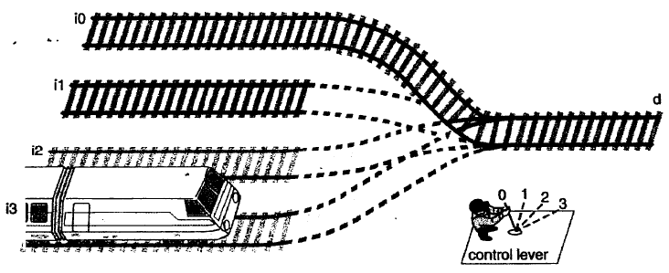
Multiplexer equivalent
I0
I1
I2
I3
0
1
2
3
Out
1 0
(Ref.: F. Vahid, “Digital Design”, J. Wiley, 2007)
S1 S0

Slide 66
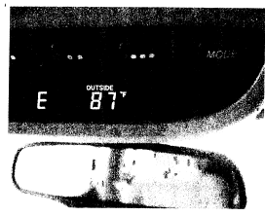
Many uses of multiplexers
In computers to select among signals
To implement command:
Trip controller in a car to display mileage, time, speed, etc.
X
Y
0
1
Z
if A=0 then Z=XY
else Z=X⊕Y
A
clock
4:1
(F. Vahid)
0
1
2
3
odometer
speed
Display
1 0
S1 S0
mileage
Push button

Slide 67
Example of a 4-input MUX
4 inputs mux requires 2 select lines:
I0
I1
I2
I3
4:1
I0
I1
I2
I3
0
1
2
3
0
1
2
3
Out
Out
1 0
S1 S0
S1 S0
Table (condensed truth table):
S1 S0 OUT
0 0 I0
0 1 I1
1 0 I2
1 1 I3

Slide 68
Example of a 4-input MUX
4 inputs mux requires 2 select lines with Enable:
E
I0
I1
I2
I3
I0
I1
I2
I3
4:1
0
1
2
3
Out
0
1
2
3
Out
1 0
S1 S0
E S1 S0
E
1
1
1
1
0
S1 S0 OUT
0 0 I0
0 1 I1
1 0 I2
1 1 I3
X X 0
Table (condensed truth table):

Slide 69
4:1 MUX realization
Expression for OUT
Circuit implementation: SOP
4 AND gates (4 product terms)
2-to-4 line decoder (to generate the minterms)
S1 S0 OUT
0 0 I0
0 1 I1
1 0 I2
1 1 I3
OUT = S1S0 I0+ S1S0 I1+ S1S0 I2+ S1S0 I3
m0
m1
m2
m3
2^{k}-1
or OUT = Σ mi Ii
i=0

Slide 70
4:1 MUX realization
S1 S0 OUT
0 0 I0
0 1 I1
1 0 I2
1 1 I3
Expression for OUT
Circuit implementation: SOP
4 AND gates (4 product terms)
2-to-4 line decoder (to generate the minterms)
OUT =( S1S0 I0+ S1S0 I1+ S1S0 I2+ S1S0 I3 ) E
m0
m1
m2
m3
2^{k}-1
or OUT = Σ mi Ii E
i=0

Slide 71
Example: 4-to-1-line Multiplexer
2-to-2²-line decoder
2² x 2 AND-OR
Decoder
m0
m1
m2
m3
Gate input cost: 22

Slide 72

Example: 4-to-1-line Multiplexer
2-to-2²-line decoder
2² x 2 AND-OR
Gate input cost: 22
m0
m1
m2
m3

Slide 73
4:1 Quad Multiplexer
Quad refers to the fact that each input consists of a 4-bit wide signal (vector)
I0[3:0]
I1[3:0]
I2[3:0]
I3[3:0]
4
4:1
0
1
2
3
4
Out [3:0]
1 0
S1 S0
Single inputs for the select signals

Slide 74
Exercise
Build a 8:1 MUX using two 4:1 and one 2:1 muxes
I0
I1
I2
I3
4:1
0
1
2
3
1 0
0
1
OUT
S1 S0
I4
I5
I6
I7
4:1
0
1
2
3
S2
1 0
Ex: S2S1S0=110 : select I6
S1 S0
Notes:
We need 3 select signals: S2,S1 and S0

Slide 75
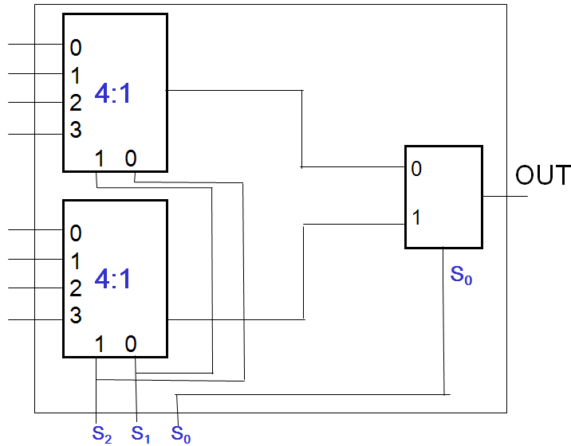
Exercise
A student was working late and get confused. He designed the following 8-to-1 MUX but did not label the inputs. Can you do so?
S2S1S0
out
000
010
S1 S2
100
110
001
011
101
111
Next, rewire the circuit so that we have a regular 8-1 MUX whose inputs corresponds to the selection code A2A1A0
Notes:
We need 3 select signals: S2,S1 and S0
S2 should be connected to the 2-1 Mux, and S1 to the select “1” input of both 4-1 Muxes; and S0 to the select “0” input.

Slide 76
Exercise
A student was working late and get confused. He designed the following 8-to-1 MUX but did not label the inputs. Can you do so?
0
S2S1S0
2
4
000
0
2
4
6
1
3
5
7
Accesses I0
6
010
Accesses I2
Top 4-1 mux
S1 S2
100
1
Accesses I1
3
110
Accesses I3
5
7
001
Accesses I0
011
Accesses I1
101
Accesses I2
Bottom 4-1 mux
111
Accesses I3
Next, rewire the circuit so that we have a regular 8-1 MUX whose inputs corresponds to the selection code A2A1A0
Notes:
We need 3 select signals: S2,S1 and S0
S2 should be connected to the 2-1 Mux, and S1 to the select “1” input of both 4-1 Muxes; and S0 to the select “0” input.

Slide 77
Multiplexer-based combinational circuits realization- Approach 1
A mux can be easily used to implement a function defined by a truth table (lookup table)
Indeed the output F of a mux is equal to:
2^{k}-1
F = Σ mi Ii
Example
i=0
Give the input Ii the
value of 0 or 1
as shown in the truth table
A B OUT =F
0 0 I0 0
0 1 I1 1
1 0 I2 1
1 1 I3 0
m0
m1
0
1
1
0
4:1
m2
0
1
2
3
m3
F
F= Σm(1,2)
1 0
A B

Slide 78
Example: Gray to Binary Code
Design a circuit to convert a 3-bit Gray code to a binary code
The formulation gives the truth table on the right
It is obvious from this table that X = C and the Y and Z are more complex
Gray
Binary
A B C
x y z
0
0
0
0
0
0
1 0
0
0
0 1
1
1 0
0 1 0
0 1 0
0 1
1
0 1
1
1 0
0
1
1
1
1 0 1
1 0 1
1
1 0
0
0 1
1
1
1

Slide 79
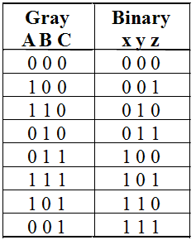
Gray to Binary (continued)
Rearrange the table so that the input combinations are in counting order
Functions y and z can be implemented using a dual 8-to-1-line multiplexer by:
connecting A, B, and C to the multiplexer select inputs
placing y and z on the two multiplexer outputs
connecting their respective truth table values to the inputs

Slide 80
Gray to Binary (continued)
Note that the multiplexer with fixed inputs is identical to a ROM with 3-bit addresses and 2-bit data!
0
D00
0
D10
1
D01
1
D11
1
D02
1
D12
0
D03
0
D13
0
D04
1
D14
1
Out
Y
0
Out
Z
D05
D15
1
D06
0
D16
0
D07
1
D17
A
S2
A
S2
8-to-1
8-to-1
B
S1
B
S1
MUX
S0
MUX
C
S0
C

Slide 81
Gray to Binary (continued)
Inputs |  |  |  | Outputs
w | x | y | z | a | b | c | d
0 | 0 | 1 | 1 | 0 | 0 | 0 | Z
0 | 1 | 0 | 0
0 | 1 | 0 | 1 | 0 | 0 | 1 | Z’
0 | 1 | 1 | 0
0 | 0 | 1 | 1 | 0 | 1 | 0 | Z’
1 | 0 | 0 | 0
1 | 0 | 0 | 1 | 0 | 1 | 1 | Z’
1 | 0 | 1 | 0
1 | 1 | 1 | 1 | 1 | 0 | 0 | Z’
1 | 1 | 0 | 0
Note that the multiplexer with fixed inputs is identical to a ROM with 3-bit addresses and 2-bit data!
0
0
D10
D00
1
1
D11
D01
1
1
D12
D02
0
0
D13
D03
0
1
D14
D04
0
Out
Z
1
Out
Y
D15
1
D05
0
D16
D06
1
D17
0
D07
A
A
S2
8-to-1
S2
8-to-1
B
S1
B
S1
MUX
C
MUX
C
S0
S0

Slide 82
Multiplexer-based combinational circuits - Approach 2
One can further simplify the implementation:
Previous example:
Example
A B OUT F
0 0 I0 0
0 1 I1 1
1 0 I2 1
1 1 I3 0
B
B
B
B
0
1
F
A

Slide 83
Combinational Logic Implementation - Multiplexer Approach 2
Implement any m functions of n + 1 variables by using:
An m-wide 2^{n}-to-1-line multiplexer
Design:
Find the truth table for the functions.
Based on the values of the first n variables, separate the truth table rows into pairs
For each pair and output, define a rudimentary function of the final variable (0, 1, X, )
X

Slide 84
Gray to Binary - Approach 2
Rearranged the table so that the input combinations are in counting order.
Gray A B C | Binary x y z | Rudimentary Functions of C for y | Rudimentary Functions of C for z
0 0 0 | 0 0 0
0 0 1 | 1 1 1
0 1 0 | 0 1 1
0 1 1 | 1 0 0
1 0 0 | 0 0 1
1 0 1 | 1 1 0
1 1 0 | 0 1 0
1 1 1 | 1 0 1
F = C
F = C
F = C
F = C
F = C
F = C
F = C
F = C

Slide 85
Gray to Binary (continued)
Assign the variables and functions to the multiplexer inputs:
Note that this approach (Approach 2) reduces the cost by almost half compared to Approach 1.
C
D00
C
D10
C
D01
C
D11
C
C
C
D02
Out
Y
C
D12
Out
Z
C
D03
C
D13
A
S1
8-to-1
A
S1
8-to-1
B
S0
MUX
B
S0
MUX

Slide 86
Exercise 1 (cont)
Implement the function F(A,B,C)=Σm(0,1,2,5) using a 4:1 mux
A B C F
0 0 0 1
0 0 1 1
0 1 0 1
0 1 1 0
1 0 0 0
1 0 1 1
1 1 0 0
0 1 1 0
1
C
C
0
4:1
1
C
C
0
0
1
2
3
F
1 0
A B

Slide 87

Exercise: Controller for rear lights of a car
Word description of the problem: Design a circuit that controls the rear lights of a car: Left and Right rear lights.
Assume that is a single lamp in each of the rear lights.

Slide 88
Example (continued): Specification
The inputs to the controller are:
Outputs signals:
Name Description
LT Left turn signal: causes blinking of left side light
RT Right turn signal
EM Emergency flasher: both lights blink
BR Break is applied: both lights are on
BL Internal signal of 1Hz frequency
Name Description
Left Power control for the left rear light
Right Power control for the right rear light

Slide 89
Example (continued): Specification 2
The break BR overrides the emergency EM signal
The Left turn LR and Right turn RT overrides the break signals BR.
Implement the two power control signals as:
Minimized SOP
Decoder with NOR gates
Multiplexer

Slide 90
Example (cont): Formulation
Left
Light
LT BR EM BL Left
0 0 0 0
0 0 0 1
0 0 1 0
0 0 1 1
0 1 0 0
0 1 0 1
0 1 1 0
0 1 1 1
1 0 0 0
1 0 0 1
1 0 1 0
1 0 1 1
1 1 0 0
1 1 0 1
1 1 1 0
1 1 1 1
Right
Light
RT BR EM BL Right
0 0 0 0
0 0 0 1
0 0 1 0
0 0 1 1
0 1 0 0
0 1 0 1
0 1 1 0
0 1 1 1
1 0 0 0
1 0 0 1
1 0 1 0
1 0 1 1
1 1 0 0
1 1 0 1
1 1 1 0
1 1 1 1
0
0
0
1
1
1
1
1
0
1
0
1
0
1
0
1
0
0
0
1
1
1
1
1
0
1
0
1
0
1
0
1

Slide 91
Example (cont): Mapping (SOP)
LT BR EM BL Left
0 0 0 0
0 0 0 1
0 0 1 0
0 0 1 1
0 1 0 0
0 1 0 1
0 1 1 0
0 1 1 1
1 0 0 0
1 0 0 1
1 0 1 0
1 0 1 1
1 1 0 0
1 1 0 1
1 1 1 0
1 1 1 1
0
0
0
1
1
1
1
1
0
1
0
1
0
1
0
1
K-map:
Left
EM
0 0 1 0
1 1 1 1
BR
0 1 1 0
LT
0 1 1 0
BL
Left= LT.BL + LT’.BR + EM.BL
Same for Right: Right= RT.BL + RT’.BR + EM.BL

Slide 92
Example (cont): Mapping (SOP)
One could have written the logic expression directly without the truth table:
Left = LT.BL + LT’.BR + LT’.BR’.EM.BL
Simplify:
Left = LT.BL+ LT’(BR+ BR’.EM.BL)
= LT.BL+ LT’(BR+ EM.BL)
= LT.BL + LT’.BR + LT’.EM.BL
= (LT + LT’.EM)BL + LT’.BR
= (LT + EM)BL + LT’.BR
= LT.BL + EM.BL + LT’.BR

Slide 93
Example (cont): Encoder with NOR
Left signal: implement the complement
Left’= Σm(0,1,2,8,10,12,14)
0
1
2
3
4
5
6
7
8
9
10
11
12
13
14
15
Left
LT
BR
EM
BL
3
2
1
0

Slide 94
Example (cont) 8:1 Multiplexer
LT BR EM BL Left
0 0 0 0
0 0 0 1
0 0 1 0
0 0 1 1
0 1 0 0
0 1 0 1
0 1 1 0
0 1 1 1
1 0 0 0
1 0 0 1
1 0 1 0
1 0 1 1
1 1 0 0
1 1 0 1
1 1 1 0
1 1 1 1
0
0
0
1
1
1
1
1
0
1
0
1
0
1
0
1
0
0
0
1
2
3
4
5
6
7
BL
BL
1
1
LR
1
BL
BL
2 1 0
BL
LT BR EM
BL

Slide 95
Same for Right Signal
0
0
1
2
3
4
5
6
7
BL
1
Right
2 1 0
RT BR EM

