Slide 1
Chapter 5 ----Sequential Circuits

Slide 2

Combinational and Sequential Circuits
Up to now we have discussed combinational circuits.
In many cases, one can reduce the complexity of the hardware by using sequential circuits.
Sequential circuits allow for more flexible and more sophisticated circuit realizations with richer behavior and dynamics.

Slide 3
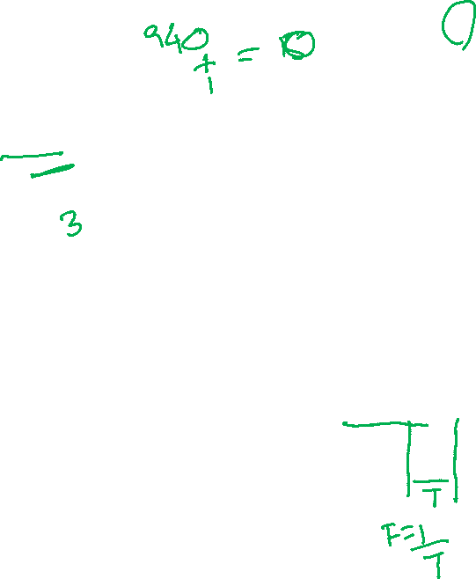
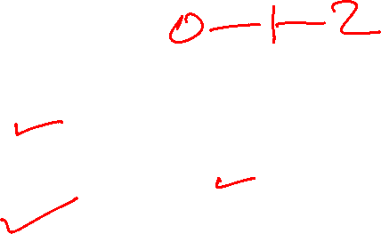

5-1 Sequential circuit block diagram
Outputs
Inputs
Combina-tional
Logic
Next
State
Storage Elements
State
(or present state)
Combinatorial Logic gives:
  Next state function
  Next State = f(Inputs, State)
  Output function
CLOCK
Synchronous machine

Slide 4



Types of Sequential Circuits
Synchronous
  Behavior defined from knowledge of its signals at discrete instances of time
  Storage elements observe inputs and can change state only in relation to a timing signal (clock pulses from a clock)
Asynchronous
  Behavior defined from knowledge of inputs an any instant of time and the order in continuous time in which inputs change
The synchronous abstraction makes complex designs tractable!
t1 t2 t3 t4
t1 t2 t3 t4

Slide 5
Moore and Mealy Models
Sequential Circuits or Sequential Machines are also called Finite State Machines (FSMs). Two formal models exist:
Moore Model
  Named after E.F. Moore
  Outputs are only a function of states
Mealy Model
  Named after G. Mealy
  Outputs are a function of inputs and states

Slide 6



Types of Sequential Circuits Illustra
Moore machine:
  Outputs = h(State)
Mealy machine
  Outputs = g(Inputs, State)
Mealy
Comb.
logic
Outputs
Inputs
Combina-tional
Logic
Next
State
Storage Elements
State
(or present state)
CLOCK

Slide 7



5-2 Storing information: Latches
How to store information?
Use feedback:
t_{pd}
t_{pd}
A
B=A
C= A
Signal B=A appears after a short delay:
Reinforces the input A
A
t_{pd}
t_{pd} = propagation delay
B
t_{pd}
C

Slide 8
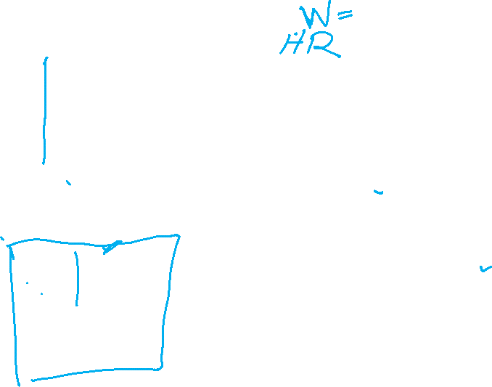
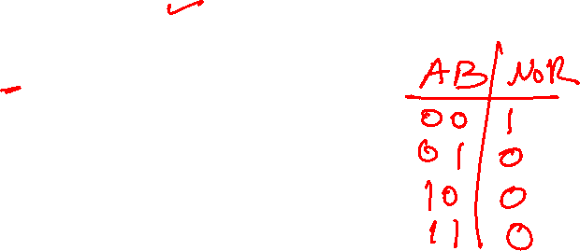
Latches: Cross-coupled NORs
0
A=0 is memorized
B=A=1
C= A=0
1
2
A=0
0
How to change contents A from 0 to 1: apply “1” to the first input
Set
0
1
1
0
1
0
0
0
1
1
1
2
0
1
0
1
0
Hold or memory
We have written “1” into the latch: “set” operation
Making the input go to “0” again will memorize the output C=“1”

Slide 9











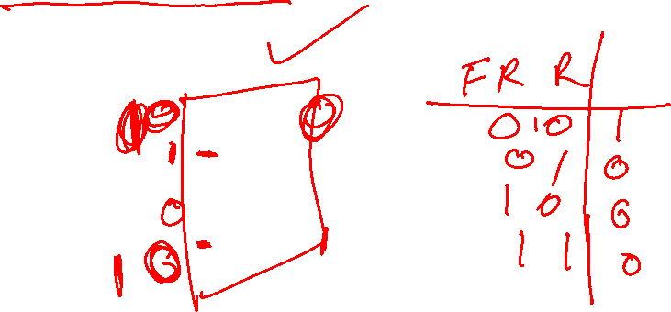
Basic (NOR) S – R Latch
Function Table:
This element is also the basic building block in SRAM memories
R (reset)
Q
S (set)
Q
S R Q Q
0 0
0 1
0
1 1
hold, no change
0 1 Reset
1 0 Set
0 0 not allowed, unstable (Q=Q)

Slide 10

Basic (NOR) S – R Latch
Function Table:
This element is also the basic building block in SRAM memories
R (reset)
Q
S (set)
Q
S R Q Q
0 0
0 1
0
1 1
hold, no change
0 1 Reset
1 0 Set
0 0 not allowed, unstable (Q=Q)

Slide 11

Exercise: Basic (NOR) S – R Latch
Time sequence behavior:
S
1
Q
R
2
Q
Time
R
S
Q
Q
Comment
0
0
?
?
Stored state unknown
0
1
1
0
“Set” Q to 1
0
0
1
0
Now Q “remembers” 1
1
0
0
1
“Reset” Q to 0
0
0
0
1
Now Q “remembers” 0
1
1
0
0
Both go low
0
0
?
?
Unstable!

Slide 12


Timing waveforms of NOR S-R latch
S
1
Q
R
2
Q
S
0
R
0
0
set
Q
Q
1
reset
t_{pd}
No change
unstable
not allowed

Slide 13
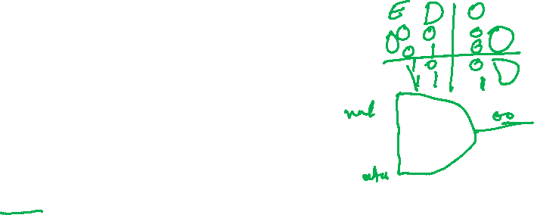
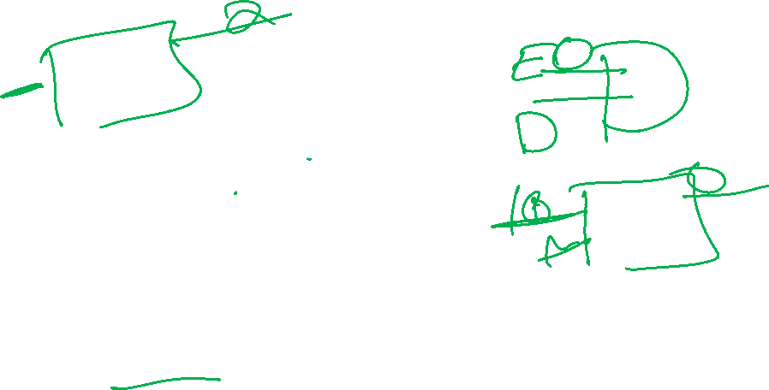
Clocked (NOR) S-R Latch
S
1
Q
Clk
2
Q
R
Clk=0: input has no effect: latch is always in “hold” mode
Clk=1: latch is a regular S-R latch

Slide 14
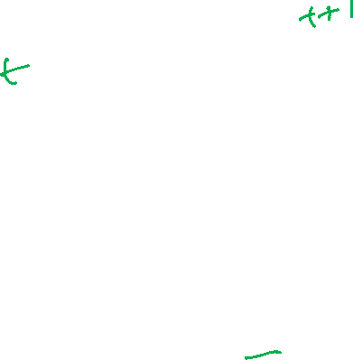

Clocked S - R Latch (continued)
The Clocked S-R Latch can be described by a table:
The table describes
what happens after the
clock [at time (t+1)]
based on:
  current inputs (S,R) and
  current state Q(t).
C S R Next state Q(t+1)
S
1
Q
0 x x
0 0
1 0 1
1 1 0
1 1 1
Q(t) no change
Clock
Q(t) no change
Q(t+1) = 0, Reset
2
Q
R
Q(t+1) = 1, Set
Undefined

Slide 15

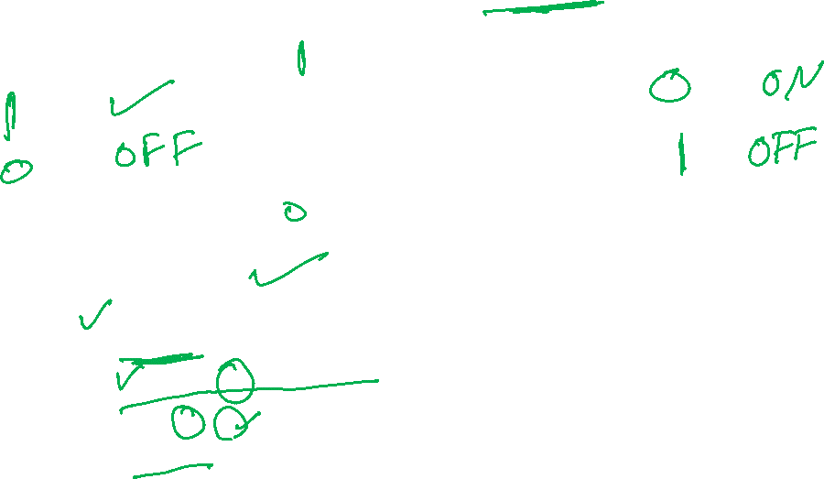

Function table of the (NAND) S - R latch
S (set)
Q
Q
R (reset)
Function table:
S R Q Q
1 1
0 1
0
0 0
hold, no change
1 0 Set
0 1 Reset
1 1 not allowed, unstable (Q=Q=1)
S = 0, R = 0 is
forbidden as input pattern

Slide 16


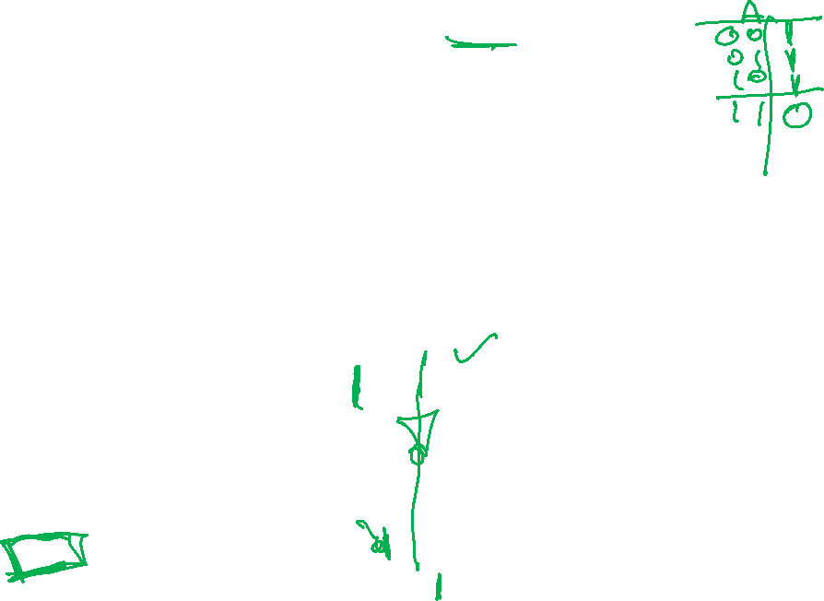
Latch with NAND
A
=
1
A
A
A
When both S=R=1: the NAND gates act as inverters and the circuit implements two inverters: “hold mode”
1
Q
Q
Q
Clocked latch:
1
Q
C S R Next state Q(t+1)
Q(t) no change
S
S
0 x x
0 0
1 0 1
1 1 0
1 1 1
Q
Q(t) no change
Q(t+1) = 0, Reset
C
Q(t+1) = 1, Set
R
Q
Q=Q’=1 Undefined
R

Slide 17

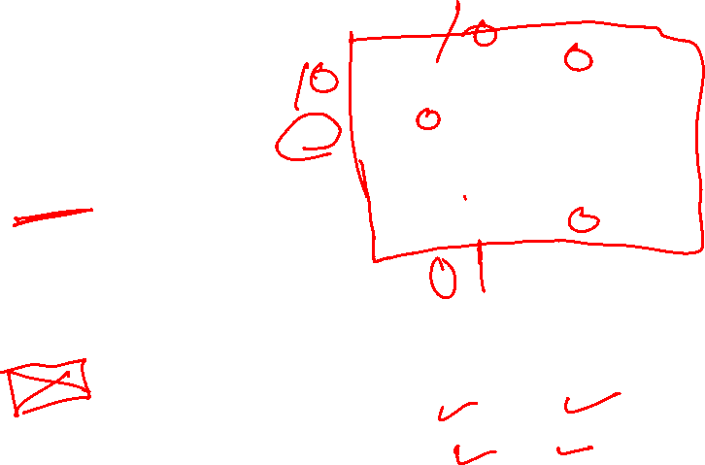
D Latch (Delay latch)
S-R Latch can be used
for at D Latch:
D
Q
C
Q(t+1)
SR latch:
Q
S R Q⁺ Q⁺
0 0 hold,
0 1 0 1
0 1 0
1 1 0 0
Function table D latch:
D Q(t+1)
0 0
1 1
D
Q
C
Q

Slide 18

Latch issues
Latches can cause serious timing problems (races) in sequential circuits
  Due to the fact that a latch is “transparent” when the clock C = 1
The timing problems can be prevented by using “Flip-Flops”

Slide 19


The Latch Timing Problem (continued)
Similar timing problems in the sequential circuits:
Outputs
Inputs
Combina-tional
Logic
X2
X₁
X2
X₁
X₀
X2
X₁
X3
D Latch
(storage)
X₀
X1
X2
Next State
State
C=0
→1
The state should change only once every new clock cycle:
  C=1:
    Now the current state becomes X₁ and a new state is generated by the combinational logic circuit: X₂.
    However, if C=1, the new “next state” X₂ will create a new current state X₂!, etc…

Slide 20

How to solve the timing problem: use Flip-Flops
A solution to the latch timing problem is to break the closed path from In to Out within the storage element
In
Out
In
Out
D
Q
D
Q
C: 0 1
C: 0 1
C
Q
C
Q
D-Latch
D-Flip-Flop
C
C
In
In
Out
Out

Slide 21
S-R Master-Slave Flip-Flop - review
Consists of two clocked S-R latches in series with the clock on the second latch inverted
Y
S
S
Q
S
Q
Q
C
C
C
R
R
Y’
Q
R
Q
Q
Master Latch
Slave Latch
C
Master Latch responds to input (Y changes)
Slave latch is inactive: Q unchanged
Master Latch is inactive
Slave latch responds to inputs Y, Y’;
Output Q changes

Slide 22
Symbol: Master-Slave Flip-Flop
S
Y
S
Q
S
Q
Q
C
C
C
R
R
Q
Y’
R
Q
Q
Notice; the output changes when the clock C goes low.
C
Symbol:
S
C
R
Q
Q
Sometimes one adds:
To indicate that the input responds when C=1, but the output changes when C goes to 0

Slide 23

Timing diagram of a (Nor) S-R Master-Slave Flip-Flop
S
Y
S
C
R
S
Q
S
Q
Q
Q
C
C
C
R
R
Q
Y’
R
Q
Q
Q
C
S
R
Master out
Y
0
Slave out
Q
0
Master
active
Slave
active
Output changes at neg. clock edge:
Negative edge-trigger FF

Slide 24
Flip-Flop Problem: 1’ catching
Glitch
C
S
R
Y
Master out
Q
Slave out
Master
active
Slave
active
1’ catching
Y
wrong output
should have been 0
S
S
Q
S
Q
Q
C
C
C
R
R
Q
Y’
R
Q
Q

Slide 25
Flip-Flop Solution: Edge-triggered
An edge-triggered flip-flop changes values at the clock edge (transition):
  responds to its input at a well-defined moment (at the clock-transition)
  ignores the pulse while it is at a constant level
Negative edge-triggered
Positive edge-triggered
Clock
ignored
In
The value of the input at the clock transition (negative or positive) determines the output

Slide 26
Flip-Flop Solution
A master-slave D flip-flop which exhibits edge-triggered behavior can be used:
  Replacing the first clocked S-R latch with a clocked D latch or
  Adding a D input and inverter to a master-slave S-R flip-flop
S
S
Q
S
Q
Q
D
D
Q
S
Q
Q
C
C
C
C
R
R
Q
R
Q
Q
C
C
Q
R
Q
Q

Slide 27
Edge-Triggered D Flip-Flop
The 1s-catching behavior is not present with D replacing S and R inputs
The change of the D flip-flop output is associated with the negative edge at the end of the pulse:
It is called a negative-edge triggered flip-flop
D
D
Q
S
Q
Q
C
C
C
Q
R
Q
Q

Slide 28

No 1’s catching in the edge-triggered D Flip-Flops
Y
D
D
Q
S
Q
Q
C
C
C
Q
R
Q
Q
C
D
Y
Master out
Q
Slave out
Master
active
Slave
active
no 1’ catching
correct output

Slide 29
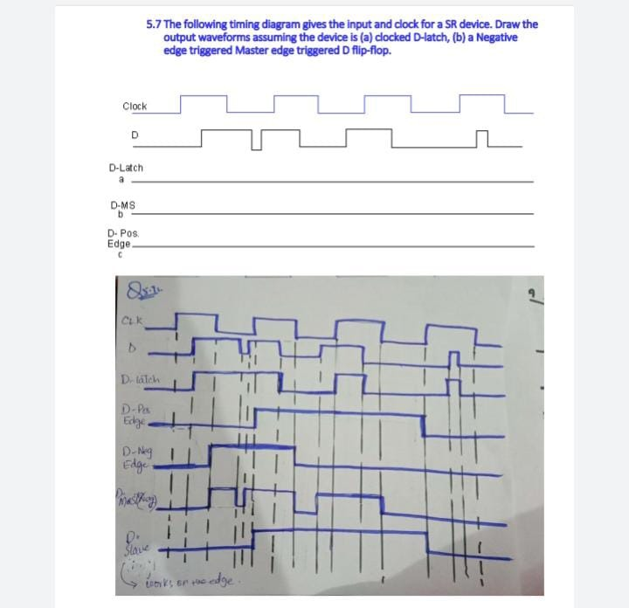


Slide 30

Standard Symbols for Storage Elements
Latches:
Master-Slave:
Postponed output
indicators
Edge-Triggered:
Dynamic
indicator
S
S
D
D
R
R
C
C
SR
SR
D with 1 Control
D with 0 Control
(a) Latches
S
S
D
D
C
C
R
R
C
C
Triggered SR
Triggered SR
Triggered D
Triggered D
(b) Master-Slave Flip-Flops
Input samples when C=1 but output changes when C goes 0
D
D
Input samples when C=0 but output changes when C goes 1
C
C
Triggered D
Triggered D
(c) Edge-Triggered Flip-Flops

Slide 31
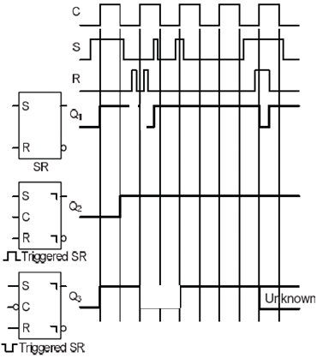
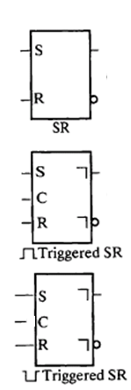
Exercise

Slide 32

Timing diagram of a (Nor) S-R Master-Slave Flip-Flop
S
C
R
S
Y
Q
S
Q
S
Q
Q
=
C
C
C
Q
R
R
Q
Y’
R
Q
Q
Slave
active
Master
active
Master
active
C
S
R
Y
undefined
Master out
Y’
undefined
Q
undefined
Slave out

Slide 33

Direct Inputs
At power up or at reset, all or part
of a sequential circuit usually is
initialized to a known state before
it begins operation
This initialization is often done
outside of the clocked behavior
of the circuit, i.e., asynchronously.
Direct R and/or S inputs that control the state of the latches within the flip-flops are used for this initialization.
For the example flip-flop shown
  0 applied to R resets the flip-flop to the 0 state
  0 applied to S sets the flip-flop to the 1 state
S
D
Q
C
Q
R

Slide 34

Direct inputs: active-low or active-high
D flip-flop with active-low direct inputs :
Active high direct inputs:
Direct inputs
S
S R C D Q Q’
0 1 x x 1 0
0 x x 0 1
1 1 0 0 1
1 1 1 1 0
D
Q
C
Q
R
S R C D Q Q’
0 1 x x 0 1
0 x x 1 0
0 0 0 0 1
0 0 1 1 0
S
D
Q
C
Q
R

Slide 35

Timing Constraints (Section 6.3)
0101101101100110

Slide 36

Flip-Flop Timing: Setup and Hold times – critical time constraints!
Proper operation requires strict timing rules:
  Minimum clock pulse width: t_{w} (t_{WH}, t_{WL})
  Set-up time t_{S}: minimum amount of time that the input signal must be present prior to occurrence of the clock transition that causes the output to change
  Hold time t_{h}: time the input must be kept after the clock transition

Slide 37

Case of Edge triggered Flip-Flop: set-up and hold times
Negative edge-triggered
In
Out
D
Q
C
C
Q
C
In (D)
t_{S}
t_{h}
Propagation delay
(measured from clock transition):
t_{p,max}
t_{p,min}
Out

Slide 38
Flip-Flop Timing: Setup and Hold times
Master-Slave S/R flip-flop (output changes at falling clock):
C
S/R
t_{S}
t_{h}

Slide 39
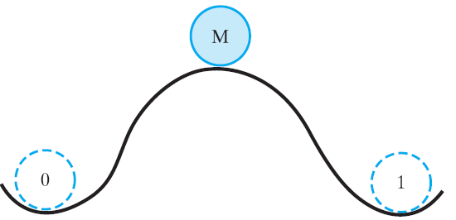
Metastability
When one violates the set-up or hold times, the flip-flop can enter a metastable state!
Flip-flops can have three states:
  State 0 (Stable)
  State 1 (Stable)
  Metastable state
Compare to a ball on a hill:
After a short, non deterministic time the ball will roll to either state 0 or 1!
This will give unpredictable behavior

Slide 40
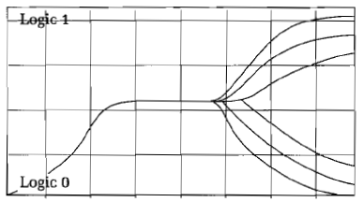
Metastable behavior
Example of metastable behavior:
After a while the flip-flop will go into a stable state (randomly).
If this happens before the next clock edge, the actual circuits will see a defined input.
The longer the clock period is the less chance of synchronization failure.
Or use two synchronization flip-flops in series
Logic 1 (Hi)
metastable
Eventually, the flip-flop will settle
Logic 0 (Lo)
(Oscilloscope trace)

Slide 41
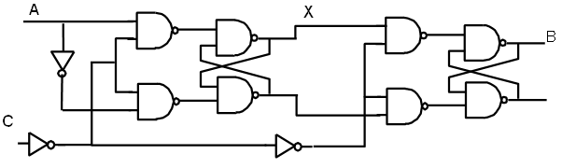
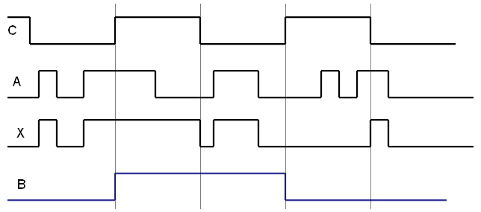
Exercise solution
Complete the waveforms below
1st stage active
2nd stage active

Slide 42
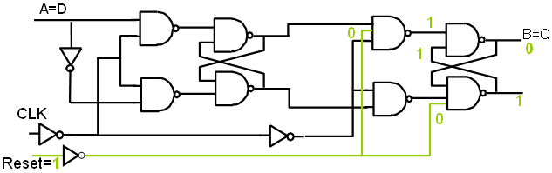
Exercise (continued)
Modify this circuit to give a DIRECT (i.e. asynchronous) active-high reset input (make minimal changes to the circuit: add the required reset input)

Slide 43
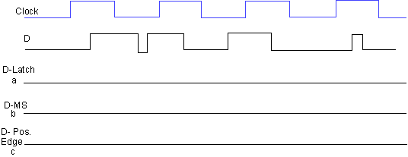
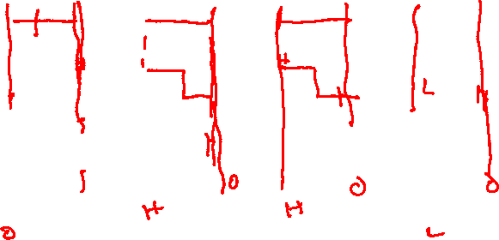
Exercise - solution
The following timing diagram gives the input and clock for a SR device. Draw the output waveforms assuming the device is (a) clocked D-latch, (b) a Negative edge triggered Master Slave D flip-flop, and (c) a Positive edge triggered D flip-flop.
D- Neg.
Edge

Slide 44
Exercise - solution
The following timing diagram gives the input and clock for a SR device. Draw the output waveforms assuming the device is (a) clocked D-latch, (b) a Negative edge triggered Master Slave D flip-flop, and (c) a Positive edge triggered D flip-flop.
D- Neg.
Edge

Slide 45
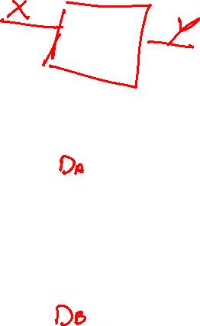
5-4 Sequential Circuit Analysis
Consider the following circuit:
input
What does it do?
How do the outputs change when an input arrives?
x
Q
A
D
C
Q’
A
states
D
Q
B
CLK
C
Q'
y
output
Notes:
Mealy machine: x goes into the output circuit

Slide 46
Sequential Circuit Model
General Model
  Current or Present State at time (t) is stored in an array of flip-flops.
  Next State is a Boolean function of State and Inputs.
  Outputs at time (t) are a Boolean function of State (t) and (sometimes) Inputs (t).
Mealy
Comb.
logic
Outputs
Inputs
Combina-tional
Logic
Next
State
Storage (D Flip-flops)
State
(or current state)
CLOCK

Slide 47

Previous Example (from Fig. 5-15)
Input: x(t)
Output: y(t)
State: (A(t), B(t))
  Example: (AB)= (01), (10)
Next State:
  (D_{A}(t), D_{B}(t))
  = (A(t+1), B(t+1))
Comb. Input logic
x
D_{A}
D
Q
A
Present state
C
Q’
A
Next State
D_{B}
D
Q
B
CLK
C
Q'
y
Is this a Moore or Mealy machine?
Output logic
Notes:
Mealy machine: x goes into the output circuit

Slide 48
Steps for Analyzing a Sequential Circuit
Find the input equations (D_{A}, D_{B}) to the flip-flops (next state equations) and the output equation.
Derive the State Table (describes the behavior of a sequential circuit).
Draw the State Diagram (graphical description of the behavior of the sequential circuit).
Simulation

Slide 49
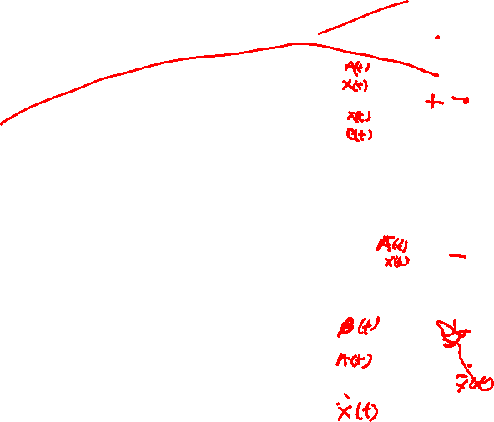
Step 1: Input and output equations
Boolean equations for the inputs to the flip flops:
  D_{A} = A(t)x(t)+B(t)x(t)
  D_{B} = A(t)x(t)
Output y
  y(t) = x(t)(B(t) + A(t))
x
D_{A}
D
Q
A
Present state
C
Q’
A
Next State
D_{B}
D
Q
B
CLK
C
Q'
y
Output

Slide 50
Step 2: State Table Characteristics
The state table: shows what the next state and the output will be as a function of the present state and the input:
The State Table can be considered a truth table defining the combinational circuits:
  the inputs are Present State, Input,
  and the outputs are Next State and Output
Inputs of the combinational circuit
Outputs of the table
Present State
Input
Next State
Output

Slide 51
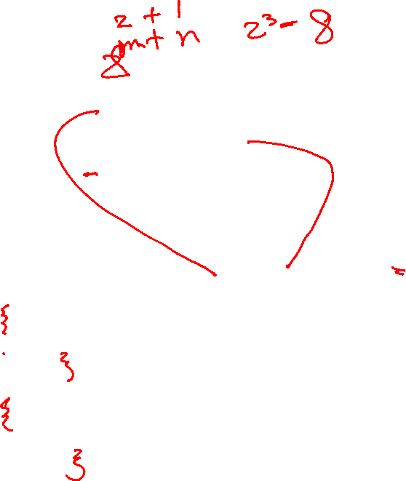
State Table
For the example: A(t+1) = A(t)x(t) + B(t)x(t)
        B(t+1) =‾A (t)x(t)
        y(t) =‾x (t)(B(t) + A(t))
Inputs of the table
Outputs of the table
Present State
Input
Next State
Output
A(t) B(t)
x(t)
A(t+1) B(t+1)
y(t)
0 0
0
0 0
0
0 0
1
0 1
0
2³ rows
0 0
1
(2^{m+n}) rows
0 1
0
0 1
1
1 1
0
1 0
0
0 0
1
1 0
1
1 0
0
m: no. of FF
n: no. of inputs
0 0
1
1 1
0
1
1
1
1 0
0

Slide 52

Alternate State Table
The previous (1-dimensional table) can become quite lengthy with 2^{m+n} rows (m=no. of FF; n=no. of inputs)
Alternatively, a 2-dimensional table has the present state in the left column and inputs across the top row
  A(t+1) = A(t)x(t) + B(t)x(t)
  B(t+1) =‾A (t)x(t)
  y(t) =‾x (t)(B(t) + A(t))
Present
Next State
Output
State
x(t)=0 x(t)=1
x(t)=0 x(t)=1
A(t) B(t)
A(t+1)B(t+1) A(t+1)B(t+1)
y(t) y(t)
0 0
0 0 0 1
0 0
2^{m}
0 1
0 0 1 1
1 0
1 0
0 0
1 0
1 0
1 1
0 0 1 0
1 0

Slide 53

Example 1(from Fig. 5-15) (continued)
Where in time are inputs, outputs and states defined?
1
0
1
0
0
0
1
0

Slide 54
Step 3: State Diagrams
The sequential circuit function can be represented in graphical form as a state diagram with the following components:
  A circle with the state name in it for each state
  A directed arc from the Present State to the Next State for each state transition
  A label on each directed arc with the Input values which causes the state transition, and
  A label:
    In each circle with the output value produced, or
    On each directed arc with the output value produced.
in
State
in
State
out
In/out
State

Slide 55
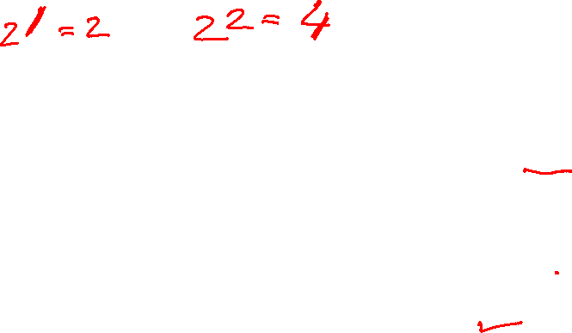
State diagram convention
Moore Machine:
Mealy Machine:
to next state
in
In/out
State
State
out
Example:
x/y’
x
1
x=1/y=0
AB
01
01
01
y
1
    Mealy type output depends on state and input
Moore type output depends only on state

Slide 56

State Diagram for the example
Graphical representation of the state table:
x=0/y=0
x=0/y=1
x=1/y=0
A B
0 0
x=0/y=1
1 0
x=1/y=0
x=1/y=0
Present State
Input
Next State
Output
x=0/y=1
A(t) B(t)
x(t)
A(t+1) B(t+1)
y(t)
0 0
0
0 0
0
0 0
1
0 1
0
0 1
0
0 0
1
0 1
1 1
0 1
1
1 1
0
x=1/y=0
1 0
0
0 0
1
1 0
1
1 0
0
1 1
0
0 0
1
1
1
1
1 0
0
Notes:
Type: Mealy

Slide 57
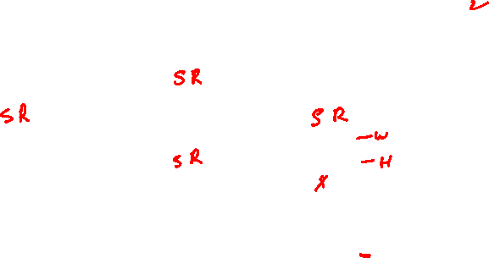




State Diagram of a SR Flip-flop
Function table
S
C
R
Q
S R Q⁺
0 0
0 1
0
1 1
Q
Q
0
SR
1
State Diagram:
-
10
00
0
1
10
01
00
01
10
Or
0X
0
X0
1
01

Slide 58
Equivalent State Definitions
Two states are equivalent if their response for each possible input sequence is an identical output sequence.
Alternatively, two states are equivalent if their outputs produced for each input symbol is identical and their next states for each input symbol are the same or equivalent.

Slide 59
Equivalent State Example
Consider the following state diagram:
Which states are equivalent?
0/0
1/0
S0
S1
0/1
0/1
0/1
1/0
1/0
S2
S3
1/0
Notes:
S2 and S3

Slide 60


Equivalent State Example
Equivalent states in the state diagram:
For states S2 and S3,
  the output for input
  0 is 1 and the for input 1,
  the output is 0
  the next state for input
  0 is S0 and for input
  1 is S2.
  By the alternative definition, states S2 and S3 are equivalent.
0/0
1/0
S0
S1
0/1
0/1
0/1
1/0
1/0
S2
S3
1/0

Slide 61
Equivalent State Example
Replacing S2 and S3 by a single state gives state diagram:
0/0
1/0
0
1
S0
S1
0/1
S0/0
S1
0/1
0/1
1/0
0/1
0/1
1/0
S2
1/0
1/0
S2
S3
1/0

Slide 62


Equivalent State Example
0/0
1/0
Are there other equivalent states?
Examining the new diagram,
states S1 and S2 are equivalent since
  their outputs for input
  0 is 1 and input 1 is 0,
  and
  their next state for input
  0 is both S0 and for input
  1 is both S2,
Replacing S1 and S2 by a
single state gives state
diagram:
S0
S1
0/1
0/1
1/0
S2
1/0
0/0
1/0
S0
S1
0/1
1/0

Slide 63
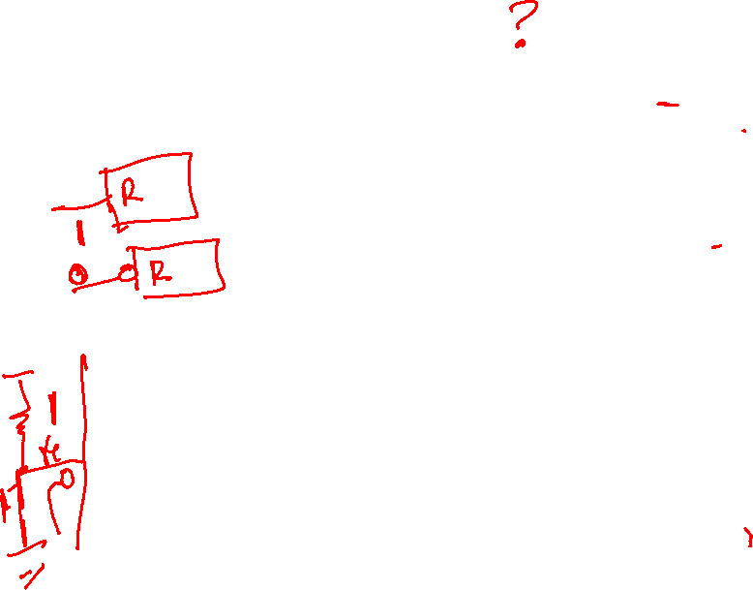

Exercise: Derive the state diagram of the following Circuit
A
Logic Diagram:
D
Q
Z
Moore or Mealy?
What is the reset state?
C
R
Q
B
D
Q
C
R
Q
5V
C
D
Q
Reset
•
•
Clock
C
R
Q
Notes:
Moore Machine
Reset state: 000

Slide 64
Exercise: Derive the state diagram of the following Circuit
A
Logic Diagram:
D
Q
Z
Moore or Mealy?
What is the reset state?
C
R
Q
B
D
Q
C
R
Q
5V
C
D
Q
Reset
•
•
Clock
C
R
Q
Notes:
Moore Machine
Reset state: 000

Slide 65
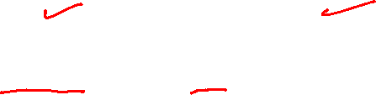
Step1: Flip-Flop Input Equations
Variables
  Inputs: None
  Outputs: Z
  State Variables: A, B, C
Initialization: Reset to (0,0,0)
Equations
  A(t+1) = BC Z = A
  B(t+1) = B’C + BC’= B ⊕ C
  C(t+1) = A’C’
Notes:
A(t+1) = BC
B(t+1) = B’C + BC’
C(t+1) = A’C’
Z = A

Slide 66


Step 2: State Table
A B C | A⁺ B⁺ C⁺ | Z
0 0 0 | 0 0 1 | 0
0 0 1 | 0 1 0 | 0
0 1 0 | 0 1 1 | 0
0 1 1 | 1 0 0 | 0
1 0 0 | 0 0 0 | 1
1 0 1 | 0 1 0 | 1
1 1 0 | 0 1 0 | 1
1 1 1 | 1 0 0 | 1
X⁺ = X(t+1) = D_{i}
  A(t+1) = BC Z = A
  B(t+1) = B’C + BC’ = B⊕C
  C(t+1) = A’C’
Notes:
A’B’C’: 0 0 1, 0 1 0, 0 1 1, 1 0 0, 0 0 0, 0 1 0, 0 1 0, 1 0 0
Z: 0 0 0 0 1 1 1 1

Slide 67


Step 3: State Diagram for the example
Start from the reset state
Are all states used? Which ones?
A B C | A⁺B⁺ C⁺ | Z
0 0 0 | 0 0 1 | 0
0 0 1 | 0 1 0 | 0
0 1 0 | 0 1 1 | 0
0 1 1 | 1 0 0 | 0
1 0 0 | 0 0 0 | 1
1 0 1 | 0 1 0 | 1
1 1 0 | 0 1 0 | 1
1 1 1 | 1 0 0 | 1
Reset
Reset
ABC
000
0
000
0
111
100
001
1
1
0
011
010
101
0
0
1
110
1
Notes:
Only states reachable from the reset state 000 are used: 000, 001, 010, 011, and 100.
The circuit produces a 1 on Z after four clock periods and every five clock periods thereafter:
000 -> 001 -> 010 -> 011 -> 100 -> 000 -> 001 -> 010 -> 011 -> 100 …
1 1

Slide 68
State Diagram
5 states are used: 000, 001, 010, 011, and 100
The function of the circuit
ABC
Reset
000
0
111
100
001
1
1
0
011
010
101
0
0
1
The circuit produces a 1 on Z after four clock periods and every five clock periods thereafter
110
1
Notes:
Only states reachable from the reset state 000 are used: 000, 001, 010, 011, and 100.
The circuit produces a 1 on Z after four clock periods and every five clock periods thereafter:
000 -> 001 -> 010 -> 011 -> 100 -> 000 -> 001 -> 010 -> 011 -> 100 …
1 1

Slide 69
Exercise: State Diagram transitions
A Mealy machine has been implemented with 4 flip-flops, and has 2 inputs (X and Y) and 5 a-synchronous output signals. Consider a complete state diagram for this Mealy machine (i.e. there are no don't cares).
  What is the minimum and maximum number of states?
  What are the minimum and maximum numbers of transition arrows starting at a particular state (leaving the state)?
  What are the minimum and maximum numbers of transition arrows that can end in a particular state?
  What are the minimum and maximum numbers of different binary output patterns that can be observed?

Slide 70
Exercise: Solution
Number of Inputs, n=2; number of FF, m=4 and number of outputs K=5
In case there are don't cares all states will be used so that the min and max numbers are equal: 2⁴=16.
The number of transitions leaving a state is always 2^{n} = 2² = 4. Thus the max and min is equal to 4.
The number of transitions entering a state: it is possible that non enters a state:
  so that minimum is 0.
  The maximum is when all transitions from all states enter the same state. Thus the maximum will be 2^{m+n} = 2⁶=64.
The max and min. no. of patterns that can be observed at the output:
  Minimum: 1.
  The maximum is either the no. of transitions 2^{m}.2^{n} = 2⁴⁺², or 2^{K} = 2⁵, whatever is the smallest. In this case the maximum is thus 2⁵=32.
Notes:
Note: for a Moore machine the no. of output patterns is the smallest of: 2^{m} (=no. of states) and 2^{k}.

Slide 71


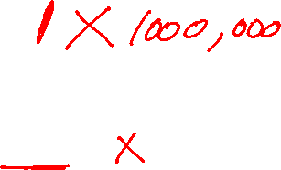
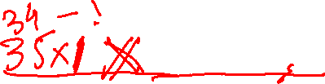
5-5 Sequential Circuit Design
Idea,
New product
Specification
?
O
U
T
IN
D_{A}
Comb.
Crct.
D_{B}
Word description
State Diagram
State Table
Select type of Flip-flop
Input equations to FF, output eq.
Verification
State encoding
Design
procedure

Slide 72
Specification
Component Forms of Specification
  Written description
  Mathematical description
  Hardware description language
  Tabular description
  Equation description
  Diagram describing operation (not just structure)

Slide 73
Formulation: Finding a State Diagram
In specifying a circuit, we use states to remember meaningful properties of past input sequences that are essential to predicting future output values.
As an example, a sequence recognizer is a sequential circuit that produces a distinct output value whenever a prescribed pattern of input symbols occur in sequence, i.e, recognizes an input sequence occurrence.
Next, the state diagram, will be converted to a state table from which the circuit will be designed.

Slide 74

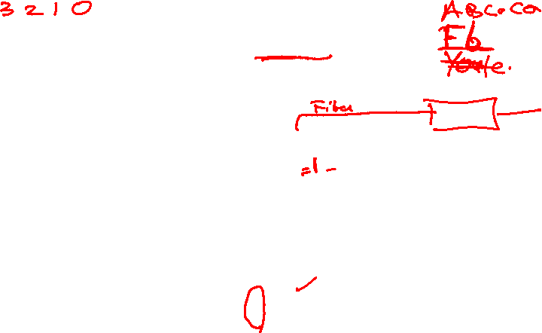
Sequence Detector: 1101
X
?
Mealy machine
Z
CLK
Input X:
Output Z:
00111001101011011010011110111
1
1
1
1
00000000001000010010000000100
Overlapping sequences are allowed

Slide 75
Sequence Detector: 1101
X
?
Mealy machine
Z
CLK
Input X:
Output Z:
00111001101011011010011110111
1
1
0
1
00000000001000010010000000100
Non-Overlapping sequences are allowed

Slide 76
Sequence Detector: 1101
X
?
Mealy machine
Z
CLK
Input X:
Output Z:
00111001001010011010011100111
1
1
0
1
00000000001000010010000000100
Non-Overlapping sequences are allowed

Slide 77
Sequence Detector: 1011
X
?
Mealy machine
Z
CLK
Input X:
Output Z:
00111001101011011010011110111
1
1
1
1
00000000001000010010000000100
Overlapping sequences are allowed

Slide 78
Step 1: Finding a State Diagram
A state is an abstraction of the history of the past applied inputs to the circuit.
  The interpretation of “past inputs” is tied to the synchronous operation of the circuit. E. g., an input value is measured only during the setup-hold time interval for an edge-triggered flip-flop.
  We add states when one needs to remember the past history
Example:
  State A represents the fact that two consecutive 1’s have appeared at the input (i.e. a 1 appears at the input during two consecutive clock edges).
C
In

Slide 79

State Diagram for the recognizer 1101
Define states for the sequence to be recognized:
  assuming it starts with first symbol X=1,
  continues through the right sequence to be recognized, and
  uses output 1 to mean the full sequence has occurred,
  with output 0 otherwise.
Starting in the initial state (named “S₀"):
  Add a state that recognizes the first "1.“
  State “S₀" is the initial state, and state “S₁" is the state which represents the fact that the "first" one in the input subsequence has occurred. The first “1” occurred while being in state S₀ during the clock edge.
Reset
input
output
1/0
S₀
S₁

Slide 80


State Diagram for the sequence 1101 (cont.)
Assume that the 2nd 1 arrives of the sequence 1101: needs to be remembered: add a state S₂
Next, a “0” arrives: part of the sequence 1101 that needs to be remembered; add state S₃
The next input is “1” which is part of the right sequence 1101; now output Z=1
1/0
1/0
0/0
1/1
?
S₀
S₁
S₂
S₃
…1
…11
…110

Slide 81

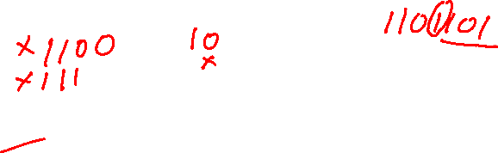
Completing the state diagram
Where does the final arrow go to:
  The final 1 of the sequence 1101 can be the beginning of another sequence; thus the arrow should go to state S₁
1/0
1/0
0/0
1/1
?
S₀
S₁
S₂
S₃
…1
…11
…110

Slide 82
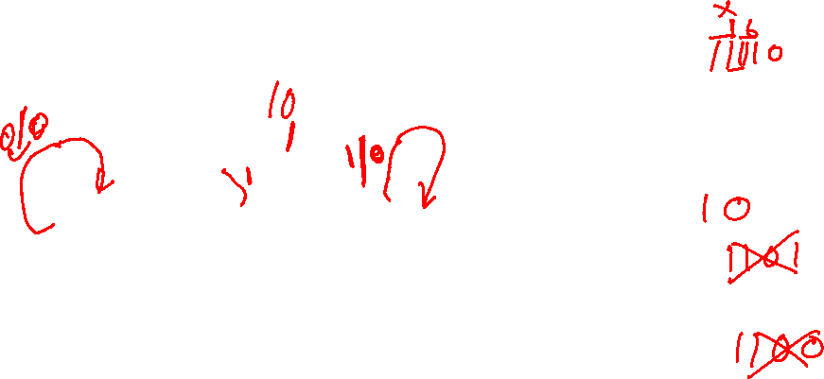

Completing the state diagram
0/0
Start is state S₀: assume an input X=0 arrives; what is the next state?
Next, consider state S₁: input X=0; next state?
Next state S₂ and S₃: completes the diagram
Each state should have two arrows leaving
1/0
1/0
1/0
0/0
1/1
S₀
S₁
S₂
S₃
0/0
…0
…1
…11
…110
0/0

Slide 83

Completing the state diagram
0/0
Start is state S₀: assume an input X=0 arrives; what is the next state?
Next, consider state S₁: input X=0; next state?
Next state S₂ and S₃: completes the diagram
Each state should have two arrows leaving
1/0
1/0
1/0
0/0
1/1
S₀
S₁
S₂
S₃
0/0
…0
…1
…11
…110
0/0

Slide 84
Step 3: State Assignment
Right now States have names such as S₀, S₁, S₂ and S₃
In actuality these state need to be represented by the outputs of the flip-flops.
We need to assign each state to a certain output combination AB of the flip-flops:
  e.g. State S₀=00, S₁=01, S₂=10, S₃=11
  Other combinations are possible: S₀=00, S₁=10, S₂=11, S₃=01
Comb.
crct
External Inputs
Combina-tional
Circuit
Next
State
Present state
Storage (D Flip-flops)
State
CLOCK
Notes:
There are 4x3x2x1=24 possible code assignments, indeed:
For the first one: 4 possibilities: 00, 01, 10, 11
For the 2nd one: 3 possibilities remain,
For the 3rd one: 2 remains.

Slide 85
Possible state assignments for 4 states with minimum number of bits
For state S₀: 4 possibilities (00, 01, 10, 11)
Than for state S₁ there will be 3 possible assignments left:
  e.g. is S₀=00, then S₁ can be 01, 10 and 11
For S₂: 2 possible
  e.g. S₀=00, S₁=01 than S₂ can be 10 or 11
For S₃: 1 assignment
Thus total of 4x3x2x1=24

Slide 86

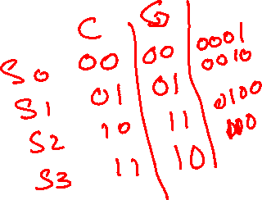
State Assignment – Mealy sequence detector
Popular state assignments:
1. Counting order assignment:
  00, 01, 10, 11
2. Gray code assignment:
  00, 01, 11, 10
3. One-hot state assignment
  0001, 0010, 0100, 1000

Slide 87
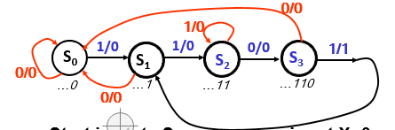


State Assignment: Counting order
“Counting Order” Assignment:
State Table:
S₀ = 0 0
Present
Next State
Output
S₁ = 0 1
S₂ = 1 0
S₃ = 1 1
State
x=0 x=1
x=0 x=1
S₀
S₀ S₁
0 0
S₁
S₀ S₂
0 0
S₂
S₃ S₂
0 0
Resulting coded state table:
S₃
S₀ S₁
0 1
Present State A B | Next State x = 0 x = 1 A⁺ B⁺ A⁺ B⁺ |  | Output x = 0 x = 1 Z Z
0 0 | 0 0 | 0 1 | 0 | 0
0 1 | 0 0 | 1 0 | 0 | 0
1 0 | 1 1 | 1 0 | 0 | 0
1 1 | 0 0 | 0 1 | 0 | 1

Slide 88
State Assignment: Gray code
“Gray Code” Assignment:
State Table:
S₀ = 0 0
Present
Next State
Output
S₁ = 0 1
S₂ = 1 1
S₃ = 1 0
State
x=0 x=1
x=0 x=1
S₀
S₀ S₁
0 0
S₁
S₀ S₂
0 0
S₂
S₃ S₂
0 0
S₃
S₀ S₁
0 1
Resulting coded state table:
Present State A B | Next State x = 0 x = 1 A⁺ B⁺ A⁺ B⁺ |  | Output x = 0 x = 1 Z Z
0 0 | 0 0 | 0 1 | 0 | 0
0 1 | 0 0 | 1 1 | 0 | 0
1 1 | 1 0 | 1 1 | 0 | 0
1 0 | 0 0 | 0 1 | 0 | 1

Slide 89
Step 4: Find Flip-Flop Input and Output Equations
Idea,
New product
Specification
A
O
U
T
IN
D_{A}
Comb.
Crct.
B
D_{B}
State Diagram
State Table
Select type of Flip-flop
Input equations to FF, output eq.
Verification
Next state A⁺ and B⁺
State encoding

Slide 90

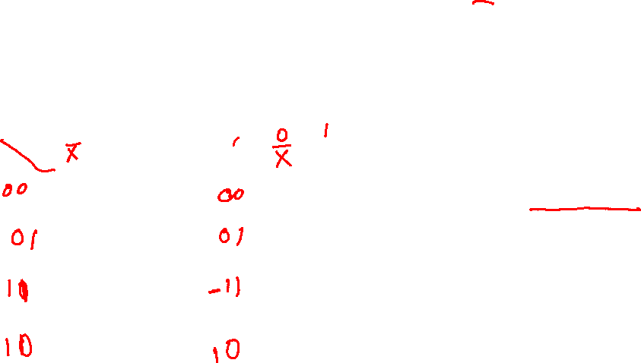
Find Flip-Flop Input and Output Equations: Example – Counting Order Assignment
Present State | Next State x = 0 x = 1 |  | Output x = 0 x = 1
AB | A⁺ B⁺ | A⁺ B⁺ | Z | Z
0 0 | 0 0 | 0 1 | 0 | 0
0 1 | 0 0 | 1 0 | 0 | 0
1 0 | 1 1 | 1 0 | 0 | 0
1 1 | 0 0 | 0 1 | 0 | 1
Using D flip-flops: thus D_{A}=A⁺, D_{B}=B⁺(the state table is the truth table for D_{A} and D_{B}).
Interchange the bottom two rows of the state table, to obtain K-maps for D_{A}, D_{B}, and Z:
D_{A}
X
D_{B}
X
0
0
0
1
Z = XAB
0
1
0
0
B
B
0
0
0
1
Gate Input Cost = 22
(plus FF: each FF needs about 14 gate inputs)
A
A
1
1
1
0
D_{A} = AB + XAB
D_{B} = XAB + XAB + XAB
Notes:
Input gate cost: DA: 7
DB: 12
Output 3
Total is 22 not counting inverters

Slide 91
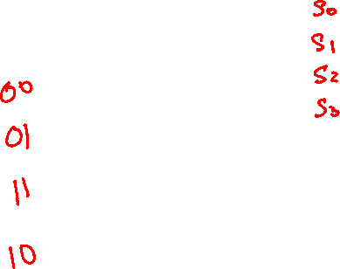
Find Flip-Flop Input and Output Equations: – Gray Code Assignment
Present State A B | Next State x = 0 x = 1 A⁺ B⁺ A⁺ B⁺ |  | Output x = 0 x = 1 Z Z
0 0 | 0 0 | 0 1 | 0 | 0
0 1 | 0 0 | 1 1 | 0 | 0
1 1 | 1 0 | 1 1 | 0 | 1
1 0 | 0 0 | 0 1 | 0 | 0
Assume D flip-flops
K-maps:
D_{A}
X
0
0
0
1
B
D_{B}
X
1
1
0
1
Z = XAB’
A
0
0
0
1
B
0
1
D_{A} = AB + XB
A
0
1
D_{B} = X
Gate Input Cost = 9

Slide 92

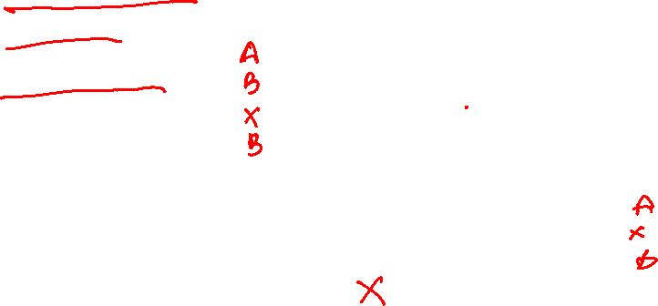
Circuit for Gray Code assignment: Map Technology
D_{A} = AB + XB
D_{B} = X
Z = XAB’
D_{A}
A
D
C
R
5V
Z
D_{B}
B
X
D
Clock
C
Reset
R
Reset

Slide 93


Exercise: Map the Circuit into Nand-Nand implementation
D_{A} = AB + XB
D_{B} = X
Z = XAB’
D_{A}
A
D
C
R
Z
5V
Z
D_{B}
B
X
D
Clock
C
Reset
R
Reset

Slide 94
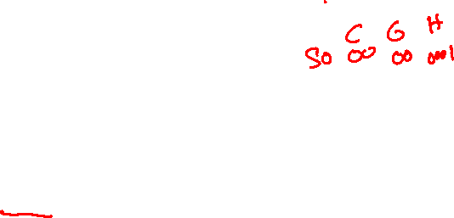
Alternative State Assignment: One FF per state
One Flip-flop per State or One-Hot Assignment
Example codes for four states:
Now requires 4 flip-flops:
S₃, S₂, S₁, S₀ = 0001, 0010, 0100, and 1000.

Slide 95

One-hot State Assignment – Previous example
One-Hot Assignment:
State Table:
Present
Next State
Output
S₀ = 1000
S₁ = 0100
S₂ = 0010
S₃ = 0001
State
x=0 x=1
x=0 x=1
S₀
S₀ S₁
0 0
S₁
S₀ S₂
0 0
S₂
S₃ S₂
0 0
S₃
S₀ S₁
0 1
Present State ABCD | Next State x = 0 x = 1 A⁺B⁺C⁺D⁺ |  | Output x = 0 x = 1
S₀ 1000 | 1000 | 0100 | 0 | 0
S₁ 0100 | 1000 | 0010 | 0 | 0
S₂ 0010 | 0001 | 0010 | 0 | 0
S₃ 0001 | 1000 | 0100 | 0 | 1

Slide 96
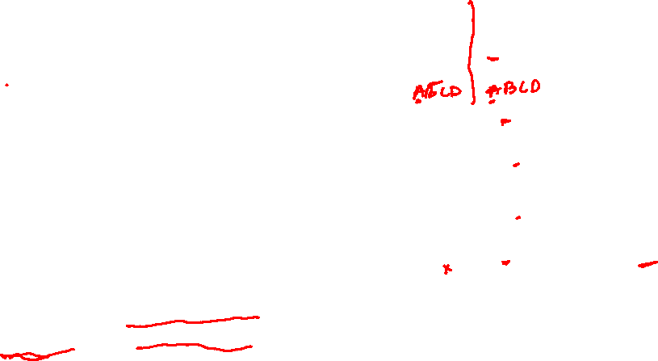
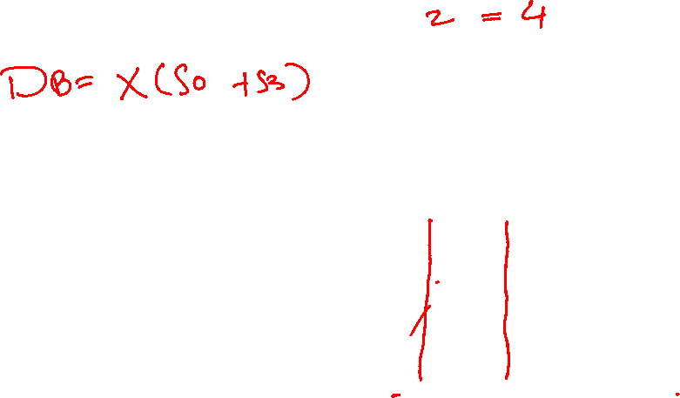

Optimization: One Hot Assignment
Equations can be easily determined from the table:
A⁺ = D_{A} = X(S₀+ S₁ + S₃)=X(A+B+D)
B⁺ = D_{B} = X(S₀+ S₃)= X(A+D)
C⁺ = D_{C} = X(S₁+ S₂)=X(B+C)
D⁺ = D_{D} = X S₂ = X C
Z = XS₃ = X D
Gate Input Cost = 17
Combinational cost intermediate plus cost of two more flip-flops needed.
Advantages: ease of design, reliability and performance
Present State ABCD | Next State x = 0 x = 1 A⁺B⁺C⁺D⁺ |  | Output Z x = 0 x = 1
S₀ 1000 | 1000 | 0100 | 0 | 0
S₁ 0100 | 1000 | 0010 | 0 | 0
S₂ 0010 | 0001 | 0010 | 0 | 0
S₃ 0001 | 1000 | 0100 | 0 | 1
In equations, only the variable that is 1 for the state needs to be included, e. g., state with code 0001, is represented in equations by S0 instead of
S3 S2 S1 S0 because all codes with 0 or two or more 1s have don’t care next state values.

Slide 97
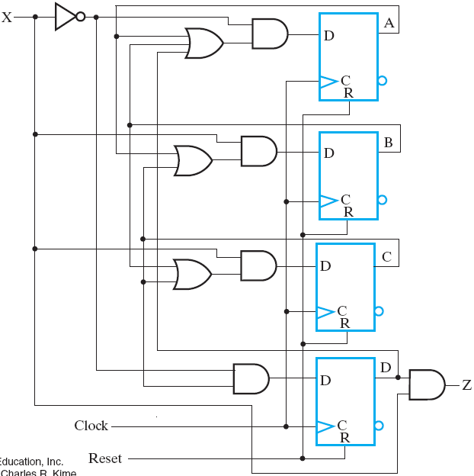
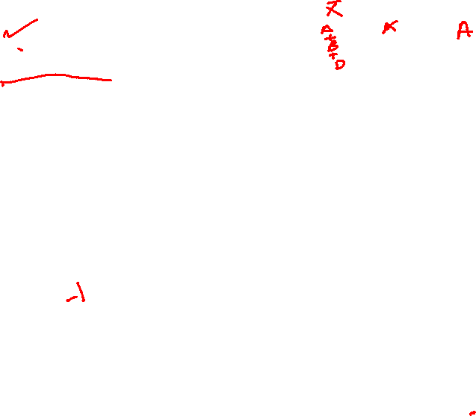

Circuit for the One-Hot coded circuit
D_{A} = X(A+B+D)
D_{B} = X(A+D)
D_{C} = X(B+C)
D_{D} = X C
Z = X D
5V

Slide 98

Example: Vending machine
Design the control circuit for a vending machine with the following specifications:
    The vending machine accepts nickels (N) and dimes (D)
    When the machine has received 15 cents it delivers a package of candy.
    If too much money has been added, the machine returns the difference.
    When the candy has been released, ,the release mechanism brings the circuit back to the original, starting state.
Coin
insert
release

Slide 99
Design Procedure - review
Understanding the problem and adding specs if needed
State diagram
State table
State encoding
Select the type of flip-flop
Derive the input equations to the FF; and the output equations
Draw the diagram
Verify

Slide 100
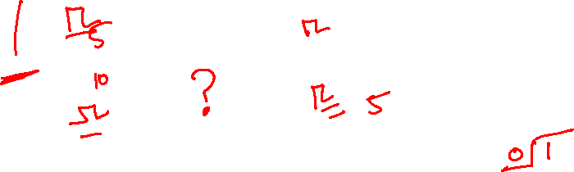

Step 1: Understanding the problem
Vending
Sequential Crt
Y
Coin
sensor
N
Release candy
mechanism
D
Z
Return change
mechanism
Inputs: N and D
Outputs: Y and Z
Only one of the inputs N or D are asserted at one time (never together)
N and D is asserted for only one clock cycle when a coin has been inserted
Pennies are not accepted
Z=0 (no change); Z=1 (change returned: 5 cents)

Slide 101


Step 2: State Diagram (Moore)
Reset
Convention:
ND
S₀
00
S_{i}
YZ
state
input
N
output
D
S₁
00
5c
X
X
N
D
S₂
00
10c
D
N
Requires 5 states
20c
release gum;
return 5c
S₄
11
S₃
10
15c
release
gum

Slide 102


Step 2: State Diagram (Mealy)
Reset
Convention:
ND/YZ
S₀
S_{i}
state
Input/
output
N/00
D/10
D/00
S₁
D/11
5c
20c
release gum;
return 5c
15c
release
gum
N/00
N/10
S₂
10c
Requires 3 states

Slide 103
Step 2: State Diagram (Mealy)
The notation in the previous diagram was simplified: we assumed that when an input=0 there is no change.
A more complete diagram would be:
ND/YZ
S_{i}
Convention:
Input/
Reset
N.D
state
output
S₀
N/00
D/10
N.D
D/00
S₁
D/11
5c
20c
release gum;
return 5c
15c
release
gum
N/00
N/10
N.D
S₂
10c

Slide 104

Step 3: State table for Mealy machine
Present State | Inputs D N | Next States | Outputs Y Z
S₀ | 0 0 | S₀ | 0 0
S₀ | 0 1 | S₁ | 0 0
S₀ | 1 0 | S₂ | 0 0
S₀ | 1 1 | x | x x
S₁ | 0 0 | S₁ | 0 0
S₁ | 0 1 | S₂ | 0 0
S₁ | 1 0 | S₀ | 1 0
S₁ | 1 1 | x | x x
S₂ | 0 0 | S₂ | 0 0
S₂ | 0 1 | S₀ | 1 0
S₂ | 1 0 | S₀ | 1 1
S₂ | 1 1 | x | x x
S₃ | 0 0 | x | x x
S₃ | 0 1 | x | x x
S₃ | 1 0 | x | x x
S₃ | 1 1 | x | x x
Reset
S₀
N/00
D/10
D/00
S₁
D/11
5c
N/00
N/10
S₂
10c

Slide 105
Step 4: State Encoding
Three states requires 2 flip-flops: A and B
Use the following encoding:
  S₀ = 00
  S₁ = 01
  S₂ = 10
Encoded state table

Slide 106
Encoded state table
Present State | Inputs D N | Next States | Outputs Y Z
S₀ | 0 0 | S₀ | 0 0
S₀ | 0 1 | S₁ | 0 0
S₀ | 1 0 | S₂ | 0 0
S₀ | 1 1 | x | x x
S₁ | 0 0 | S₁ | 0 0
S₁ | 0 1 | S₂ | 0 0
S₁ | 1 0 | S₀ | 1 0
S₁ | 1 1 | x | x x
S₂ | 0 0 | S₂ | 0 0
S₂ | 0 1 | S₀ | 1 0
S₂ | 1 0 | S₀ | 1 1
S₂ | 1 1 | x | x x
S₃ | 0 0 | x | x x
S₃ | 0 1 | x | x x
S₃ | 1 0 | x | x x
S₃ | 1 1 | x | x x
Present State A B | Inputs D N | Next States A⁺ B⁺ | Outputs Y Z
0 0 | 0 0 | 0 0 | 0 0
0 0 | 0 1 | 0 1 | 0 0
0 0 | 1 0 | 1 0 | 0 0
0 0 | 1 1 | x | x x
0 1 | 0 0 | 0 1 | 0 0
0 1 | 0 1 | 1 0 | 0 0
0 1 | 1 0 | 0 0 | 1 0
0 1 | 1 1 | x | x x
1 0 | 0 0 | 1 0 | 0 0
1 0 | 0 1 | 0 0 | 1 0
1 0 | 1 0 | 0 0 | 1 1
1 0 | 1 1 | x | x x
1 1 | 0 0 | x | x x
1 1 | 0 1 | x | x x
1 1 | 1 0 | x | x x
1 1 | 1 1 | x | x x

Slide 107
Step 5: Select type of flip-flop
We will use D flip-flops: A and B
Other flip-flops are possible (see later):
  JK flip-flop
  SR flip-flop
  T flip-flop

Slide 108
Step 6: Derive the inputs to the flip-flops and output equations
The combinational circuits can be implemented in a variety of ways:
  Minimized SOP
  Decoders and OR gates
  Multiplexers
Let’s use the minimized SOP:
  Use K-maps for optimization

Slide 109

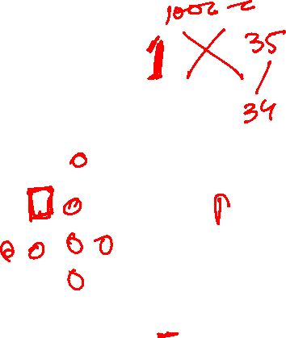
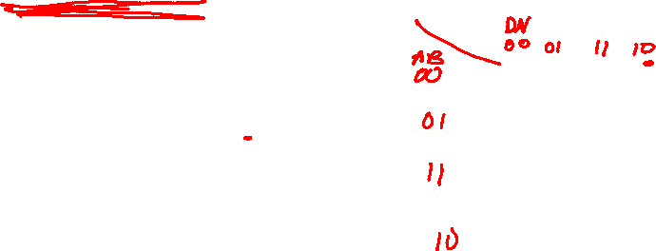
Input equations for D_{A} and D_{B}
Present State A B | Inputs D N | Next States A⁺ B⁺ | Outputs Y Z
0 0 | 0 0 | 0 0 | 0 0
0 0 | 0 1 | 0 1 | 0 0
0 0 | 1 0 | 1 0 | 0 0
0 0 | 1 1 | x | x x
0 1 | 0 0 | 0 1 | 0 0
0 1 | 0 1 | 1 0 | 0 0
0 1 | 1 0 | 0 0 | 1 0
0 1 | 1 1 | x | x x
1 0 | 0 0 | 1 0 | 0 0
1 0 | 0 1 | 0 0 | 1 0
1 0 | 1 0 | 0 0 | 1 1
1 0 | 1 1 | x | x x
1 1 | 0 0 | x | x x
1 1 | 0 1 | x | x x
1 1 | 1 0 | x | x x
1 1 | 1 1 | x | x x
D
D_{A}
0
0
x
1
0
1
x
0
B
x
x
x
x
A
1
0
x
0
N
D_{A}=BN+ABD+AND
D
D_{B}
0
1
x
0
1
0
x
0
B
x
x
x
x
A
0
0
x
0
N
D_{B}=BND+ABN

Slide 110


Output equations
Present State A B | Inputs N D | Next States A⁺ B⁺ | Outputs Y Z
0 0 | 0 0 | 0 0 | 0 0
0 0 | 0 1 | 0 1 | 0 0
0 0 | 1 0 | 1 0 | 0 0
0 0 | 1 1 | x | x x
0 1 | 0 0 | 0 1 | 0 0
0 1 | 0 1 | 1 0 | 0 0
0 1 | 1 0 | 0 0 | 1 0
0 1 | 1 1 | x | x x
1 0 | 0 0 | 1 0 | 0 0
1 0 | 0 1 | 0 0 | 1 0
1 0 | 1 0 | 0 0 | 1 1
1 0 | 1 1 | x | x x
1 1 | 0 0 | x | x x
1 1 | 0 1 | x | x x
1 1 | 1 0 | x | x x
1 1 | 1 1 | x | x x
D
Y
0
0
x
0
0
0
x
1
B
x
x
x
x
A
0
1
x
1
N
Y=BD+AN+AD
D
Z
0
0
x
0
0
0
x
0
B
x
x
x
x
A
0
0
x
1
Z=AD
N

Slide 111
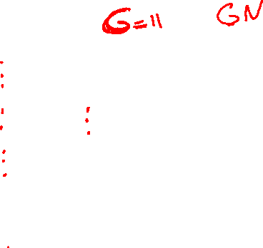
Step 7: Circuit
D_{A}=BN+ABD+AND
D_{B}=BND+ABN
D
Y=BD+AN+AD
N
D_{A}
Z
D
A
Z=AD
Q
Y
D_{B}
D
B
Q
CLK

Slide 112
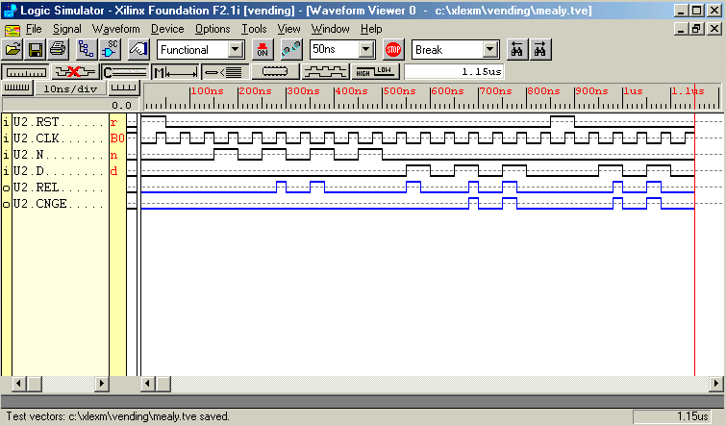



Simulation and verification: Mealy machine
inputs
N
N
N
N
D
D
D
Y
Z
outputs
release
Release &
Change (OK)
release
wrong output
glitch
glitches

Slide 113
Mealy machine: extra outputs!
In/out
Did anything go wrong?
Key: when is the input valid?
  A set-up time before the clock transition: in our case this is just before the positive clock edge:
  Thus, the output is valid just before the clock edge (i.e. at the end of the state time): for state S_{i} and valid input In
S_{i}
State S_{i}
State S_{i+1}
Clock
valid In
In
t_{S}
t_{h}
Out
Not necessarily valid
Valid
In/out
S_{i}

Slide 114
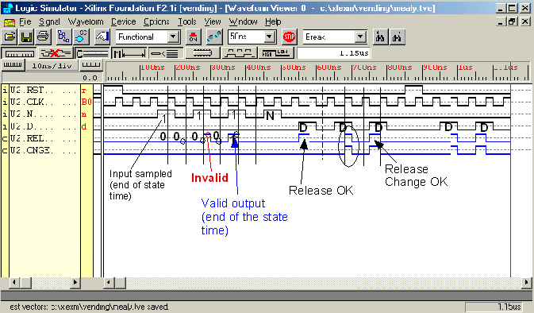

Mealy machine: simulation
Output are only valid at the end of the state time!
Be careful with outputs of Mealy machines.

Slide 115
Moore machine: timing
Since the output is only function of the state and NOT of the inputs: timing is easier.
The output is valid at the next clock cycle (when in the new state S_{i+1})
S_{i}
Out_{i}
in
S_{i+1}
Out_{i+1}
State S_{i}
State S_{i+1}
Clock
valid In
In
t_{S}
t_{h}
Out
Out_{i}
Valid
Out_{i+1}

Slide 117
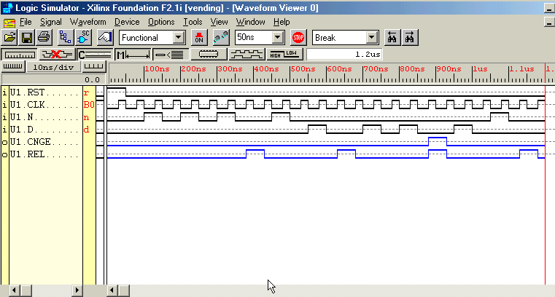








Step 8: Simulation and verification: Moore machine
N
N
N
N
D
D
D
release
Release &
Change (OK)
release
Moore machine gives the correct outputs

Slide 118
5-6 Other Flip-Flop Types
J-K and T flip-flops
  Behavior
  Implementation
Basic descriptors for understanding and using different flip-flop types
  Characteristic tables
  Characteristic equations
  Excitation tables

Slide 119

J-K Flip-flop
Behavior of JK flip-flop:
  Same as S-R flip-flop with J analogous to S and K analogous to R
  Except that J = K = 1 is allowed, and
  For J = K = 1, the flip-flop changes to the opposite state (toggle)
Behavior described by the characteristic table (function table):
J
Q
C
K
J K Q(t+1)
0 0 Q(t) no change
0 1 0 reset
0 1 set
1 1 Q(t) toggle

Slide 120

Design of a J-K Flip-Flop
State table of a JK FF:
Q(t+1)=D_{A}
J
Present Inputs Next
state state
0 0 1 1
Q J K Q(t+1)
Q
1 0 0 1
0 0 0
0 0 1
0 1 0
0 1 1
1 0 0
1 0 1
1 1 0
1 1 1
0
0
1
1
1
0
1
0
K
Q(t+1)= D_{A}=JQ’ + K’Q
Called the characteristic equation
J
D
K
C

Slide 121

T Flip-flop
Behavior described by its characteristic table:
  Has a single input T
    For T = 0, no change to state
    For T = 1, changes to opposite state
T Q(t+1)
0 Q(t) no change
1 Q(t) complement
Characteristic equation:
Q(t+1)=T’Q(t) + TQ’(t)
= T⊕Q(t)
T
C

Slide 122


T Flip-flop realization
Using a D Flip-flop: D=T⊕Q(t)
Or use a J-K flip-flop:
D
T
C
J K Q(t+1)
0 0 Q(t)
0 1 0
0 1
1 1 Q’(t)
Make J=K=T

Slide 123
Excitation table of Flip-Flops
  Characteristic table - defines the next state of the flip-flop in terms of flip-flop inputs and current state
  Characteristic equation - defines the next state of the flip-flop as a Boolean function of the flip-flop inputs and the current state.
  Excitation table - defines the flip-flop input variable values as function of the current state and next state. In other words, the table tells us what input is needed to cause a transition from the current state to a specific next state.
For analysis
For design

