Slide 1
CSCI-442 Project 2: UNIX Shell
Introduction
DISCLAIMER: These slides are intended for in-class presentation and do not contain all the necessary information about the project. You should read the project readme in full, twice, before starting the project.

Slide 2
The Shell Project
For this project, you will implement a UNIX Shell (similar to shells Like bash), using the C programming language.
The shell serves as the user interface of an operating system, and some shells provide additional functionality, such as scripting.
Learning Objectives:
Understand the system call Application Binary Interface (ABI) to UNIX systems by writing a program which uses system calls such as fork, execve, and more.
Become familiar with UNIX file descriptors, both associated to files on the filesystem and to pipes, by implementing a shell which supports pipelines, file input, file output, and file appending.
Sharpen systems programming skills by working on a large project.
Learn how to manage time.

Slide 3
The Shell Project
There are two deliverables in this project.
The function of multiple deliverables is to prevent you from falling behind on this large project.
Please note:
Solutions to D1 will not be provided after the due date. You are expected to make D2 function on-top of your own work from D1.
It is recommended to finish D1 significantly before the provided due date so that you can get a head-start on D2. D2 is much more difficult than D1.
All functionality due in Deliverable 1 must continue to function when you submit Deliverable 2.
Points will be deducted from your Deliverable 2 grade if features have regressed that you submitted with Deliverable 1.

Slide 4
The Shell Project
When you run your ./shell you will get something that looks like this. Note the username, host and the directory will be different.
You run your commands here like a normal terminal. Do note the smile. The smile means that the command ran successfully.

Slide 5
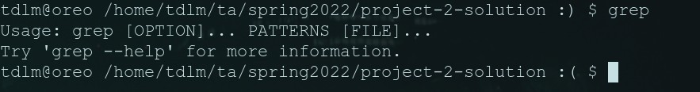
Project Details
In this example we see that the command 'echo hello’ resulted in a smile. Echo ran correctly and it created a smile on the new terminal line.
In this image we see that the grep command ran BUT it gave an error. This resulted in a frown in the next line even though the command was real.

Slide 6
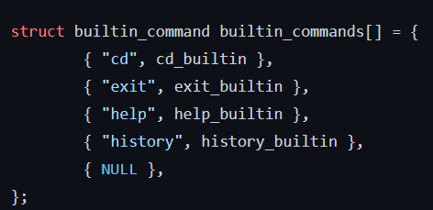
Built-in Commands
Builtin commands are commands supported by the shell which do not require running an external program. For all bulitin commands, if the user provides an invalid input (such as incorrect number of arguments, provides a non-existent file or directory, etc.), your shell should print an appropriate error message on stderr and indicate the command failure status in the prompt.
All required builtin commands are implemented in the starter code (in src/shell_builtins.c) for you already.

Slide 7
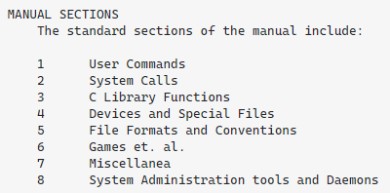
Project Requirements
Deliverable 1: External commands:
[D1] When the user types a command which is not known as a builtin to the shell, the shell should find the command in the PATH and execute the command using fork(2) and execve(2). You may use any of the exec* family of library functions (such as execvp(3)) to help you find the command in the PATH before executing it, if you wish.
[D1] The shell should wait on the external command finishing before returning to the prompt. As an example, you should be able to type gedit, the editor will open, and you won't get your shell prompt again until the editor is closed. See man 2 wait for info on how to do this.

Slide 8
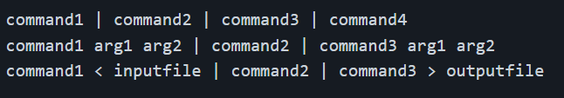

Project Requirements
Deliverable 2: Pipes and file redirection:
[D2] Your shell should be able to handle an arbitrary number of commands piped together.
For an example of a real piped command, try this (which gives the number of lines in mains/parseview.c which contain the word int):
Note: builtin commands do not need to work with pipelines of more than a single command, nor input or output files.

Slide 9
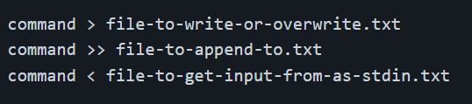
Project Requirements
Deliverable 2: Pipes and file redirection:
[D2] Your code must handle file redirection using > (overwrite to a file), >> (append to a file), or < (input from a file). For example:
[D2] For > and >>, you should create the file if it does not exist.
[D2] You should support < at the beginning of a pipeline, and >> or > at the end of a pipeline.

Slide 10
Starting the project
The starter code provides an input loop, input parser, and builtin commands, well as a Makefile, but does not dictate how you should structure the code for external commands, pipelines, or redirection.
It's up to you to break your code into useful helper functions, or even separate files entirely.
If you are just opening the starter code and want to look for somewhere to start, try this:
Run make and observe the output directories and where the programs end up.
Run ./shell. Observe the working builtin commands, and what happens if you try to run an external command.
Run ./parseview and type some commands. Each output shows the resultant struct command structure than you'll get at dispatch_external_command. Use this tool to rationalize the meaning of each of the fields in the struct.
Open the src/dispatcher.c, read thru the comments in there.
Start hacking away at dispatch_external_command!

Slide 11
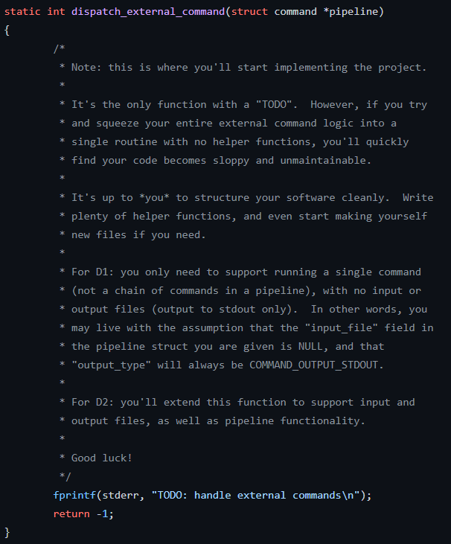
Starting the project
All the work you will be doing is inside a file called src/dispatcher.c
This file has a function that you need to implement called dispatch_external_command. This function is incharge of running the command given. It takes the struct described in the previous slides as input.
The parser, terminal, and all other code is already implemented.

Slide 12
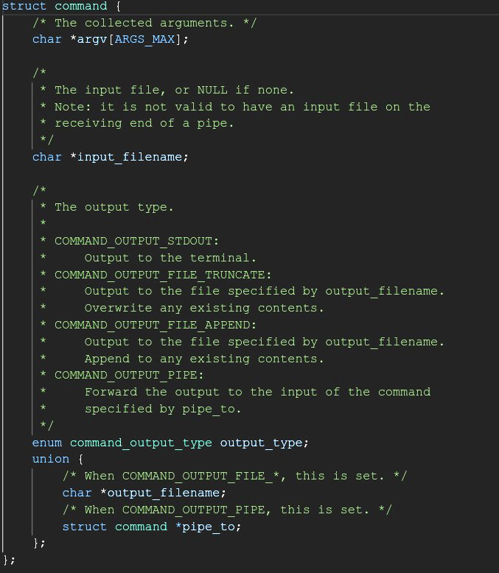
struct command
We will look at these variables one at a time

Slide 13
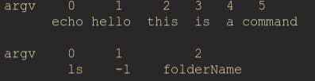
struct command: argv
This is how two different Linux commands will look like in argv.
The zero element will always be the command being ran and the following elements are the arguments the command is called with.
The argv array is what you need to pass into whichever exec function you decide to use. The exact way to pass it in is described in the man page for the exec family of functions.

Slide 14
struct command: input_filename
The variable is NULL if there is no < character.
If there is a < and a file is provided, then the variable is a char array of that filename.
In the example provided in the image, input filename will be ”inputfile.txt”
You must open the file and dup the file descriptor to standard in. This will make the contents of the file automatically go to cat.

Slide 15
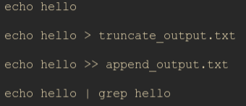
struct command: output_type
There are 4 main types of output.
standard output (std_out) where it prints to terminal
truncation to file where the contents of the file are deleted and replaced with the output of the command before the >
append to file where the output of the command is put at the end of the filename
pipe to another command where the output of the command on the left of the | is turned into the input of the command on the right

Slide 16
struct command: output_type
To identify which needs to happen we have an enum declared. This enum is what is set in this output type variable.
The enums go as follows.
COMMAND OUTPUT_STD_OUT
COMMAND OUTPUT_FILE_TRUNCATE
COMMAND OUTPUT_FILE_APPEND
COMMAND OUTPUT_PIPE

Slide 17

struct command: output_filename
Much like input file, this variable is NULL if there is no > or >>
This option is a char array if and only if output type is COMMAND_OUTPUT_FILE_TRUNCATE
or
COMMAND_OUTPUT_FILE_APPEND

Slide 18
struct command: output_filename
Remember:
Truncate means you need to erase everything in the file and replace it with the new contents.
Append means you need to add the command output to the bottom of the file (if it already exists)
If the file doesn’t exist you create it.

Slide 19
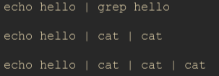
struct command: pipe_to
The data structure is a type of linked list of struct commands.
The first command is in the first struct.
The next command is in the struct that pipe_to of that struct points to.
pipe_to is NULL if there is no | character.

Slide 20
struct command: pipe_to
This slide is here purely to say that the next slide is a picture that shows how the struct is made for commands.
A command can have both an input file and an output file. It will just look like a combination of the two shown.

Slide 21

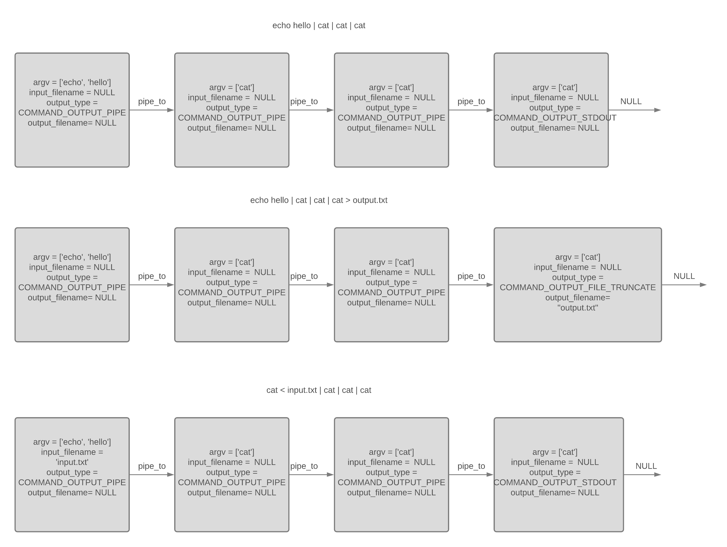



struct command examples

Slide 22

Invalid commands
Input will ALWAYS be on the first command and will never be in in the middle of the pipe as seen in the first example.
Output will ALWAYS be on the end and will never be in the middle of the pipe as seen in the second example.

Slide 23
Recommendations and hints
Split what you need to do into functions
Having functions that correctly dup input and output for you depending on if the output_type is a pipe, truncate, or append is really helpful (keeps that logic in one spot so you don’t have to edit it in 5 places)
Make sure that you exit any child process. If you don’t you will end up with a shell running inside a shell.
When you run your code typing ’exit’ once should exit your code. If it takes more than this you forgot to exit from the child

Slide 24
Recommendations and hints
As for implementations for handling the logic. There are two methods you can do.
Recursive or a Loop
You can recurse through the list of commands and run them one at a time redirecting output as needed
The order that the commands are run in does not matter. A command will wait for input before running.
'echo hello | grep h | cat | less'
Let’s say that in your implementation you run less first and then run the commands backwards.
less won’t run until it recieves input so it will wait for cat to run.
In turn cat will wait for grep and so on.

Slide 25
Important things to check
In Linux, false is a command that just fails. So in this command the first command in the pipe (echo) passes successfully then false fails but this then goes into cat which passes. This ultimately results in a smile because the exit code of the last command is what matters.
In this command, the failure is at the end thus it does result in a frown.

Slide 26
Copyright Notice
This presentation is for CSCI-442.
Individual authors may have certain copyright or licensing restrictions on their presentations. Please be certain to contact the original author to obtain permission to reuse or distribute these slides.

