Slide 1
Lab 07 Overview
SIFT and Harris

Slide 2
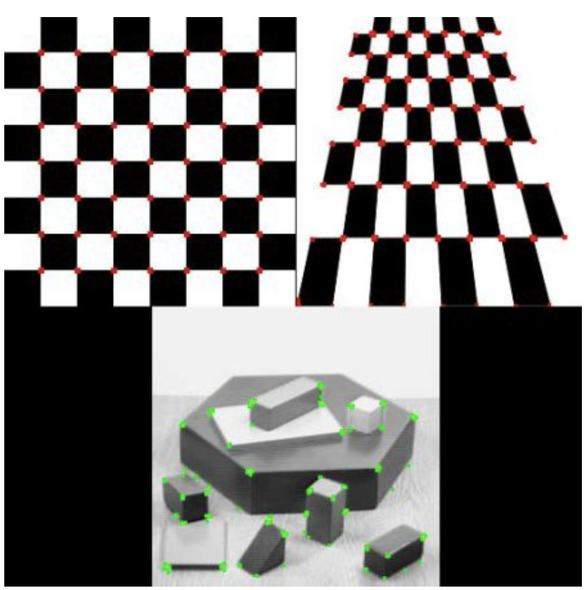
Harris (1988)
Finds corners.
Checks for two edges together.
Edge can be seen as a sudden change in value (high derivative).
Derivatives can be estimated using a Taylor expansion.
Doesn’t care about orientation of corner (rotation invariant).

Slide 3
Harris
Don’t take my word for it! Look at these resources:
https://en.wikipedia.org/wiki/Harris_corner_detector
https://docs.opencv.org/3.4/dc/d0d/tutorial_py_features_harris.html
The OpenCV resource I found to be particularly useful, goes into the math much better than the Wikipedia one (~10-minute read). Highly recommend.

Slide 4
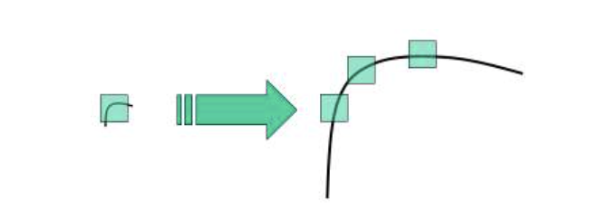
Downside of Harris?
Works well for boxy things. What about a curved thing? What if the object we are looking for is much bigger than the convolutional frames?

Slide 5
Scale Invariant Feature Transformation (SIFT)
First paper published on the SIFT in 2004:
https://www.cs.ubc.ca/~lowe/papers/ijcv04.pdf
About ~25 pages, a relatively easy read that takes ~1 hour.
Highly recommend. Inquiry/curiosity driven over stress driven.
SIFT is another algorithm to find key features.
Invariant to scale, rotation, partially invariant to illumination and 3D camera viewpoint.
SIFT finds location, scale, orientation to each feature.
Another good resource: https://docs.opencv.org/4.x/da/df5/tutorial_py_sift_intro.html
~10 minute read, good alternative to the original published paper.

Slide 6
SIFT Overview
SIFT uses a difference-of-Gaussian (DOG) function.
An example DOG application:
I = imread('cameraman.tif');
blurredImage = imgaussfilt(I, 2);
extraBlurredImage = imgaussfilt(I, 10);
differenceOfGaussian = blurredImage - extraBlurredImage;
subplot(1,2, 1), imshow(I)
subplot(1,2, 2), imshow(differenceOfGaussian)

Slide 7
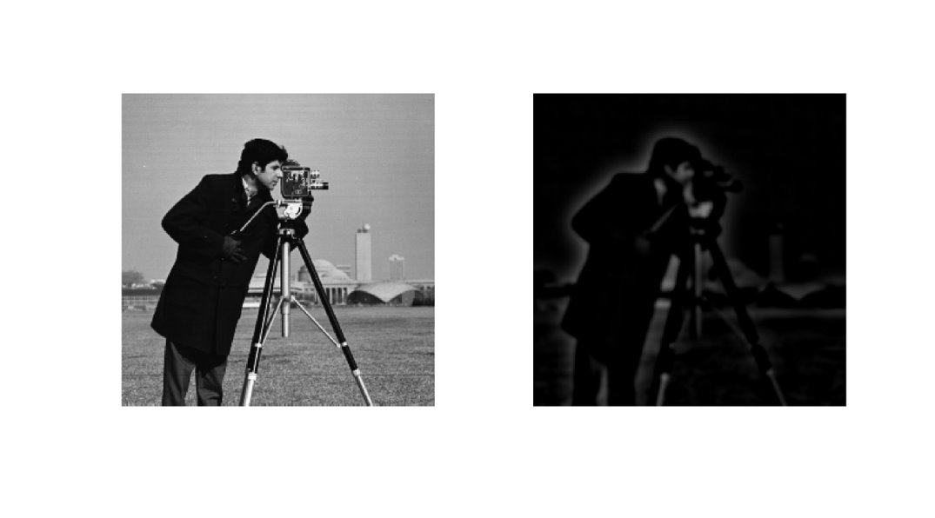

Slide 8
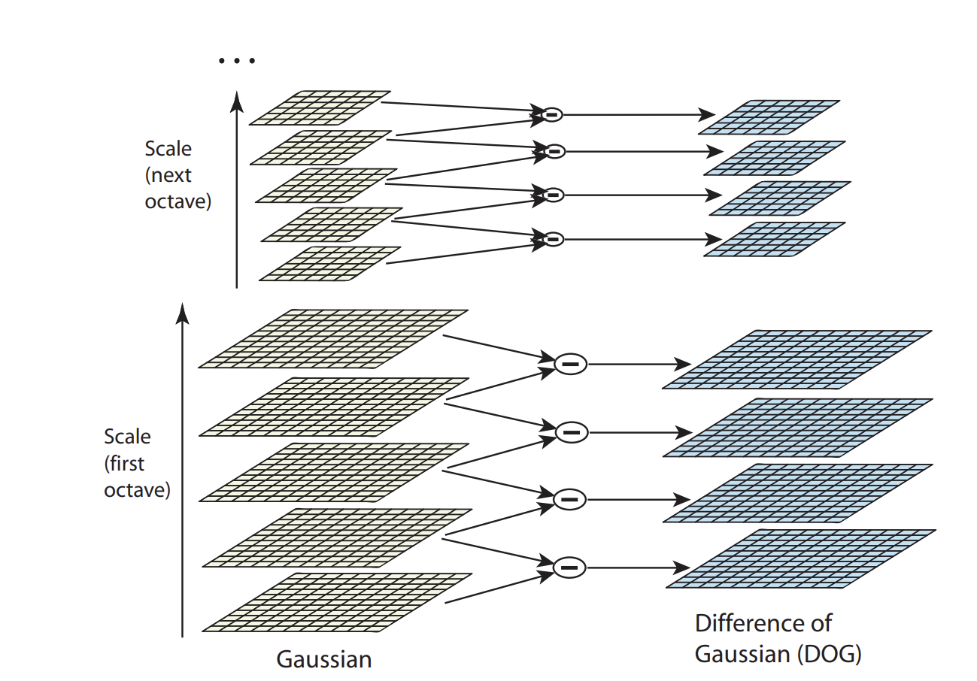
Scale invariant?
Uses the DOG function for different sizes of Gaussian filters. This finds key features of various sizes, or scales. Also used for feature matching.
Finds features by taking the local extrema (max, min of the DOG results).

Slide 9
Direction?
Uses an orientation histogram of 36 bins for 360 degrees.
Good balance between computational efficiency and precision
Bins are filled with gradient orientations of sample points around the feature we are interested in.
Samples added to histogram are weighted by magnitude of gradient and direction (larger magnitude means more we care about it and higher weight)
A 3 point quadratic interpolation is used on the histogram maximums to find direction.
In the case with Multiple points can be found at this stage with same location and magnitude but different direction.

Slide 10
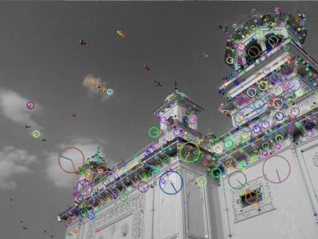

Slide 11
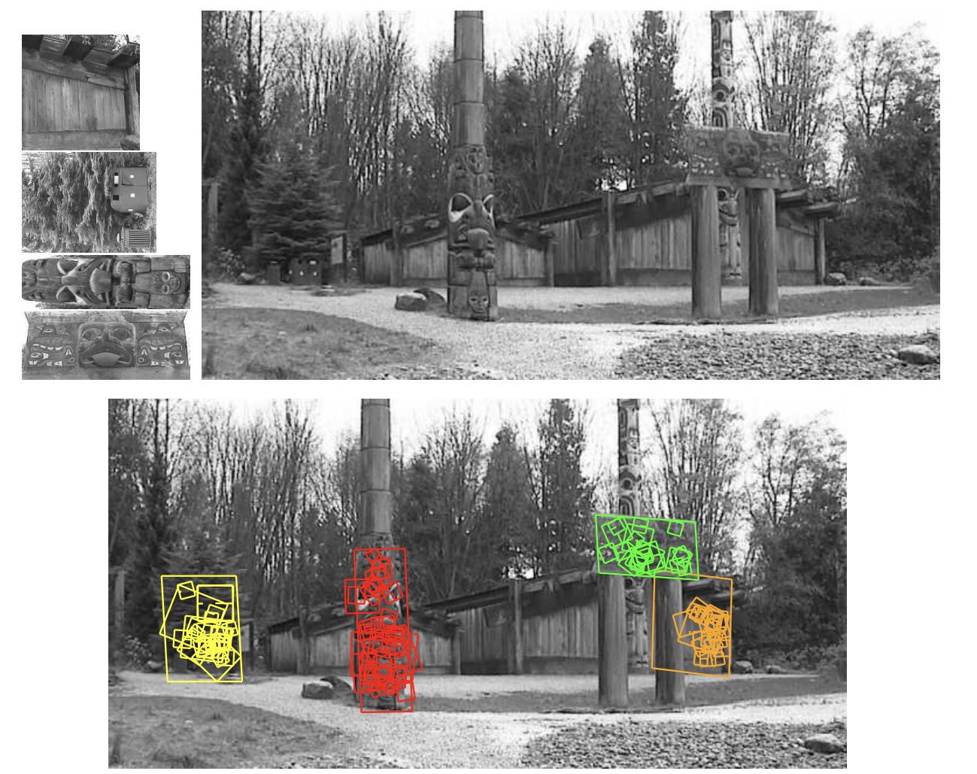
What is this used for?

Slide 12
How to use SIFT in Matlab?
OpenCV should reference the linked OpenCV sites earlier in the slides.
Detect SIFT features in Matlab:
points = detectSIFTFeatures(I)
Select the top n points:
strongest = points.selectStrongest(n);

Slide 13
How to use Harris in Matlab?
OpenCV should reference the linked OpenCV sites earlier in the slides.
Detect Harris corners in Matlab:
points = detectHarrisFeatures(I)
These points can just be plotted...
I recommend plotting the top 10, 50, 100 matched points to see which corners matches best.

Slide 14
