Slide 1

Colorado School of Mines
Computer Vision
Lab06

Slide 2
Prepare for the lab:
Students should reference
Lecture 13: PyCharm Tutorial
Lecture 14: Python and Numpy Tutorial
Lecture 15: OpenCV Tutorial

Slide 3
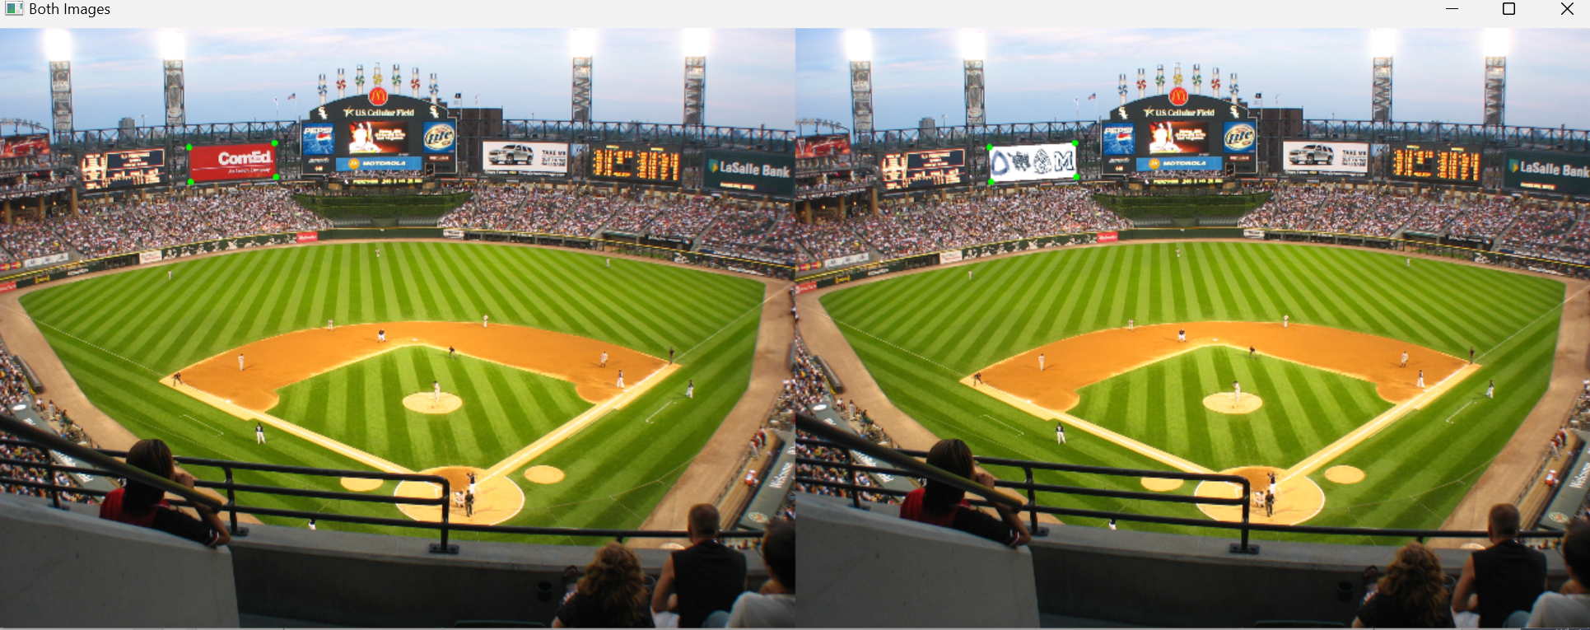


What we are trying to do

Slide 4
High level overview
Read in points.
Transform image using a built in transformation (e.g. perspective).
Create a mask for background and sign.
Multiply stadium by background, logo by sign, add together.
Display images.
Draw circles on the points.

Slide 5
Read in points (you are given points)
Matlab
Python
% Load points
load('pts.mat');
import cv2
import numpy as np
# Read in the points
points = []
with open('pts.dat', 'r') as file:
# Iterate through each line in the file
for line in file:
# Process each line into a point
points.append(list(map(float,(line.strip().split()))))
# Process point inputs to floats (You might need ints, not floats)
points = np.float32(points)

Slide 6
Do transformation
Matlab:
T21 = fitgeotrans(Pts2, Pts1, 'transformation type');
I2warp = imwarp(I2, T21, 'OutputView', imref2d(size(I1), [1 size(I1,2)], ...
[1 size(I1,1)]), 'Interp', 'cubic');
OpenCV Python:
transformationMatrix = cv2.getPerspectiveTransform(facebookPoints, stadiumPoints)
warpedFacebook = cv2.warpPerspective(facebook, transformationMatrix, (stadium.shape[1],
…
stadium.shape[0]))

Slide 7
What is a mask?
FinalImage = stadium * backgroundMask + facebook * facebookMask

Slide 8
Get Mask
Matlab
facebookMask= poly2mask(Pts1(:,1), Pts1(:,2), size(I1,1), size(I1,2));
backgroundMask= ~facebookMask;
Python
# Get the mask
facebookMask= np.zeros_like(stadium)
stadiumPoints=stadiumPoints.astype(np.int32)
# Fill the region defined by the points we will multiply by
cv2.fillPoly(mask, pts=[stadiumPoints], color=(255, 255, 255)) # Threshold to get these to 1 or 0
# Invert the mask (background becomes white, foreground becomes black)
backgroundMask = cv2.bitwise_not(mask)

Slide 9
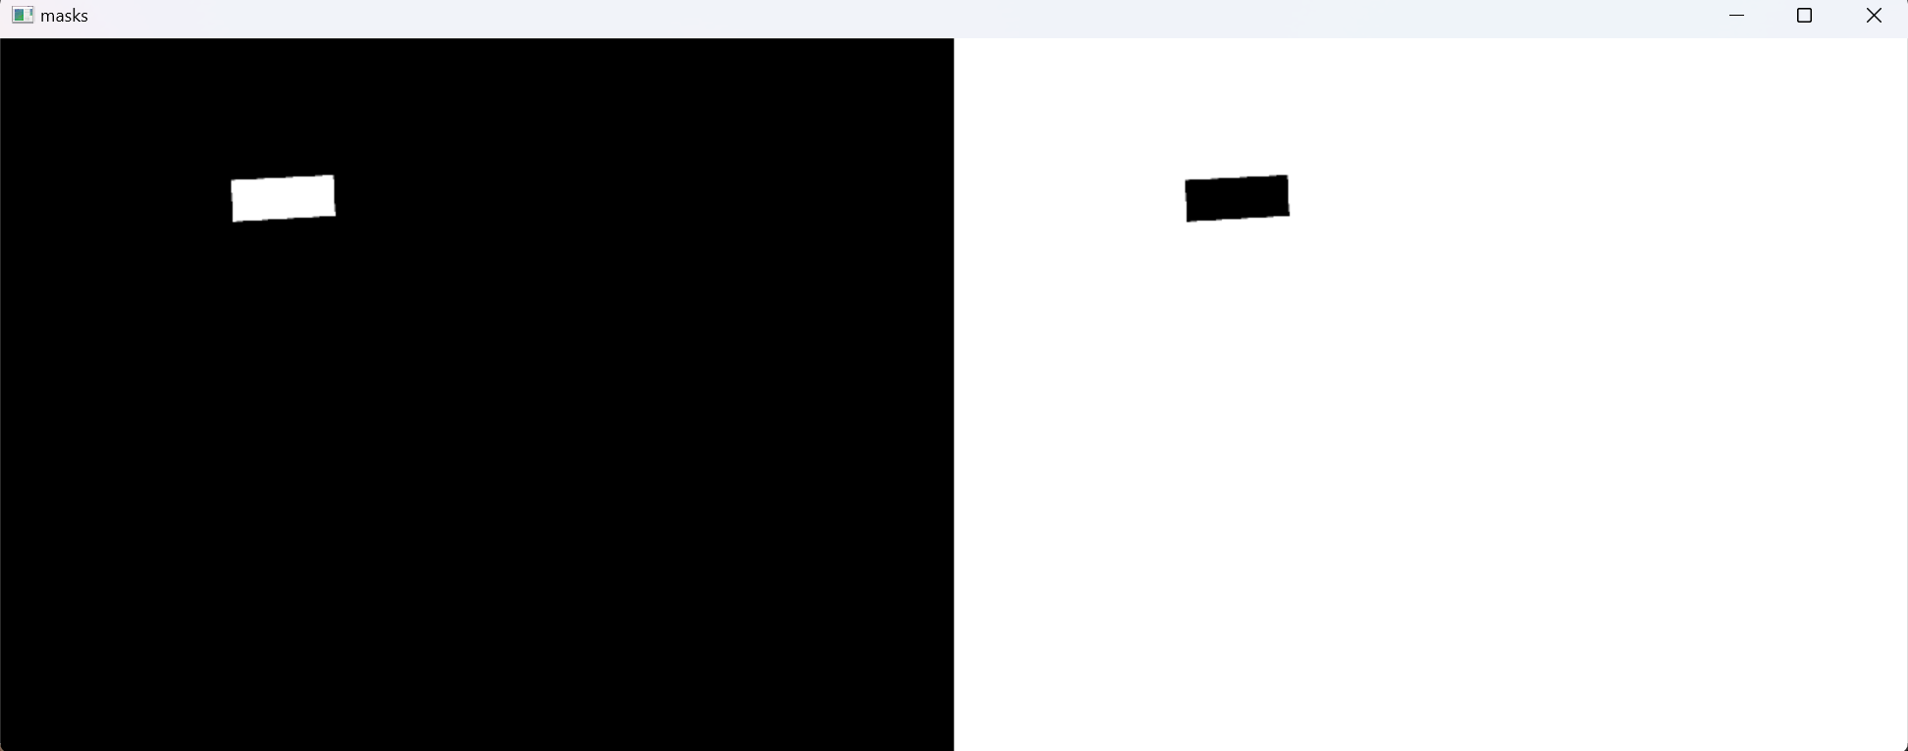
Both Masks

Slide 10
We have warped image and mask
Now what?
We use the masks to overlay the warped image onto the background.
Something like the following:
finalImage = stadium * backgroundMask + facebook * facebookMask
*Note you will want to do element operations for the images.
*Numpy does element operations automatically (MATLAB is .*)

Slide 11
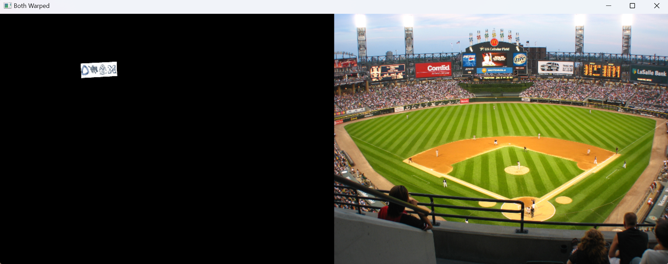
finalImage = facebook * facebookMask + stadium * backgroundMask

Slide 13
Display points and image
Draw images (imshow for OpenCV and MATLAB.)
Draw the points onto the corner of the image.
You should have done this before if you have used MATLAB.
If you are using OpenCV, here is code to draw a point:
cv2.circle(finalImage, point, 10, (0,255,0), -1)

