Slide 1
Final Project : Identifying Personal Attacks in Wikipedia Comments
Presenter: Pooja Dinesh Khivasara

Slide 2
Data and Business Problem
Dataset: “Wikipedia Talk Labels: Personal Attacks” data set, Version 6 of 22 Feb 2017, available from https://figshare.com/articles/Wikipedia_Talk_Labels_Personal_Attacks/4054689 (Reference – Project Document)
Wikipedia has comments (English) which might be Personal attack
Multiple annotators have labelled the comment as Personal attack or not.
Task – Generate a classification model to identify if a comment is personal attack or not.

Slide 3
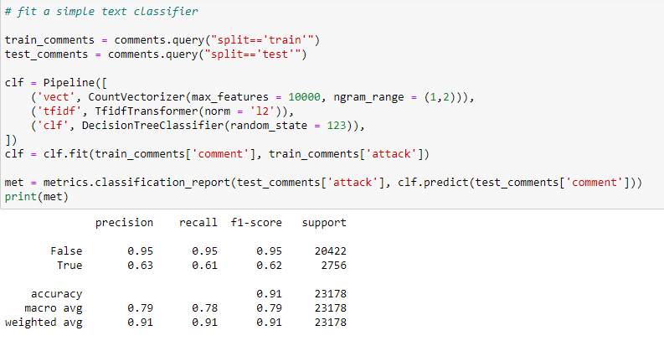
Baseline Model

Slide 4
Steps
Understanding the Data
Data Cleaning
(removing Newline, spaces, punctuations NaN, Stop words, accent words)
Feature Extraction
Split train-test data
Model Generation
Tuning Hyperparameters
Performance Evaluation
Balance the classes

Slide 5
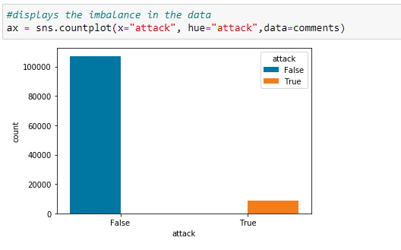
Understanding Class Imbalance

Slide 6
Data Cleaning, Feature Selection
Following cleaning steps are carried out:
Removing NewLine Token
Removing TabToken
Removing Punctuations
Removing Stop words (done on vectorizer)
Removing english accent words.
Check for NaN or None (No null or NaN found)
Feature Selected: Comment

Slide 7
Models Tried
TF-idf and Gaussian NB: Accuracy: 0.5633359219949953
Tf-idf Vectorizer and Logistic Regression: Accuracy: 0.9416688238847183
Tf-idf Vectorizer and MultinomialNB: Accuracy: 0.934075416343084
Tf-idf Vectorizer and LinearSVC(Accepted as model): Accuracy: 0.9464578479592717
Cross-validation is tried however, performs like Hold-out estimate in splitting train-test data.

Slide 8
Final Model (TfidfVectorizer + Linear SVC)
clf_4 = Pipeline([('tfidf', TfidfVectorizer(max_features = 10000, ngram_range = (1,1),norm = 'l2',analyzer ='word', lowercase = True, stop_words ={'english'}, strip_accents = 'ascii')),
('clf', LinearSVC(random_state=87,C=1.5,max_iter = 1871))
])
clf_4 = clf_4.fit(X_train_df, y_train_df)
y_predict_4 = clf_4.predict(X_test_df)
met_4 = metrics.classification_report(y_test_df, y_predict_4)
print(met_4)
print("Accuracy:", accuracy_score(y_test_df, y_predict_4))

Slide 9
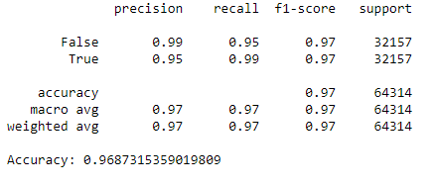
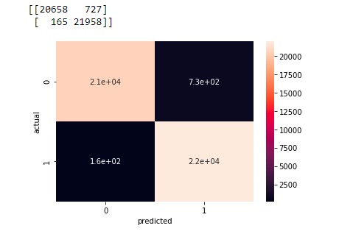
Performance Evaluation (Classification Report and Confusion Metrics)

Slide 10
Conclusion
The dataset was imbalanced (attack = True, attack = False). Thus, it is important to have a balanced dataset to get a better performance.
Comment is an important feature in the dataset and thus cleaning step is critical.
Feature extraction in Text data ensures better accuracy. (TF-IDF)

Slide 11
Questions?

Slide 12
Thank-You

