Slide 1
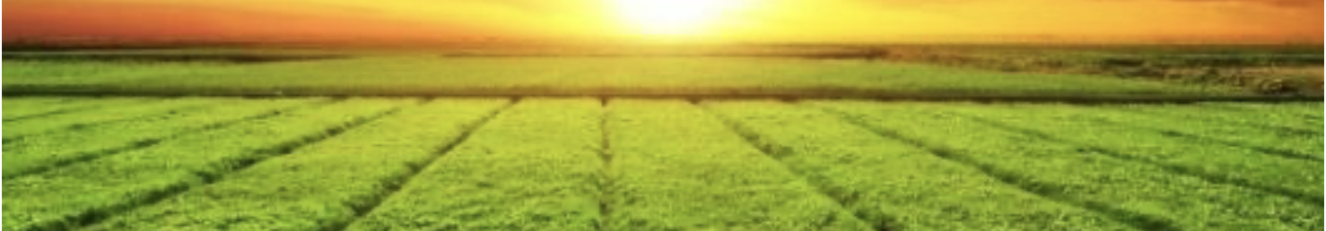
Crop Recommendations
Using Machine Learning Algorithms
Project Report Presentation
February 28, 2022
Kim K. Hixson

Slide 2
Introduction, Background, Goal
Precision agriculture is in trend nowadays
Precision agriculture helps farmers make informed decisions about their farming strategy
Feature data used here was obtained from farms in India:
Features included those which measured rainfall, climate parameters(temperature, humidity), fertilizer parameters (nitrogen-N, phosphate-P, and potassium-K), and soil parameters (pH).
Crop (target data) includes rice, maize, chickpea, kidneybeans, pigeonbeans, mothbeans, mungbean, blackgram, lentil, pomegranate, banana, mango, grapes, watermelon, muskmelon, apple, orange, papaya, coconut, cotton, jute, and coffee.
Goal:
Recommend/predict which crop is best to grow given the soil pH, climate and fertilizer regimen
Source of Data: (https://www.kaggle.com/atharvaingle/crop-recommendation-dataset)

Slide 3
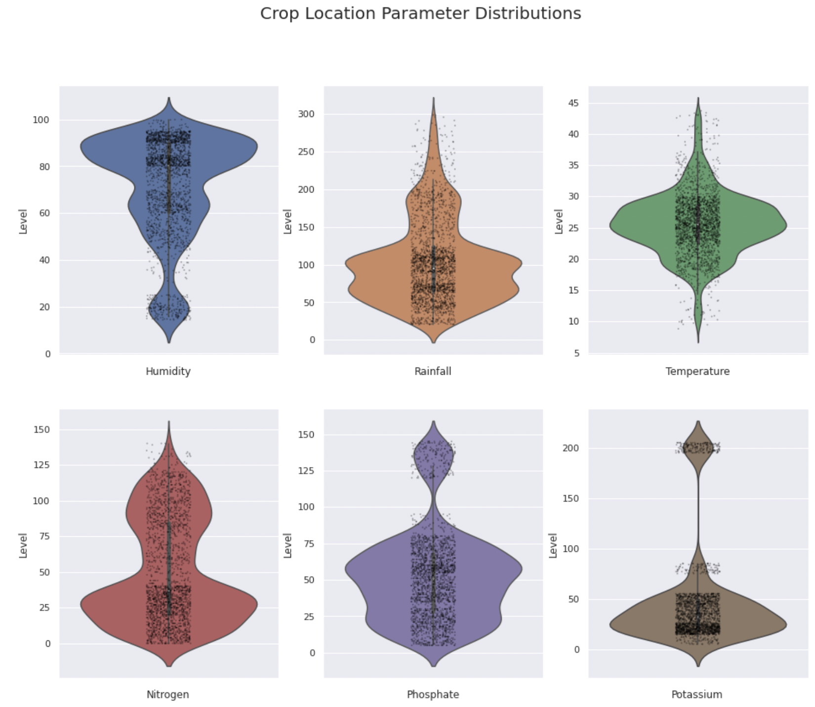
Crop Distribution According to Parameter
Most crops required high humidity
Most crops required relatively low levels of rainfall, nitrogen, and potassium.
Most crops were grown in temperate regions
Humidity
Rainfall
Temperature
Nitrogen
Phosphate
Potassium

Slide 4
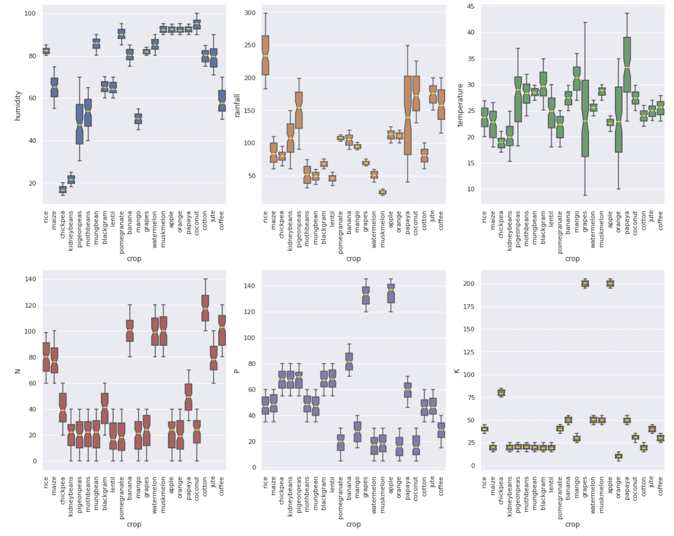
Crop Outliers
Chickpeas and Kidney beans are grown in low humidity
Rice is grown where there is the most rainfall
Banana, Watermelon, Muskmelon, Cotton, and Coffee are grown where N levels are high
Grapes and apples are grown with high phosphate
Humidity
Rainfall
Nitrogen
Phosphate

Slide 5
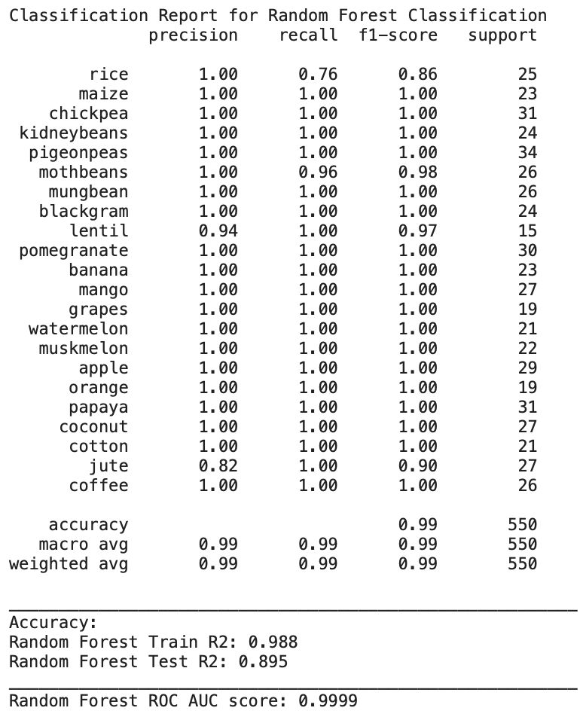
Random Forest Classifier Production Model
K-Nearest Neighbor, LightGBM and Random Forest Classifier Models Tested
Random Forest Classifier was chosen as the ‘Production Model’
GridSearchCV Used to Tune Hyperparameters:
'max_depth' = 80
'max_features' = 2
'min_samples_leaf' = 3
'min_samples_split' = 8
'n_estimators' = 300

Slide 6
Final Recommendations
Random Forest Classifier Model performs well to predict which crop is grown in a region depending on rainfall, humidity, temperature, pH and fertilizer (N, P, K)
When using the Random Forest (RF) Classifier Model, higher instances of false positives predictions (lower precision) are associated with lentils and jute, while higher instances of false negatives (lower recall) are associated with rice and mothbeans
The crop prediction/recommendation RF model performs with 99% accuracy and would be a good predictor of which crops could be planted for a given region with a given fertilizer regimen

