Slide 1

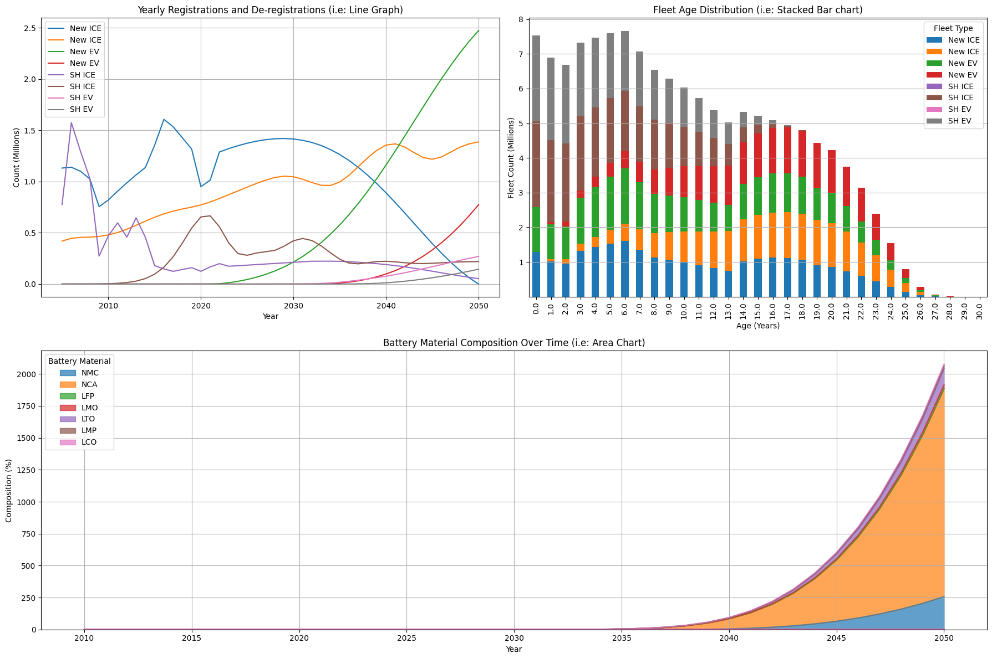
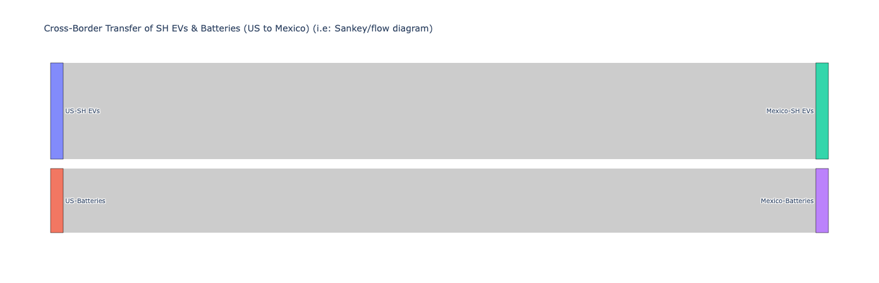
EV Fleet Evolution and Battery Sustainability: A Data-Driven Insight Framework for Visualization
Author: MUHAMMAD KHIZAR MASROOR, Dr. J. C. Roberts
Introduction:
Electric vehicles (EVs) are at the forefront of the global shift toward sustainable transportation. This report delves into the evolution of EV fleets and the sustainability of battery materials, using a dataset that spans from 2005 to projections for 2050. The dataset, sourced from Dryad, provides insights into registrations, deregistrations, fleet age distribution, and battery material composition. By employing advanced visualization techniques, this report aims to tell a compelling story about the transition to sustainable transportation and the challenges associated with battery recycling.
Story Highlights:
The shift from ICE to EV fleets has been significant, with a steady increase in EV registrations since 2005.
Older fleet vehicles are gradually being replaced, but ICE vehicles still dominate certain age brackets.
Battery sustainability remains a critical focus, with a notable shift toward materials with better recycling potential.
Cross-border trade of second-hand EVs and batteries between the US and Mexico provides opportunities for sustainability but also poses challenges in tracking and managing recycling efforts.
Conclusion:
This demonstrates the power of data visualization in uncovering insights into EV fleet evolution and battery sustainability. The combination of line graphs, bar charts, area charts, and Sankey diagrams provides a comprehensive view of the data, making it accessible to a wide audience. Future work could focus on enhancing interactivity and incorporating real-time data updates to keep the visualizations relevant and impactful.
Metadata:
Source Data: Published on Dryad (September 10, 2024).
Audience: Policymakers, environmental researchers, and industry experts.
Tools Used: Python for visualization, including libraries like Matplotlib and Plotly.
Reference:
J. C. Roberts, C. Headleand, and P. D. Ritsos. Sketching designs using the
five design-sheet methodology. IEEE transactions on visualization and
computer graphics, 22(1):419–428, 2015. 3

