Slide 1


4+2-Bit Opcode Computer
Khizar Ali Shah - 2020196
Syed Muhammad Ashaar Shah - 2020478
Muhammad Omer bin Atique - 2020335
Harris Abdullah - 2020159

Slide 2
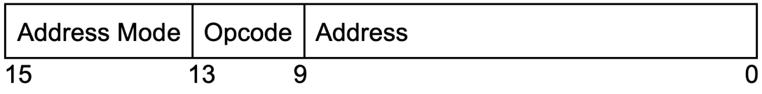
Instruction format
Instruction is 16 bit Long.
2 bit for mode
4 for opcode
10 for address / operand

Slide 3

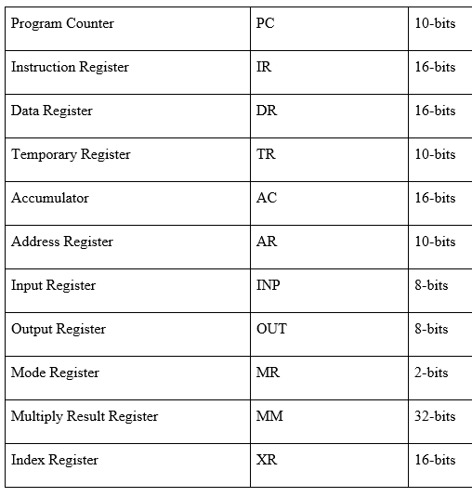
Registers
A total of 11 registers are used.

Slide 4
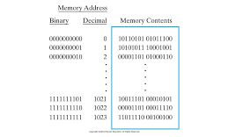
Main Memory
The memory size was chosen to be 2^10 = 1024.
The address line is 10 bit long.

Slide 5
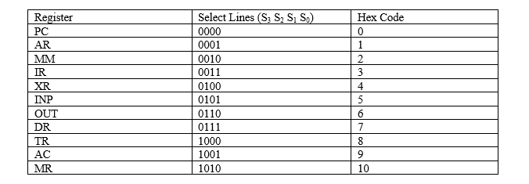
Common Bus
The size of the common bus is 16 bits.

Slide 6
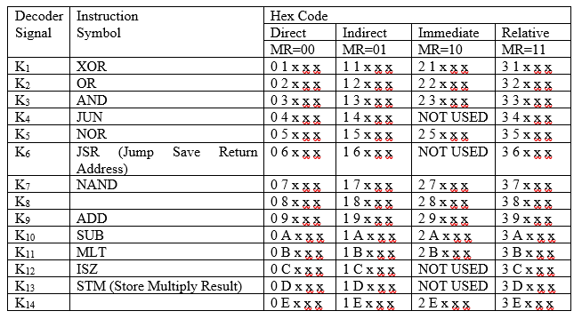
Memory Reference Instructions

Slide 7
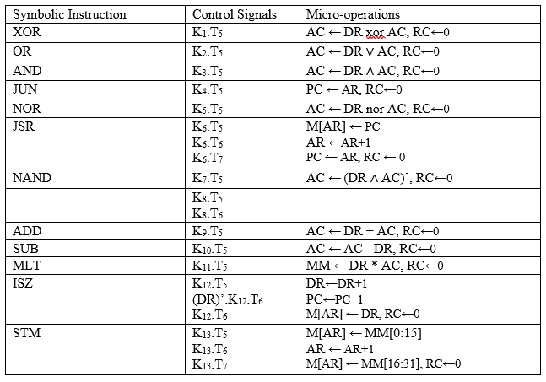
Execution of Memory Reference Instructions

Slide 8
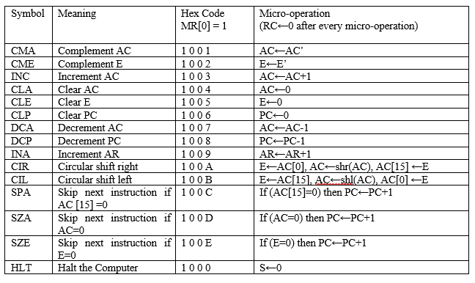
Register Reference Instructions

Slide 9
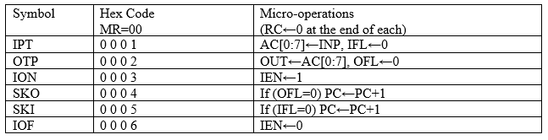
I/O
Instructions

Slide 10
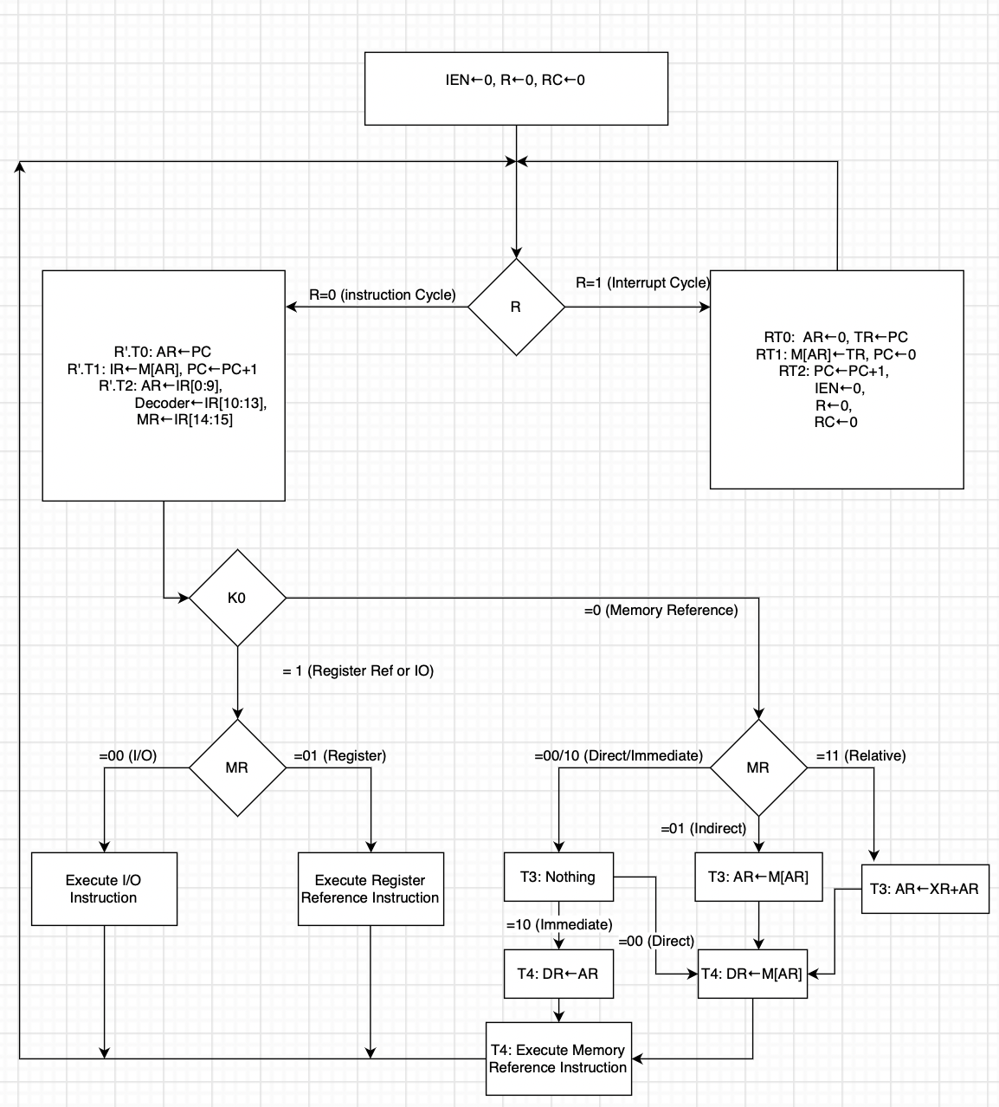
Instruction Cycle Flowchart

Slide 11
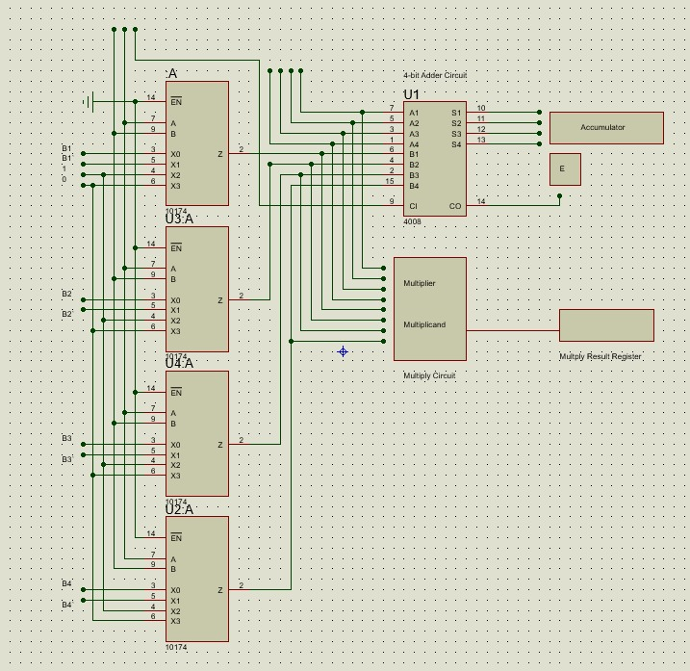
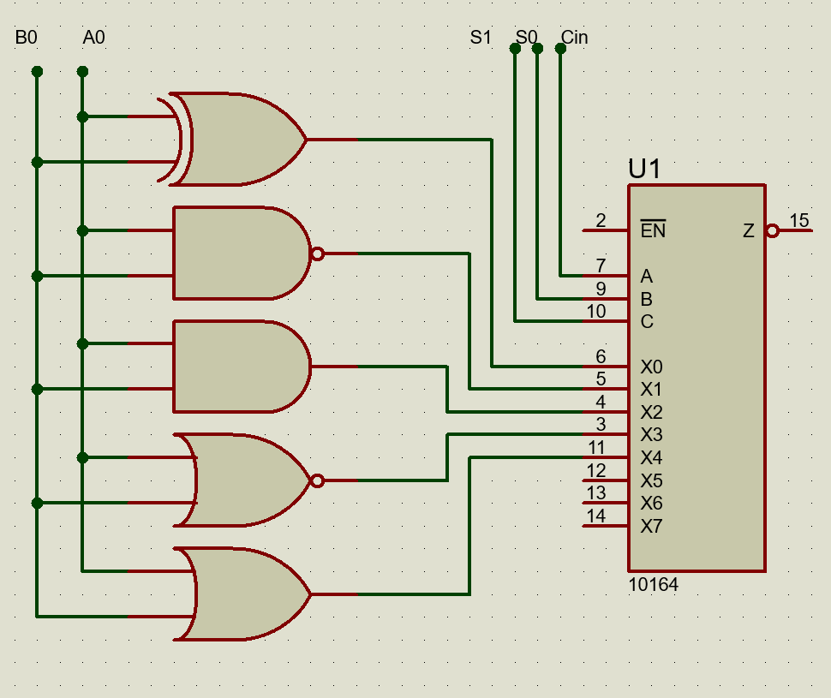
Arithmetic Unit
Logic Unit

Slide 12
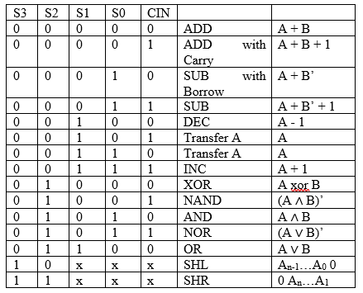
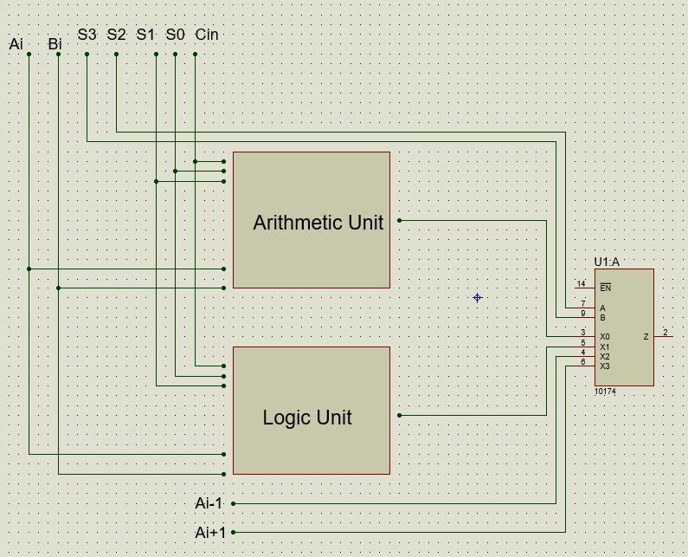
Arithmetic Logic Shift Unit

Slide 13
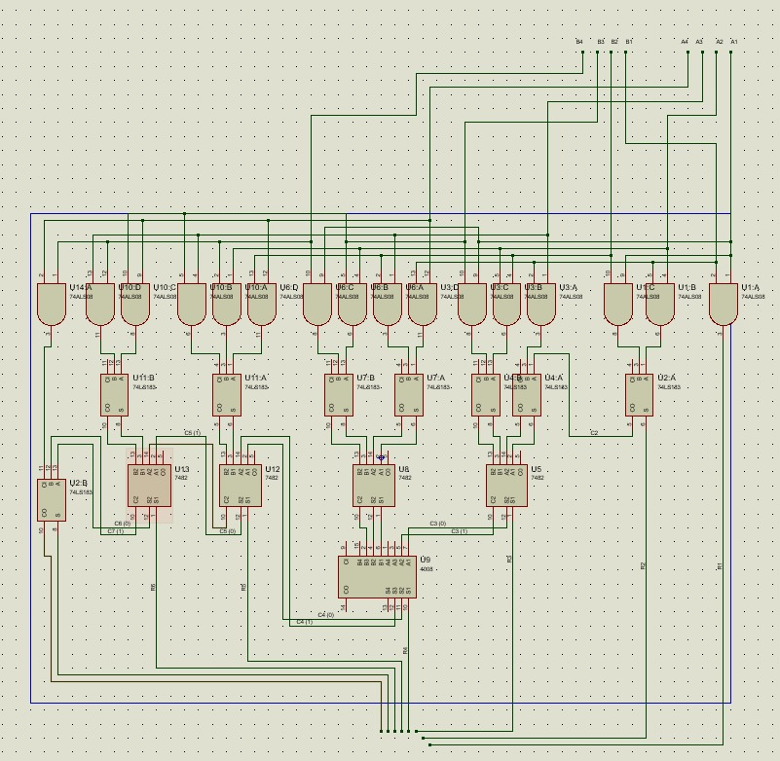
Multiplication Circuit

