Slide 1
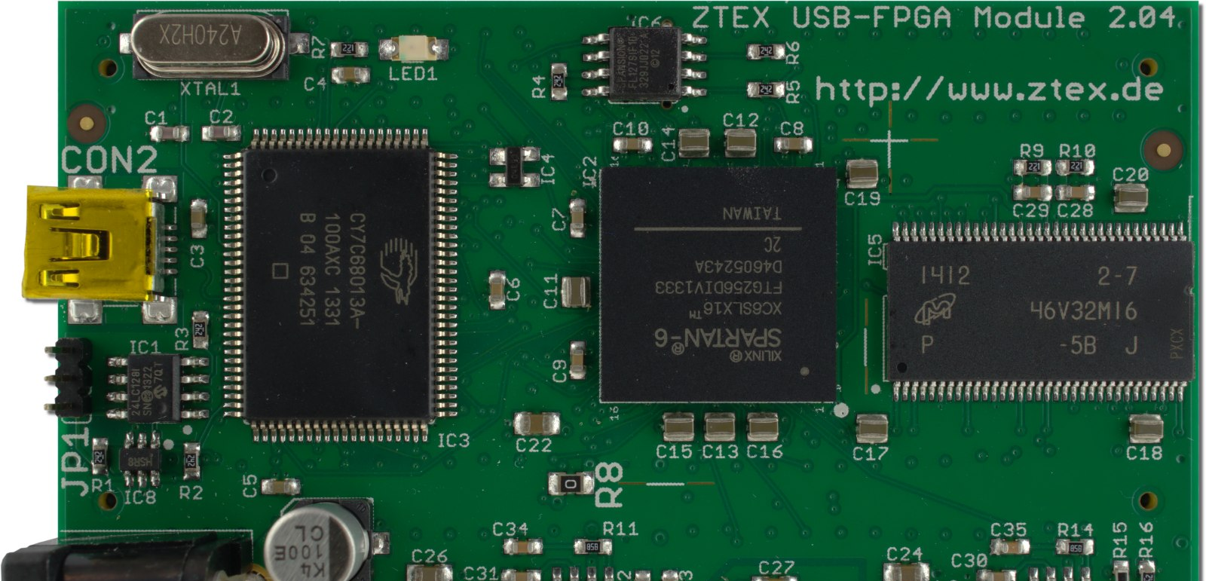

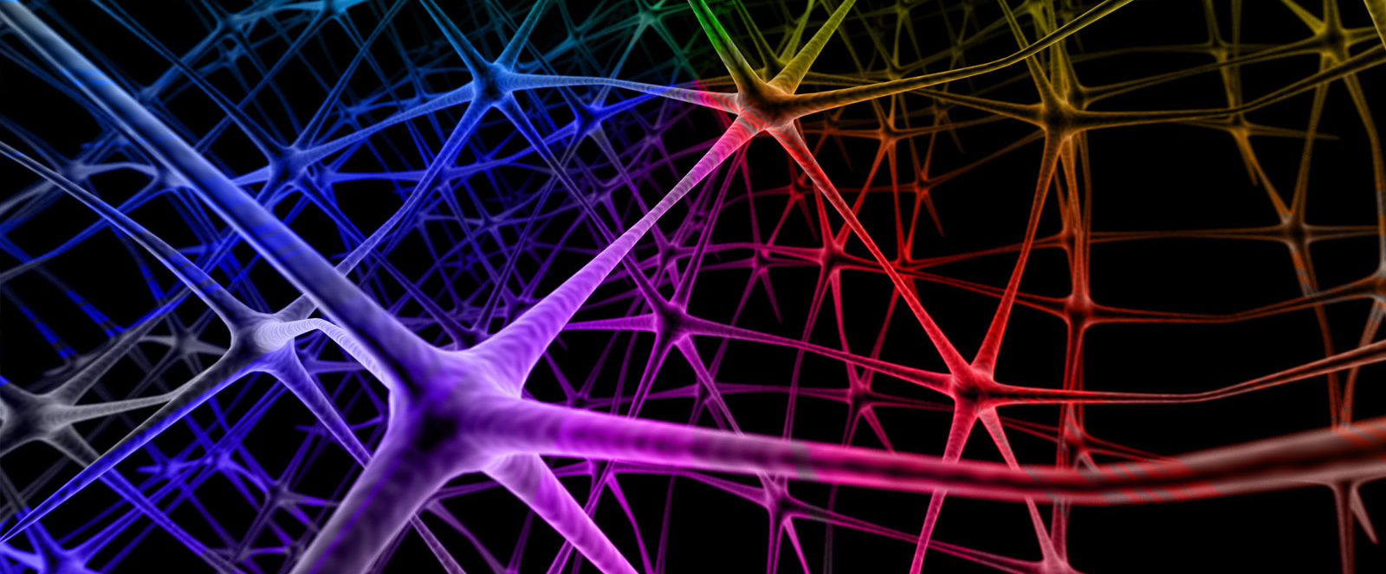
FPGA-based CNN Accelerator

Slide 2
Group Members
Syed Muhammad Ashhar Shah 2020478
Hasaan Noor 2020546
Khizar Ali Shah 2020196
Supervisor: Dr. Muhammad Taj

Slide 3
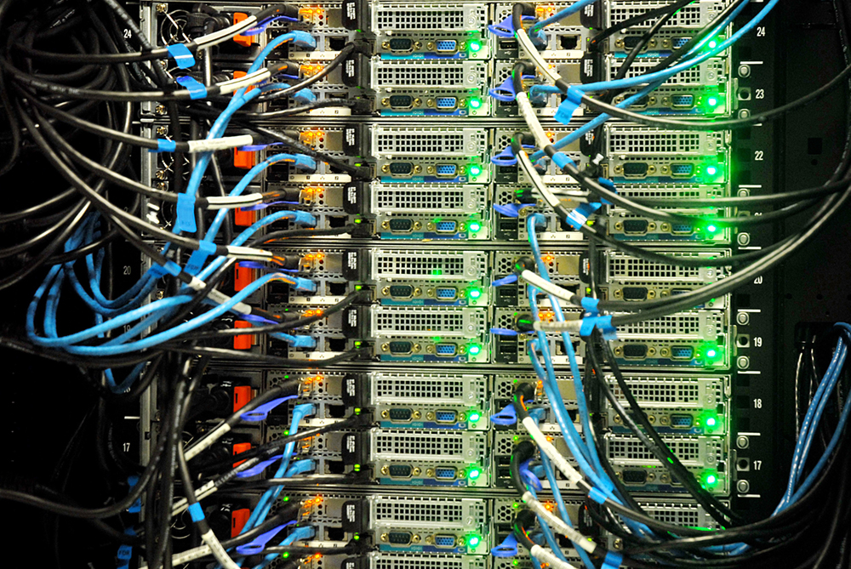
Problem Statement
Convolutional Neural Networks (CNNs) have become a fundamental tool in the field of computer vision and deep learning. However, their computational requirements can be demanding, especially for large-scale models or real-time applications. To achieve high detection accuracy, the large and complex CNN models are used, but this leads to expensive computational cost, which is hard to process in real time in resource-constrained devices with strict latency and energy requirements.
CPUs, and GPUs may not provide the necessary real-time or energy efficiency required for these tasks. Secondly, the physical size and energy efficiency of GPUs is not feasible to be implemented in many such scenarios.
Problem: High computation, physical size, energy efficiency, and other constraints cause to CPU and GPU based CNNs be unusable or not being fully utilized in real-time applications involving resource-constraint devices.
Notes:
What. Where. Why. Who. When.
Surveillance Systems. Autonomous Vehicles. Robotics. VR. UAV.

Slide 4

Motivation
In recent years, convolutional neural networks (CNNs) have demonstrated their ability to solve problems in many fields and with accuracy that was not possible before. However, this comes with extensive computational requirements, which made general central processing units (CPUs) unable to deliver the desired real-time performance. At the same time, field-programmable gate arrays (FPGAs) have seen a surge in interest for accelerating CNN.
Motivated by Power Efficiency, Low Latency, and High Computational Performance. This is the best combination of technology for something like CNN. Usable in real-time systems like Surveillance (specially in Satellites) and Autonomous Vehicles.
An amazing combination of Hardware, Software, and Mathematics. From the lowest levels of Computer Science’s hierarchy to the abstract highest levels of Neural Networks.

Slide 5
Justification
Limitation of CPU and GPU architectures
Better performance per watt than GPU
Low latency
Energy efficiency
On-chip memory
Physical Size
Parallelism
Look at the combined effect
Notes:
Energy Efficient: FPGAs can achieve high energy efficiency for CNN computations. By implementing only the necessary operations in hardware and eliminating redundant computations, FPGAs can reduce power consumption compared to general-purpose processors or GPUs.
On-chip memory: FPGAs typically provide large on-chip memory resources that can be utilized for storing CNN parameters, intermediate feature maps, and other data. This on-chip memory reduces the need for external memory accesses, which can be a significant bottleneck in terms of latency and power consumption.
Limited parallelism: CPUs are designed for general-purpose computing and lack specialized hardware for efficient parallel processing of CNN operations. Although modern CPUs have multiple cores, the level of parallelism they provide may not be sufficient to fully exploit the inherent parallelism present in CNNs. This can result in suboptimal performance for CNN workloads.

Slide 6
Literature Review
Real-time Object Tracking:
https://www.researchgate.net/publication/359411914_AlgorithmHardware_Co-Design_for_Real-Time_On-Satellite_CNN_based_Ship_Detection_in_SAR_Imagery
Achieving Parallelism:
https://www.researchgate.net/publication/368529697_Model_Parallelism_Optimization_for_CNN_FPGA_Accelerator
Notes:
Novelty: Reduce Memory Footprint. Achieve better optimization in a custom way to get better results. Since there’s no magic formula, we’ll try different architectures and methods and see.

Slide 7
Engineering Challenges
Optimizing the resources available on the target FPGA device to deliver the optimal performance
Writing RISC-V Assembly Language Code of CNN
Due to growing complexity of CNN architectures, it is hard to meet performance metrics such as latency and throughput while optimizing power

Slide 8
Attributes Included
Wide-ranging/conﬂicting technical issues
FPGAs have finite resources and the CNNs, especially deep and complex models, require significant computational resources and memory to operate efficiently. Conflicts can arise when trying to strike a balance between performance and power consumption.
Component Parts / Sub Problems
When implementing a design on an FPGA (Field-Programmable Gate Array), several component parts or subproblems need to be considered. This includes but not limited to FPGA Fabric, Clocking, Memory, Arithmetic Units, etc.
Diverse Group of Stakeholders
In this project there are diverse groups of stakeholders involved, each with their own interests, roles, and responsibilities such as Hardware Engineers, Software Engineers, Data Scientists and Artificial Intelligence Engineers.

Slide 9

Work Plan
Learn CNN
Verilog
Explore some CNN Achitectures
FPGA Tools
FPGA Design Flow
Verilog -> Simulation -> RTL Schematic -> Burn
Understanding CNN Working:
ML/DL -> Python -> C -> RISC-V
Measurement: Keep comparing it with software models and ‘repeat’
Deliverables (Tentative)
Workable first design by the 3rd week of 7th semester
Debugged and Optimizeed design by the end of 7th semester

