Slide 1
C++ OOP PROJECT
Attendance
Monitoring System
A Console-Based Student Attendance Tracking System
Built with C++ using OOP Principles
Object-Oriented Programming • File Handling • Data Structures • Memory Management

Slide 2
PROJECT OVERVIEW
Slide 2
🎯 Purpose
🏗️ Architecture
💾 Persistence
Track student attendance efficiently with automatic percentage calculation and defaulter identification
Two-class design: Student (data model) + AttendanceSystem (controller) following OOP best practices
File-based storage using text files with pipe-delimited format to save and restore all data between sessions
100 Max Students
365 Days Capacity
75% Pass Threshold
Auto File Save/Load

Slide 3
HEADERS, CONSTANTS & clearscreen()
Slide 3
#include<iostream>
#include
<fstream>
#include
<string>
#include
<iomanip>
using namespace
std;
const int
MAX_STUDENTS = 100;
const int
MAX_DAYS = 365;
#include Libraries
iostream — console I/O
fstream — file read/write
string — text management
iomanip — output formatting
Global Constants
MAX_STUDENTS = 100: Array size cap
MAX_DAYS = 365: Max days per year
Defined once, used everywhere safely
clearscreen()
Cross-platform screen clearing
#ifdef detects OS at compile time
cls = Windows, clear = Linux/Mac
void clearscreen() {
#ifdef _WIN32 system("cls");
#else system("clear");
#endif
}

Slide 4
STUDENT CLASS — Private Members & Constructors
Slide 4
class Student {
private:
string studentId, name, department;
int totalClasses, attendedClasses;
int
attendanceRecord[MAX_DAYS];
public:
Student() {
studentId.clear(); name.clear();
totalClasses = attendedClasses =
0; for (int i=0; i<MAX_DAYS; i++)
attendanceRecord[i] =
0;
}
Student(string id, string n, string dept)
: studentId(id), name(n), department(dept) {
totalClasses = attendedClasses =
0;
for
(int i=0;i<MAX_DAYS;i++)
attendanceRecord[i]=
0;
}
Private Data Members
studentId / name / department: Student identity fields
totalClasses: Total classes held so far
attendedClasses: Count of days present
attendanceRecord[365]: Day-by-day presence array
Default Constructor
Called when no arguments are passed.
Clears strings with .clear() and sets counters to 0.
Initializes all 365 attendance slots to 0 (absent).
Parameterized Constructor
Uses initializer list ': studentId(id), name(n)...'
for efficient member initialization.
Also zeroes the attendance array for fresh start.

Slide 5
STUDENT CLASS — Setters, Getters & Encapsulation
Slide 5
💡 ENCAPSULATION: Private members are hidden from outside. Only controlled access via public setters & getters.
// SETTERS (write access)
// GETTERS (read access)
void setStudentId(const string& id) { if (!id.empty()) studentId = id; } void setName(const string& n) { if (!n.empty()) name = n; } void setDepartment(const string& d) {
if (!d.empty())
department = d; }
string getStudentId() const
{ return
studentId; } string getName() const
{ return
name; } float getPercentage() const {
return totalClasses > 0 ?
(attendedClasses * 100.0f /
totalClasses) : 0.0f; }
Validated Setters
const Getters
getPercentage()
Each setter checks !empty() before assigning.
Prevents blank data from corrupting records.
Marked 'const' → won't modify object state.
Safe to call on read-only (const) objects.
Ternary checks totalClasses>0 to avoid
divide-by-zero errors. Returns float %.

Slide 6
STUDENT METHODS — markAttendance, updateTotals & display
Slide 6
bool markAttendance(int day, int status) {
if (day >= 0 && day < MAX_DAYS &&
(status == 0 || status == 1)) {
attendanceRecord[day] = status;
return
true;
}
return
false;
}
markAttendance(day, status)
Validates: day within 0-364, status 0 or 1 only.
Stores 1=present, 0=absent in the array.
Returns bool to indicate success/failure.
void updateTotals(int days) {
if (days < 0 || days > MAX_DAYS)
return;
totalClasses = days;
attendedClasses = 0;
for (int i = 0; i < days; i++)
if (attendanceRecord[i] == 1)
attendedClasses++;
}
updateTotals(days)
Recounts attended days by scanning the array.
Resets attendedClasses to 0 then increments
for each slot equal to 1 (present).
void display() const {
cout << "ID: " << studentId;
cout << "Dept: " << department;
cout << "Percent: " << getPercentage() << "%";
}
display() const
Prints formatted student summary.
Marked const → safe on read-only objects.
Calls getPercentage() for live calculation.

Slide 7
FRIEND FUNCTIONS — displayReport, saveStudent & loadStudent
Slide 7
💡 FRIEND FUNCTIONS: Declared inside class with 'friend' keyword — allows access to private members from outside the class
displayReport()
saveStudent()
loadStudent()
void displayReport(const Student& s) {
cout << "=====" << endl;
s.display();
cout <<
(s.getPercentage()>=75
? "PASS" : "FAIL");
}
bool saveStudent(
const
Student& s,
ofstream& file) {
file << s.studentId
<< "|" << s.name
<< "|" << ...
return
true;
}
bool loadStudent(
Student& s,
ifstream& file) {
// Parse line by '|'
s.studentId = ...;
s.name = ...;
return
true;
}
📄 File Format (pipe-delimited):
2
30
S001|Ali Khan|CS|30|25|111111111111111111111111100000...
S002|Sara|EE|30|28|111111111111111111111111111100...
← studentCount & totalDays on first two lines

Slide 8
ATTENDANCESYSTEM CLASS — Constructor & Destructor
Slide 8
class AttendanceSystem {
private:
Student* students[MAX_STUDENTS];
int studentCount, totalDays;
string filename;
void cleanup() {
for (int i=0; i<studentCount; i++) {
delete students[i];
students[i] = nullptr;
}
studentCount = 0;
}
public:
AttendanceSystem() : studentCount(0),
totalDays(0), filename("attendance.txt") {
for (int i=0; i<MAX_STUDENTS; i++)
students[i] = nullptr;
loadFromFile();
}
~
AttendanceSystem() {
cleanup();
saveToFile();
}
};
Private: Pointer Array
Student* students[100]: Array of POINTERS.
Each slot holds address of a heap-allocated Student.
Allows dynamic creation and deletion.
cleanup() — Memory Safety
Iterates through all students, calling 'delete'.
Sets each pointer to nullptr after deletion.
Prevents dangling pointer bugs and memory leaks.
Constructor (RAII)
Initializer list sets all values at once.
Nulls all pointers for safety.
Automatic loadFromFile() on startup.
Destructor (~)
Called automatically when object leaves scope.
Runs cleanup() then saveToFile().
Guarantees data is never lost on program exit.

Slide 9
addStudent() & findStudent() Methods
Slide 9
void addStudent() {
if (studentCount >= MAX_STUDENTS) {
cout << "*** Limit reached! ***";
return;
}
string id, name, dept;
cin >> id;
if (id.empty()) return;
cin.ignore();
getline(cin, name);
getline(cin, dept);
// Duplicate ID check
for (int i=0; i<studentCount; i++)
if (students[i]->getStudentId()==id)
return; // Already exists!
students[studentCount] =
new Student(id, name, dept);
students[studentCount]->
updateTotals(totalDays);
studentCount++;
}
addStudent() Logic Flow
1
Capacity Check
If studentCount >= 100, refuse and return early
2
Input & Validate
Read ID, name, dept. Reject if any field is empty
3
Duplicate Check
Linear search: if ID exists, reject with error message
4
Dynamic Allocation
'new Student(id, name, dept)' creates on heap memory
int findStudent(const string& id) const {
for (int i=0; i<studentCount; i++)
if (students[i]->getStudentId() == id)
return i;
return -1; }
5
Sync Totals
updateTotals(totalDays) syncs new student to class days

Slide 10
markBatchAttendance() — Bulk Attendance Marking
Slide 10
void markBatchAttendance() {
if (studentCount == 0) return;
int presentDays;
for (int i=0; i<studentCount; i++) {
cout << students[i]->getName();
cout << "Days present (0-"
<< totalDays << "): ";
cin >> presentDays;
// Input validation loop
while (presentDays<0 ||
presentDays>totalDays) {
cout << "ERROR! Re-enter: ";
cin >> presentDays;
}
// Mark all days
for (int day=0; day<totalDays; day++)
students[i]->markAttendance(
day, day<presentDays ? 1 : 0);
students[i]->updateTotals(totalDays);
}
}
Batch Processing Loop
Iterates ALL students in one session.
Asks admin: 'How many days was X present?'
Input Validation (while loop)
Keeps asking until value is 0 ≤ input ≤ totalDays.
Prevents negative or impossible attendance.
Clever Array Fill
Ternary trick: day < presentDays → 1 else 0.
Fills first N slots as present, rest as absent.
Design Note
Uses summary input (N days present) not
day-by-day — faster for large classes. Trade-off:
loses which specific day a student was absent.

Slide 11
viewAllStudents, showDefaulters & deleteStudent Methods
Slide 11
viewAllStudents()
showDefaulters()
deleteStudent()
void viewAllStudents() const {
if (studentCount == 0) return;
for (int i=0; i<studentCount; i++) {
cout << "Student " << (i+1);
students[i]->display();
}
}
void showDefaulters() const {
bool found = false;
for (int i=0; i<studentCount; i++)
if (students[i]->
getPercentage() < 75.0f) {
students[i]->display();
found = true;
}
if (!found) cout << "All OK!";
}
void deleteStudent() {
int idx = findStudent(id);
if (idx == -1) return;
// Confirm deletion
delete students[idx];
// Shift array left
for (int i=idx; i<count-1; i++)
students[i] = students[i+1];
studentCount--;
}
Explanation
Explanation
Explanation
Iterates and prints all students.
Marked const — does not modify state.
Calls each student's display() method.
Filters students < 75% attendance.
'found' flag handles 'all good' case.
75% is the standard pass threshold.
Uses findStudent() to locate target.
delete frees heap memory safely.
Shifts array left to fill the gap.
Decrements count for correct tracking.

Slide 12
FILE HANDLING — saveToFile() & loadFromFile()
Slide 12
💾 saveToFile()
ofstream — Writing
bool saveToFile() const {
ofstream file(filename);
if (!file) return
false;
file << studentCount << endl
<< totalDays << endl;
for (int i=0; i<studentCount; i++)
saveStudent(*students[i], file);
file.close();
return
true;
}
Opens file for write. Overwrites existing content.
Writes header (count + days), then each student via saveStudent() friend function.
ifstream — Reading
Opens file for reading. If not found, returns false (fresh start).
Calls cleanup() first to clear old data in memory.
📂 loadFromFile()
file.ignore()
bool loadFromFile() {
ifstream file(filename);
if (!file) return
false;
cleanup(); // clear existing data
file >> studentCount >> totalDays;
file.ignore();
for (int i=0; i<studentCount; i++) {
students[i] = new Student();
loadStudent(*students[i], file);
}
file.close();
return
true;
}
After 'file >> x' (integer read), a newline '\n' remains
in the buffer. ignore() discards it before getline() calls.
Error Handling
If count is invalid (>100 or <0), the system resets cleanly.
try/catch in loadStudent guards against corrupted file data.

Slide 13
menu() — Program Loop & main() Entry Point
Slide 13
void menu() {
int choice;
clearscreen();
do {
cout << "=== MENU ===";
cout << "1. Add Student";
cout << "2. Mark Attend";
cout << "3. View All";
cout << "4. View Report";
cout << "5. Defaulters";
cout << "6. Delete";
cout << "7. Save";
cout << "0. Exit";
cin >> choice;
switch (choice) {
case 1: addStudent(); break;
case 2: markBatchAttendance(); break;
case 3: viewAllStudents(); break;
case 4: viewStudentReport(); break;
case 5: showDefaulters(); break;
case 6: deleteStudent(); break;
case 7: saveToFile(); break;
case 0: return;
}
cin.ignore(); clearscreen();
} while (true);
}
int
main() {
AttendanceSystem sys;
sys.menu();
return 0;
}
☰ MAIN MENU
1. Add New Student
2. Mark Attendance
3. View All Students
4. View Student Report
5. Show Defaulters (<75%)
6. Delete Student
7. Save Data to File
0. Exit Program
do-while Loop (Infinite)
'while(true)' + 'case 0: return' pattern.
Menu loops forever until user picks 0.
Stack vs Heap in main()
'AttendanceSystem sys' — created on STACK.
Automatically destroyed when main() exits.
Destructor auto-called: saves file safely.

Slide 14
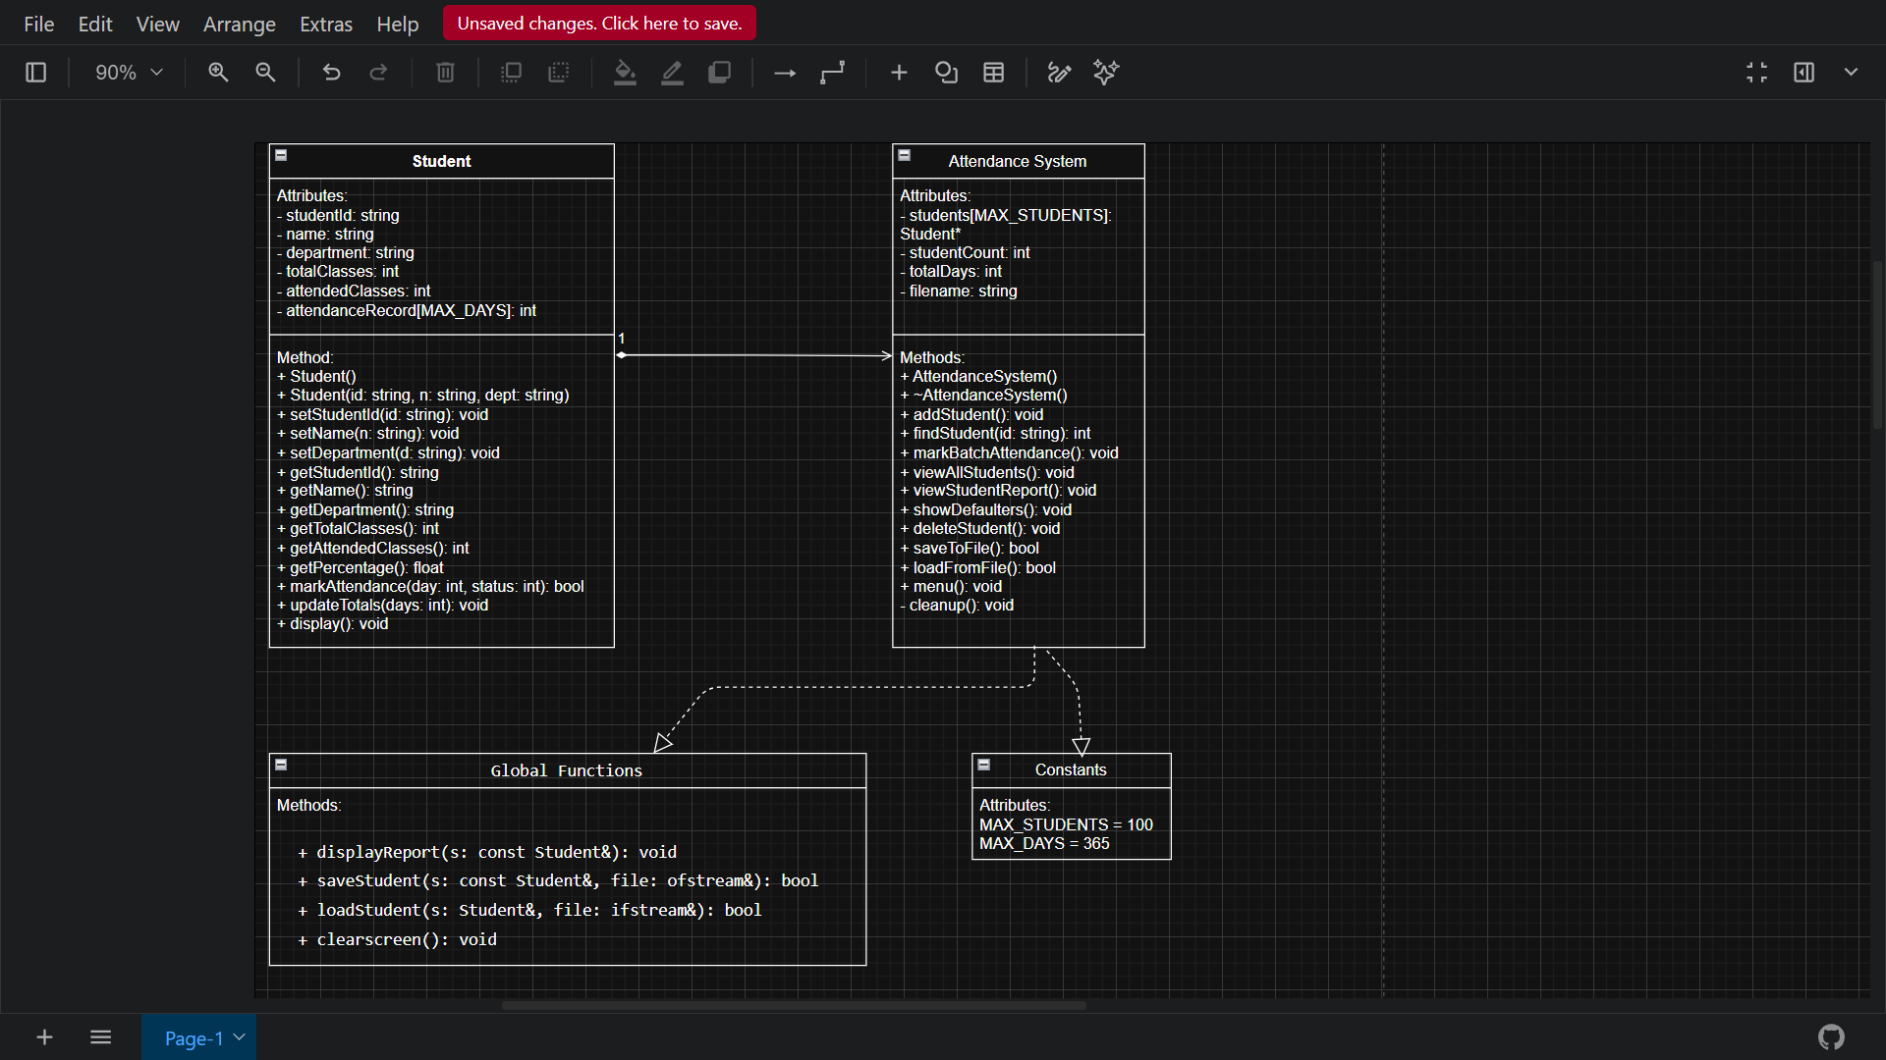
UML CLASS DIAGRAM
Slide 14
📐
INSERT YOUR UML CLASS DIAGRAM HERE
Paste your screenshot of the UML diagram showing Student & AttendanceSystem classes
with their relationships, attributes, and methods

Slide 15
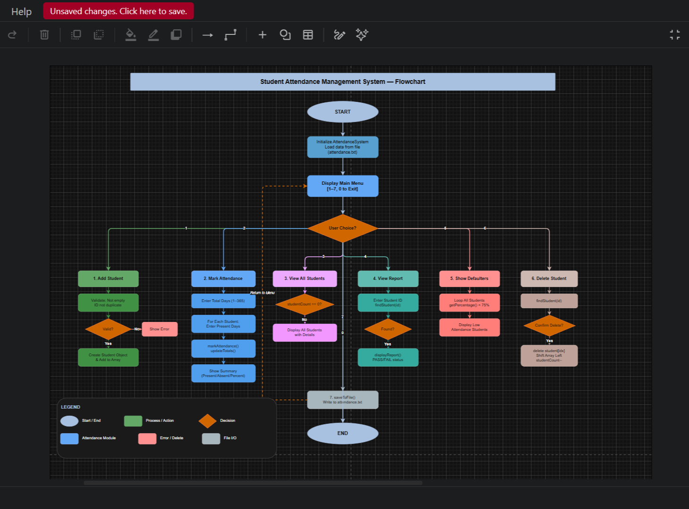
SYSTEM FLOWCHART
Slide 15
🔀
INSERT YOUR SYSTEM FLOWCHART HERE
Paste your screenshot of the program flowchart showing the main loop,
menu decisions, and data flow between operations

Slide 16
OOP CONCEPTS DEMONSTRATED
Slide 16
🔒 Encapsulation
🏗️ Abstraction
Private members (studentId, name, attendanceRecord)
Controlled via public setters & getters
Data integrity enforced in setter validation
User calls sys.addStudent() without knowing internals
Complex file I/O hidden behind saveToFile()
Clean interface exposes only necessary operations
👥 Classes & Objects
🤝 Friend Functions
Student class models real-world student entity
AttendanceSystem manages a collection of Students
Each instance has unique state (id, name, records)
displayReport, saveStudent, loadStudent declared 'friend'
Access private members without breaking OOP
Used for I/O operations that need full access
⚙️ Constructors & Destructor
💡 Dynamic Memory
Default + Parameterized constructors (overloading)
Initializer list for efficient initialization
Destructor auto-saves data on program exit (RAII)
new Student() allocates on heap at runtime
delete students[i] manually frees memory
nullptr assignment prevents dangling pointers

Slide 17
Project Summary
Attendance Monitoring
System
✅ Two OOP classes: Student + AttendanceSystem
✅ File persistence: save & load with error handling
✅ Input validation at every user entry point
✅ Dynamic memory: new/delete with nullptr guards
✅ Cross-platform: Windows & Linux/Mac support
Thank You

