Slide 1

90-minute tutorial
From API calls to EO data cubes
Dask basics, xarray mental models, and a cubo-first tutorial for Africa and Asia
Built for Jupyter notebooks and GitHub Pages
Stack
`cubo` → `xarray` → `dask`
Examples
Africa + Asia
tutorial deck
Notes:
[Sources] - Background image: NASA Visible Earth “Earth from Space” / MODIS globe image https://visibleearth.nasa.gov/images/885/earth-from-space - cubo overview and create() examples: https://cubo.readthedocs.io/en/latest/ - GitHub Pages can publish from a branch root or /docs folder: https://docs.github.com/en/pages/getting-started-with-github-pages/configuring-a-publishing-source-for-your-github-pages-site

Slide 2
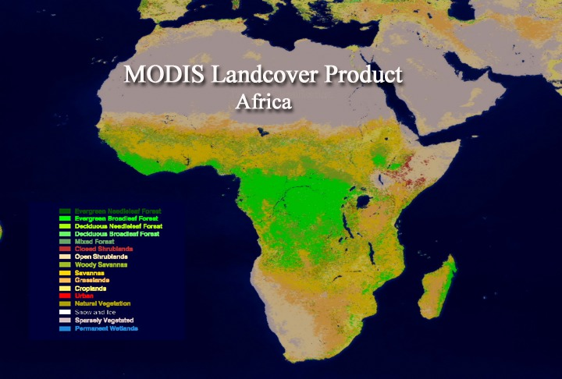
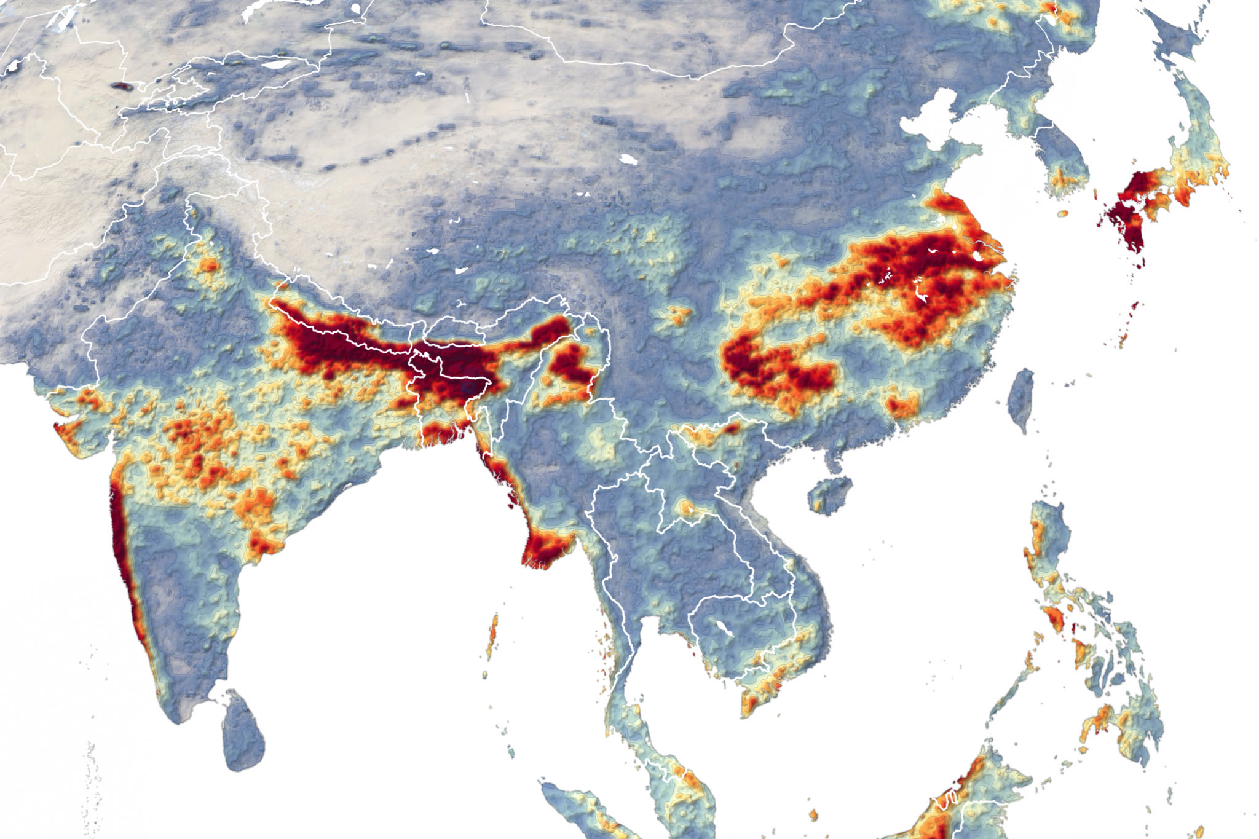
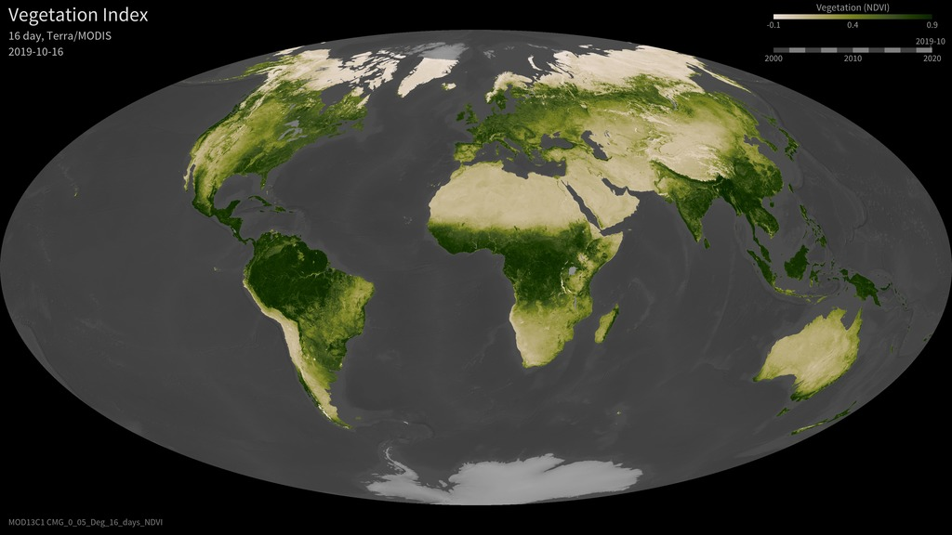
Why this stack for climate resilience and risk monitoring
Use one simple access pattern, then keep the analysis labeled and scalable.
A practical teaching workflow
Medium-resolution EO is good for vegetation, coastal water, floods, and regional monitoring.
`cubo` hides backend switching so learners focus on concepts first.
Africa example · MODIS vegetation context
Asia example · Sentinel-3 coastal quicklook
`xarray` gives named dimensions; Dask lets the same object stay lazy and chunked.
NDVI / EVI time series for drought and crop stress discussions
A simple path from remote API calls to regional visualization
The same notebook can become a static GitHub Pages tutorial.
Learner payoff
clear mental model for remote EO access
one notebook that can be reused and published
API access
data cubes
lazy ops
publish docs
small examples that still scale conceptually
cubo · xarray · Dask · GitHub Pages
Notes:
[Sources] - cubo overview: https://cubo.readthedocs.io/en/latest/ lines 60-61 and 79-96 explain STAC + GEE and xr.DataArray output. - xarray with Dask: https://docs.xarray.dev/en/stable/user-guide/dask.html lines 106-113 explain chunks and Dask integration. - Africa image: NASA SVS “MODIS Land Cover of Africa” https://svs.gsfc.nasa.gov/2266 - Asia image: NASA Earth Observatory “Excessive Monsoon Rains Flood Asia” https://earthobservatory.nasa.gov/images/147006/excessive-monsoon-rains-flood-asia - MODIS vegetation image: NASA SVS “Global Vegetation Index, Terra MODIS” https://svs.gsfc.nasa.gov/31053

Slide 3
Mental model: API call → xarray cube → lazy computation
Teach the pipeline before the product details.
metadata
search
subset
DataArray
coords
dims
chunks
task graph
1. Remote catalog
or Earth Engine
2. `cubo.create(...)`
returns a cube
3. `xarray` keeps
dims + coords
4. Dask runs tasks
when needed
collection · bands · time
same call, different backend
sel · mean · groupby
compute only at the end
If learners understand this pipeline, they can swap collections and endpoints later without changing the conceptual workflow.
cubo · xarray · Dask · GitHub Pages
Notes:
[Sources] - cubo overview and create() returning xr.DataArray from STAC and GEE: https://cubo.readthedocs.io/en/latest/ lines 60-79 and 81-96. - xarray methods work with Dask arrays: https://docs.xarray.dev/en/stable/user-guide/dask.html lines 106-110. - Dask collections produce task graphs executed by schedulers: https://docs.dask.org/en/stable/10-minutes-to-dask.html lines 214-216.

Slide 4
Dask basics for EO tutorials
Chunk wisely, stay lazy, and compute late.
01
Chunk the array
1 cube = cube.chunk({"x": 256, "y": 256}) 2 ndvi = cube.sel(band="NDVI") / 10000.0 3 summary = ndvi.mean(("x", "y")) 4 summary.compute()
Two beginner warnings
Chunks are small blocks of the larger dataset.
`chunks` means chunk shape, not number of chunks.
Very small chunks create too much scheduling overhead.
02
Keep operations lazy
Most xarray operations can build a task graph without loading everything at once.
How to explain chunks visually
Use small AOIs and short time windows in teaching notebooks, then scale up once the pattern is clear.
03
Trigger compute at the boundary
one summary
series
Use `.compute()`, plotting, or writing to disk only for the final result.
inspect
chain ops
compute
many chunks
cubo · xarray · Dask · GitHub Pages
Notes:
[Sources] - xarray with Dask: chunks and chunked reading are described at https://docs.xarray.dev/en/stable/user-guide/dask.html lines 106-113 and 125-127. - Dask chunk guidance that chunks means chunk shape, not number of chunks: https://docs.dask.org/en/latest/array-chunks.html . - Dask overview: collections, task graphs, schedulers at https://docs.dask.org/en/stable/10-minutes-to-dask.html lines 214-216.

Slide 5
API calling with xarray using `cubo`
One function call controls what, where, when, and which backend.
1 cube = cubo.create( 2 lat=8.98, 3 lon=39.79, 4 collection="MODIS/061/MOD13Q1", 5 bands=["NDVI", "EVI"], 6 start_date="2021-01-01", 7 end_date="2021-12-31", 8 edge_size=64, 9 resolution=250, 10 gee=True, 11 )
What
Where
When
collection + bands
lat + lon
start + end
How much data
Which backend
edge_size + resolution
default STAC, `stac="..."`, or `gee=True`
default STAC
custom STAC
endpoint
GEE
cubo · xarray · Dask · GitHub Pages
Notes:
[Sources] - cubo create() examples and feature list: https://cubo.readthedocs.io/en/latest/ lines 126-198. - Default STAC is Planetary Computer and another endpoint can be set with stac=...: https://cubo.readthedocs.io/en/latest/ lines 172-184. - GEE mode requires gee=True and collection as GEE ID: https://cubo.readthedocs.io/en/latest/tutorials/using_gee.html lines 58-67 and 72-83.

Slide 6
The xarray mental model
A remote EO cube becomes a labeled array with dimensions you can name.
Think in dimensions
1 cube.sel(time="2024-01") 2 cube.isel(time=0) 3 cube.mean("time") 4 cube.groupby("time.month") 5 cube.plot()
Why this matters in class
learners say what they want by dimension name
time
the same API works whether arrays are NumPy-backed or Dask-backed
band
metadata stays attached to the analysis object
y
x
In practice
Ask learners to say their operation out loud in xarray terms: “select a band”, “average over time”, “summarize over space”. That makes the code easier to remember than raw indexing.
Typical EO cube
`(time, band, y, x)`
cubo · xarray · Dask · GitHub Pages
Notes:
[Sources] - xarray Dask guide notes that nearly all xarray methods work with Dask arrays: https://docs.xarray.dev/en/stable/user-guide/dask.html lines 106-110. - Basic xarray dimensions/metadata overview reference: https://knowledge.dea.ga.gov.au/notebooks/Beginners_guide/08_Intro_to_xarray.html .

Slide 7
Suggested 90-minute flow
Front-load the concepts, then move quickly into live notebook work.
10 min
15 min
20 min
20 min
15 min
10 min
Dask + xarray basics
cubo API pattern
Africa / MODIS demo
Asia / Sentinel-3 demo
STAC endpoint swap
GitHub Pages wrap
Rule of thumb
Notebook rhythm
Site deliverables
Never spend most of the session on installation details; show the object shape and chunks as early as possible.
create cube → inspect dims → lazy op → compute
slides + notebook + rendered HTML page
cubo · xarray · Dask · GitHub Pages
Notes:
[Sources] - Timing/layout is instructional guidance by author; GitHub Pages docs for publishing from /docs are at https://docs.github.com/en/pages/getting-started-with-github-pages/configuring-a-publishing-source-for-your-github-pages-site lines 73-76 and 91-99.

Slide 8
Tutorial example 1 — Africa vegetation monitoring
Use MODIS NDVI/EVI to explain scale factors, time series summaries, and late compute.
1 ee.Initialize(opt_url="https://earthengine-highvolume.googleapis.com") 2 3 cube = cubo.create( 4 lat=8.98, 5 lon=39.79, 6 collection="MODIS/061/MOD13Q1", 7 bands=["NDVI", "EVI"], 8 start_date="2021-01-01", 9 end_date="2021-12-31", 10 edge_size=64, 11 resolution=250, 12 gee=True, 13 ) 14 15 ndvi_ts = (cube / 10000.0).sel(band="NDVI").mean(("x", "y"))
What to emphasize
same create pattern as every other example
vegetation products often need scale-factor handling
summaries over space can stay lazy until plotting
Suggested teaching AOI
QA masking is the next step after the basic demo
Horn of Africa or Sahel
small spatial window, one seasonal year
250 m
16 days
NDVI/EVI
cubo · xarray · Dask · GitHub Pages
Notes:
[Sources] - MOD13Q1 in Earth Engine: https://developers.google.com/earth-engine/datasets/catalog/MODIS_061_MOD13Q1 lines 58-84 and 76-84. - cubo GEE initialization and gee=True usage: https://cubo.readthedocs.io/en/latest/tutorials/using_gee.html lines 58-67 and 72-83. - Africa image: NASA SVS “MODIS Land Cover of Africa” https://svs.gsfc.nasa.gov/2266

Slide 9
Tutorial example 2 — Asia coastal quicklook
Keep the same cubo call structure, swap the collection, and discuss band choice.
1 cube = cubo.create( 2 lat=22.20, 3 lon=90.70, 4 collection="COPERNICUS/S3/OLCI", 5 bands=["Oa08_radiance", "Oa06_radiance", "Oa04_radiance"], 6 start_date="2024-01-01", 7 end_date="2024-01-10", 8 edge_size=96, 9 resolution=300, 10 gee=True, 11 ) 12 13 rgb = cube.median("time")
Discussion prompts
why Sentinel-3 is useful for regional coastal monitoring
which bands you would visualize first
how quicklooks differ from quantitative indicators
Suggested teaching AOI
Ganges–Brahmaputra delta / coastal Bangladesh
300 m
21 bands
~2 days
cubo · xarray · Dask · GitHub Pages
Notes:
[Sources] - Sentinel-3 OLCI Earth Engine catalog: https://developers.google.com/earth-engine/datasets/catalog/COPERNICUS_S3_OLCI lines 58-65, 76-85, and 93-99. - Asia image: NASA Earth Observatory “Excessive Monsoon Rains Flood Asia” https://earthobservatory.nasa.gov/images/147006/excessive-monsoon-rains-flood-asia - cubo GEE usage: https://cubo.readthedocs.io/en/latest/tutorials/using_gee.html lines 64-67.

Slide 10
Put the tutorial on GitHub Pages
The simplest path is a /docs folder with a landing page and static assets.
Recommended repo structure
1 docs/ 2 index.md 3 tutorial.md 4 slides.md 5 assets/ 6 cubo_xarray_dask_tutorial.ipynb 7 cubo_xarray_dask_tutorial.html 8 cubo_xarray_dask_presentation.pptx
branch
/docs
site
GitHub Pages accepts a branch source and can publish from `/docs`.
The top-level entry can be `index.html`, `index.md`, or `README.md`.
Keep the notebook, rendered HTML, and PowerPoint in one place so the site becomes the teaching hub.
Link the notebook HTML and the `.pptx` from the landing page.
cubo · xarray · Dask · GitHub Pages
Notes:
[Sources] - GitHub Pages publishing source docs: https://docs.github.com/en/pages/getting-started-with-github-pages/configuring-a-publishing-source-for-your-github-pages-site lines 73-76 and 91-99. - GitHub Pages entry file docs: https://docs.github.com/en/pages/getting-started-with-github-pages/creating-a-github-pages-site lines 107-110 and 146.

Slide 11
Key takeaways
Keep the toolchain simple enough to teach, but correct enough to scale later.
Access
Model
Scale
Publish
Use `cubo` as the single entry point.
Treat the result as an `xarray` object with named dimensions.
Let Dask keep the workflow lazy until the final step.
Turn the notebook and deck into a small GitHub Pages site.
Best closing line for the session: “same call, same object model, same notebook — only the collection changes.”
end
Notes:
[Sources] - Summary slide synthesizes sources already cited: cubo docs, xarray Dask guide, Dask overview, and GitHub Pages docs.

