Slide 1
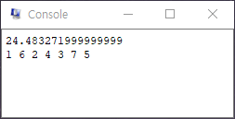
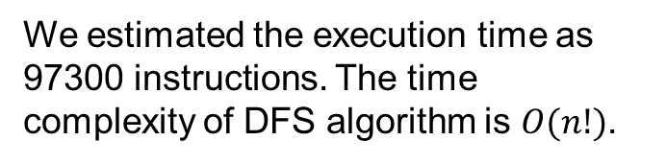
Team. 20 Hyungjun Kim, Ju-eun Park
Computer Architecture 2019 Spring: Course Project
Adopted Algorithm
Simulation Result
We adopted the DFS algorithm which uses pruning to deal with the TSP in this project.
The console output means the distance of the shortest tour and the ordered node numbers of the shortest route, respectively.
Estimated Execution time
We estimated the execution time as 97300 instructions. The time complexity of DFS algorithm is $O(n!)$.
Figure1. QtSpim console output result (tsp.s)
Table1. Comparison of execution times
Estimated Execution Time | Measured Execution Time
97300 inst. | 64600 inst.
Depart of Software, SungKyunKwan Univ.
2019-06-11

