Slide 1
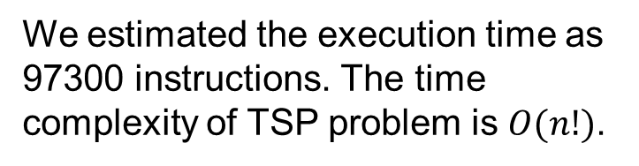
Team. 20 Hyungjun Kim, Ju-eun Park
Computer Architecture Spring 2019: Course Project
Adopted Algorithm
Estimated Execution time
We adopted the DFS and backtracking algorithm which uses pruning to deal with the TSP1) in this project.
We estimated the execution time as 97300 instructions. The time complexity of TSP problem is $O(n!)$.
DFS + Backtracking
Estimation
97300 inst.
1) Traveling Salesman Problem
Dept. of Software, SungKyunKwan Univ.
2019-06-11

Slide 2
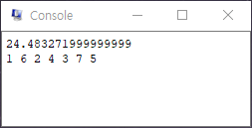
Team. 20 Hyungjun Kim, Ju-eun Park
Computer Architecture Spring 2019: Course Project
Simulation Result
The console output means the distance of the shortest tour and the ordered node numbers of the shortest route, respectively.
Review
Backtracking algorithm pruning the unnecessary path, reduced the instruction by 2/3. Optimizing algorithm is most important.
Estimated Execution Time | Measured Execution Time
97300 inst. | 64600 inst.
Figure1. QtSpim console output result (tsp.s)
Table1. Comparison of execution times
Dept. of Software, SungKyunKwan Univ.
2019-06-11

